Slide 1
Painless MySQL HA, Scalability and Flexibility With Ansible, MHA and ProxySQL
Building a test environment from scratch in 5 minutes

Slide 2
/me
Miklos ‘Mukka’ Szel
From Hungary
Started using Linux in 1997 and MySQL in 2000, used to be a backend developer
Worked for Own Startup, ISP, Walt Disney(ESPN,Cricinfo), PalominoDB/Pythian
Freelance Consultant since 2015 – Edmodo
Mail: miklos.szel at gmail.com

Slide 3
DAMP – Components
Docker
Ansible
MHA
ProxySQL
https://github.com/mszel42/Ansible-MHA-ProxySQL-Docker

Slide 4
Docker
“Build once run anywhere.”
Docker containers wrap up a piece of software in a complete filesystem that contains everything it needs to run: code, runtime, system tools, system libraries – anything you can install on a server. This guarantees that it will always run the same, regardless of the environment it is running in.
DAMP uses Ubuntu 16.04

Slide 5
Ansible
Config management tool
Simple
Agentless
Uses ssh to perform changes
Templating
MySQL/ProxySQL modules

Slide 6
MHA
Open Source HA utility written in Perl
Easy to configure
Automated/Interactive Master failover
Doesn’t deal with moving the VIPs

Slide 7
ProxySQL
Query routing/rewriting/blocking/killing based on rules/patterns
Load balancer with read/write split
Query cache
Connection pooling
Prioritize queries based on importance (query throttling)
(and many more…)
It doesn't execute replication topology changes

Slide 8
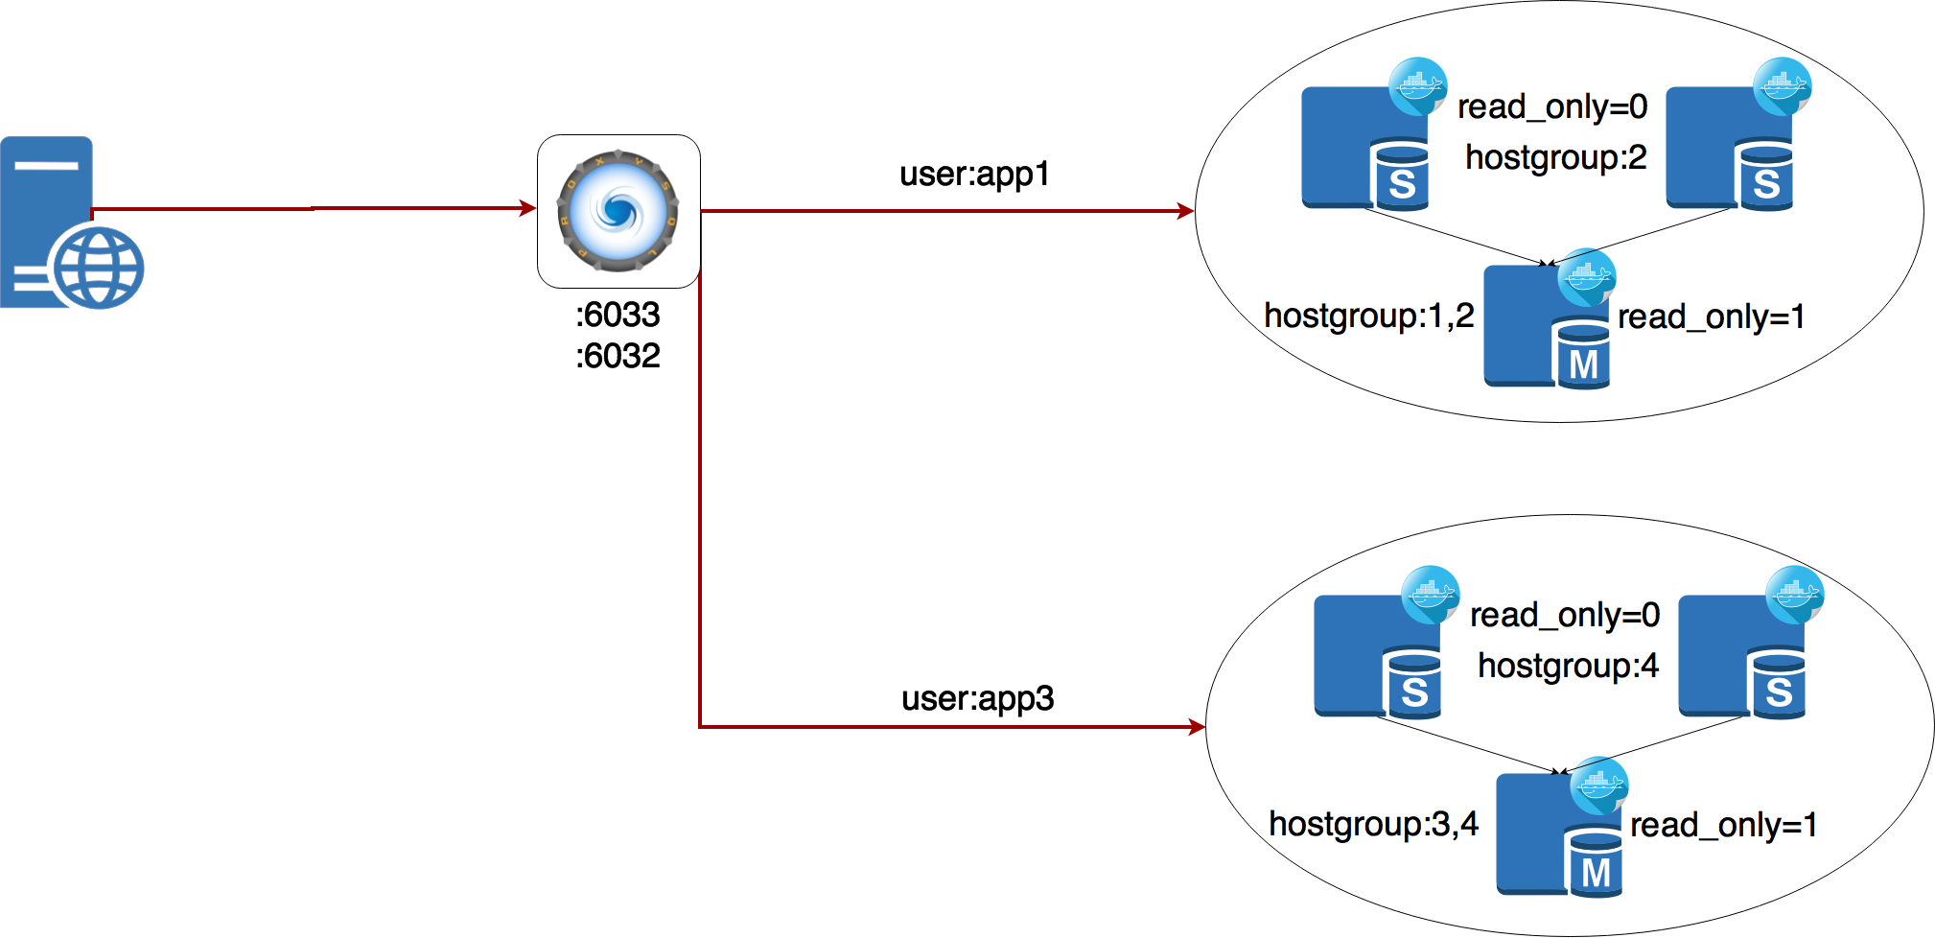

Slide 9
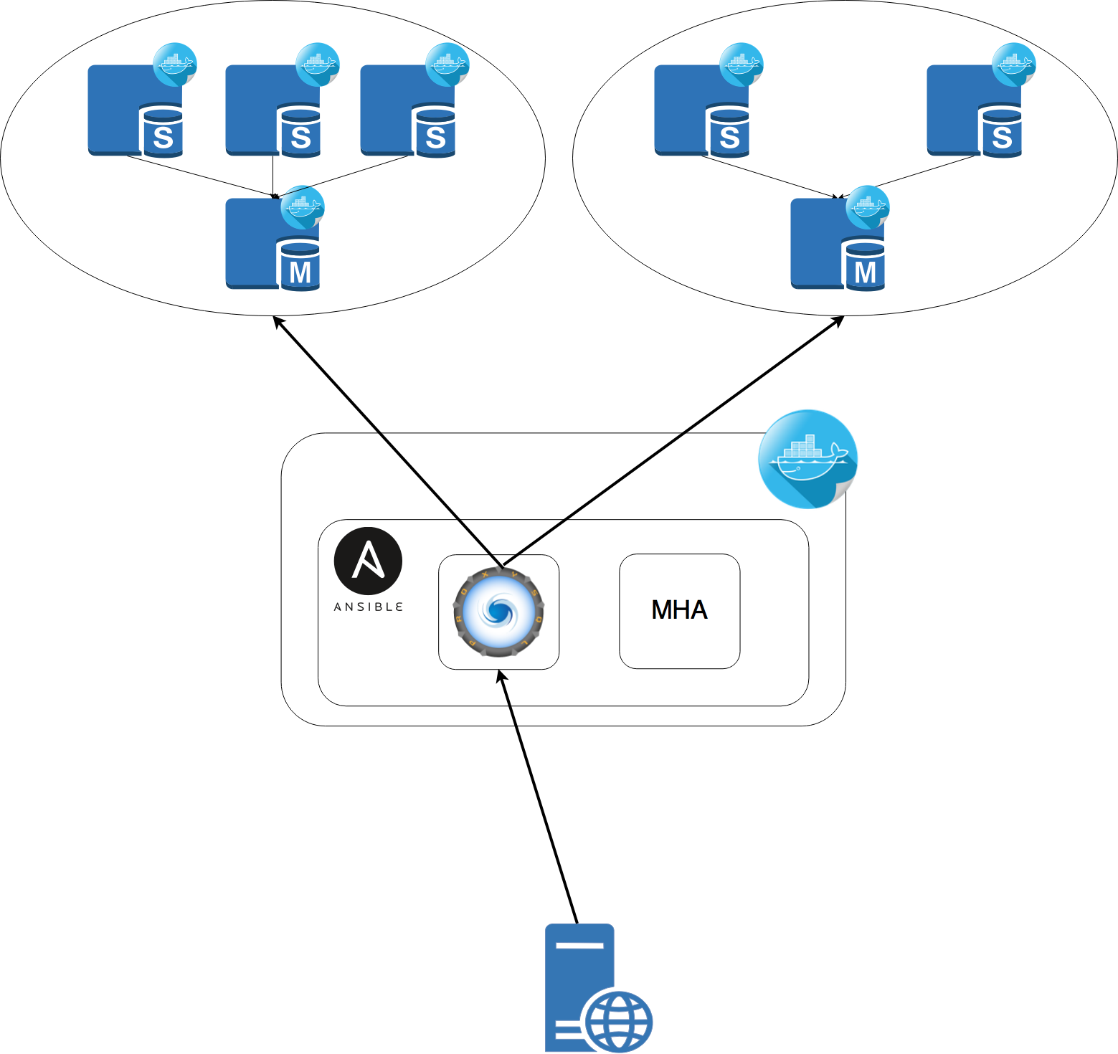

Slide 10
DEMO

Slide 11
Useful resources
https://www.percona.com/live/plam16/sessions/use-proxysql-improve-your-mysql-high-availability-solution
https://www.percona.com/live/plam16/sessions/proxysql-tutorial
https://www.percona.com/live/plam16/sessions/proxysql-use-case-scenarios
https://www.percona.com/blog/2016/09/13/proxysql-and-mha-integration/
https://www.tusacentral.net/joomla/index.php/mysql-blogs/180-sharding-with-proxysql.html
https://github.com/mszel42/ansible_mha

Slide 12
Thanks
René Cannaò
Ben Mildren
Dave Turner
Derek Downey
Frédéric 'lefred' Descamps
Andrea Hupczik

Slide 13
Questions?

