Slide 1
WebPush Channels
The pub-sub channels based push service…..

Slide 2

Mansimar Kaur
Software Intern at Mozilla
Open source contributor at Brackets (Adobe)

Slide 3

What is ?
Initiative of the Software Freedom Conservancy
Open to participation for women, transgenders and other underrepresented communities.
For more information — you can visit https://www.gnome.org/outreachy

Slide 4
Kinto
Synchronization over multiple devices
The path to deploying is short!
Decoupled storage location
Mutualisation of services and self-hosting
And it’s awesomeness!
Notes:
Kinto lets you focus on writing great user-facing interfaces and takes care of storing, sharing and synchronizing your application state with multiple devices or users.
It is often a big deal for developers to develop web APIs that handle CORS, are secure, respect users privacy by supporting encryption when building applications that work offline, store data remotely, and synchronise across devices. Existing solutions either rely on big corporations that crave user data, or require a non-trivial amount of time and expertise to develop a new server for every new project.
We want to help developers focus on their business logic and value proposition, and we don’t want the challenge of storing user data or developing backends to get in their way. The path between a new idea and deploying to production should be short!
Also, we are firm believers of the fact that data belongs to users, and not necessarily to the application authors. Applications should be decoupled from the storage location, and users should be able to choose where their personal data is stored.
The backend can often be universal, generic and reusable. We envision mutualisation of services and self-hosting: the backend is deployed, secured and scaled only once for several applications, which is amazing!

Slide 5

Kinto and Open Source
https://www.github.com/kinto
Please join our irc channel — #kinto on irc.freenode.net
If you use slack — https://slack.kinto-storage.org/

Slide 6
What is Web Push
?

Slide 7
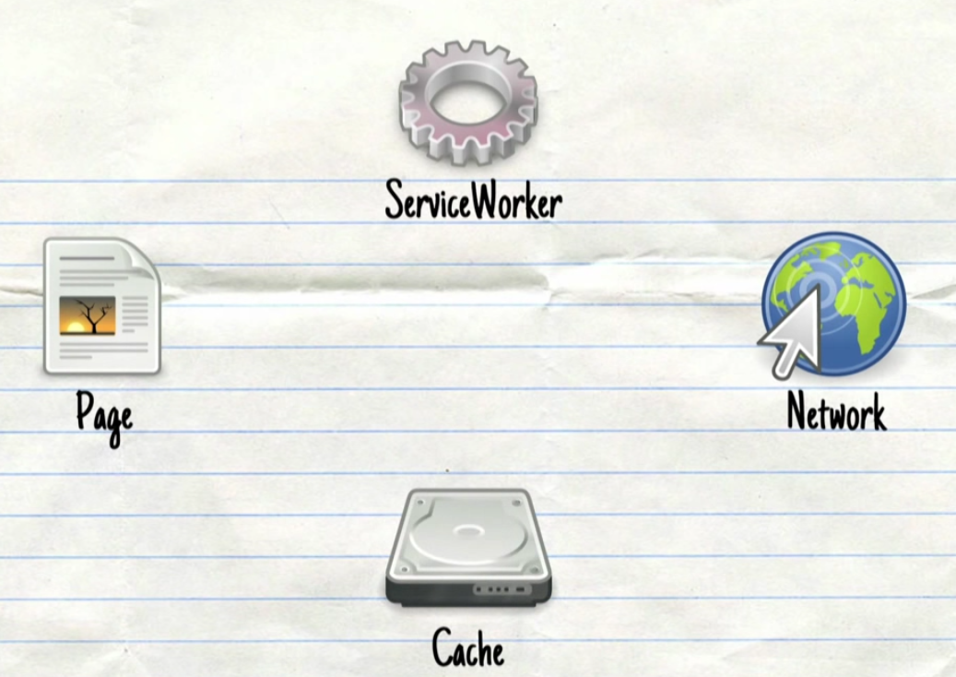
A JS file as a background worker.
A proxy server
Only HTTPS
No DOM handling
Notes:
Future of service worker
Actuvation is next

Slide 8
How does a service worker become active?
$ ServiceWorkerContainer.register()
Downloaded (after every 24h or so)
Installed if new
Activated (if the old service worker is not being currently used)

Slide 9
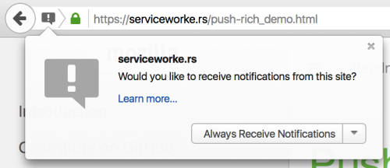
PushManager.subscribe()
Capability url and encryption keys service worker web app server.

Slide 10
The Push Server
The middle man
Communication channel b/w service worker and push service
UAID
Channel ID
Notes:
The push server is the middle man, routing the payload between the web app server and the client’s service worker. Each service worker opens up a communication channel to communicate with the push service. The push service uses a globally unique UserAgent ID (UAID) to associate clients with their associated channel IDs i.e. there is only one websocket per browser and then all notifications for all service worker are routed to the same websocket using the UserAgent ID and then the browser will route the payload to the right service worker using the channel ID

Slide 11
PushManager.subscribe()
Capability url and encryption keys service worker web app server.

Slide 12
Example Request:
$ echo '{"data": {"endpoint": "www.mansimar.com", "keys": {"auth": "authToken", "p256dh":"encryption_keys"}}}' | http POST http://localhost:9999/v0/subscriptions --auth "token:mkaur"
POST /v0/subscriptions HTTP/1.1
Accept: application/json
Accept-Encoding: gzip, deflate
Authorization: Portier dccd8ac07f3e45c9907da638e994ff98
Connection: keep-alive
Content-Length: 25
Content-Type: application/json
Host: localhost:9999
User-Agent: HTTPie/0.9.2
{
"data": {
"endpoint": "www.mansimar.com",
"keys": {
"auth": "authToken",
"p256dh": "encryption_keys"
}
}
}

Slide 13
Example Response:
HTTP/1.1 201 Created
Access-Control-Expose-Headers: Retry-After, Content-Length, Alert, Backoff
Content-Length: 169
Content-Type: application/json
Date: Wed, 01 Feb 2017 21:10:26 GMT
Etag: "1485983426583"
Last-Modified: Wed, 01 Feb 2017 21:10:26 GMT
Server: waitress
X-Content-Type-Options: nosniff
{
"data": {
"endpoint": "www.mansimar.com",
"id": "1c224ce5-a134-4214-867b-944736ce38d8",
"keys": {
"auth": "authToken",
"p256dh": "encryption_keys"
},
"last_modified": 1485983426583
}
}

Slide 14
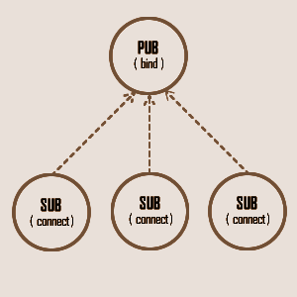
What is PubSub?
Published messages characterized into channels
Subscribers subscribe to one or more channels

Slide 15
How to subscribe to a channel?
Example Request:
$ http PUT http://localhost:9999/v0/channels/formbuilder-update
/registration --auth “token:mkaur”
PUT /v0/channels/formbuilder-update/registration HTTP/1.1
Accept: */*
Accept-Encoding: gzip, deflate
Authorization: Portier dccd8ac07f3e45c9907da638e994ff98
Connection: keep-alive
Host: localhost:9999
User-Agent: HTTPie/0.9.2
Example Response:
HTTP/1.1 202 Accepted
Access-Control-Expose-Headers: Backoff, Retry-After, Alert
Date: Thu, 18 Jun 2015 17:02:23 GMT
Server: waitress

Slide 16
How to publish to a channel?
Example Request:
$ echo ‘{“data”: {“last_modified”: 1434647996969}}’ |
http POST http://localhost:9999/v0/channels/formbuilder-update \
--auth “token:mkaur”
POST /v0/channels/formbuilder-collections-update HTTP/1.1
Accept: application/json
Accept-Encoding: gzip, deflate
Authorization: Basic Ym9iOg==
Connection: keep-alive
Content-Length: 25
Content-Type: application/json
Host: localhost:9999
User-Agent: HTTPie/0.9.2
{
"data": {
"last_modified": 1434647996969
}
}

Slide 17

Example Response:
HTTP/1.1 202 Accepted
Access-Control-Expose-Headers: Backoff, Retry-After, Alert
Date: Thu, 18 Jun 2015 17:02:23 GMT
Server: waitress
Encryption done by WebPusher.
The data payload will be encrypted for each subscription and sent authenticated through the endpoint.
To the Push Service

Slide 18
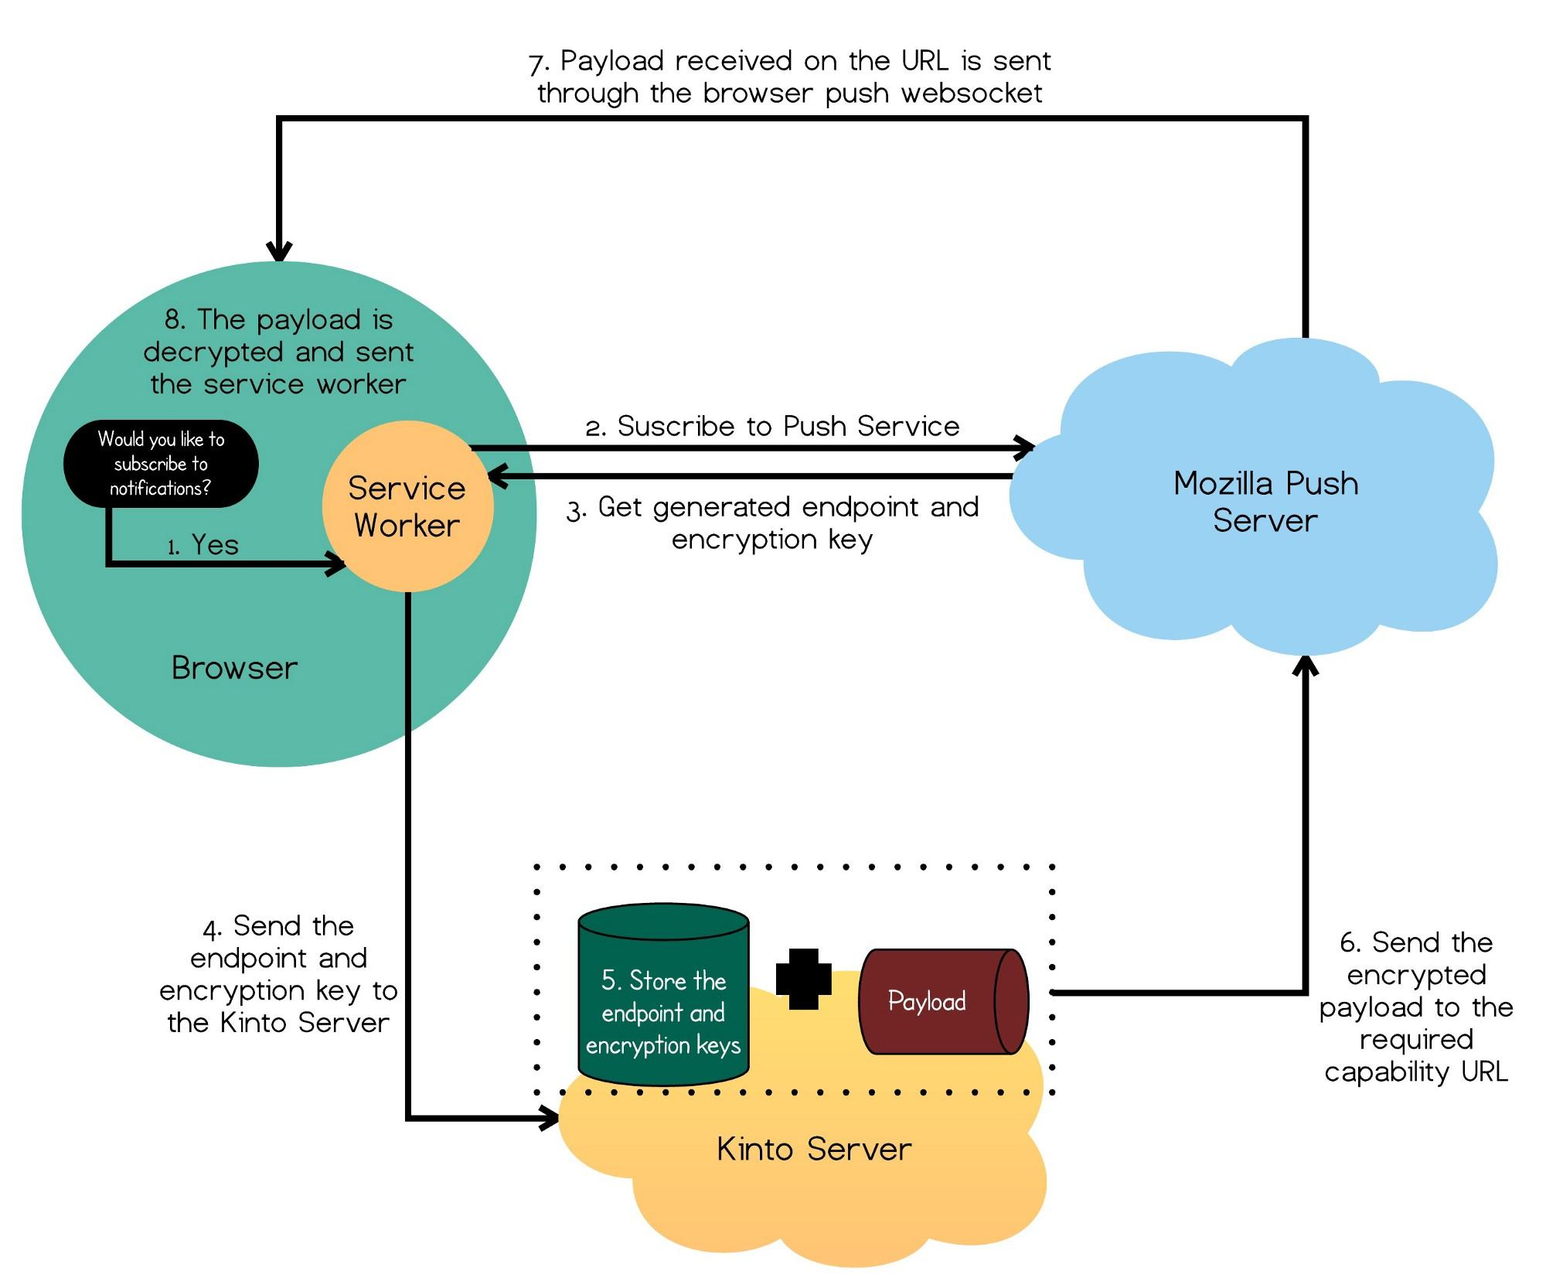

Slide 19
Thank you!
LinkedIn
@mansimarkaur
Twitter
@mkaur1102
Website
http://www.mansimar.com
Github
@mansimarkaur
Medium
@mansimarkaur.mks

