Slide 1
Bliss
Labs & OS

Slide 2
BlissLabs
A volunteer based 501c(3) non-profit organization that helps open-source projects thrive
BlissLabs’ goal is to create and maintain various open source operating systems and other software that helps to extend the life of devices in order to help with the world's e-waste problems.
BlissLabs maintains BlissOS and other OSS softwares
Not a bunch of projects , but a very matured open source org with a proper org structure .
Notes:
Its an ocean of projects with a proper org structure and needed infra support.

Slide 3
BlissLabs - Mission
We work to mentor and teach future open source developer's in all aspects of development and design, including animation
We form alliances with other projects that share in our visions.
We develop tools to help minimize the complex development process and aid in learning.
We act as a global fiscal host for open source projects, allowing for a much larger opportunity to work with others globally and increase user base.

Slide 4
Diversity - BlissLabs
Region - Continent - Asia, North America, South America , Europe, Oceana , Middle-East, Eurasia .
Age group - 13 - 60
Students - Professionals - Retirees
Women - Men - LGBT - Differently Abled in key positions like CFO,CPO,CTO.
Education - Middle school to Phd
Notes:
Proper org structure - mention space for all -documentation, web, product, testers , design - not only coders, management , process , quality etc…and still growing. This makes us stand apart as an Org instead of just a bunch of OSS projects. Having said we maintain proper monitoring/control with a very flat structure and low ego. We give enough credit for contributors if they ask as recommendation/linkedin etc. Student contribution hours .

Slide 5
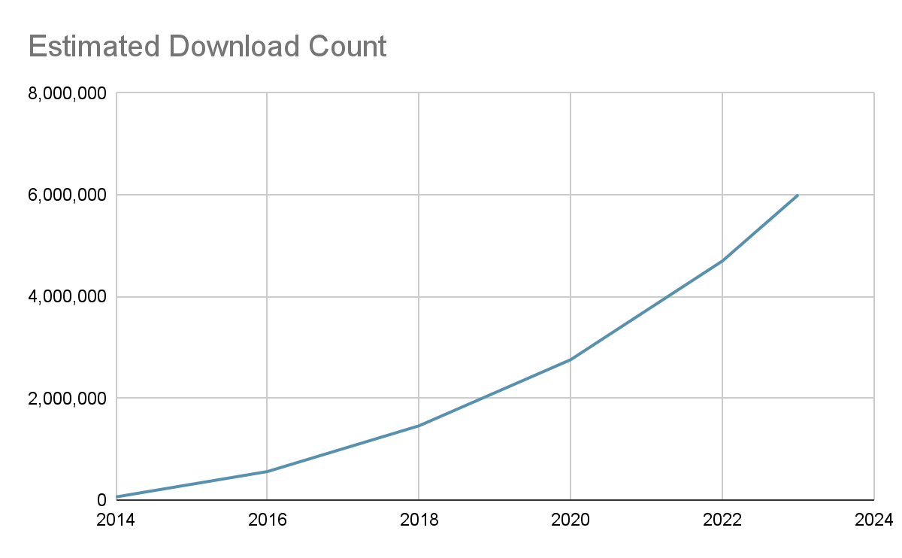
6 Million+
Downloads till Date (2023)
Across BlissLabs’ Suite of Projects
Notes:
Blissos-x86: 2017-12-21 - 2023-07-01: 2,753,341
Blissos-dev: 2019-11-16 - 2023-08-01: 1,688,493
Total: 4,441,834
Waydroid (Sourceforge downloads):
2021-08-20 to 2023-08-14: 753,860
BlissROM (Sourceforge downloads): 2018-02-20 to 2023-08-14: 763,495
Total: ~6M

Slide 6
BlissLabs
What we represent now
Notes:
How many of you recognize any of these ??????. Although this is the current phase, we are expanding . But having said that we do have a project screening criteria(mention main criteria) . But generally we a bunch of friendly democratic folks across projects.We live in harmony.

Slide 7
Bliss Labs - Project portfolio
Bliss OS & Bliss OS Go - “Unified android experience irrespective of hardware”
Android-x86 OS for Intel & AMD x86_64v2 devices
Waydroid - “Android integration with Linux - light weight”
Containerized approach for Android on Linux (using Wayland)
Android-Linux hybrid - “Control fully from Linux, but at the same time run as an independent hardware-accelerated OS”
SmartDock - “Desktop experience like windows/chromeOS for android”
FOSS Desktop UI app for Android - multiwindow , taskbar , dock etc.
XT Mapper - “Only OSS gaming focused keymapper for android”
FOSS on-screen keymapper solution for Android
Supreme Gamers - “Android-x86 Development community who made - installer , recovery solutions etc “
Boringdroid - “Complete OSS Desktop UI solution for AOSP built into source”
Bliss Bass - “Production ready example of Android on x86 hardware, based on BlissOS, adding further customization/configuration, rebrandability and built to be used with our build automation toolkits.”
Android-Generic Project - “Easy button for Bliss OS build” . Rapid Prototyping toolkit for Android-x86 based builds.
BlissROM - Custom Android OS for mobile devices
Notes:
An Ocean of Projects ;). Talk about the quotes only . Stress on Bass part and say clearly that blissbass is an example based on blissOS. Similarly AG is and OSS tool which can be used/customized for other similar projects. BlissROM base code defaults with FOSS stuff - blissOS source. But but there are gapps and vendor blobs made by users/developers using the base BlissROM abd BlissOS also but that's part of freedom and we don’t directly support / are neither liable.

Slide 8
BlissLabs Process
Matured Process model
Build
Testing
Release
Documentation - dev & users
Post release support
Notes:
Testing is standard + use community supports for specific devices .

Slide 9
Popular OSS products having links with our projects
BlendOS - Waydroid
Ubuntu web - Waydroid & Android-Generic
Ubuntu Touch - Waydroid
Prime OS - Uses Android-Generic
Android-x86 - We supply team resources, build servers, development, etc.
Notes:
Mention :- There are some of the popular projects/products out there who use our work with/without acknowledgement . But unfortunately i guess that's part of open source.

Slide 10
BlissLabs - Support for sub projects
Attending Conference
Hardware for testing
Hardware for development (Personal equipment)
Hardware build / web servers
Communication server (slack/discord/gsuite/telegram)
Software services - storage(sourceforge,gdrive), dev(gitlab,github),process(jira,confluence,trello)-atlassian suite, Web servers (google,github,update-ota)
Notes:
We are welcoming home for the projects as mentioned earlier. So if you feel your projects needs a home or you need like minded friends to work with or just to share your thoughts feel free to contact us

Slide 11
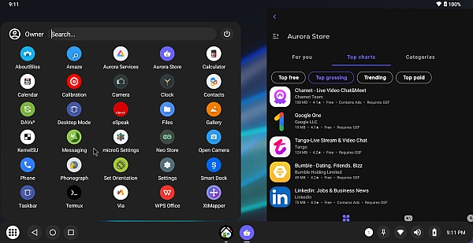
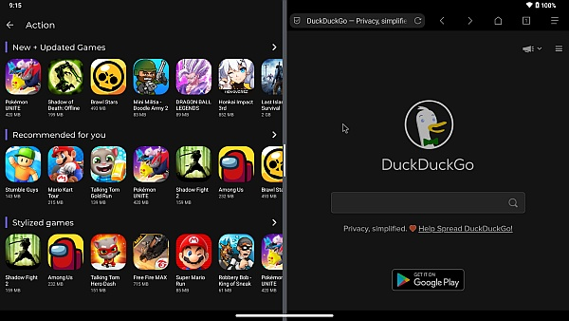
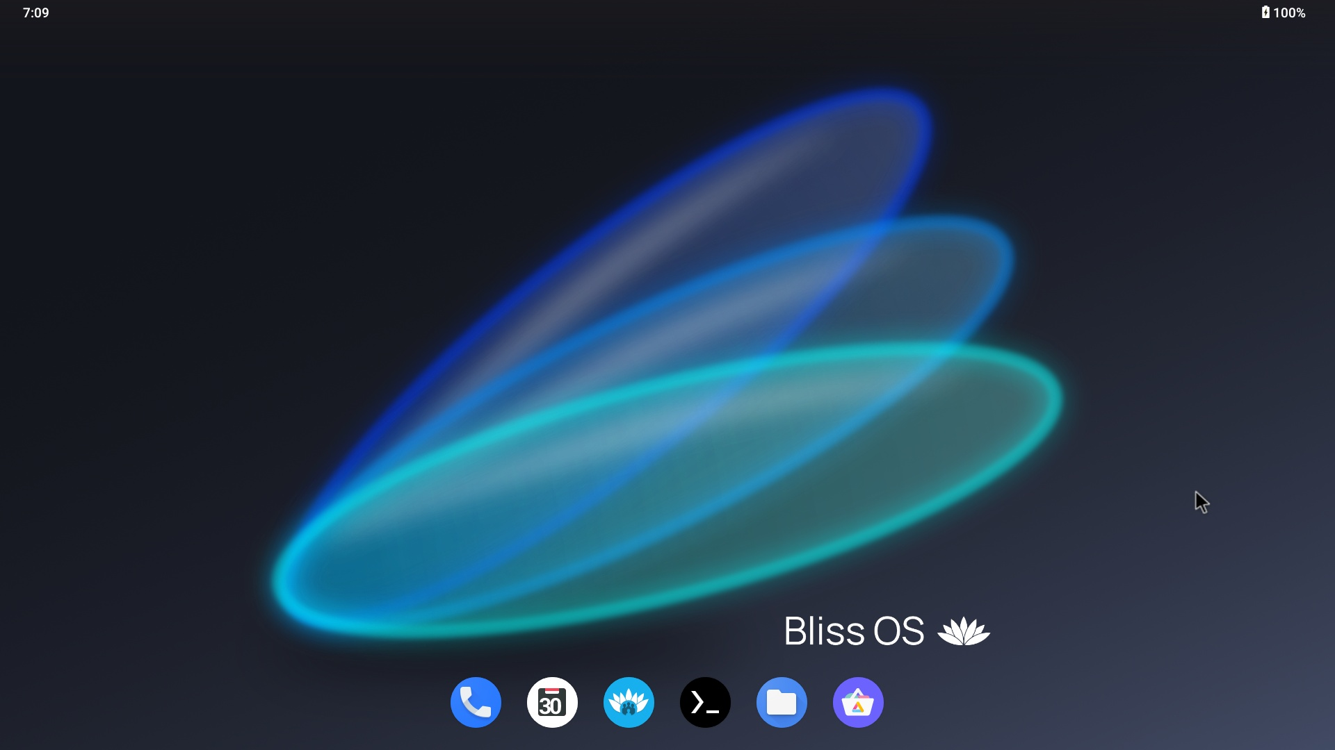
Bliss OS
“Android for your PC”
An Android-based open source OS that incorporates many optimizations, features, and modular device support for x86 based PC hardware and peripherals.

Slide 12
Bliss OS - Features
Mainline Linux based with Android x86 patches
Features - Desktop UI, changes for x86 hardware, custom HAL’s, etc.
Generic Builds (one .iso to rule them all)
Tons of customization options included
Low-resource based subsystem
High performance on x86 based hardware
Added Linux tools integrated with Android (Termux, networking & device configuration, etc)

Slide 13
DIVERSE TYPE OF USE-CASES
Kiosk
Mobile
PC’s (new & older)
Gaming
Automotive display
POS/CFD
Menu Displays
Ad Displays
TV/Large Screen
IOT/IIOT
Industrial Displays
GAMING
Component Displays

Slide 14
Bliss OS licensing and Funding
Bliss OS - Apache v2/GPLv2/GPLv3
Using Bliss OS using as is - free and open source anywhere.
Using Bliss OS using modified and source code released - still comes as open source.
Open for anyone to use the project; coming to BlissLabs in request for consultation/modification is not required.
Small per-device or perpetual licensing cost for those that are using a modified source, and do not wish to release source code.

Slide 15
Milestones - Achievements
EIDU - Pilot Programs
Companies using it in products
Shortlisted by Sourceforge multiple times as Featured project.
More devices added - More reach across different segments
Notes:
Really Elaborate EIDU and the reach . Segments - business segments(POS, KIOSK, etc) , user segments (kids to professional) , use-case application segments

Slide 16
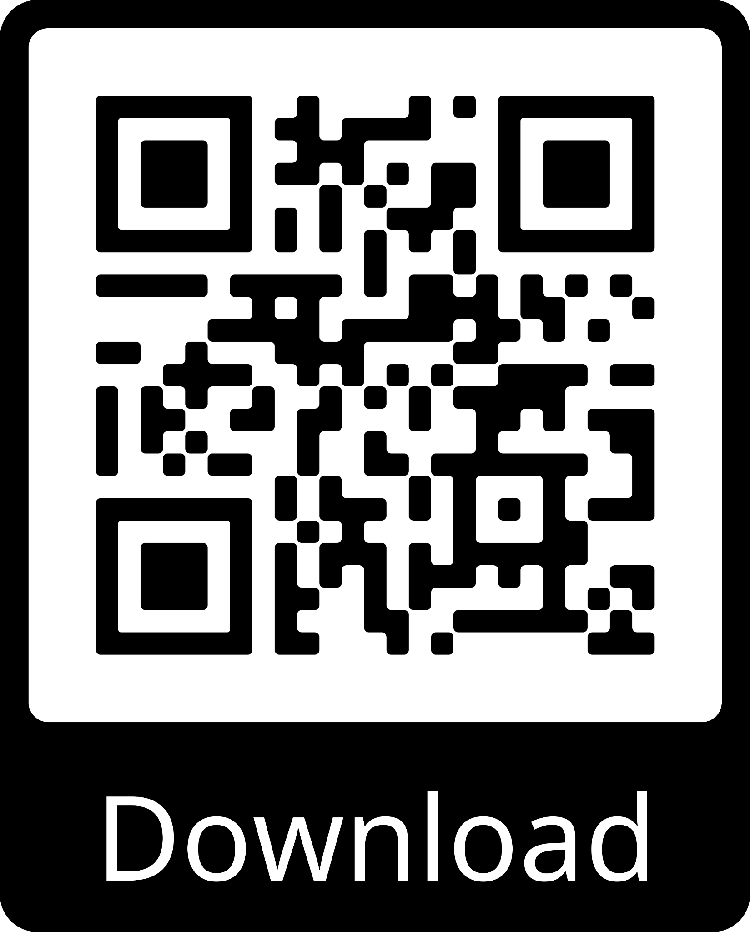
DEMO BLISS OS - https://blissos.org
You can find Demo Videos on our website
You can download an ISO for Android 11, 12 & 13 from the website too

Slide 17
BlissOS - announcement
New Release (version) happening just after the talk
Key Features
Bliss OS v17.0 (Android 14)
Initial features ported from A13 to A14
Notes:
Update the feature list and put the version numbers , can maybe talk about how people can request for features and how the major releases happens and OTA and upgrade.

Slide 18
WHAT TO EXPECT IN NEAR FUTURE
Product -
More device groups - Raspi , RISCV
More features -
Moving towards Linux hybrids
More independent and complete FOSS ecosystem.
OSS tools/sw
Custom FOSS app store
Edge/IOT/IIOT
Process
Documentation even for newbies
Improved/automated installation support
Fine tune already AI enabled support chat bot increase user support automation.
Notes:
In complete FOSS eco system mention we have process to ask the users to request for more features and also encouraging them to back to specific gaming groups for proper FOSS support . Talk more in the chat bot and how we are ready to go with the technology innovation and try to adopt it within the organization and for the projects like AI on Edge in cards.
Advocating for universal device development on Android (ARM, ARM64, x86, x86_64)

Slide 19
Community Engagement
Contests
Easter Eggs
Goodies
Git points
Blissify videos link in the blisslabs site
Notes:
Blissify videos is something new…And if any of you already have feel free to be proud and post. Already people post in the telegram and we want to acknowledge as a community engagement.

Slide 20
Opportunities
Internships
Mentorship
Matured org
Open roles (paid) - hopefully soon - eg:- web development, server maintenance, project management, HR,finance, developer etc.
Contributors (can get mileage for next move or can be absorbed)
Ease of joining
Inclusive , healthy culture. (ego & drama free)
Democracy and flat structure
Notes:
Can just mention how welcoming an org we are. Rest they can read maybe?. Remove the details in bracket if you can remember

Slide 21
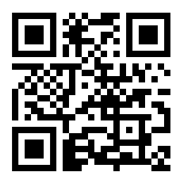
THANK YOU
WHERE TO FIND US
BlissLabs - blisslabs.org
Facebook
Telegram
Discord
LinkedIn
X (Twitter)
Bliss OS - blissos.org
Matrix
Telegram
X (Twitter)
Discord
XDA
Get in Touch!

