Slide 1
Open Media devroom 2017 Introduction
Christophe Massiot (FOSDEM 2017)
cmassiot@upipe.org
http://upipe.org/

Slide 2
Open Media devroom
3rd year in a row
Audio & video applications
Standards
Formats
Codecs
Video analytics and Search to Web video
IPTV
Broadcasting
Radio

Slide 3
DEV ROOM SPONSORS
OpenHeadEnd
- Christophe Massiot - cmassiot@upipe.org
EBU - European Broadcasting Union
Adi Kouadio - kouadio@ebu.ch
Frans de Jong - dejong@ebu.ch
Open Broadcast Systems
- Kieran Kunhya kierank@obe.tv

Slide 4
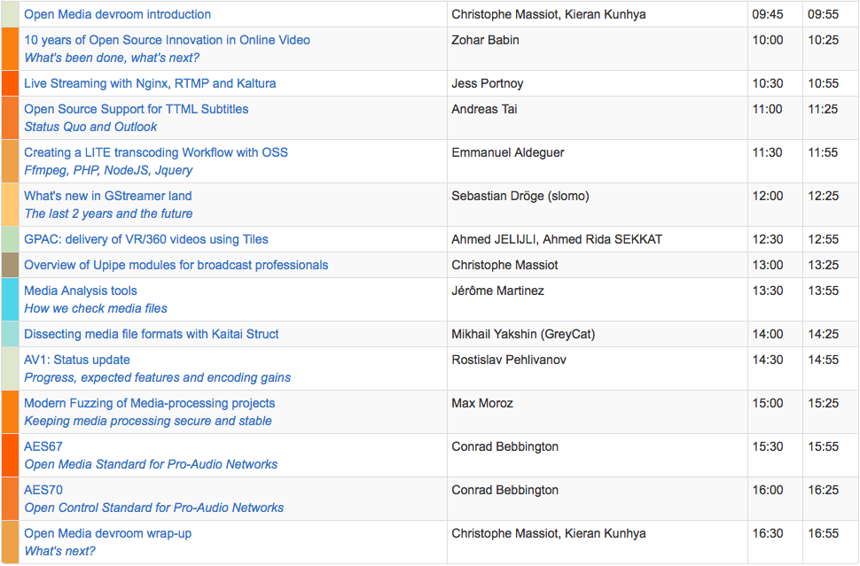
Web delivery
Frameworks
Codecs
& Formats
Standards

Slide 5
Web delivery
10:00 10 years of Open Source Innovation in Online Video (Zohar Babin)
10:30 Live Streaming with Nginx, RTMP and Kaltura (Jess Portnoy)
11:00 Open Source Support for TTML Subtitles (Andreas Tai)
11:30 Creating a LITE transcoding Workflow with OSS (Emmanuel Aldeguer)

Slide 6
Frameworks
12:00 What's new in GStreamer land (Sebastian Dröge)
12:30 GPAC: delivery of VR/360 videos using Tiles (Ahmed JELIJLI & Ahmed Rida SEKKAT)
13:00 Overview of Upipe modules for broadcast professionals (Christophe Massiot)

Slide 7
Codecs & formats
13:30 Media Analysis tools (Jérôme Martinez)
14:00 Dissecting media file formats with Kaitai Struct (Mikhail Yakshin)
14:30 AV1: Status update (Rostislav Pehlivanov)
15:00 Modern Fuzzing of Media-processing projects (Max Moroz)

Slide 8
Standards
15:30 AES67 (Conrad Bebbington)
16:00 AES70 (Conrad Bebbington)

Slide 9
Conclusion
16:30 Open Media devroom wrap-up (devroom team)

Slide 10
What else?
All videos will be put online to fosdem.org
Please rate the presentations using the links on the schedules (fosdem.org) or feedback@fosdem.org
Please help us keep the room clean

Slide 11
cmassiot@openheadend.tv

