Slide 1
Graph-based analysis of JavaScript repositories
Adam Lippai
Web team lead of Tresorit,
the encrypted cloud storage company

Slide 2
ingraph
  Graph database engine for incremental evaluation of openCypher queries
  https://github.com/szarnyasg
  Similar to Neo4j + incremental evaluation
Notes:
I’m going to present the topic of an academic project, done by the students of the Budapest Univesity of Technology. The research group historically studies fault tolerant systems and model verification. This spin-off project started 3 years ago, by Gabor Szarnyas developing a Scala based, distributed, incremental graph database engine called Ingraph, followed by Daniel Stein and later Soma Lucz by starting static analysis tool called codemodel-rifle

Slide 3
openCypher – pattern matching
C
user | friend | foaf
A | B | C
A | B | D
A
B
D

Slide 4
Incremental evaluation
A v B v C
A v B v C v D
(In reality it’s more complex, the actual algorithm is called RETE and it’s based on radix trees)
Notes:
The concept of incremental evaluation means we do not re-compute the given task, only the required parts.

Slide 5
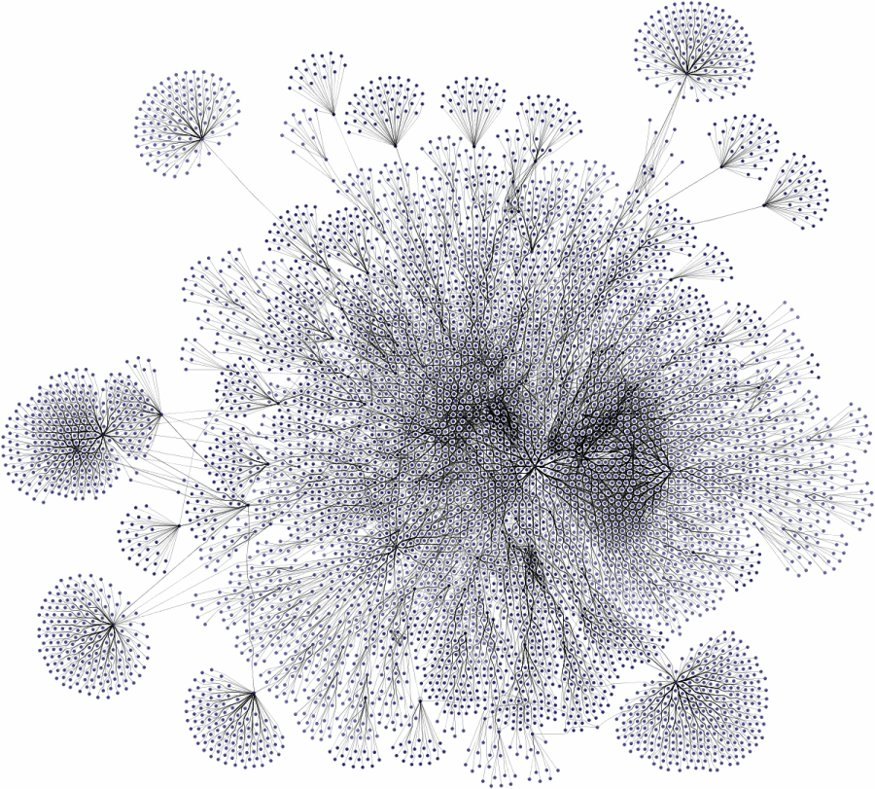
Notes:
What is a graph database? It’s really like traditional database, but instead of tables it enables arbitrary connections.
3 years ago there was a project which aimed incremental query evaluation on graphs and by graphs I mean really large graphs with more than 10-100 million nodes.

Slide 6
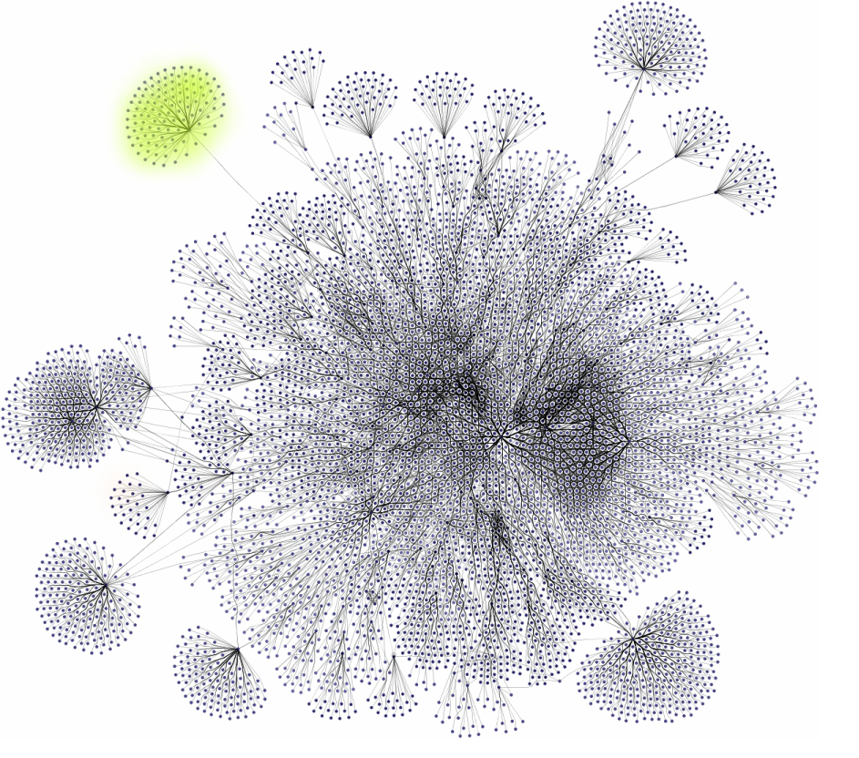
Notes:
Ingraph makes it possible, to track the graph changes, build indexes and cache the partial query results. Changing the green part of this graph usually results in running the query over the whole graph

Slide 7
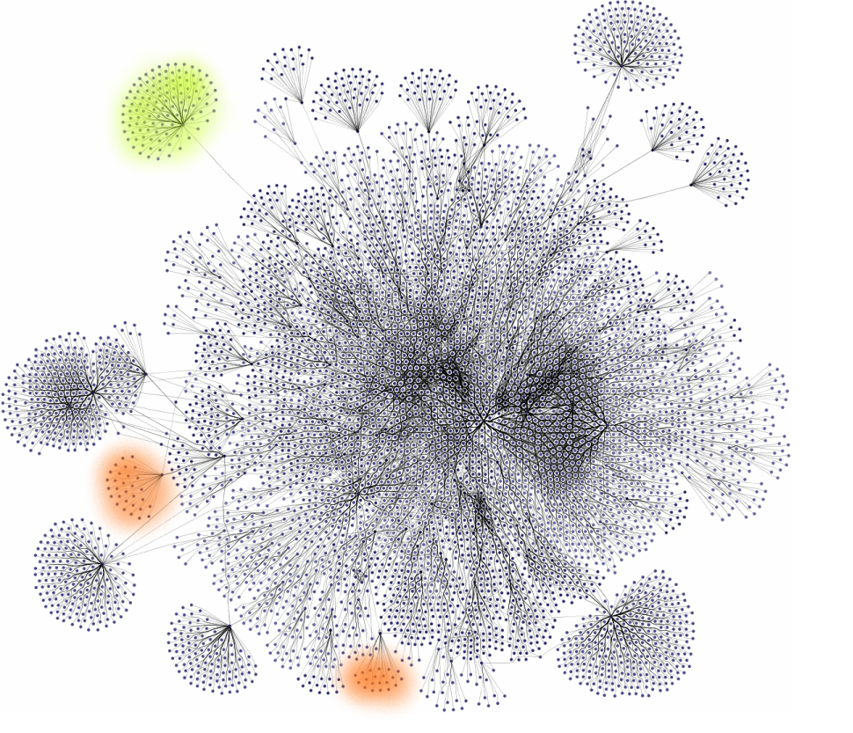
Notes:
But the caching may result in not doing a “full table scan” on every change, but running the query only on small parts and reuse the previously cached results.

Slide 8
Why is static analysis important?
QA is expensive
  Money: Get the bugs fixed in the earliest stage, cut the administration and release overhead
  Developer experience: less round-trips -> better focus on one task
Learning by example
Insights for project and code health
It scales across companies
  Patterns that lead to bugs can be shared
  Find bugs in your code already found by Microsoft, Facebook, Google
Notes:
So why this exact project?
Quality Assurance is expensive, not just because you test the product (you would test it anyways), but you have to handle the feedback loop and process the results. This generates administration overhead and it causes delayed releases even in the most agile company.
Skipping some fixing & testing rounds (even with continuous integration having really fast response) pays off by not distracting the developer, maintaining their flow, keeping their focus.
Static analysis guides the newcomers joining the company to write code similar to her senior colleagues. For me and lot of software engineers it’s the most effective way to learn new frameworks, workflow, “grow into” a new project
Also this can enable new types of insights. For psychology and management researchers it is nearly impossible to examine how coding happens.
Static analysis scales not only within the company, but it’s a form of knowledge and tooling shareable in the IT industry.

Slide 9
What does the new database enable?
Granularity & scope
Developer empowerment
Maintainability
Notes:
It improves Granularity and scope
It empowers developers
It helps maintainability

Slide 10
Granularity – now
Linters work within files
TypeScript Compiler and other IDE tools create “interfaces of the imported files” for specific use-cases (e.g. type inference)
Notes:
Linters do not parse dependencies or projects

Slide 11
Granularity – future
Complete project
  Every JS file, together
Multiple projects
  Every project – think npm install or npm update
Over time, over Git branches
  A project doesn’t have 10000 states, but 1 initial state and 9999 changes
Notes:
Every imported 3rd party project should be analyzable in the context of our project.

Slide 12
Developer empowerment – now
CTRL + F
Find class/method/function in IDE
Class maps for OOP
Scaffolded Babylon, Acorn or TS compiler script
Generated + searchable docs based on JSDoc

Slide 13
Developer empowerment – future
Where is this code used?
What parts of the code can modify this variable?
What side effects can this call or assignment have?
Did I change my libs API? Is it a breaking change?
How to structure my code?
Where to cut modules and bundles?
-> ingraph enables such queries

Slide 14
Maintainability – now
We have unified data structures (similar AST formats)
De facto standard language: XPath
Unique visitor patterns
Hard testability of plugin system
  Plugins mutate state
  Problem of “multi-pass” analysis

Slide 15
Maintainability – future
Adding abstraction without losing information
Common declarative query language – openCypher
MATCH (bi:BindingIdentifier)
<-[:binding]-()-->
(be:BinaryExpression)
-[:right]->(right:Expression)
WHERE be.operator = 'Div'
AND right.value = 0.0
RETURN bi

Slide 16
var foo = 1 / 0;
MATCH (bi:BindingIdentifier)
<-[:binding]-()-->
(be:BinaryExpression)
-[:right]->(right:Expression)
WHERE be.operator = 'Div'
AND right.value = 0.0
RETURN bi
  VariableDeclarator
binding
init
bi
be
  BindingIdentifier
  name = `foo`
  BinaryExpression
  operator = `Div`
left
right
  Expression
  value = 1.0
  Expression
  value = 0.0
right

Slide 17
Graphs are powerful
Existing optimal algorithms and good heuristics instead of „not that bad code”
Incremental query caching is possible – eg. RETE or TREAT

Slide 18
Use cases for incremental pattern matching
Type propagation and checking (type inference)
Dead code elimination
(Asynchronous) code flow checks – can the program reach a specified state, can a value be undefined etc.
Fuzzing like behavior, e.g. integration test generation
Code vectorization -> AI

Slide 19
The right tool is
Declarative
  what instead of how
Stateful and incremental
  cache the existing knowledge
Instant
  inside your IDE

Slide 20
Codemodel-rifle
  Parsing JS using Shift Java
  Transforming
  Loading the model into Neo4j or ingraph
  Executing queries on top of it
  https://github.com/steindani
  https://github.com/luczsoma

Slide 21
Thank you!

