Slide 1
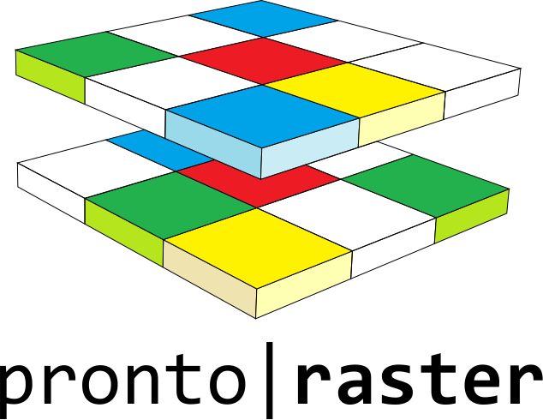
Pronto Raster: A C++ library for Map Algebra
Alex Hagen-Zanker
a.hagen-zanker@surrey.ac.uk

Slide 2
Map algebra
Local operations
Focal operations
Zonal operations
Σ
5
A
B
B
B
3
1
3
2
A
B
A
B
2
A
A
A
B
+
=
1
2
1
2
Σ
4
4
2
2
4
13
3
4
3
2
=
=
Zone | Σ
A | 17
B | 13
7

Slide 3
That is basic! Don’t we have tools?
Geodata management: GDAL, Proj, GeoTIFF, etc.
Image processing: OpenCV, GIL, etc.
Linear algebra: Eigen, Blitz, UBLAS, etc.
Scripting languages: ArcGIS Python, PC Raster, R - raster, Geotrellis
GIS software: Raster Calculator and specific tools in QGIS, SAGA ArcGIS
All of these facilitate Map Algebra operations, but none meets all (my) requirements

Slide 4
Expected user and requirements
Researcher / consultant working in geocomputational domain who does not like being constrained by built-in methods
Requirement | Key challenge
Customizable | Be able to apply custom local, focal and zonal functions on any number of layers
Scalable | Work with large raster data sets that exceed available memory
Efficient | Minimal creation of temporary datasets for intermediary results
Flexible | Work with wide range of data types with no need for data preprocessing
Usable | Idiomatic interface, minimal use of boiler plate code
Compatible | Be able to use in conjunction with other libraries (e.g. for optimization, simulation control, etc.)

Slide 5
Design: Raster and Raster View concepts
Range*
Gives access to a sequence of values through iterator access. Unlike a Container does not have to store its own values
Range View
A Range that can be copied O(1) and is meant to be passed to functions by value
Raster
A Range of which we know the number of rows and columns. And, must also give access to sub-raster .
Raster View
A Raster that is also a View.
*Official proposal to C++ standard, see also https://ericniebler.github.io/range-v3/

Slide 6
Design: Raster and Raster View concepts
Concept | Main requirements
Range | iterator_type begin(); iterator_type end();
Sized | size_type size();
View | copy-constructor O(1)
Raster | sub_type sub_raster(start_row, start_col, rows, cols); size_type rows(); size_type cols();

Slide 7
Using the Raster concept (1)
Use GDAL to open a raster dataset as a model of the Raster View concept
#include <pronto/raster/io.h>
namespace pr = pronto::raster;
int main()
{
auto ras = pr::open<int>("my_file.tif")
int sum = 0;
for(auto&& v : ras)
{
sum += v; }
}
Use range-based for-loop to iterate over all values in the raster

Slide 8
Using the Raster concept (2)
#include <pronto/raster/io.h>
namespace pr = pronto::raster;
int main()
{
auto ras = pr::open<int>("my_file.tif")
int sum = 0;
for(auto&& v : ras.sub_raster(2,3,10,20))
{
sum += v; } }
Iterate over subset of the raster. First cell at (2,3) then 10 rows and 20 columns

Slide 9
Design: Expression Templates (ET) for local operations
Local operations take Raster Views as input and produce an ET as output that also is a Raster View.
Cell values of the ET are only calculated once they are iterated over
No need to allocate memory
Input and output conform to the same concept: highly composable
A generic function, transform, is implemented, other local functions can be implemented in terms of transform

Slide 10
Using local operations(1)
#include <pronto/raster/io.h>
#include <pronto/raster/transform_raster_view.h>
#include <functional>
namespace pr = pronto::raster;
int main()
{
auto a = pr::open<int>("a.tif");
auto b = pr::open<int>("b.tif");
auto sum = pr::transform(std::plus<int>, a, b);
for(auto&& v : sum.sub_raster(2,3,10,20))
{
// do something
} }
Open two datasets
Create a Raster View that applies std::plus to each cell of both input datasets
Iterate over a sub-raster of the Raster View and calculate the required values only

Slide 11
Using local operations(2)
Create a RasterView of square of differences in two steps
auto a = pr::open<int>("a.tif");
auto b = pr::open<int>("b.tif");
auto diff = pr::transform(std::minus<int>, a, b);
auto sqr_lambda = [](int x){return x*x;};
auto sqr_diff = pr::transform(sqr_lambda, diff);
int sum_of_squared_diff = 0;
for(auto&& v : square_diff)
{
sum_of_squared_diff += v; }
Iterate over values, without allocating extra memory, or creating temporary dataset.

Slide 12
Using local operations(3)
#include <pronto/raster/io.h>
#include <pronto/raster/raster_algebra_operators.h>
#include <pronto/raster/raster_algebra_wrapper.h>
namespace pr = pronto::raster;
int main()
{
auto a = pr::raster_algebra_wrap(br::open<int>("a.tif"));
auto b = pr::raster_algebra_wrap(br::open<int>("b.tif"));
auto square_diff = (a – b) * (a – b);
for(auto&& v : square_diff)
{
// do something } }
Wrap a and b in raster_algebra_wrapper to allow use of overloaded operators
Iterate over values.

Slide 13
Design: use optional<T> for flagging and processing nodata values
#include <pronto/raster/io.h>
#include <pronto/raster/nodata_transform.h>
#include <pronto/raster/plot_raster.h>
namespace pr = pronto::raster;
int main()
{
auto in = pr::open<int>("demo.tif");
auto nodata = pr::nodata_to_optional(in, 6);
auto un_nodata = pr::optional_to_nodata(nodata,
-99);
}
Value type: int
0 3 6 2 5
1 4 0 3 6
2 5 1 4 0
3 6 2 5 1
Value type: std::optional<int>
0 3 - 2 5
1 4 0 3 -
2 5 1 4 0
3 - 2 5 1
Value type: int
0 3 -99 2 5
1 4 0 3 -99
2 5 1 4 0
3 -99 2 5 1
Providing an idiomatic way for functions to skip over missing values or to leave cells unspecified

Slide 14
Design: fundamental spatial operators avoid copying data
Function | Effect
pad | add const-valued leading and trailing rows and columns with a unmutable value
sub_raster | as required by the Raster concept
offset | returns value found at a fixed spatial offset in the input RasterView
h_edge / v_edge | iterate over all pairs of horizontally / vertically adjacent cell pairs

Slide 15
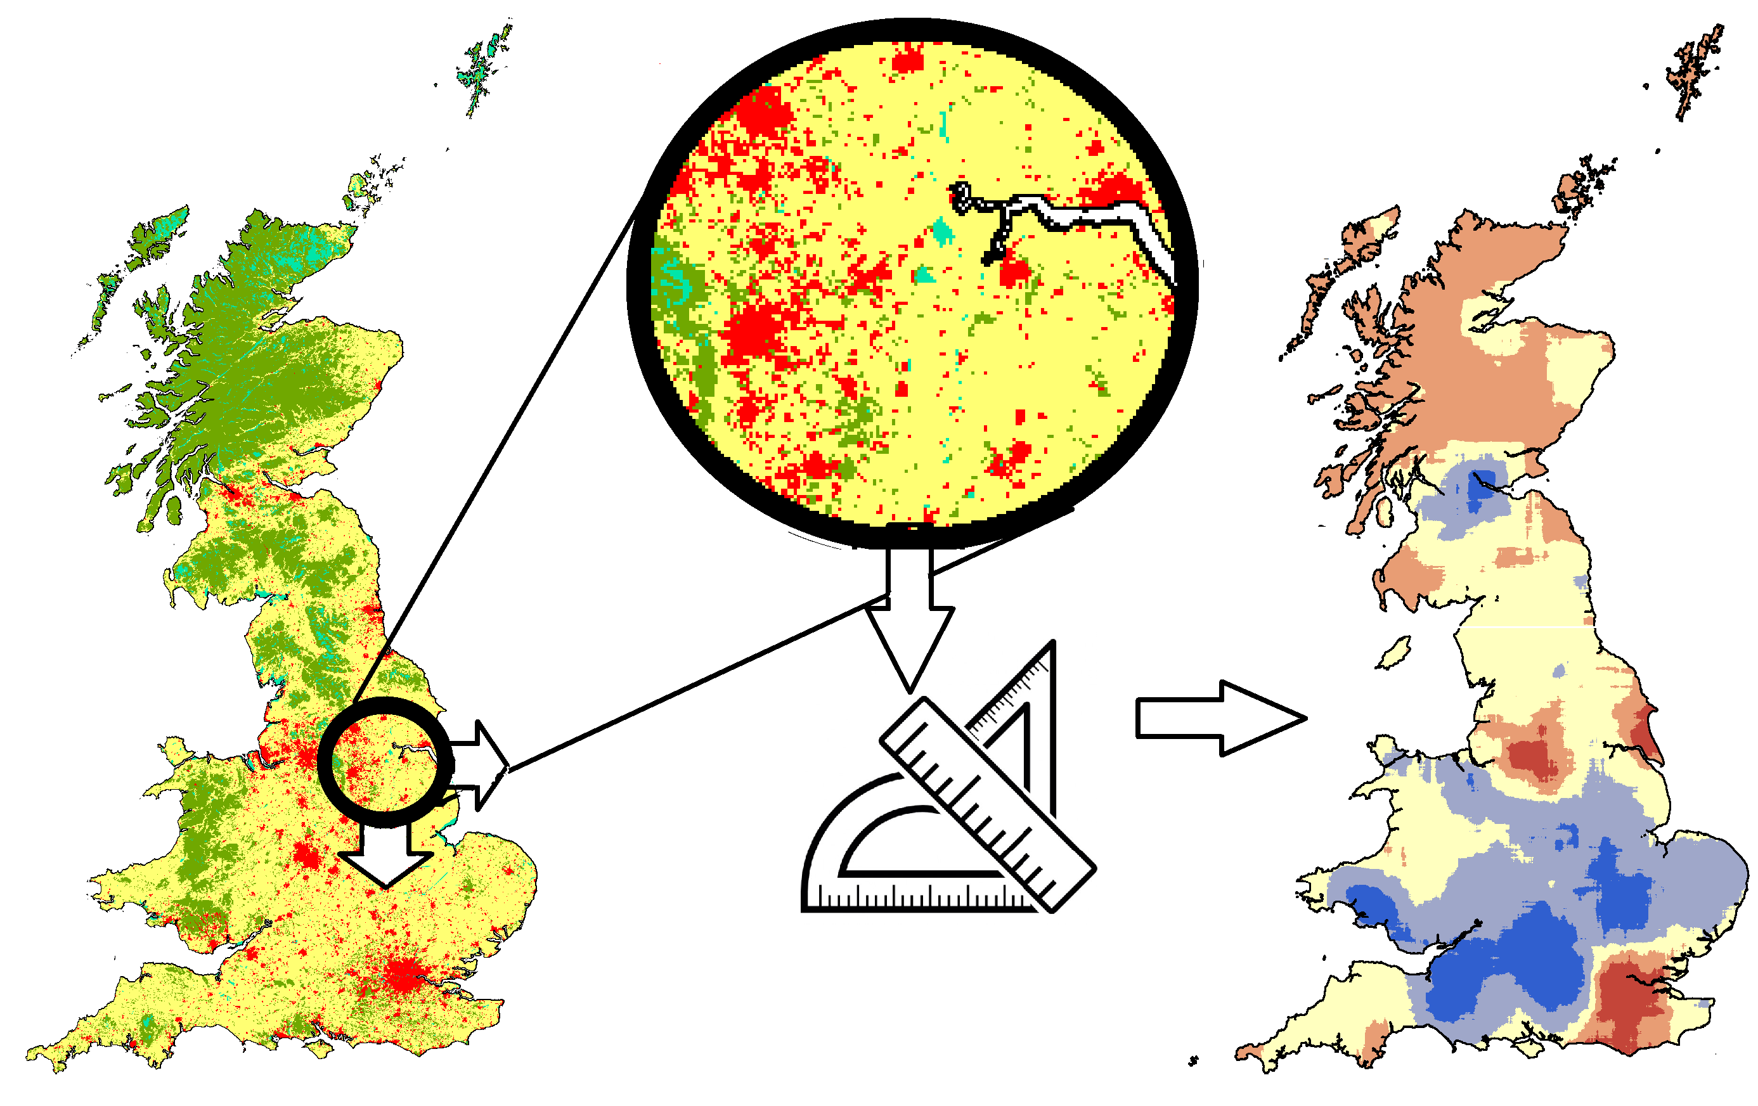
Design: moving windows as Expression Templates
Moving window analysis is a common type of Focal Operation
Each cell obtains the value of a summary statistics calculated for cells in a surrounding window
Efficient implementations exploit overlap in windows of adjacent cells (especially for large windows)

Slide 16
Moving window schemes
Circular window of cells
Circular window of edges
O(r x n)
r = radius
n = raster size
Square window of cells
Square window of edges
O(n)
n = raster size
Hagen-Zanker, AH (2016) A computational framework for generalized moving windows and its application to landscape pattern analysis International Journal of Applied Earth Observation and Geoinformation.

Slide 17
Design: Indicator concept
Implement statistics in terms of a few functions
add(element, weight)
subtract(element, weight)
add(subtotal, weight)
subtract(subtotal, weight)
extract()
Can be used with moving window methods
Can be used for zonal statistics

Slide 18
Using moving window indicators
#include <pronto/raster/moving_window_indicator.h>
#include <pronto/raster/indicator/mean.h>
namespace pr = pronto::raster;
int main()
{
auto in = pr::open<int>("my_file.tif");
auto window = pr::circle(2);
auto indicator = pr::mean_generator<int>{};
auto out = pr::moving_window_indicator(in, window, indicator);
for(auto&& v : out)
{
// do something }
}
Specify circular window with radius of 2 cells.
Specify to use the mean statistic.
"out" is a Raster View, satisfying all the same requirements as "in".

Slide 19
The assign function forces evaluation of lazy Expression Templates
#include <pronto/raster/assign.h>
#include <pronto/raster/io.h>
#include <cmath>
namespace pr = pronto::raster;
int main()
{
auto in = pr::open<int>("my_file.tif");
auto sqrt = pr::transform([](int x){return std::sqrt(x);}, in);
auto out = pr::create_from_model<float>("sqrt.tif", in);
pr::assign(b, out);
}
Cheap: Create ET for the sqrt of values in “my_file.tif”
Expensive: Create “sqrt.tif” and write values

Slide 20
Design: Runtime polymorphism through type erasure
Runtime polymorphism is sometimes required
operations specified by user (e.g. Raster Calculator)
value type of raster dataset unknown at compile time
Type erased class | Holds | Is a Raster View?
any_raster<T> | Raster View object with value type T | Yes
any_blind_raster | any_raster<T>, where T is a supported type | Has: rows(), cols(), sub_raster(…) Lacks: begin(), end()

Slide 21
Using any_raster<T>
pr::any_raster<int> plus_or_minus(bool do_plus)
{
auto a = pr::open<int>("a.tif");
auto b = pr::open<int>("b.tif");
if(do_plus) {
auto x = pr::transform(std::plus<int>, a, b));
return pr::make_any_raster(x);
} else {
auto y = pr::transform(std::minus<int>, a, b));
return pr::make_any_raster(y);
}
}
Runtime decision
x and y are different types; but both are Raster Views with int as value type

Slide 22
Using any_blind_raster
pr::any_blind_raster a_in= pr::open_any("a.tif");
pr::any_blind_raster b_in= pr::open_any("b.tif");
auto a = pr::raster_algebra_wrap(a_in);
auto b = pr::raster_algebra_wrap(b_in);
auto c = (b-a) * (b-a);
pr::export_any("out.tif", c.unwrap());
Opened as the appropriate value type
Raster algebra made to work with any_blind_raster
Exported to the appropriate value type
Unwrap from raster_algebra_wrapper

Slide 23
Future music: Parallel processing
The sub_raster() requirement of Raster Views combined with the Expression Template design allows doing calculation for only a part of the raster
For local operations and moving window indicators only the assign function needs to be parallelized
Split the rasters into sub-raster blocks
Assign all blocks asynchronously
And… rest of library needs to be thread safe

Slide 24
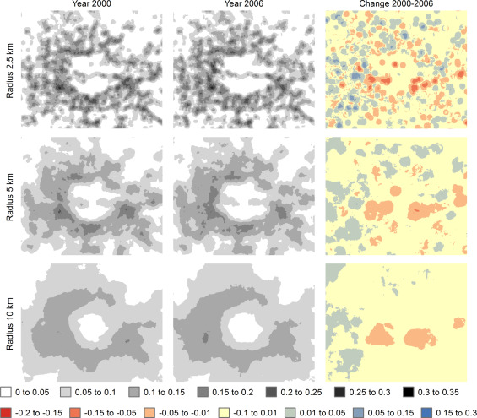
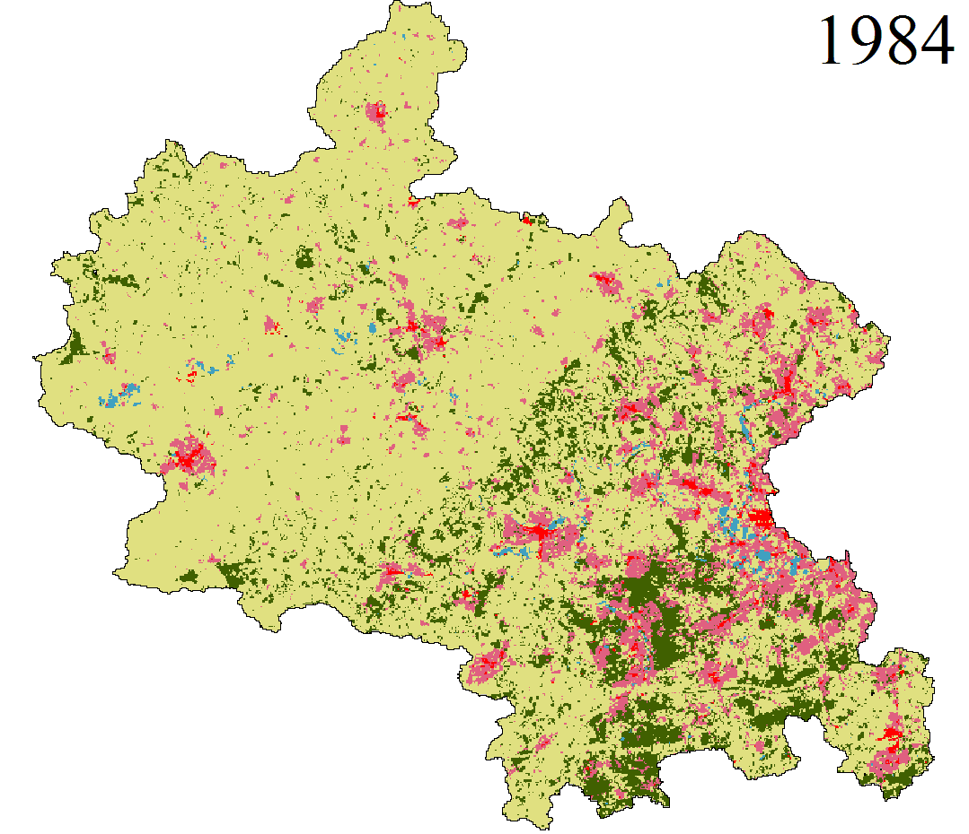
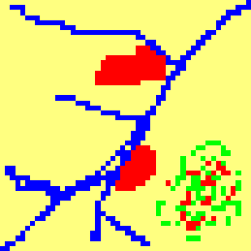
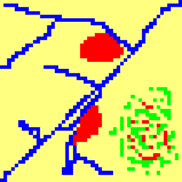
Applications
Scale dependent landscape metrics
Cellular Automata land use model
Fuzzy set map comparison

Slide 25
Conclusions
Requirement | Key challenge | Solution
Customizable | Be able to apply custom local, focal and zonal functions on any number of layers | Transform function Indicator concept Generic moving windows
Scalable | Work with large raster data sets that exceed available memory | Uses GDAL buffering and LRU
Efficient | Minimal creation of temporary datasets for intermediary results | Using expression template Using non-copying spatial operations Potential for parallelization
Flexible | Work with wide range of data types with no need for data preprocessing | Uses GDAL for data access
Usable | Idiomatic interface, minimal use of boiler plate code | Range based for-loop std::optional
Compatible | Be able to use in conjunction with other libraries (e.g. for optimization, simulation control, etc.) | C++ Simple concepts

Slide 26
Thank you!
github.com/ahhz/raster
a.hagen-zanker@surrey.ac.uk

