Slide 1
A road to network automation Christophe Closset Gervais-Martial Ngueko FOSDEM – Brussels, Feb. 3, 2018

Slide 2
Agenda
Introduction to ONAP
A use case – vCPE
Control loop – why and how?

Slide 3
Who We Are
Christophe Closset (AT&T – Namur)
15+ years app development and design in telecom area
Active contributor to ONAP
Gervais-Martial Ngueko (AT&T – Namur)
20+ years app development and design in telecom area
ONAP CLAMP PTL

Slide 4
What is ONAP?
“The ONAP project was formed in March 2017 in response to a rising need for a common platform for telecommunication, cable and cloud operators – and their solution providers – to deliver differentiated network services on demand, profitably and competitively, while leveraging existing investments.”

Slide 5
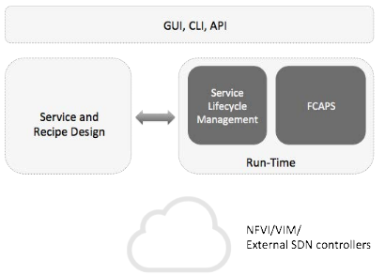
Introduction to ONAP
ONAP is a platform to orchestrate the lifecycle of VNFs in an SDN.
ONAP is a composition of several (10+) applications.
ONAP is divided in 2 main functional areas: design & run-time.

Slide 6
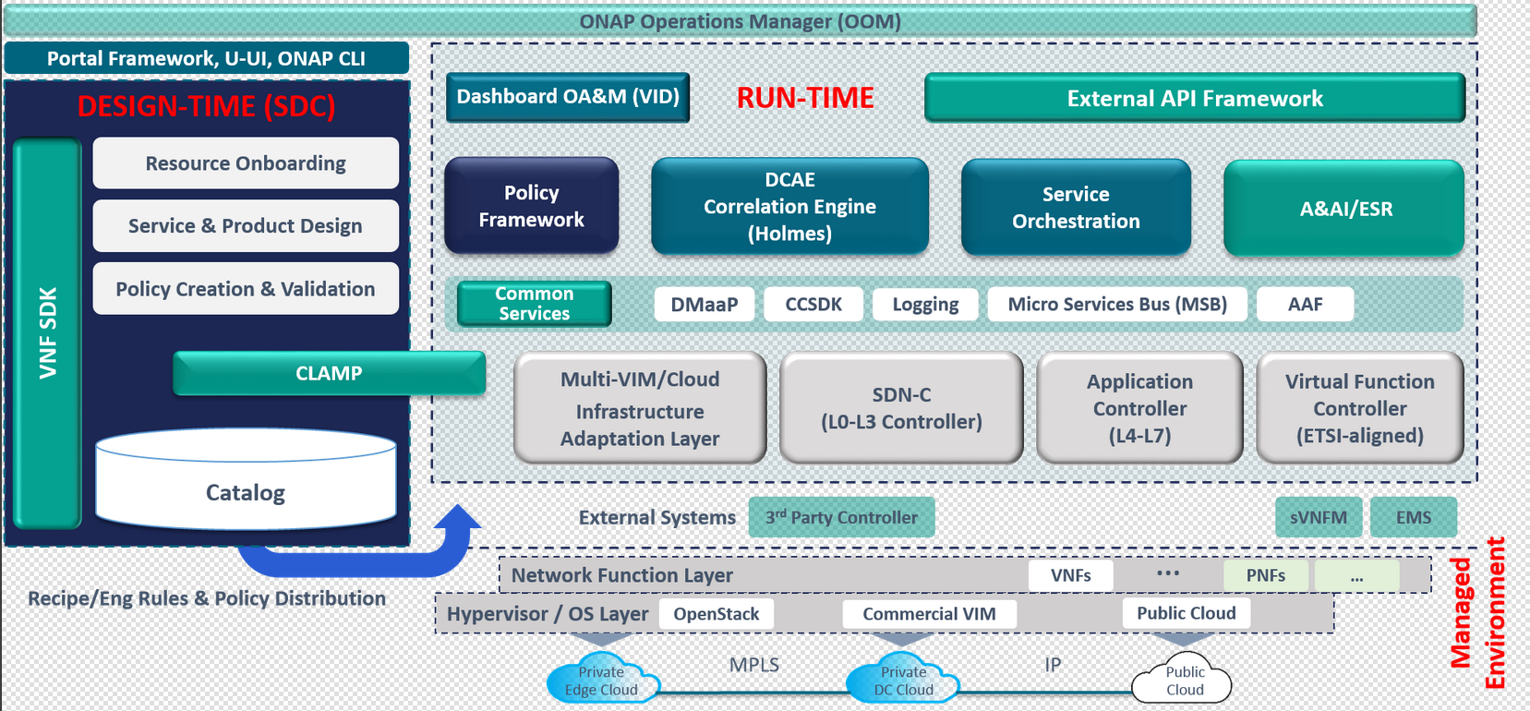
ONAP Architecture

Slide 7
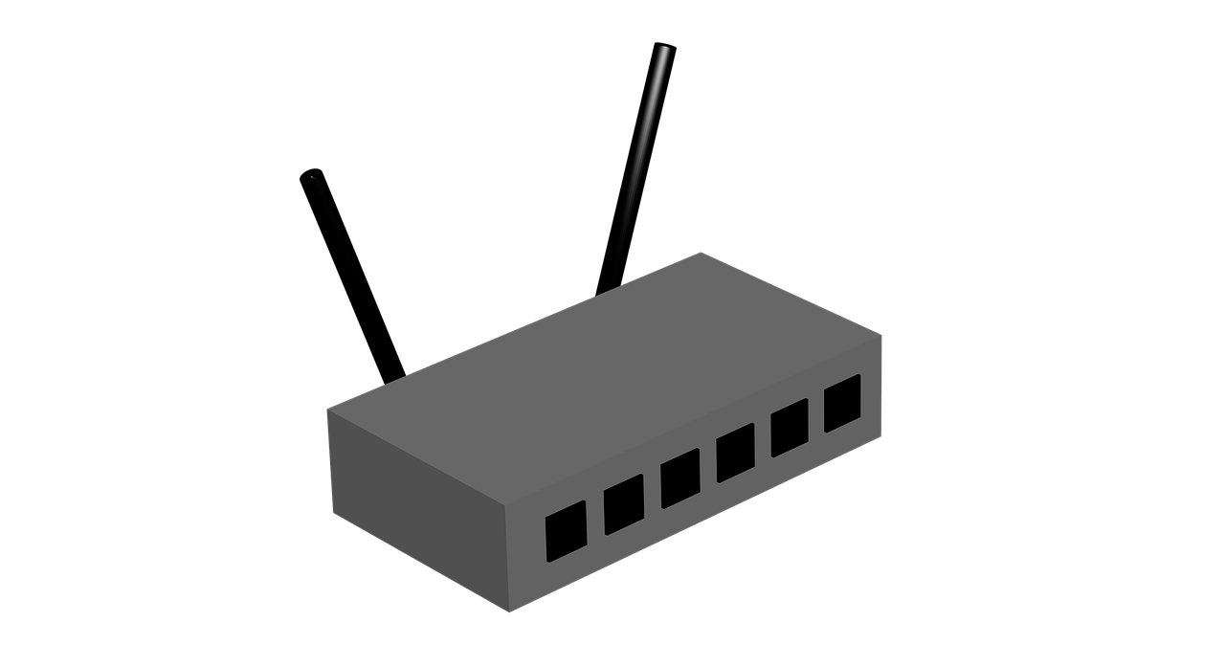
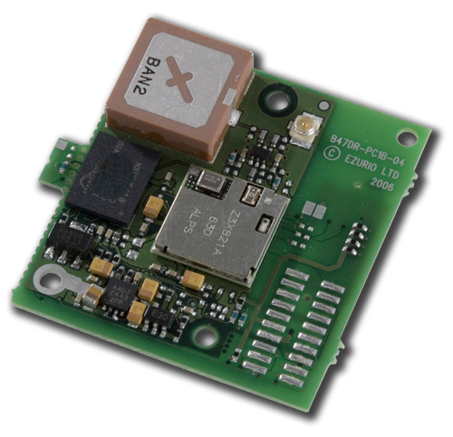
ONAP Use Case – vCPE
From :
To :
NAT – FW – Media Server – AAA - ….
Internet
vAAA – vFW – vDLNA - etc
Simple GW
Cheap – Provider agnostic
Internet
Edge

Slide 8
ONAP Use Case – vCPE
Functions provided traditionally by RG are distributed between:
On-site device (Bridged Residential Gateway — BRG)
Cloud-based component (Virtual Gateway — vG)
Logical Subscriber Link (LSL)
BRG
vG
BRG-LAN Interface
BRG-LSL Interface
Logical vG-LSL Interface
Logical vG-WAN Interface

Slide 9
ONAP Use Case – vCPE
DCAE
(Collector)
DMaaP
SDNC
Control
Infrastructure
ONAP OAM Neutron Network
Data + Control
Per Customer
vDHCP
Dynamic Host Config Protocol
vAAA
Authorization, Authentication, Accounting
vDNS + vPDHCP
Home Network 1
BRG
Emulator 1 (VPP)
vG1
(VPP)
vBNG
(VPP)
vG MUX
(VPP)
CPE Public Neutron Network
Web Server
Home Network 2
BRG
Emulator 2
(VPP)
vG2
(VPP)

Slide 10
ONAP Use Case – Design Time – Onboarding
Upload descriptive model of the virtual function (Heat, TOSCA)
Validate, assign, license, certify virtual function
Create catalog entry, assign data/metadata
Distribute for instantiation

Slide 11
ONAP Use Case – vCPE
Control
Infrastructure
Data + Control
Per Customer
All VNFs are open source, no physical components
HEAT templates produced for all VNFs
ISC
https://www.isc.org/downloads/dhcp/
FreeRadius
https://freeradius.org/
BIND
https://www.isc.org/downloads/bind/
vDHCP
Dynamic Host Config Protocol
vAAA
Authorization, Authentication, Accounting
vDNS
Vector Packet Processing (VPP) + modifications
https://fd.io/technology/
Apache Web Server 2
BRG
Emulator 1 (VPP)
vBNG
(VPP)
vG MUX
(VPP)
vG1
(VPP)
Web Server

Slide 12
ONAP Use Case – Design Time – Onboarding – YAML
description: Heat template to deploy vCPE Infrastructue Metro vGMUX
##############
# #
# PARAMETERS #
# #
##############
parameters:
vcpe_image_name:
type: string
label: Image name or ID
description: Image to be used for compute instance
vcpe_flavor_name:
type: string
label: Flavor
description: Type of instance (flavor) to be used
….
#############
# #
# RESOURCES #
# #
#############
resources:
random-str:
type: OS::Heat::RandomString
properties:
length: 4
vgmux_0:
type: OS::Nova::Server
properties:
image: { get_param: vcpe_image_name }
flavor: { get_param: vcpe_flavor_name }
name: { get_param: vgmux_name_0 }
key_name: { get_resource: my_keypair }
networks:
- network: { get_param: public_net_id }
- port: { get_resource: vgmux_private_0_port }
- port: { get_resource: vgmux_private_1_port }
- port: { get_resource: vgmux_private_2_port }
metadata: {vnf_id: { get_param: vnf_id }, vf_module_id: { get_param: vf_module_id }}
user_data_format: RAW
user_data:
str_replace:
params:
__mux_to_bng_net_ipaddr__ : { get_param: vgmux_private_ip_0 }
__oam_ipaddr__ : { get_param: vgmux_private_ip_1 }
__mux_gw_net_ipaddr__ : { get_param: vgmux_private_ip_2 }
__bng_to_mux_ipaddr__ : { get_param: bng_gmux_private_ip }
__bng_mux_net_cidr__ : { get_param: bng_gmux_private_net_cidr }
__oam_cidr__ : { get_param: onap_private_net_cidr }
__mux_gw_net_cidr__ : { get_param: mux_gw_private_net_cidr }
}
template: |
#!/bin/bash
# Create configuration files
mkdir /opt/config
echo "__mux_to_bng_net_ipaddr__" > /opt/config/mux_to_bng_net_ipaddr.txt
__" > /opt/config/mux_gw_net_ipaddr.txt
echo "__bng_to_mux_ipaddr__ " > /opt/config/bng_to_mux_net_ipaddr.txt
echo "__bng_mux_net_cidr__" > /opt/config/bng_mux_net_cidr.txt
/opt/config/hc2vpp_source_repo_branch.txt
echo "__hc2vpp_patch_url__" > /opt/config/hc2vpp_patch_url.txt
echo "__libevel_patch_url__" > /opt/config/libevel_patch_url.txt
# Download and run install script
curl -k __repo_url_blob__/org.onap.demo/vnfs/vcpe/__install_script_version__/v_gmux_install.sh -o /opt/v_gmux_install.sh
cd /opt
chmod +x v_gmux_install.sh
./v_gmux_install.sh

Slide 13
ONAP Use Case – Run-Time
Instantiate virtual functions
LifeCycle: start / stop / reset / scale up / scale down / configure…
Monitoring metrics
Control loops

Slide 14
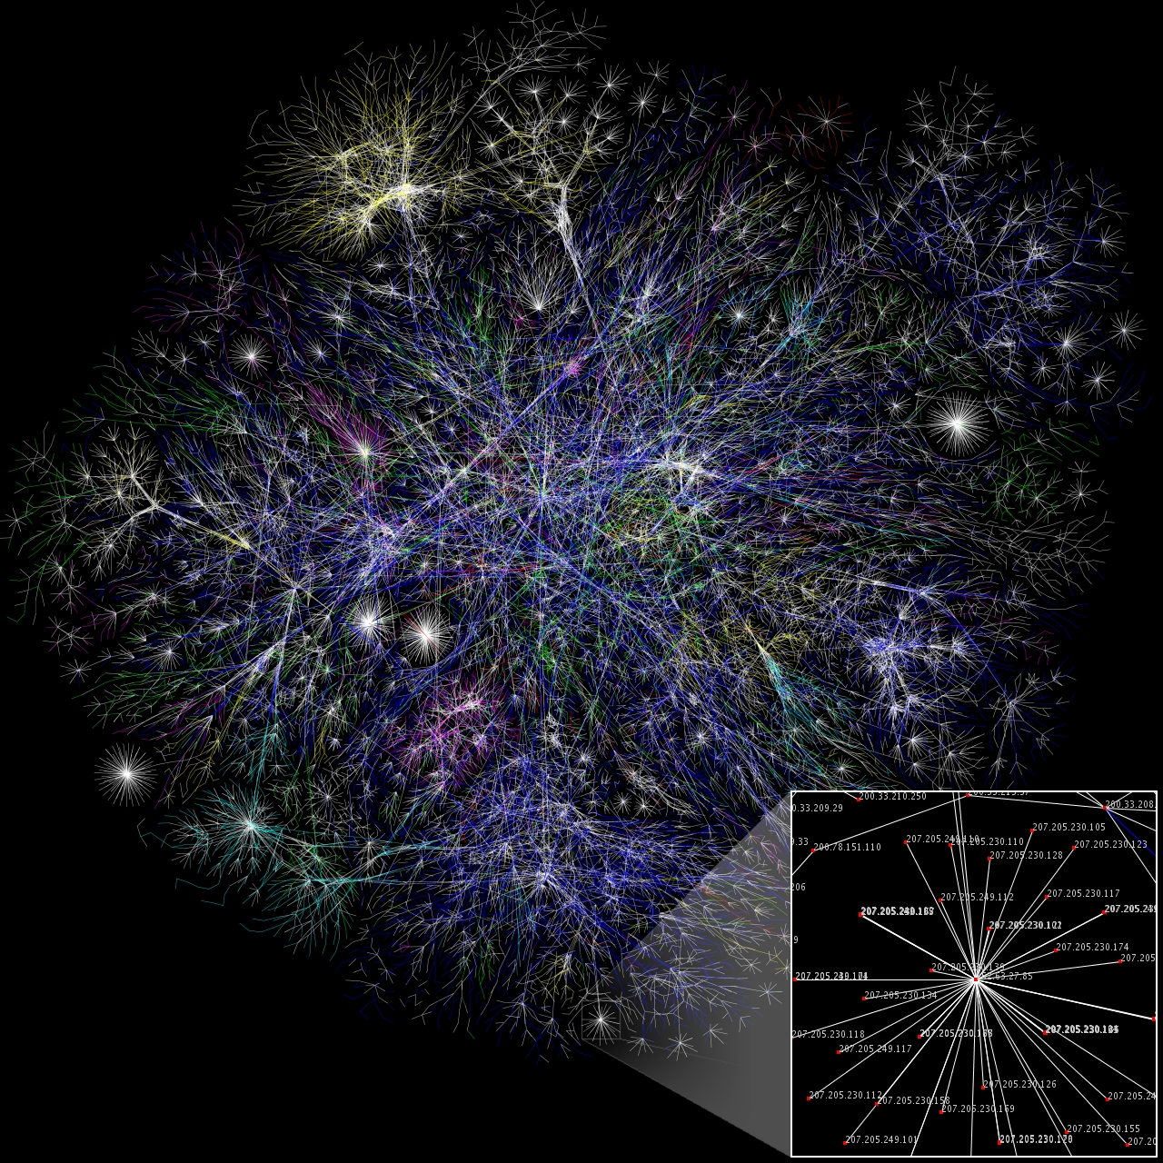
ONAP End Goal: Automating the Network

Slide 15
ONAP vCPE - video
vCPE – Instantiation Video

Slide 16
ONAP Control Loop
The core/main ONAP components involved in C.L. are: DCAE, CLAMP, Policy and SDC.
A Control Loop does several functions:
Collect data about VNFs or VNF infrastructure
Compute analytics based on collected data
For open loop, send message to ticketing system for human intervention
For closed loop, execute one of many actions to remediate the network condition
For closed loop, detect that a network condition has been corrected through our actions

Slide 17
ONAP Control Loop – Design Time (under re-design)
Choose/create microservices sequence that makes the Control Loop
Binding to a VNF in a Service
Choose from pre-existing sequence
Build a brand new sequence
Generate model file (YAML and cloudify blueprint) to be distributed to run-time part of control loop (DCAE/CLAMP)

Slide 18
ONAP Control Loop Run-Time (1)
Configuring the Control Loop
Driven by the VNF (list of alarms,…)
Configuring microservices parameters values (configuration policies)
Configuring the action to be taken (operational policy)
Trigger Deployment of Control Loop
Trigger API exposed by DCAE
Lifecycle Management of the Control Loop
Stopping/restarting/updating configurations
Monitoring (status of the C.L.)

Slide 19
ONAP Control Loop Run-Time (2)
Closed Loop Flow’s
Analytics Micro service x: “TCA”, “Holmes”, …
Signature
Drools Policy
datan
data1
Analytics Micro service 1
DMaaP
PDP- POLICY engine
DMaaP
DMaaP
Analytics Micro service n
Events/
Alarms
Action
Collector
(VES, SNMP, …)
Docker/CDAP
Docker/CDAP
DMaaP/REST
Docker/CDAP
DCAE
Action Execution
…
VNF
Action’s
Action Execution
Action Execution
App-C
SO
Notes:
VES: Nvf Event Steam, convergence to a common event stream format to simplify Control Loop Automation; https://wiki.opnfv.org/display/VES

Slide 20
ONAP Closed Loop applied: vCPE
vCPE – Closed Loop Video

Slide 21
Questions? We invite you to join us! To learn more, visit: onap.org
FOSDEM – Brussels, 2018

