Slide 1
XCI
Cross Community CI
Yolanda Robla Mota, Red Hat Fatih Degirmenci, Ericsson

Slide 2
Agenda
Network Transformation & NFV
OPNFV and its challenges
Cross Community CI (XCI)
Tooling

Slide 3
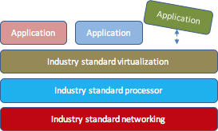
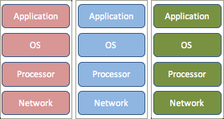
Open and Standardized Networks
From Physical Network Functions (PNF)
To Virtual Network Functions (VNF)
Specialized HW & OS
To open, industry standard

Slide 4
Open Platform for NFV
OPNFV is a carrier-grade, integrated, open source platform to accelerate the introduction of new NFV products and services.

Slide 5
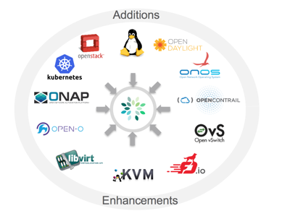
What does OPNFV Actually do?

Slide 6
Resulting in lots of combinations...

Slide 7
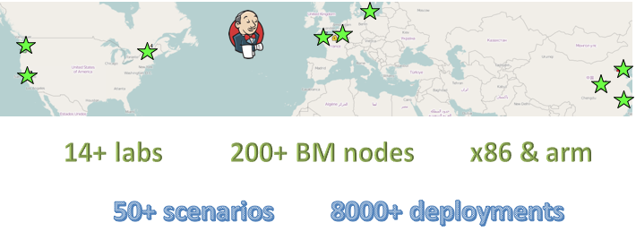
CI on Distributed Baremetal Labs

Slide 8
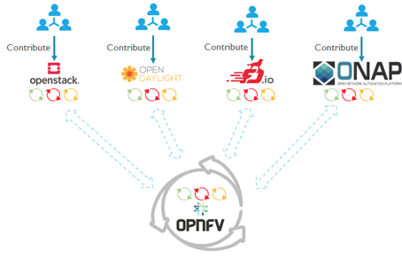
Cross Community CI - XCI

Slide 9
XCI Pipelines

Slide 10
Tooling
+
+
+
zuul
bifrost
openstack-ansible
kubespray

Slide 11
Zuul
Cross-project CI/CD with Ansible
Used for project-gating and cross-project testing
Based on pipelines: check, gate, post…
Speed up testing: testing in parallel
Tested at scale: used by OpenStack project gating
We are currently on a POC, meanwhile we use Jenkins

Slide 12
Bifrost
Standalone Ironic
Tool for provisioning virtual and bare metal machines
Ansible based
Supports Ubuntu, CentOS, and openSUSE
Easy to use – create inventory, install bifrost, enroll & deploy
Rock-solid!
OPNFV runs 3rd Party CI for all the patches!

Slide 13
Openstack-ansible
Tool for installing OpenStack
Containerized (lxc) OpenStack services
Ansible based
Easy integration – write your own role
Source based deployment/developer mode
Supports Ubuntu, CentOS, and openSUSE

Slide 14
Kubespray
Tool for installing a Kubernetes cluster
Can be deployed on multiple platforms
Composable (choice of different network plugins)
Supports CoreOS, Debian, Ubuntu, CentOS
Continuous integration tests
Ansible-based

