Slide 1
Reaching const evaluation singularity
eval("eval("1+1")")

Slide 2
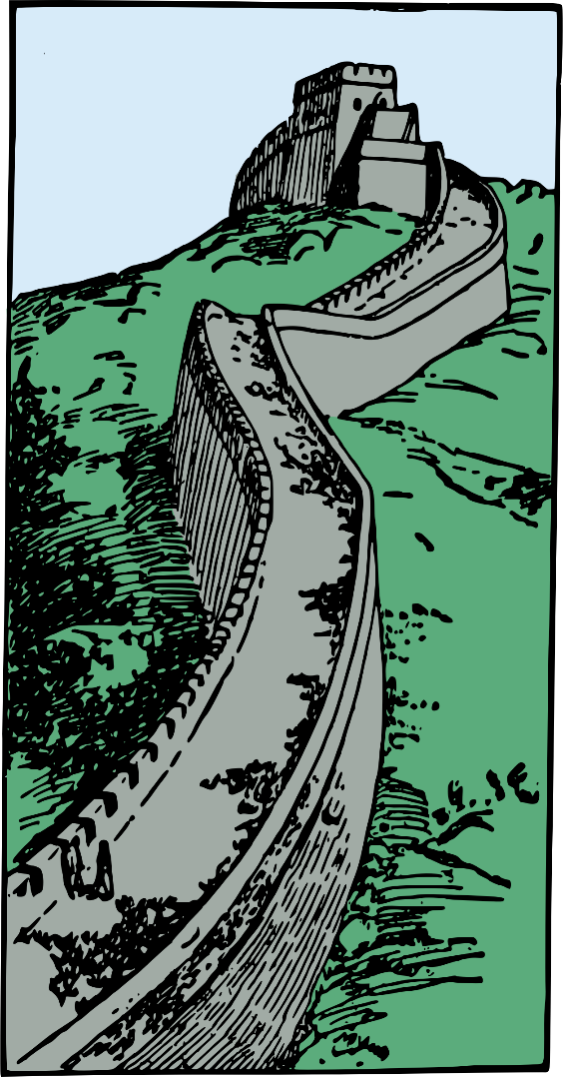
We hit a wall
A rust compiler developer
Better
Constant
evaluation

Slide 3
So we got the MIR back into Orbit

Slide 4
It‘s the only way to be sure

Slide 5
What is const evaluation?

Slide 6
Why const evaluation?
Array lengths
Enum Discriminants
Moving work from runtime to compile-time
Detecting more errors at compile-time
Producing more lints

Slide 7
How does const eval work?
5
*
3
+
2
-
4

Slide 8
How does const eval work?
5
*
15
3
+
2
-2
-
4

Slide 9
How does const eval work?
15
+
13
-2

Slide 10
But…

Slide 11
Doing it right
2015: MIR
2016: miri
2017: add miri to rustc
2018: eliminate const folder

Slide 12
Scale
Adding miri to rustc (Rustfest 2017)
1600 commits
7k LOC
Remove old const evaluator (Today-ish)
100 commits
Touches 6k LOC
Removes 800 LOC

Slide 13
What is MIR?
Medium Intermediate Representation
Assembler
With Types
Without Registers
Used for
Borrow checking
Guaranteed Optimizations (e.g. Tail Call)

Slide 14
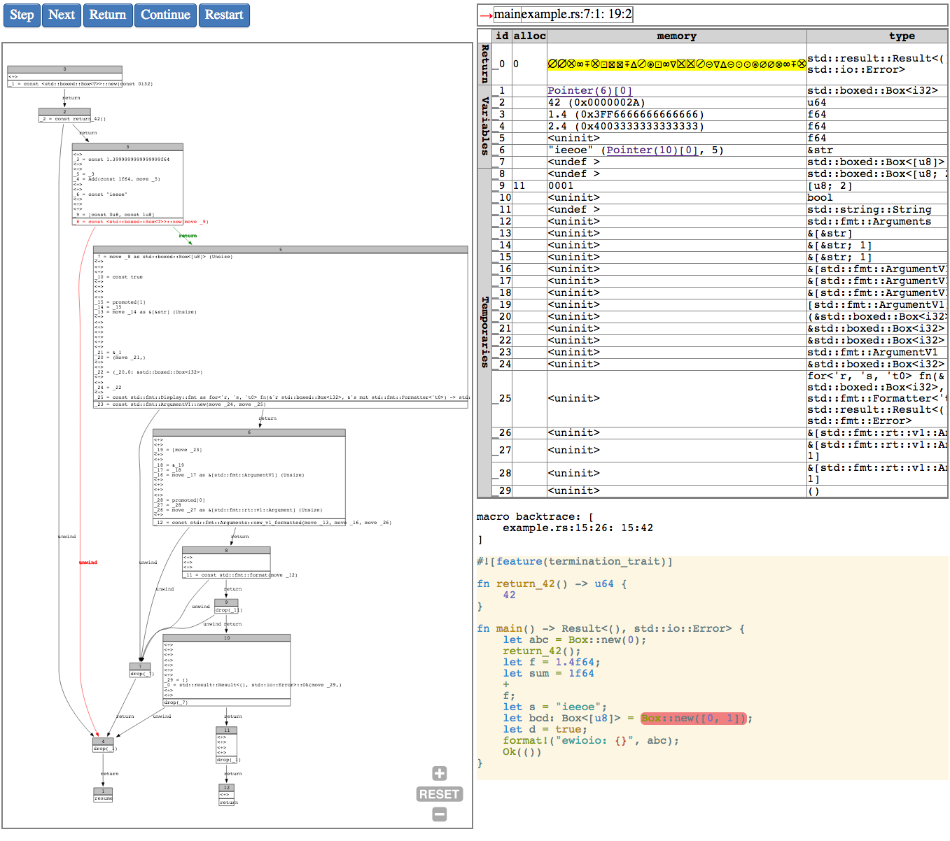
fn main() -> std::result::Result<(), std::io::Error>{
let mut _2: u64;
let mut _5: f64;
let mut _8: std::boxed::Box<[u8; 2]>;
let mut _9: [u8; 2];
let mut _11: std::string::String;
let mut _12: std::fmt::Arguments;
let mut _13: &[&str];
let mut _14: &[&str; 1];
let mut _15: &[&str; 1];
let mut _16: &[std::fmt::ArgumentV1];
let mut _17: &[std::fmt::ArgumentV1; 1];
let mut _18: &[std::fmt::ArgumentV1; 1];
let mut _19: [std::fmt::ArgumentV1; 1];
let mut _20: (&std::boxed::Box<i32>,);
let mut _21: &std::boxed::Box<i32>;
let mut _23: std::fmt::ArgumentV1;
let mut _24: &std::boxed::Box<i32>;
let mut _25: for<'r, 's, 't0> fn(&'r std::boxed::Box<i32>, &'s mut std::fmt::Formatter<'t0>) -> std::result::Result<(), std::fmt::Error>;
let mut _26: &[std::fmt::rt::v1::Argument];
let mut _27: &[std::fmt::rt::v1::Argument; 1];
let mut _28: &[std::fmt::rt::v1::Argument; 1];
let mut _29: ();
bb0: {
_1 = const <std::boxed::Box<T>>::new(const 0i32) -> bb2;
}
bb1: {
resume;
}
bb2: {
_2 = const return_42() -> [return: bb3, unwind: bb4];
}
bb3: {
_3 = const 1.3999999999999999f64;
_5 = _3;
_4 = Add(const 1f64, move _5);
_6 = const "ieeoe";
_9 = [const 0u8, const 1u8];
_8 = const <std::boxed::Box<T>>::new(move _9) -> [return: bb5, unwind: bb4];
}
bb4: {
drop(_1) -> bb1;
}
bb5: {
_7 = move _8 as std::boxed::Box<[u8]> (Unsize);
_10 = const true;
_15 = promoted[1];
_14 = _15;
_13 = move _14 as &[&str] (Unsize);
_21 = &_1;
_20 = (move _21,);
_22 = (_20.0: &std::boxed::Box<i32>);
_24 = _22;
_25 = const std::fmt::Display::fmt as for<'r, 's, 't0> fn(&'r std::boxed::Box<i32>, &'s mut std::fmt::Formatter<'t0>) -> std::result::Result<(), std::fmt::Error> (ReifyFnPointer);
_23 = const std::fmt::ArgumentV1::new(move _24, move _25) -> [return: bb6, unwind: bb7];
}
bb6: {
_19 = [move _23];
_18 = &_19;
_17 = _18;
_16 = move _17 as &[std::fmt::ArgumentV1] (Unsize);
_28 = promoted[0];
_27 = _28;
_26 = move _27 as &[std::fmt::rt::v1::Argument] (Unsize);
_12 = const std::fmt::Arguments::new_v1_formatted(move _13, move _16, move _26) -> [return: bb8, unwind: bb7];
}
bb7: {
drop(_7) -> bb4;
}
bb8: {
_11 = const std::fmt::format(move _12) -> [return: bb9, unwind: bb7];
}
bb9: {
drop(_11) -> [return: bb10, unwind: bb7];
}
bb10: {
_29 = ();
_0 = std::result::Result<(), std::io::Error>::Ok(move _29,);
drop(_7) -> [return: bb11, unwind: bb4];
}
bb11: {
drop(_1) -> bb12;
}
bb12: {
return;
}
}
MIR
MIR
(graphical)
Stack

Slide 15
miri
MIR interpreter
Virtual Memory
Essentially Vec<u8>
No Undefined Behaviour
Produces Compiler Errors instead

Slide 16
Miri „The Tool“
Can emulate various C Functions
print
syscall
Cannot interpret itself (yet)
Can be used to run tests and detect UB!
cargo install cargo-miri
cargo miri

Slide 17
Side Effects
Heap allocations
Turned into static memory
Safe unsafe pointer arithmetic
Const eval panic -> compiler error
Assertions
Index out of bounds

Slide 18
What now?
Partial Evaluation
Cannot evaluate associated constant
whose value depends on
the value of another associated constant
attached to the same type
Allow debuggers to run Rust code via miri
Inspect the memory, stack and MIR if a const eval error occurs

Slide 19
Let the RFCs begin…
Implementation already exists
Just needs an RFC so enabling it is well-documented
Make more functions const fn

Slide 20
Questions?

Slide 21
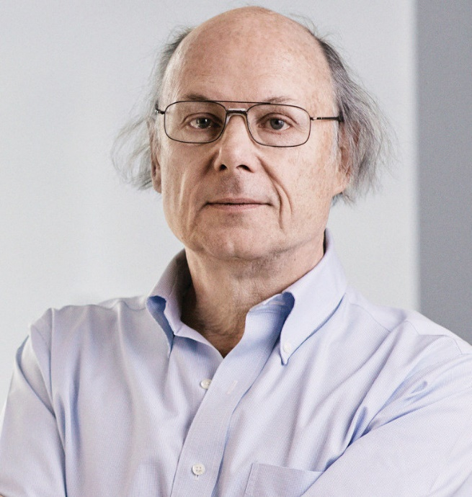
„Sufficiently advanced incremental compilation is indistinguishable from a REPL“
Linus Zuse (Inventor of LISP)

