Slide 1
A unique processor architecture meeting LLVM IR and the IoT
Dávid Juhász
david.juhasz@imsystech.com

Slide 2
Compiling with LLVM
High-Level Programming Language
LLVM
LLVM Front-end
LLVM Assembly / IR
LLVM Middle-end
LLVM Back-end
Your Typical Target ISA
Notes:
Start with LLVM 101: formats and steps when compiling with LLVM

Slide 3
Improving Efficiency by Lifting Target
High-Level Programming Language
LLVM
LLVM Front-end
LLVM Assembly / IR
LLVM Middle-end
Big gap
Complex translation
LLVM Back-end
Imsys ISA for LLVM
Reducing the gap
Your Typical Target ISA
Notes:
What this talk is about
ISAs are usually designed with no respect for compiler IR
We create an ISA tailor-made for LLVM
We expect improved efficiency in several aspects, detailed later…

Slide 4
Agenda
Imsys Company and the IoT
Imsys Lean Processing Technology
Imsys ISA for LLVM

Slide 5


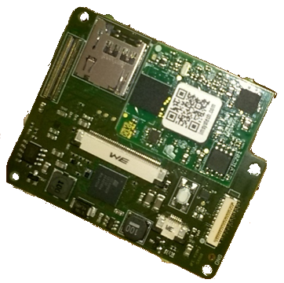
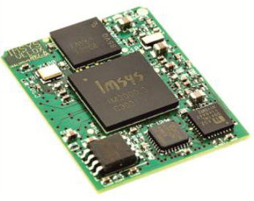
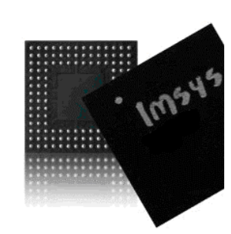

Imsys AB
Device
Module
IC
IP
Notes:
Swedish semiconductor SME
Products
Devices
Modules
IC
IP

Slide 6


Networked Embedded
Controllers
Notes:
History as supplier of networked embedded controllers
Proven core technology
Retargeting for the IoT
Good match for our values

Slide 7
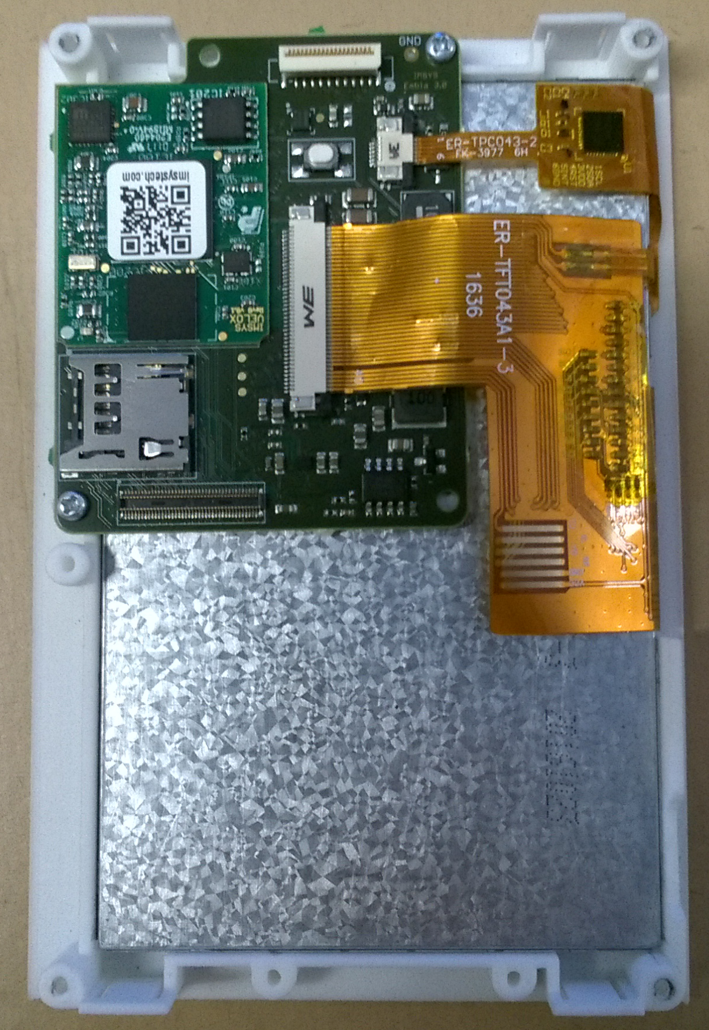
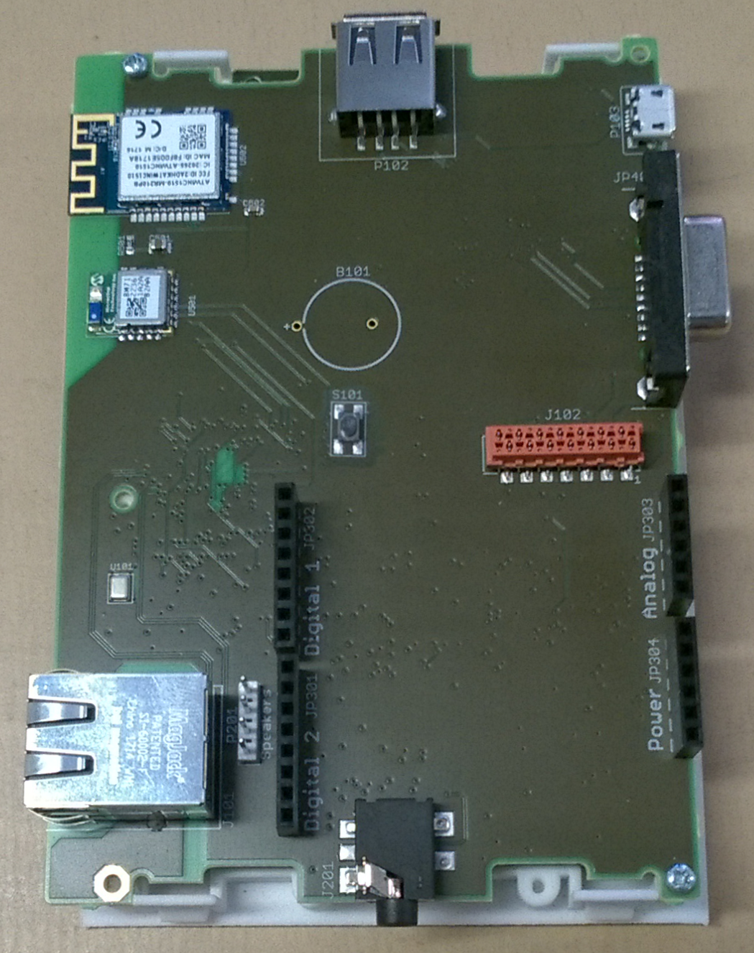
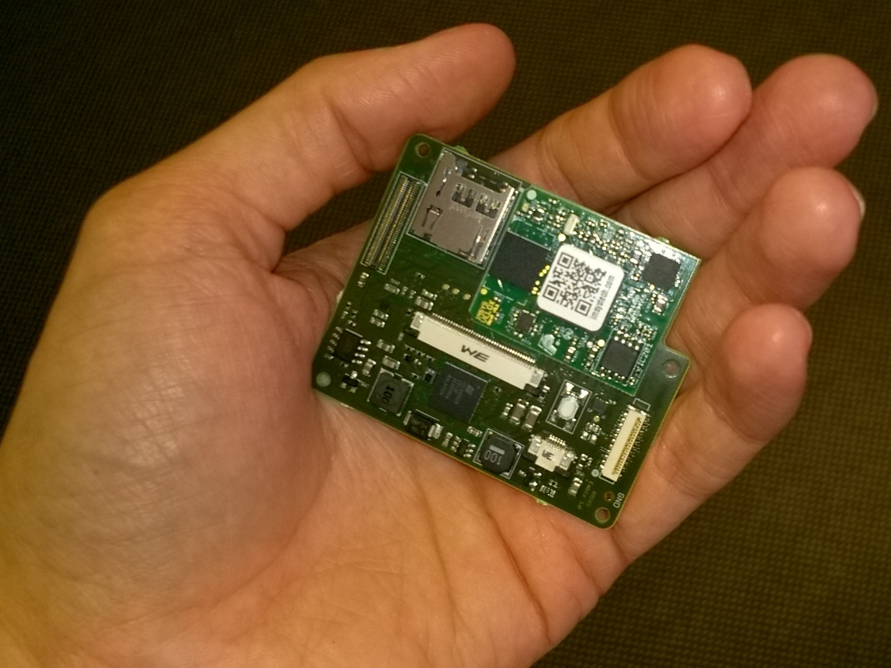
Imsys EMBLA
Single Controller Solution for the IoT
Notes:
Imsys EMBLA
Single controller board
with graphics
Various IO capabilities via extension board

Slide 8



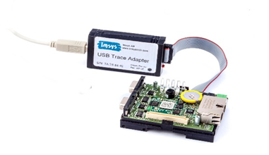
High-Level Software Platform
C/C++
Java
Application Code
Integrated
Development
Environment
LLVM
Executable Binary
Notes:
Software platform overview
Eclipse-based IDE for connecting to the development board
Application Code can be
Java
C/C++ compiled with LLVM

Slide 9
Improving Efficiency by Reducing the ISA Gap
High-Level Programming Language
LLVM
LLVM Front-end
LLVM Assembly / IR
LLVM Middle-end
Big gap
Complex translation
LLVM Back-end
Imsys ISA for LLVM
Reducing the gap
Your Typical Target ISA
Notes:
Now let’s look under the hood to see what is the basis of the Imsys lean processing technology: what makes the Imsys processor different from the mainstream and how that allows us to dedicate an ISA for LLVM Assembly.

Slide 10
Abstraction Layers
Application Code
Assembly/C/C++
JAVA
ISAL
ISAJ
Imsys Instruction Set Support
Imsys Processor Core
Notes:
Check out the main levels of abstractions – the traditional way
Processor core and its supported instruction sets
Software code in high-level – System software and application
Java with dedicated ISAJ for native execution
Assembly/C/C++ targeting ISAL

Slide 11
A Forgotten Layer of
Abstraction
Microcode
Hardware
Software
Software
Hardware
Notes:
Today’s typical categorization: Hardware & Software
There could be an extra layer in between, which gives Imsys processors unique abilities: microcode

Slide 12
The Processor Architect’s
Best Friend
Microprogram
Microinstruction
IO
Mult.
ALU
MEM
Ctrl.
Addr.
Operation-Oriented Hardware Architecture
Notes:
Microcode enables architects to master their hardware softly
Microprogram consisting of microinstructions in memory
Hardware core executes microinstructions
A microinstruction consists of fields
Each fields controls functional units of the processor core directly
Including sequence control, which selects the next microinstruction to execute
The microcode runs an Operation-Oriented Architecture focusing on the task at hand

Slide 13
Minimal Hardware
Complete Deterministic Control
Maximum Efficiency
Microcode, what is it good for?
Flexibility
Soft-Reconfigurability
Notes:
List the main characteristics provided by microcoding
Complete deterministic control – direct control over all functional parts of the core
Minimal hardware – control by microcode, hence no deep pipeline, no out-of-order or speculative execution, no cache hierarchy, no complex state
Maximum efficiency – no wasted computation, maximum utilization of hardware
Flexibility – implement any computation with high efficiency, making the processor multi-purpose
Soft-reconfigurability – microcode in memory may be changed at any time on demand

Slide 14
Abstraction Layers Revisited
Application Code
Software
ISAL
Imsys Instruction Set Support
Microcode
Imsys Processor Core
Hardware
Notes:
Match abstraction levels to our case
Processor Core is hardware
Instruction Set Support is in microcode
Application Code is software
Note that Instruction Sets are the lowest level software interface to use the microcoded features, they belong to software
A compiler, LLVM, matches the high-level application code to the instruction set

Slide 15
A Unique Balance between Hardware and Software
Application
Balanced Rich ISA
Compiler
Microcode
Domain-specific Operations
Operation-Oriented Hardware Architecture
Instruction Set Architecture
Instruction Set Architecture
Notes:
Application code is made executable by a compiler targeting an ISA
ISA is typically defined by hardware
Consider an operation-oriented hardware architecture with microcoding
A microcode-defined ISA is lifted from the hardware
A unique balance between software and hardware supports all parties to improve efficiency
Systems architects design in complex domain-specific operations and deliver a compiler-friendly ISA with optimized hardware utilization
Compiler designers target a machine supporting a balanced rich ISA with high-level operations

Slide 16
Improving Efficiency by Matching LLVM Assembly
High-Level Programming Language
LLVM
LLVM Front-end
LLVM Assembly / IR
LLVM Middle-end
Big gap
Complex translation
LLVM Back-end
Imsys ISA for LLVM
Reducing the gap
Your Typical Target ISA
Notes:
We have just looked into the basics of the Imsys Lean Processing Technology, now turn towards our tailor-made instruction set for LLVM.

Slide 17
Matching LLVM Assembly
Simple, efficient, general LLVM
LLVM Assembly
LLVM back-end for ISAL
LLVM
middle-end
Direct use of optimizations
ISAL
Semantically matching instructions
Notes:
How does ISAL match LLVM Assembly?
ISAL matches LLVM Assembly by having semantically matching instructions
Complexity propagated into ISAL implementation
How does the semantic match help?
LLVM back-end for ISAL
Simple and efficient back-end relying mostly on general LLVM facilities
No complex translation as no semantical difference
LLVM middle-end applies general optimizations to LLVM Assembly
Directly exploiting platform-independent LLVM optimizations due to the semantical match
Moreover, general LLVM optimizations are enough, no need for much architecture-specific magic

Slide 18
Meeting a Constrained Reality
 | LLVM Assembly | ISAL
Operations | Instructions & intrinsic functions | Additional system operations
Single Value Types | Virtually unlimited | Set of integer, floating point, pointer, and vector types
Registers | Unlimited | Register windows
Arguments | Source and destination registers | Registers with support of accumulating in source registers, immediate values
Binary Representation | Bitcode | Custom dense binary coding
Notes:
!Hidden original of the next animated slide!
LLVM Assembly is a theoretical model with characteristics that render it impossible to implement directly
Need to add special operations for bookkeeping
Moving data to/from/between registers
Managing execution
Handling I/O
Need to select single value types to support
Need to define actual register set
Better to support special kinds of arguments to optimize register usage
Better to optimize binary representation to improve code density, execution time, and power consumption

Slide 19
Meeting a Constrained Reality
LLVM Assembly
ISAL
Operations
Instructions &
Additional
system operations
intrinsic
functions
Single Value Types
Virtually unlimited
Set of integer, floating point,
pointer, and vector types
Registers
Unlimited
Register windows
Arguments
Source and
Registers with support of
destination registers
accumulating in source registers,
immediate values
Binary Representation
Bitcode
Custom dense binary coding
Notes:
LLVM Assembly is a theoretical model with characteristics that render it impossible to implement directly
Need to add special operations for bookkeeping
Moving data between and immediate values into registers
Managing execution state
Handling I/O
Need to select single value types to support
Need to define actual register set
Better to support special kinds of arguments to optimize register usage
Better to optimize binary representation to improve code density, execution time, and power consumption

Slide 20

Optimized
Operation Sequences
a ≔ a + b
Accumulating in source register
add a a b
opcode
dst
src1
src2
add.upd a b
opcode
src1
src2
a ≔ a + 42
Immediate values
add.imm a a 42
move b 42
add a a b
add.upd.imm a 42
Notes:
Regular instructions with destination and source registers are bloating binary code, so we have special variants.
Accumulating in source register – happens quite often
Consider example: a = a + b
The corresponding regular operation needs 3 arguments
A special accumulating (in-place update) variant works only with 2 arguments
Binary size is reduced
Working with immediate values
Consider example: a = a + 42
Using the corresponding regular instruction needs the immediate value to be moved into a register by an extra instruction
A special form with one immediate argument can do the same work as one instruction with 3 arguments
Even better, combine the two: accumulating variant with one immediate argument does it as one instruction with 2 arguments
Binary size is reduced again
ISAL has different variants operations to improve code density

Slide 21
Optimized
Binary Representation
Maximize Code Density
Optimize Microcode Size
Minimize Execution Time
Variable-length
Instructions
Notes:
Efficiently encoding such a rich set of instructions requires variable-length instructions
Instruction lengths between 1 and 10
Average 3.4
Binary format is defined considering the following goals
Software perspective makes us maximize code density
Frequent operations have shorter instruction
The microcode implementation should be economic with optimized size
Common instruction formats share decode logic
Grouped instructions share operation logic
Performance counts, so we need to minimize execution time
Time for decoding is dependent on binary representation
Simple operation should have short instruction
Time for performing operation may be dependent on binary representation
It could overlap with argument decoding if similar operations are grouped together

Slide 22
Average Binary Size of TI Suite
ARM Cortex requires 35%+ more, Intel 80%+ more program memory.
Notes:
Preliminary ISAL code density figures as average binary size of TI Suite benchmarks normalized to ISAL.

Slide 23


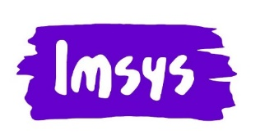
LLVM Assembly
LLVM back-end for ISAL
Imsys ISA for LLVM
ISAL
Imsys Firmware
Imsys EMBLA with ISAL
Imsys Processor Core
Imsys Lean Processing
Technology
Dávid Juhász
david.juhasz@imsystech.com
Leaner is Meaner
Notes:
Concluding with the main points
Imsys Lean Processing Technology
Operation-Oriented Hardware Architecture
Microcode-defined ISA
Imsys ISA for LLVM
How ISAL matches LLVM Assembly
Some design considerations
ISAL and its software ecosystem are currently under development, and planned to be released for Imsys EMBLA in next year

