Slide 1
What's new in Graphite 1.1
Denys Zhdanov @deniszh
FOSDEM 2018

Slide 2
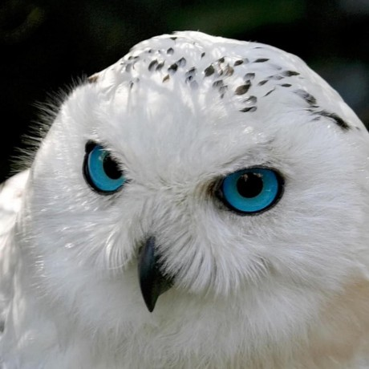
Who am I
Denys Zhdanov System engineer @ eCG / Marktplaats.nl Twitter / Github: @deniszh Sysadmin Ninja Graphite co-maintainer Data geek Pythonista Gopher

Slide 3
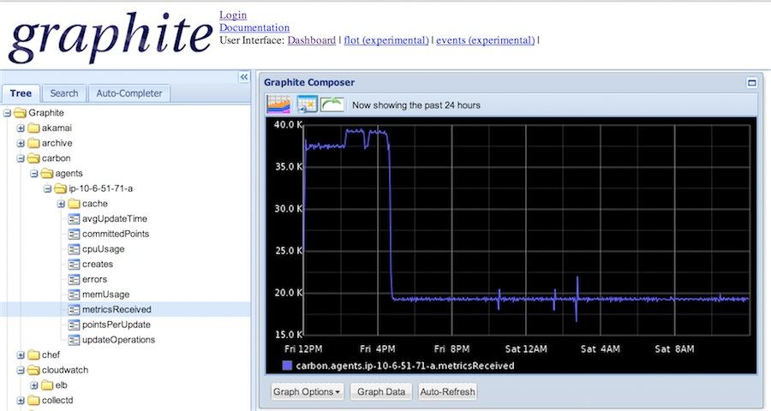
What? Graphite?
Stores Time-Series data
Renders it
http://graphiteapp.org/

Slide 4
Why do we need Graphite in 2018?
Great ecosystem: 80+ 3rd party tools on Tools page! - Collectors (for system and components): collectd / diamond / telegraf / statsd - Dashboards: (mostly Grafana now but also 20+ others) - Monitoring/Alerting: Moira / Seyren / Cabot / Grafana etc. - Compatible components: - relay/proxy: carbon-c-relay / carbon-relay-ng / grafsy / gruffalo - storage: BigGraphite / metrictank / go-carbon / carbon-clickhouse / graphouse - rendering: carbon-api / graphite-api

Slide 5
The good, the bad and ...
Pros: - simple metric format <name> <value> <timestamp>\n - push model - rich ecosystem
Cons: - no tags! - speed (use pypy or alternative backends) - scalability (use alternative backends) - hard to install (docker installation)

Slide 6
Tags, tags, tags AKA Dimensions
metric.name;tag1=value1;tag2=value2 - compatible with Carbon format and Graphite tooling.
Writing path: Normalization -> _tagged/xxxx/yyyy/metric;tag=value.wsp -> update TagDB
TagDB and Tag API documentation - https://graphite.readthedocs.io/en/latest/tags.html Redis or Django-supported databases (SQLite / MySQL / Postgres)

Slide 7
Tags
Querying: seriesByTag('tag=value') seriesByTag('name=~cpu\..*', 'tag1!=value1') - PCRE regex is supported!
groupByTags - same as groupByNode seriesByTag('name=disk.used', 'server=~web.*') | groupByTags('sumSeries', 'datacenter') aliasByTags - same as aliasByNode seriesByTag('name=disk.used','datacenter=dc1') | aliasByTags('server', 'name')

Slide 8
Tags: external integrations
Grafana: Tag support PR#9230 (Grafana 4.7.0) Auto-completion API for tags and values (Grafana 4.7.0) Tag value regex filtering & multi valued template variables PR#9911 (5.x) Prometheus: Remote read / write - PR#3533 / PR#3635 (based on example adapter) - Criteo’s Graphite-Remote-Adapter (including tags support now) - Prometheus read/write api in Graphite (WIP) - PR#2195 / PR#735

Slide 9
Python 3, finally
Python 3 finally supported in all 3 major components - whisper, carbon and graphite-web.
Should work with Python 2.7, 3.4, 3.5, 3.6 and PyPy.
Graphite-web is running on Django 1.11 LTS (supported up to 2020) .

Slide 10
Custom (user defined) functions
Pluggable functions, finally!
Put your function in /opt/graphite/webapp/graphite/functions/custom or use FUNCTION_PLUGINS = [ 'some.function_plugin', ]
Functions API curl -s "http://graphite/functions?pretty=1" (Support in Grafana planned - PR#10505, will be in Grafana 5.0b1)

Slide 11
Custom function example: ASAP
ASAP: Prioritizing Attention via Time Series Smoothing http://futuredata.stanford.edu/asap Please see details in http://www.iamsysadmin.ninja/2018/01/asap-smoothing-in-graphite.html

Slide 12
New clustering code
Pros: Local (whisper) and remote (cluster) calls are parallelized now. seriesByTag() calls will propagate to cluster members. http://cluster/render?target=xxx&target=xxx&target=seriesByTag(...) Easier way to write 3rd party finders. Cons: Beware of changes: some of 3rd party tools not ready yet, e.g. - go-carbon (supported in master, but no tags yet) - graphite-clickhouse (supported in master, but no tags yet) - graphouse (doesn’t support 1.1.x yet)

Slide 13
Pipe chaining for functions
alias(movingAverage(scaleToSeconds(sumSeries(stats_global.production.counters.api.requests.*.count),60),30),'api.avg') is really alias( movingAverage( scaleToSeconds( sumSeries( stats_global.production.counters.api.requests.*.count ) ,60) ,30) ,'api.avg')

Slide 14
Pipe chaining for functions
alias(movingAverage(scaleToSeconds(sumSeries(stats_global.production.counters.api.requests.*.count),60),30),'api.avg')
now can be written as sumSeries(stats_global.production.counters.api.requests.*.count)|scaleToSeconds(60)|movingAverage(30)|alias('api.avg') or even stats_global.production.counters.api.requests.*.count|sumSeries()|scaleToSeconds(60)|movingAverage(30)|alias('api.avg')

Slide 15
Aggregation functions and xFilesFactor
Consistent aggregations’ list: average, median, sum, min, max, diff, stddev, count, range, multiply and last. New aggregation functions aggregate, aggregateWithWildcards, movingWindow, filterSeries, highest, lowest and sortBy. Old functions are aliases for new ones e.g. sumSeries(some.metric.*) -> aggregate(some.metric.*, 'sum') xFilesFactor value to specify how many points in the window must be non-null for the output to be considered valid. https://grafana.com/blog/2016/03/03/25-graphite-grafana-and-statsd-gotchas/#runtime.consolidation

Slide 16
What’s next: beyond 1.1.x
Remove Django, but keep metric tree explorer and dashboard view as separate (optional) components
Fix for “new metric propagation delay” bug (workarounds are exists, e.g. Graphite-Clickhouse as cache)
Separate TagDB server (probably even in Go?)

Slide 17
Thank You!
Questions? issues? Contributions?
https://github.com/graphite-project
IRC: #graphite on FreeNode
https://answers.launchpad.net/graphite / graphite@librelist.com

