Slide 1
Root Zone KSK Rollover update
Roy Arends
Principal Research Scientist, Office of the CTO, ICANN
FOSDEM 2019
3 February 2019

Slide 2
The KSK rollover has happened!
The KSK rollover occurred on time as planned at
1600 UTC on 11 October 2018 with the publication of a root zone with KSK-2017 signing the root zone DNSKEY RRset for the first time.

Slide 3
Timeline of events (UTC)
13:00 Root Zone Management Partners join conference bridge
13:00 Verisign generates root zone file
13:15 Verisign inspects root zone file
13:30 Verisign sends root zone file to ICANN
13:30 ICANN inspects root zone file
15:30 ICANN Go/No-go call
15:45 ICANN approves the zone for publication
15:45 Verisign reminds root server operators of scheduled zone push
16:00 Verisign approves root zone file push
16:05 Verisign informs root server operators zone file has pushed

Slide 4
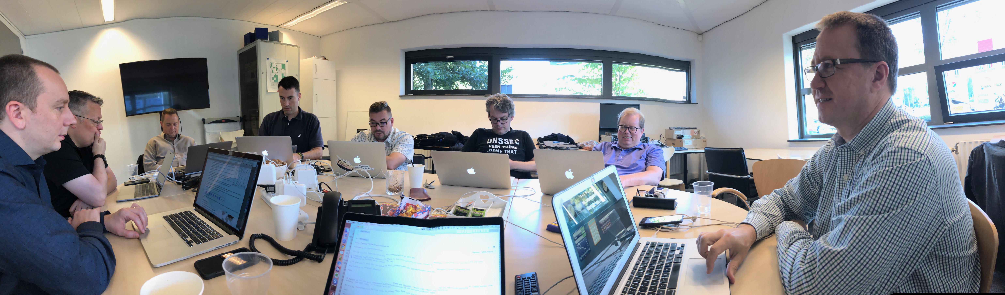
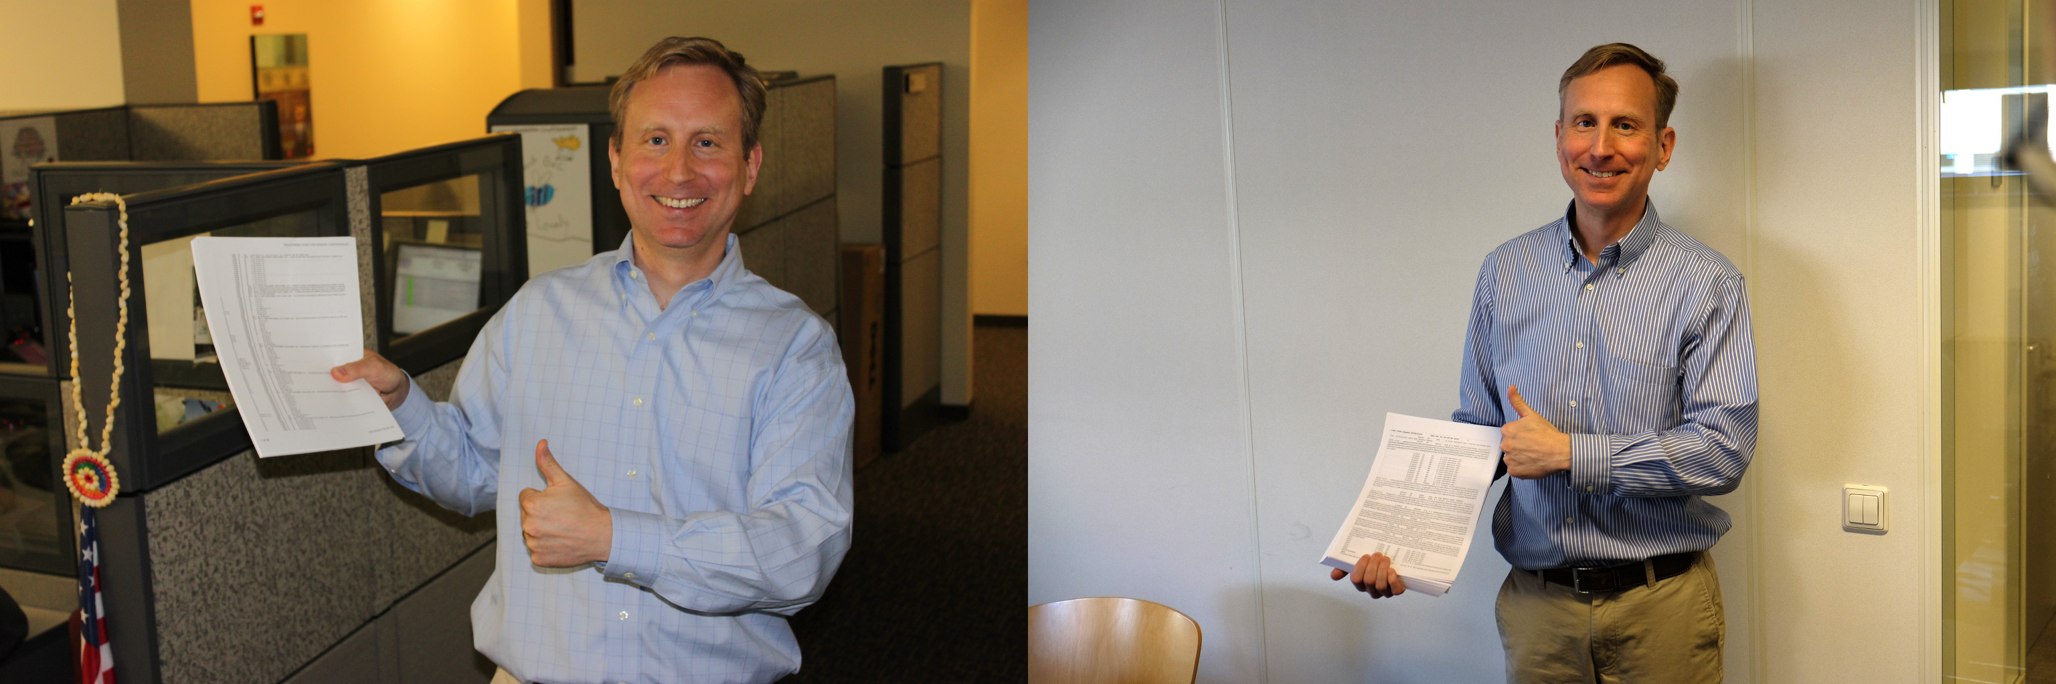
Amsterdam team

Slide 5
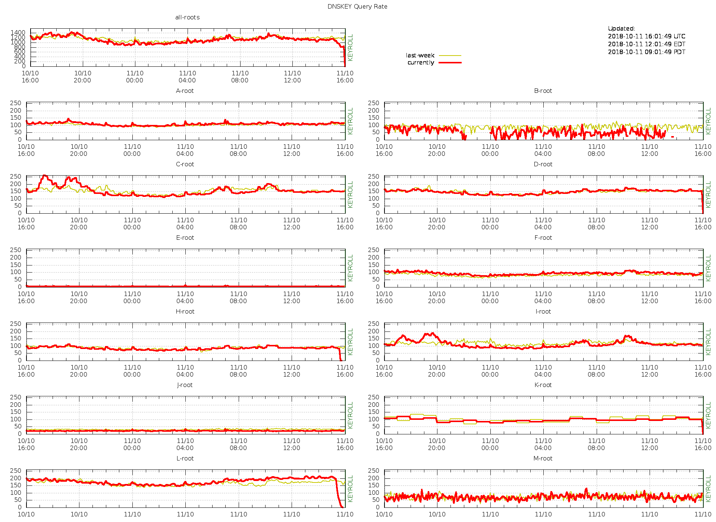
Monitoring: ./IN/DNSKEY queries at the root (just before the roll)

Slide 6
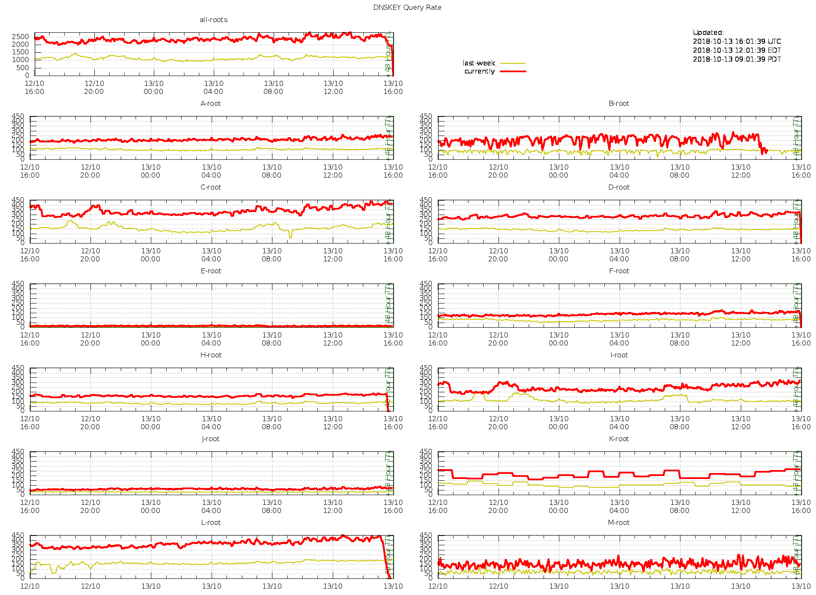
Monitoring: ./IN/DNSKEY queries at the root (48 hours after the roll)

Slide 7
Analysis of DNSKEY queries
Testing proved that stale trust anchors cause an increase in DNSKEY queries
OCTO compared DNSKEY query behavior before and after the roll
  October 10 and 14
We’ve observed a total of 1,091,215 unique resolvers asking for a DNSKEY over four days
155,117 unique resolvers observed on both 10 October and 14 October
  85,531 resolvers sent a DNSKEY request at least once a day between the 10 October and 14 October
  Vantage point was IMRS/L-root
  Resolvers might talk to other root letters
OCTO tracked each of the 155,117 resolvers for change in query behavior

Slide 8
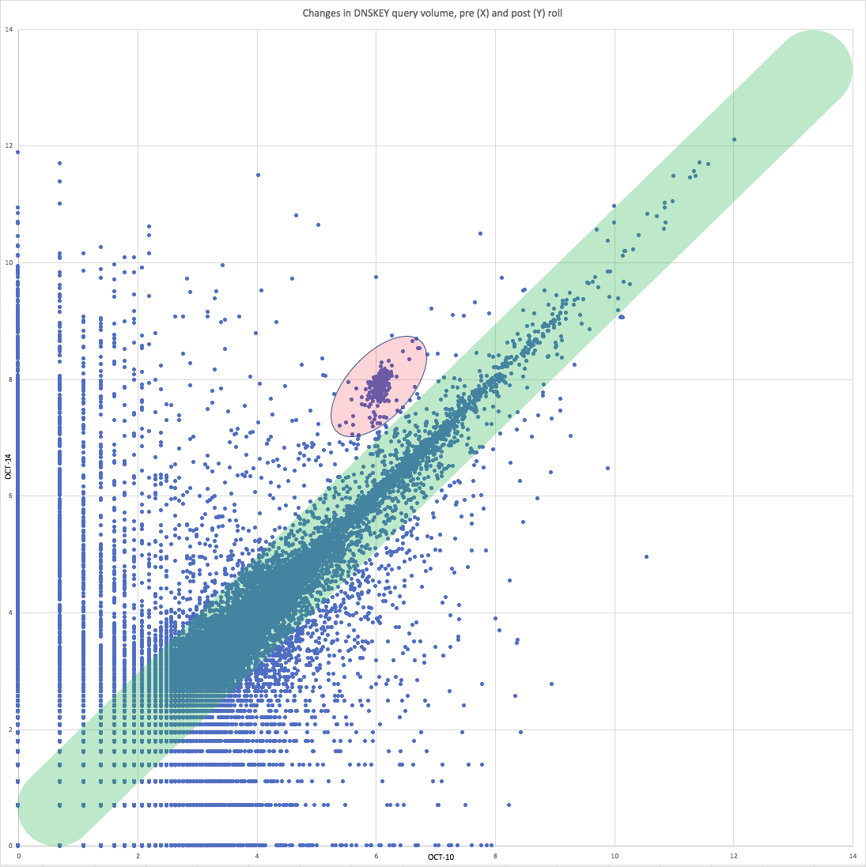
DNSKEY queries (10 October vs. 14 October)

Slide 9
DNSKEY scatter plot
The X axis represents query volume on 10 October in log scale
The Y axis represents query volume on 14 October in log scale
Each blue dot represents an observed resolver, plotted (X,Y) on the graph
Expected behavior is in the green diagonal band, showing changes within the same order
Anything above the green band is O(1) increased query volume
Anything below the green band is O(1) decreased query volume
The red represents an unexpected clustering that we’re actively investigating

Slide 10
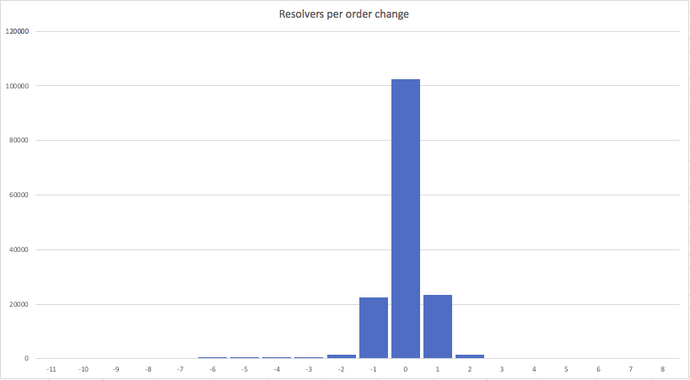
Resolvers per order change

Slide 11
Resolvers per order change
The X axis represents buckets of “volume order change”
The Y axis represents the number of resolvers in a bucket
The bulk of resolvers lie between -1 and 1
  Less than an order of magnitude change in the number of queries issued
Between -1 and 1: 148,502 resolvers or 95.7% of the total observed
  Relatively little change in volume
Great than 1: 2,084 resolvers or 1.34% of the total observed
  They see their volume increase significantly
Less than -1: 4,531 or 2.92% of the total observed
  They see their volume decrease significantly

Slide 12
root-trust-anchor-reports.research.icann.org

Slide 13
Known issues
Only one very minor report of trouble to ICANN
A small number of reports of issues (<10) via Twitter, mailing lists and operational forums
  Mostly individual administrators relating minor issues
  No reports of significant number of issues affected
Two outages may potentially be the result of the KSK rollover. We are trying to reach the ISPs involved to get more information.
  eir (Irish ISP): https://www.rte.ie/news/2018/1013/1002966-eir-outage/
  Consolidated Communications (Vermont, US ISP): https://www.wcax.com/content/news/Consolidated-Communications-scrambles-to-fix-Vt-internet-outage-497030071.html

Slide 14
The KSK revoke has happened!
The KSK rollover occurred on time as planned at
1600 UTC on 11 October 2018 with the publication of a root zone with KSK-2017 signing the root zone DNSKEY RRset for the first time.
The KSK revoke occurred on time as planned at
1400 UTC on 11 January 2019 with the publication of a root zone with KSK-2010 marked as revoked.

Slide 15
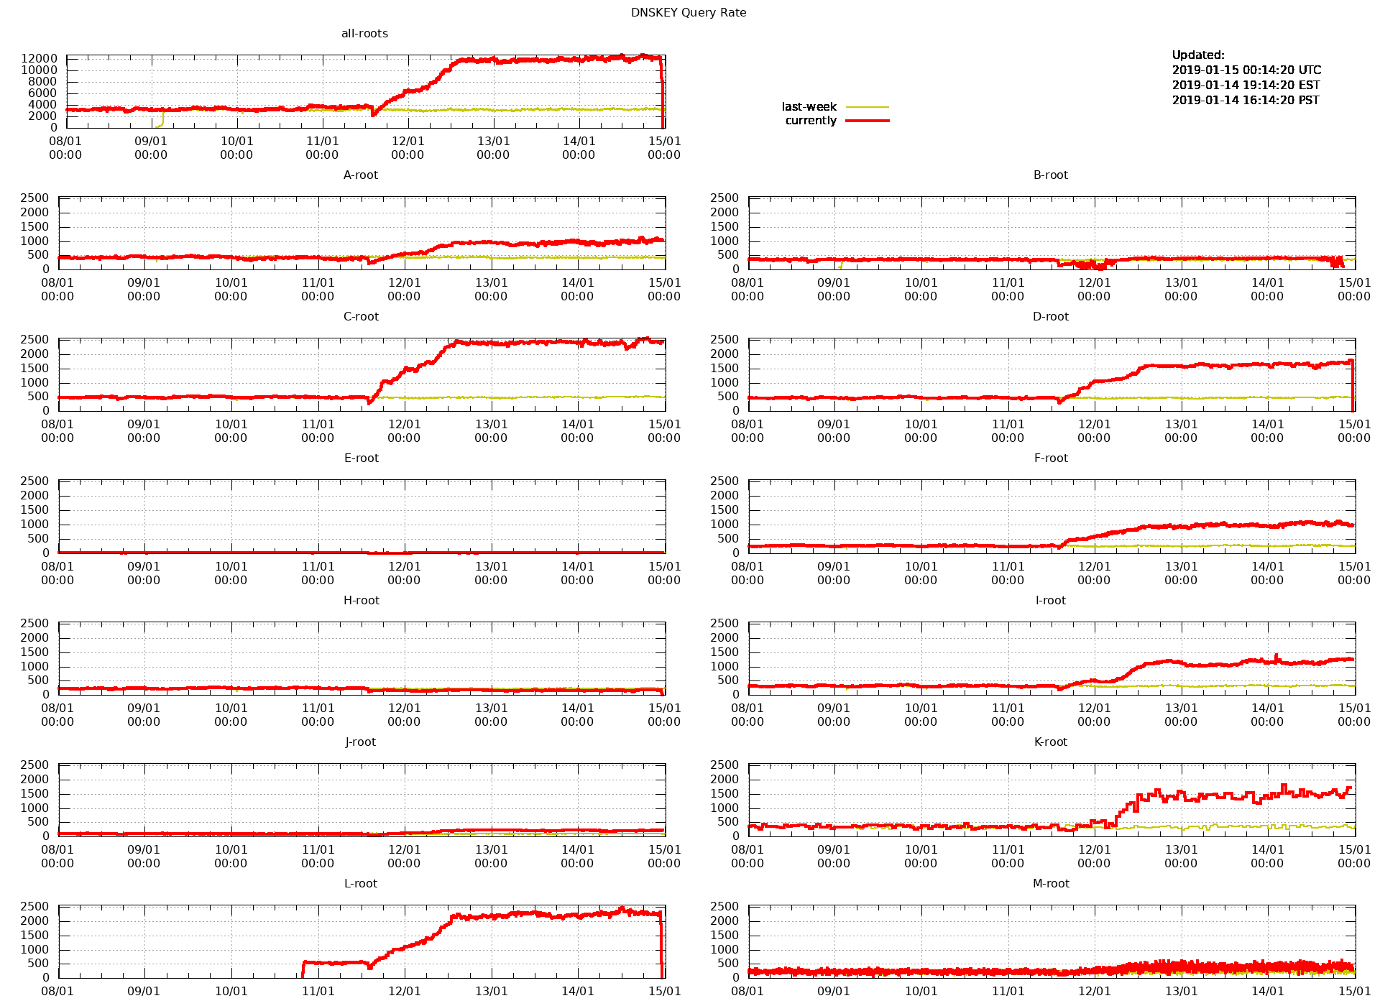
Monitoring: ./IN/DNSKEY queries at the root (48 hours after the revoke)

Slide 16
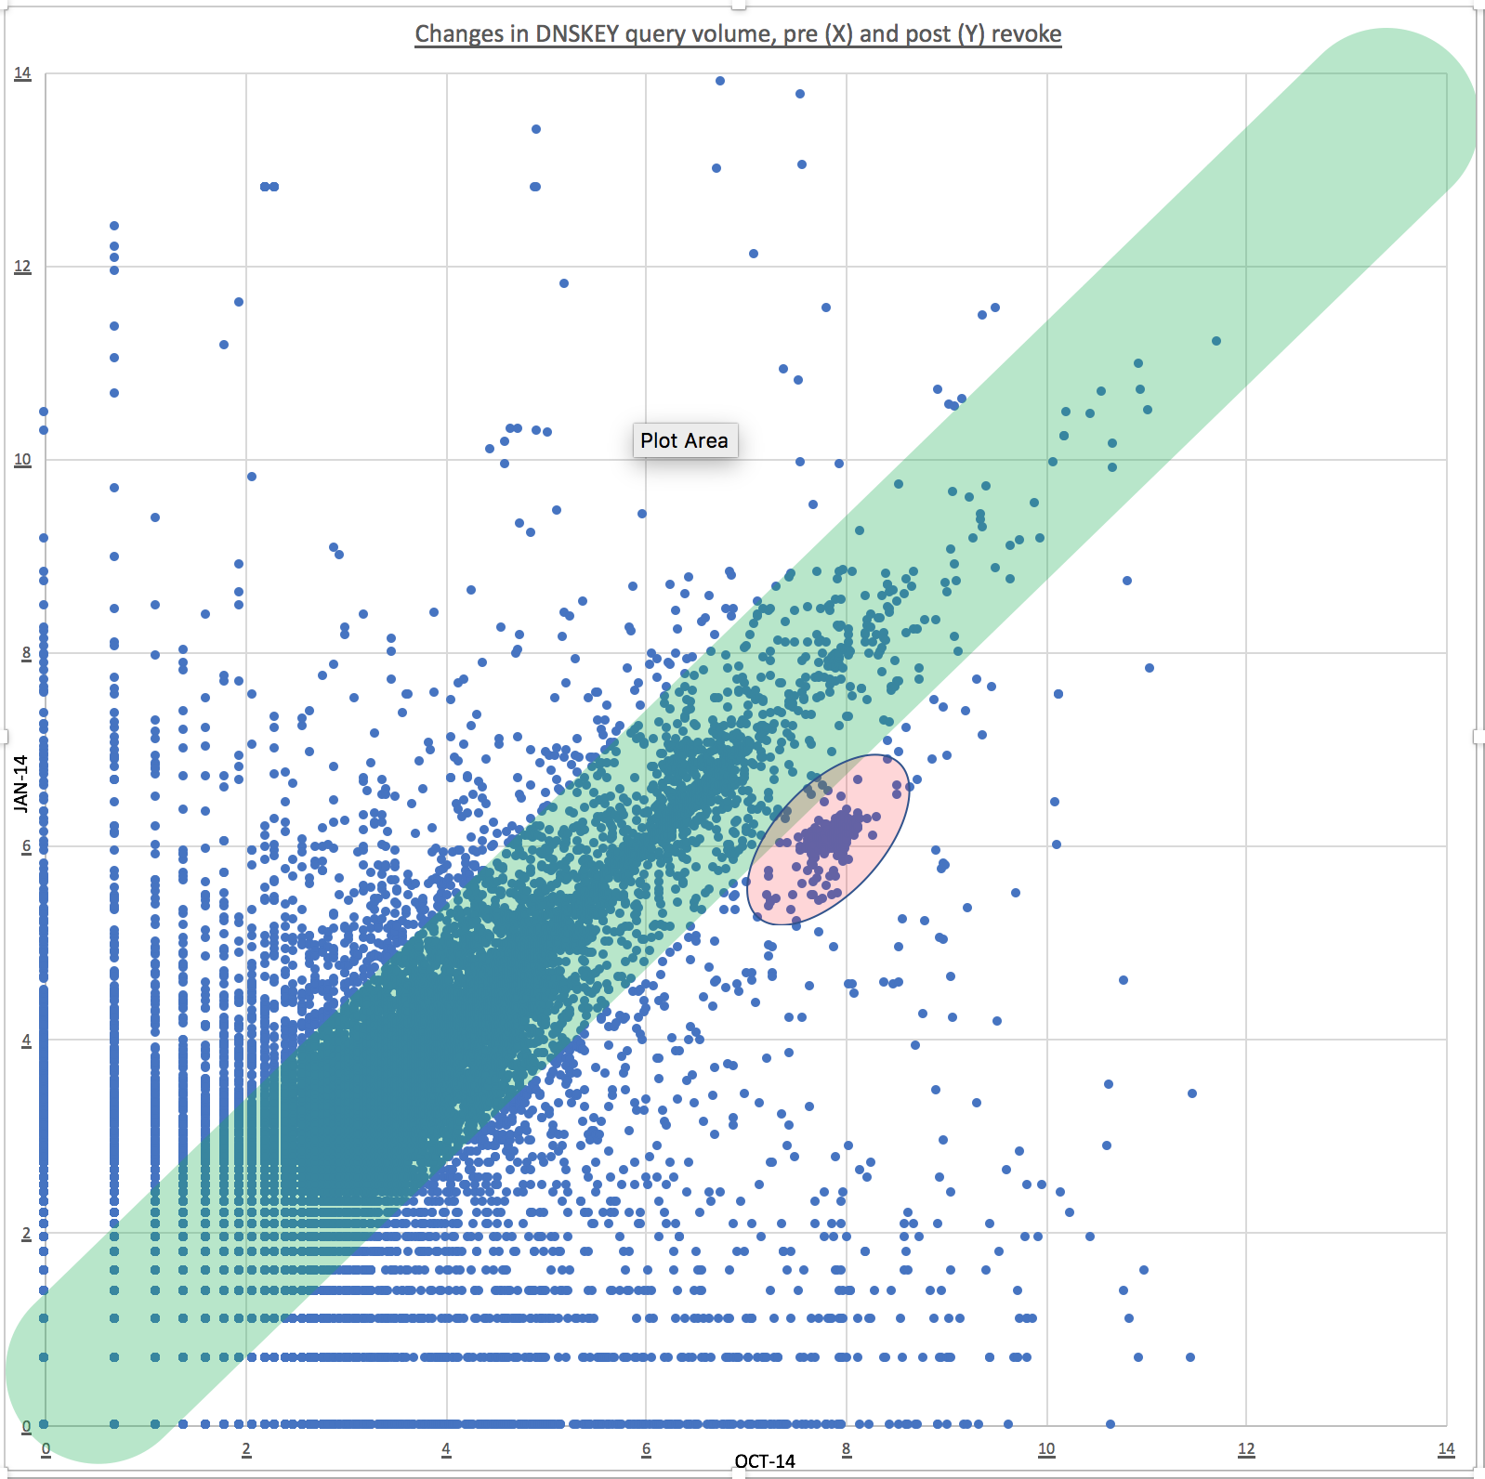
DNSKEY queries (14 October vs. 14 January)

Slide 17
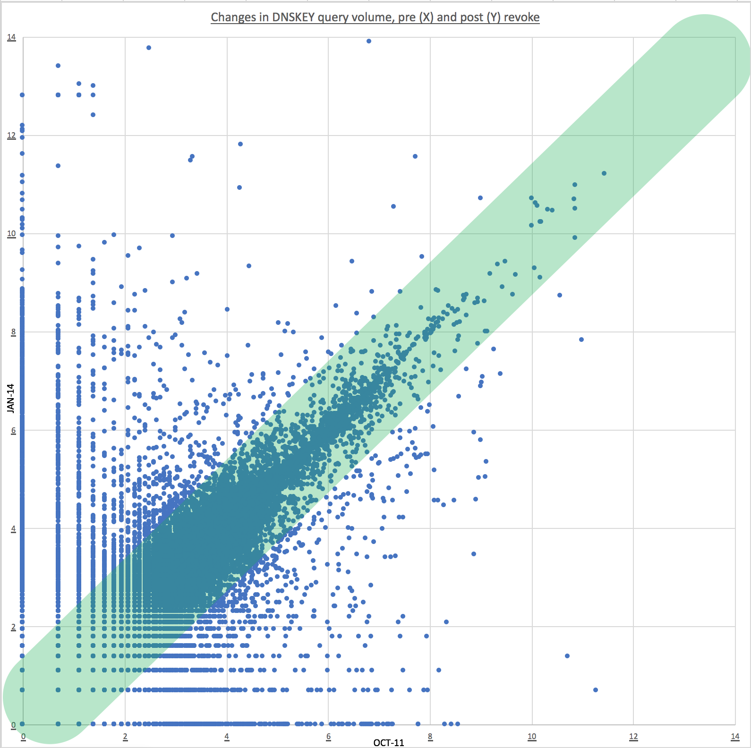
DNSKEY queries (11 October vs. 14 January)

Slide 18
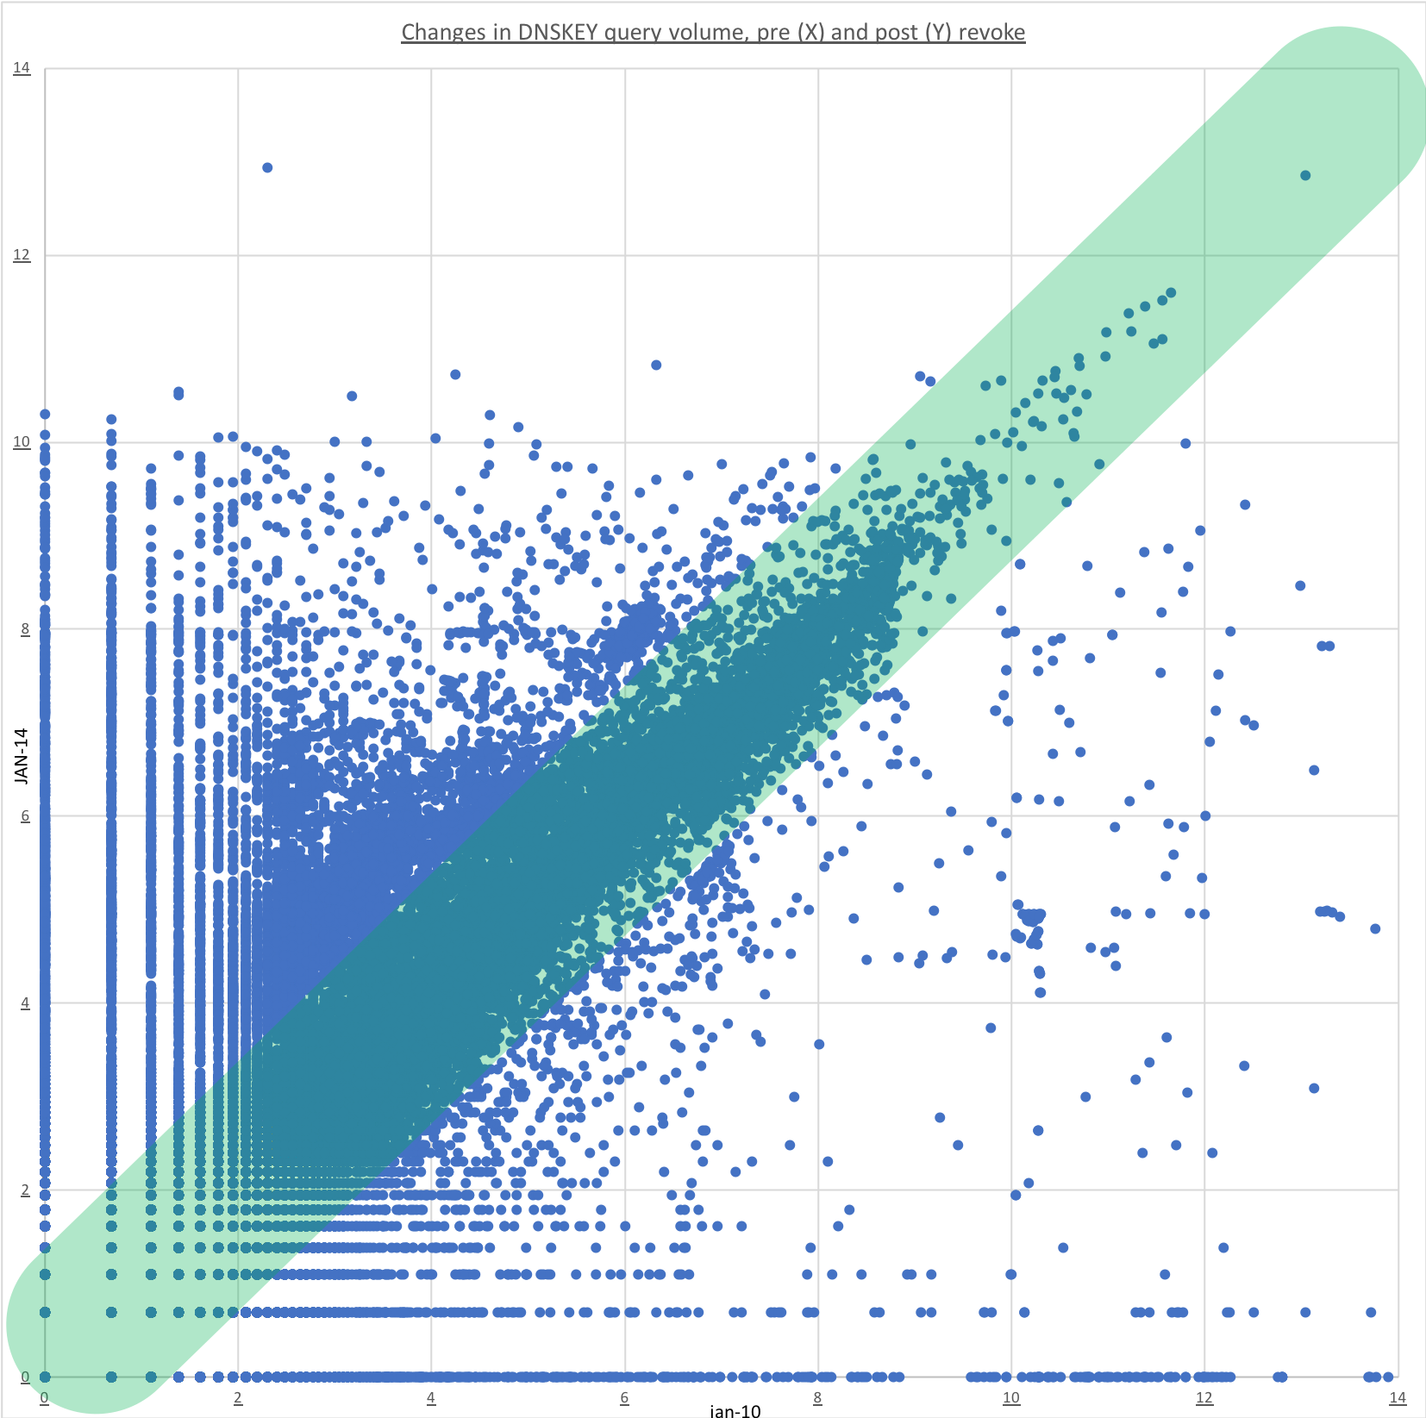
DNSKEY queries (10 January vs. 14 January)

Slide 19
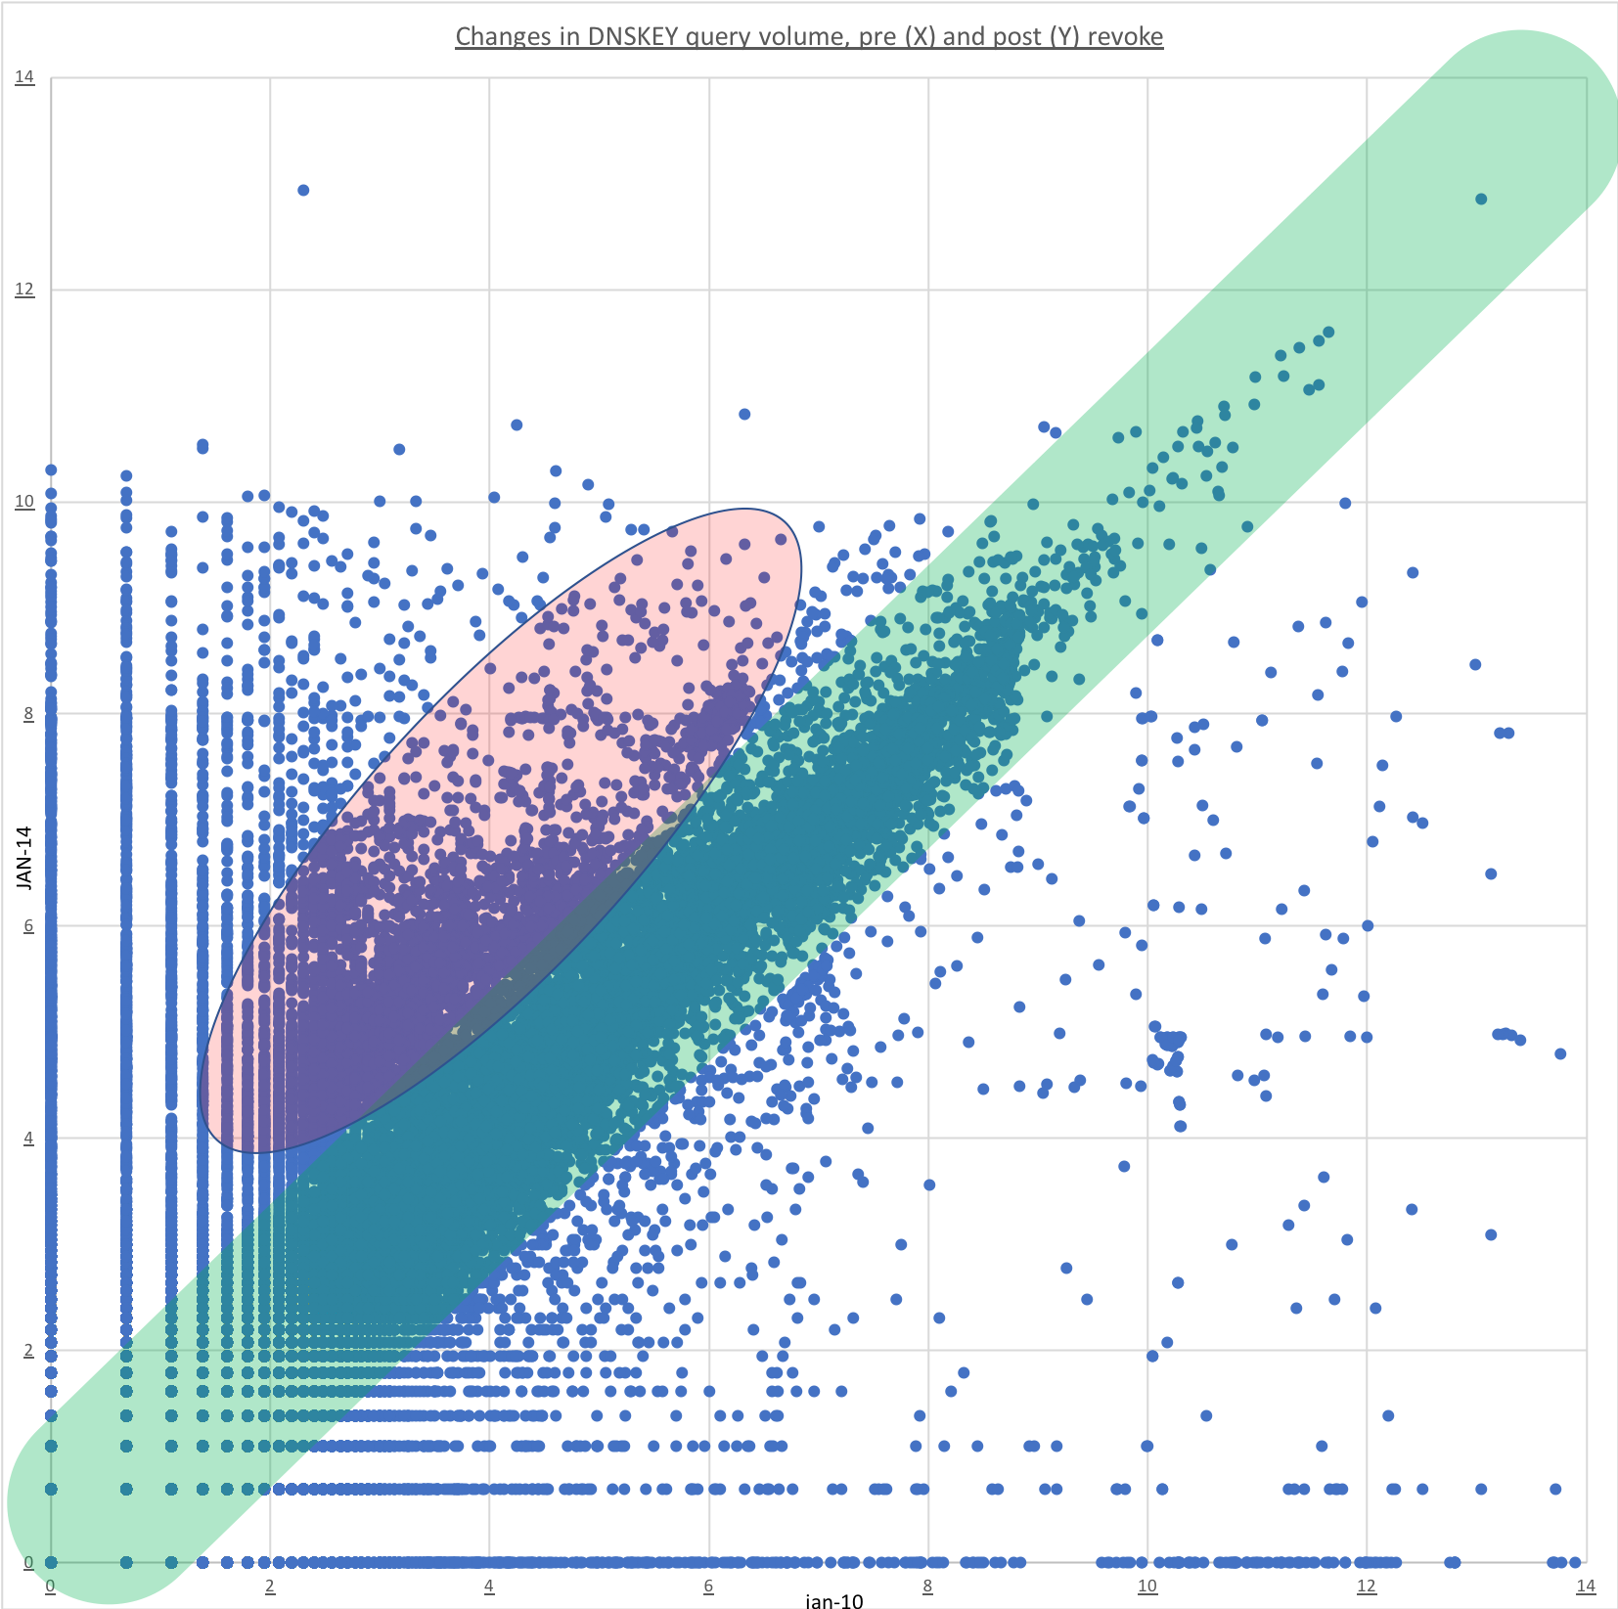
DNSKEY queries (10 January vs. 14 January)

Slide 20
Monitoring: ./IN/DNSKEY queries at the root (48 hours after the revoke)

Slide 21
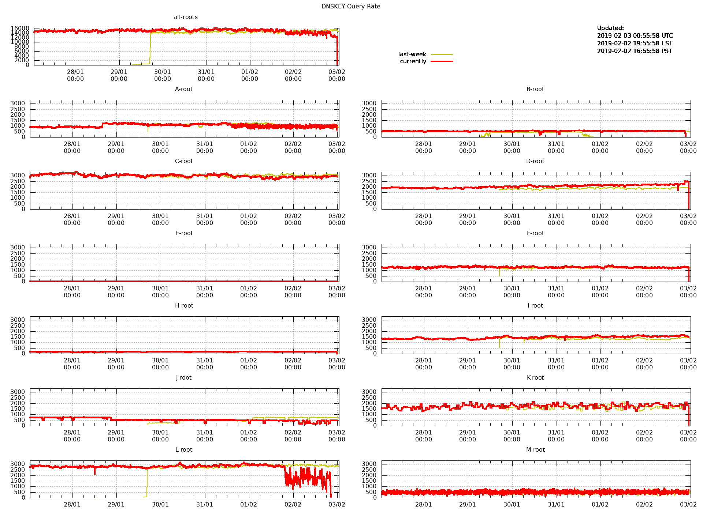
Monitoring: ./IN/DNSKEY queries at the root (now)

Slide 22
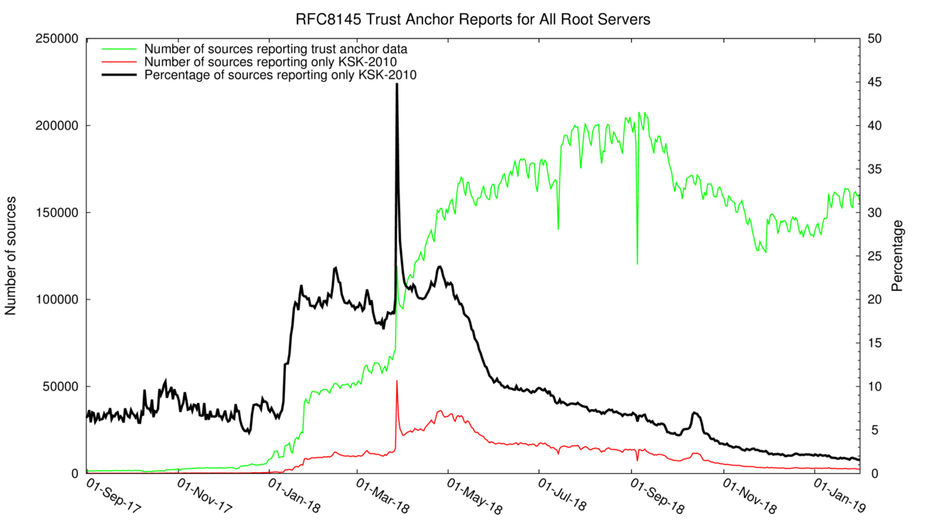
root-trust-anchor-reports.research.icann.org

Slide 23
Upcoming milestones
Q4 Root KSK Ceremony
  Signatures are generated in advance that, when published, will revoke KSK-2010 via the RFC 5011 automated update protocol
11 January 2019
  The root zone is published with the RFC 5011 revoke bit set on KSK-2010
22 March 2019
  The root zone is published without KSK-2010 for the first time
  Only KSK-2017 remains published
Q3 Root KSK Ceremony
  KSK-2010 is deleted from the HSMs in the U.S. East Coast Key Management Facility
Q4 Root KSK Ceremony
  KSK-2010 is deleted from the HSMs in the U.S. West Coast Key Management Facility

Slide 24
More maintenance is needed
The community has highlighted the desire to roll the key regularly
  Extremes are: every three months … only when there is a need.
The community has highlighted the desire for a standby-key
  This makes sure that DNSSEC deployment follows RFC5011 spec.
The community has highlighted the desire for an algorithm rollover
  We need to know how to do it, in case RSA becomes weak.
All of the above are related, and each is a significant amount of work.
  We are listening, tell us your thoughts and join the discussions at
        ksk-rollover@icann.org

