Slide 1
Enrich your NIC's capabilities with DPDK Soft NIC
Cristian Dumitrescu, Jasvinder Singh, Reshma Pattan & Kevin Laatz
Intel
FOSDEM 2019

Slide 2
Why Soft NIC?
In DPDK, we have:
Many ethdev APIs.
Lots of NIC vendors.
Not all NICs support the same features.
Soft NIC provides a solution for this by providing a software fallback for physical NICs by augmenting missing features!
Benefits
Usability: Allows consumption of advanced DPDK features without application redesign.
Performance: Allows performance boost of DPDK consumers apps.
1

Slide 3
Soft NIC Overview
2

Slide 4
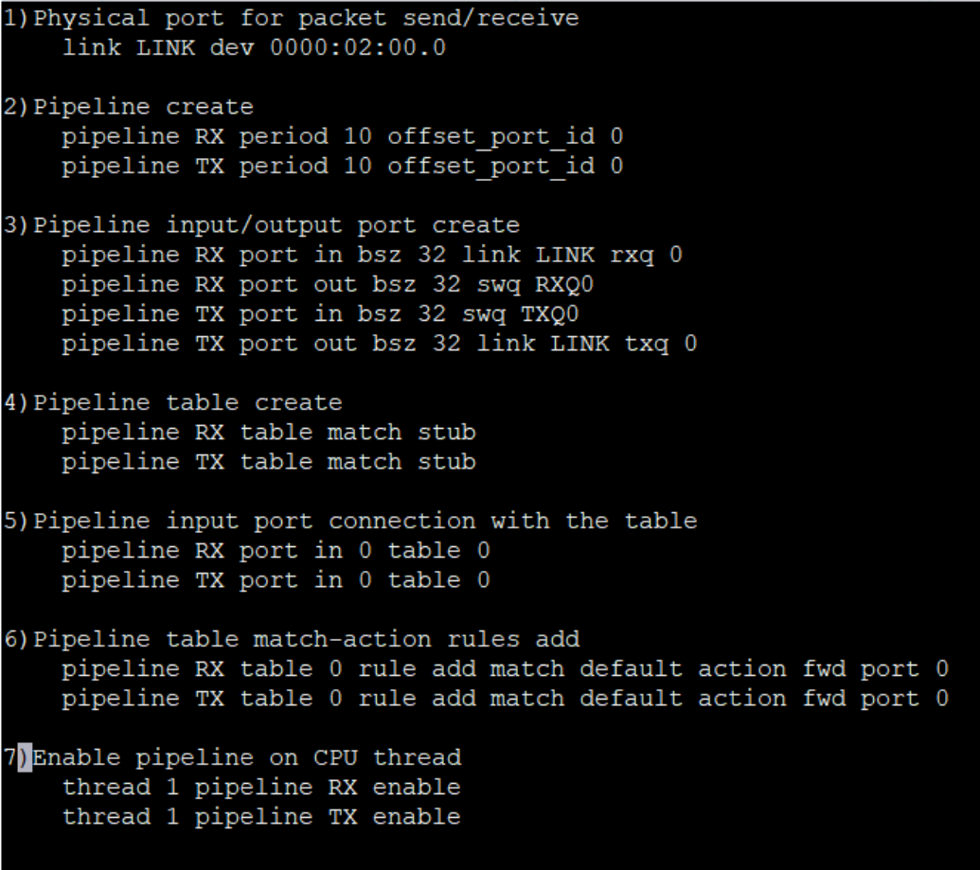
Soft NIC Internals
Configuration Script
Provision resources.
Create and configure pipelines.
Application Thread / Service Cores
Configure Soft NIC.
Read packets from/write packets to Soft NIC queues.
Update Soft NIC: Flow, QoS, Security.
Soft NIC Threads
Call the Soft NIC run API to execute the pipelines assigned to current thread.
3

Slide 5
Soft NIC Use Cases
- Available feature
L2 Fwd (Switching).
L3 Fwd (Routing).
Flow classification (Firewall, encap, NAT).
Traffic management (Metering and Policing, QoS Scheduler).
Packet processing pipelines of complex work loads (vBNG/vBRAS).
- Missing feature
- Application
Physical NIC only
Packet RX
Routing
HQoS
APP
(CPU)
ACL
Flow Classification
Metering/ Policing
Routing
Packet TX
With Soft NIC
Packet RX
Routing
HQoS
APP
(CPU)
ACL
Flow Classification
Metering/ Policing
Routing
Packet TX
Downlink Processing Blocks
Uplink Processing Blocks
4

Slide 6
Recap & References
Key take aways
Soft NIC provides a software fallback for physical NICs.
Consume advanced DPDK features without application redesign.
Potential performance improvement for consumer applications.
Many use cases – From simple forwarding to complex work loads.
DPDK Soft NIC documentation
https://doc.dpdk.org/guides/nics/softnic.html
5

Slide 7
Thank you! Questions?
Cristian Dumitrescu
cristian.dumitrescu@intel.com
Jasvinder Singh
jasvinder.singh@intel.com
Reshma Pattan
reshma.pattan@intel.com
Kevin Laatz
kevin.laatz@intel.com
6

