Slide 1
Roll your own compiler
Easy IR generation
Kai Nacke
3 February 2019
LLVM dev room @ FOSDEM‘¹⁹
Notes:
Hello! I am Kai.

Slide 2
What are the obstacles of IR generation?

Slide 3
Modula-2
First implementation in 1979 for the PDP-11
Complete language
Carefully designed syntax
Module concept
Low-level facilities and procedure types
Large code base available
The Lilith operating system
The GMD compiler toolbox (“cocktail”)
Later standardized as ISO 10514
(* Taken from PIM4, page 25. *)
MODULE gcdlcm;
FROM InOut IMPORT ReadInt, WriteLn,
WriteString, WriteInt;
VAR x, y, u, v: INTEGER;
BEGIN
WriteString("x = "); ReadInt(x); WriteLn;
WriteString("y = "); ReadInt(y);
u := x; v := y;
WHILE x # y DO
IF x > y THEN
x := x - y; u := u + v
ELSE
y := y - x; v := v + u
END
END;
WriteInt(x, 6); WriteInt((u+v) DIV 2, 6); WriteLn
END gcdlcm.

Slide 4
m2lang – The LLVM-based Modula-2 compiler
ANTLR
Semantic
Codegen
.m2
Source
AST
Decorated AST
LLVM IR
Modula-2 grammar provided by ANTLR
Semantic phase and IR generation hand-coded
Semantic phase uses hand-coded AST
Goal: replace ANTLR with RD-parser
Source will be published here: https://github.com/redstar/m2lang

Slide 5
Basic blocks
IR instructions go into a basic block
A basic block is a single entry single exit section of code
Entry is with first instruction, usually marked with a label
Ends with a terminating instruction, e.g. conditionally/unconditionally branch, return
Optimization is usually applied to basic blocks
All basic blocks of a function form a control flow graph (CFG)
if:
%6 = load i32, i32* %3, align 4
%7 = load i32, i32* %4, align 4
%8 = icmp ne i32 %6, %7
br i1 %8, label %then, label %else

Slide 6
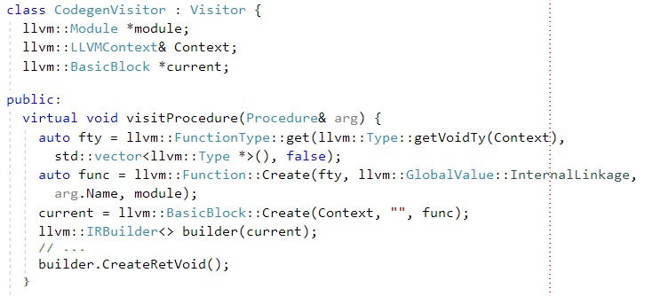
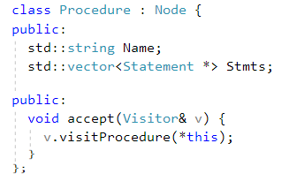
The naive approach to IR generation
Define a visitor holding pointer to current basic block
Traverse the AST and generate IR
Create a new basic block if needed

Slide 7
The trouble with naive approach
Naive approach works well with simple arithmetic
Now consider nested IF-THEN-ELSE-END structures
IF a > 0 THEN
IF b > c THEN
(* ... *)
ELSE
(* ... *)
END
ELSE
(* ... *)
END
; …
br label %end4
; …
end4:
br label %end5
;…
end5:
Current block can be empty (“END”)
Generates blocks with branch instruction only

Slide 8
The gap between AST and LLVM IR
The AST is more closely to the textual representation
The basic blocks form a control flow graph
Generation of „branch only“ basic blocks is result of this mismatch
AST
CFG of basic blocks

Slide 9
How to resolve
Do not care – let LLVM optimize it away
Simple
Induce the CFG on the AST
Just adds a pointer to the AST („next basic block“)
Can be constructed very fast with recursive visitor
Explicitly construct the CFG
Costly if only done for construction of IR

Slide 10
Transform AST into high-level CFG
Goal is to transform the AST into a representation closer to a CFG
Lower high-level constructs in low-level constructs
Replace FOR, WHILE, REPEAT with LOOP/EXIT
Replace AND/OR with nested IF
Introduce GOTO
Lowering every implicit jump into a GOTO creates a CFG
Think how to preserve debug metadata!
You now have created your own IR!
WHILE a > b DO
(* Stmts *)
END
LOOP
IF a > b THEN
EXIT
END;
(* Stmts *)
END

Slide 11
When is another IR needed?
Creating another IR can be helpful
Elaborate type checking
Scope checking
Generating synthetic code (e.g. cleanup handlers)
Do only when needed
Modula-2 seems to be simple enough to go without new IR
Be careful
Do not replicate LLVM functionality at a higher level
Consider adding a new LLVM pass instead

Slide 12
Thank you!

