Slide 1
Multilingual Kubernetes
FOSDEM 2019
Zach Corleissen
Lead Technical Writer, Linux Foundation
@zachorsarah
zcorleissen@linuxfoundation.org
Notes:
Hello! I’m Zach Corleissen, lead technical writer at the Linux Foundation and one of the co-chairs for Kubernetes SIG Docs. SIG stands for special interest group; special interest groups, or SIGs, are how Kubernetes functionality is developed.
Today let’s talk about multilingual support for Kubernetes documentation, and the toolchain and workflows that drive our multilingual support.

Slide 2
https://kubernetes.io/docs/
https://github.com/kubernetes/website
Notes:
But first, let’s be clear about what this talk is and isn’t.
We’re here to talk about doc tooling, specifically the Kubernetes website toolchain, and how our docs evolved to provide multilingual support.
This talk is not about Kubernetes functionality. That’s a different and very extensive series of talks!
Likewise, this talk is not about how to localize documentation. From a docs tools perspective, our concern is solely for the output of localization, not localization itself.
Onward!

Slide 3
Kubernetes docs natively support multilingual content.
Notes:
This is awesome!
Native multilingual support represents a big pivot in our tooling and workflow made in less than one year. It would have taken less time, but...

Slide 4
We made a lot of mistakes.
Notes:
When we first opened Kubernetes docs for multilingual content, we weren’t prepared. None of us had ever done internationalization before.
Our workflow was not scalable.
We were suddenly flooded by a significantly greater number of pull requests that we could not meaningfully review because we lacked fluency. As you can guess, requiring fluency from all reviewers for all supported languages isn’t a scalable workflow.
Our tooling was fragile.
We responded to the overload of PRs by creating separate repos for each language project.
...but we didn’t create the new repos by forking the existing one, which made upstream contributions impossible.
And of course, more repos means more repo-level maintenance.
And we hadn’t yet solved the question of how would we publish multilingual content in Jekyll.
Jekyll does not easily support multilingual content.
When we looked at multilingual support in Jekyll, we found a number of plugins, but they all appeared defunct--the freshest plugin had last received an update two years prior.
If we kept trying to publish multilingual content with Jekyll, our tool chain was going to become increasingly brittle.

Slide 5
We also made good choices!
Notes:
Good tooling choices:
After considering the increasing technical debt associated with Jekyll, not only for multilingual content but for build times as well (Jekyll build times begin slowing significantly for sites with >100 pages), we decided to change our static site generator.
We migrated from Jekyll to Hugo.
This ended up being one of our best choices overall. We resolved a lot of technical debt.
We also solved for process fragility. We figured out how to use the Kubernetes CI to handle review permissions and language filtering.
Kubernetes as a project uses a custom CI: Prow. We’ll talk more about Prow in a few minutes; for now, just hold in mind that we used our CI to create a scalable workflow for multilingual docs.
Good process choices:
Inviting localization teams into tooling discussions
This may seem obvious, but inviting stakeholders to collaborate on their tooling process widened and deepened our pool of expertise. This has yielded significant rewards at several stages of the journey:
The Korean team very politely shot our initial branching strategy full of holes and helped clarify concretely the ways in which our i18n process simply was not working.
The Chinese team has helped refine numerous functional bits of the publishing process.
This was our absolute best choice: inviting stakeholders to be equal collaborators. We evolved as a SIG from thinking of ourselves as gatekeepers of tooling to being signal boosters of good tooling.

Slide 6
We kept making choices over time.
Notes:
It’s not as if the slate of available choices was static, and we just haphazardly made some good choices and some poor ones. For example, when we started solving for multilingual docs, Prow had not yet been implemented. Hugo was still in its relative infancy.
We started working with one team, from China, with a high language barrier, then started working with other teams over the course of the project.
The point is that our decision-making remained open. As other possibilities arose, we considered and implemented them with a high degree of flexibility. We made the best choices we could at any given time, then we made better choices when better options became available. And that’s an attitude that we maintain going forward: intentional openness to better tooling and workflows, and the willingness to revisit our decisions.

Slide 7
Permissions and filtering were the most difficult pieces to solve.
Notes:
By permissions, I mean the ability of localization teams to create, review, and merge their own content without requiring approval from non-fluent speakers. And that’s a scalable solution.
By filtering, I mean the ability to sort issues and pull requests by language. Filtering by language is a critical piece of a sustainable docs review cycle.
Fortunately, Prow allows us to set permissions and create language labels for issues and pull requests using CI functionality.

Slide 8
The process wasn’t easy.
Notes:
Migrating from Jekyll to Hugo broke a lot of our docs--mainly because Jekyll and Hugo support different flavors of Markdown (Kramdown vs. Black Friday) and their respective parsers are differently strict. Changing parsers exposed some bad Markdown habits in legacy docs created before our style guide.
Black Friday had at least one glaring bug in nested ordered lists.
While we love Hugo as a site generator, it is not perfect. One of the largest pain points we experience is with page weights.
Jekyll allows (requires) you to specify page ordering in a single YAML file.
Hugo requires page weights in the front matter of each individual Markdown file. For a site with hundreds of Markdown files, that’s unsustainable.

Slide 9
...But we achieved a scalable, sustainable workflow for multilingual documentation.
Notes:
And that’s visible on our site today.

Slide 10
The kubernetes.io stack
https://kubernetes.io
Netlify
GitHub repo:
k/website
Kubernetes CI: Prow
GitHub repo:
k/test-infra/prow
Notes:
We store content in a GitHub repo: kubernetes/website, or k/website for short. I’m not going to explore its contents or file structure, that would take too long. I do encourage you to explore for yourself: github.com/kubernetes/website
The Kubernetes project uses a custom CI tool: Prow, in keeping with the nautical pilot theme of Kubernetes.
We also use Netlify to preview and publish builds.
For both Prow and Netlify, we use GitHub webhooks to automate CI and publishing.

Slide 11
GitHub: k/website
release-1.<next>
Changes from master merged into next release
master
Master merged into previous release to refresh snapshot
Next release branched from master
v1.<current> released
Master is default repo branch
release-1.<current>

Slide 12
Netlify
dev-1.<next>
dev-1.<version>-<lang>
release-1.<current+1>
master
release-1.<current+0>
release-1.<current+2>
release-1.<current+3
>
release-1.<current+4>

Slide 13
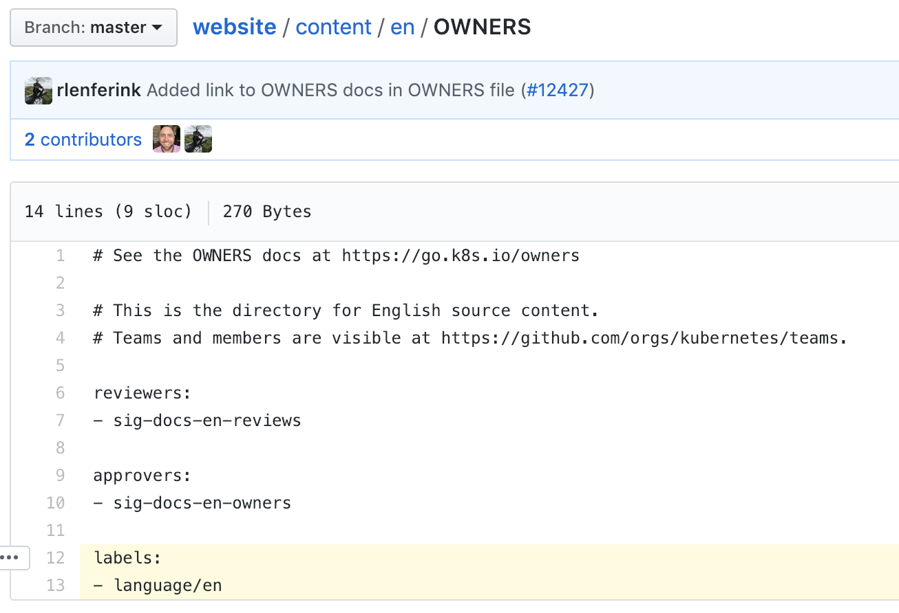
Notes:
Prow: permissions

Slide 14
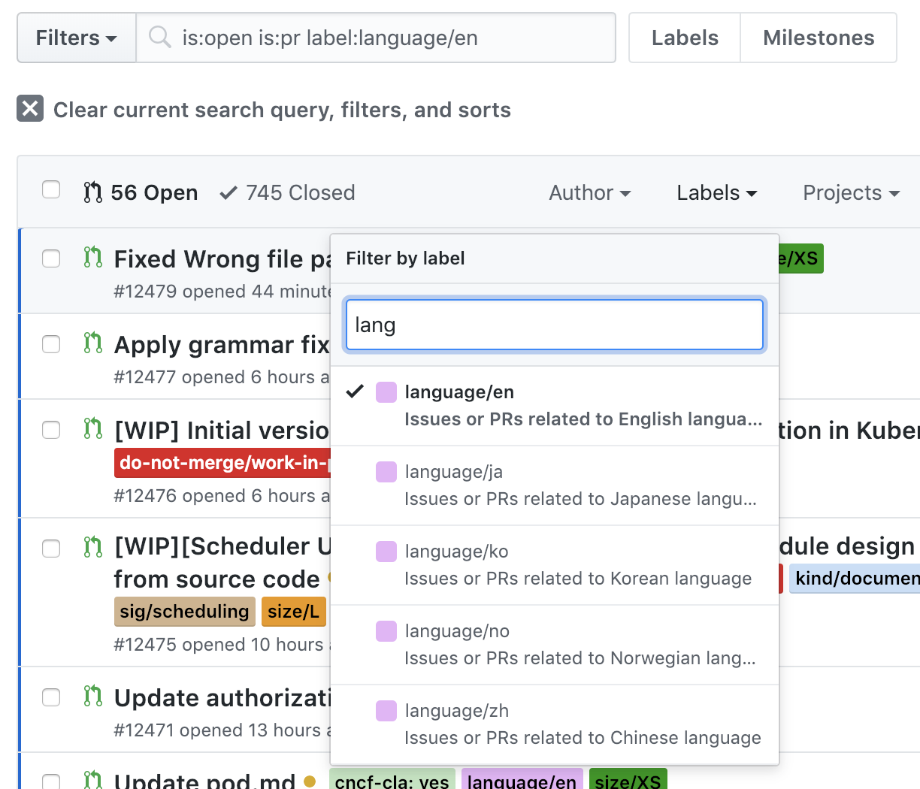
Notes:
Prow: sorting

Slide 15
Thank you.

