Slide 1
Building an open source data lake at scale in the cloud
Adrian Woodhead, Principal Engineer

Slide 2
Agenda
Background
Data Lake foundation: data + metadata
High Availability and Disaster Recovery
Data federation
Event-based data processing

Slide 4
Data Lake journey
“traditional” RDBMS Data Warehouse
Introduced on-premise Hadoop + Hive cluster
RDBMS SQL replaced by SQL from Hive
Slow at busy times
Painful upgrade path (software and hardware)
Migration to “Cloud” as primary data lake

Slide 5
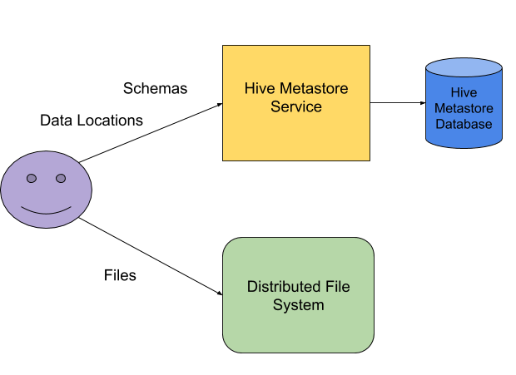
Cloud Data Lake Foundation
1
2

Slide 6
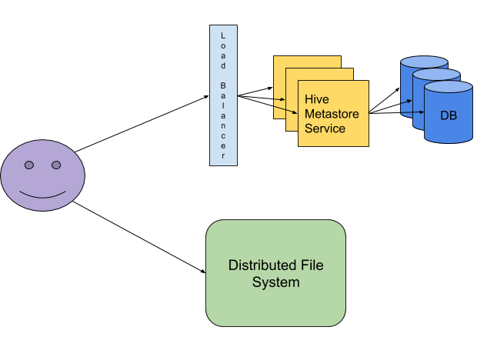
Cloud Data Lake High Availability
1
2

Slide 7
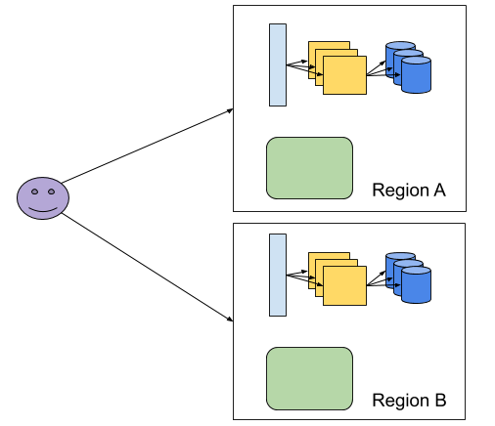
Cloud Data Lake Redundancy
1
2

Slide 8
Redundancy by replication
Data and Metadata
Co-ordinated
Data consistency during replication
No partial reads
Completeness more important than latency
1
2

Slide 9
Circus Train – Hive dataset replicator
https://github.com/HotelsDotCom/circus-train/
Metadata only available after data
Supports HDFS, S3, GCS etc.
Standard “distcp” and optimised copiers
Plugin architecture – Notifications, Copiers, Metadata transformations
Selective data replication – custom filters, “Hive Diff”
https://github.com/HotelsDotCom/shunting-yard
Event-driven Circus Train
1
2

Slide 10
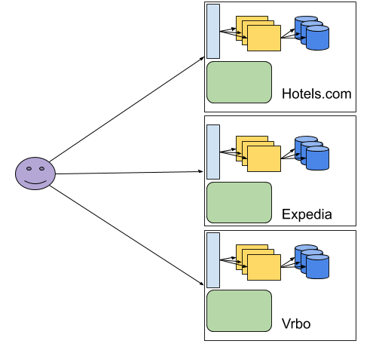
Data Lake Silos
1
2

Slide 11
Data Lake Silo Solutions
Move back to a single data lake
Scalability issues
Increased “blast radius”
Replicate shared data sets between data lakes
Cost of maintaining replication jobs
Increased file storage costs
Increased network transfer costs
1
2

Slide 12
Federated Cloud Data Lake
https://github.com/HotelsDotCom/waggle-dance/
Waggle Dance – a Hive Thrift metastore proxy
Configure it with “downstream” Hive metastores
Configure S3 bucket access permissions
Set “hive.metastore.uris” to Waggle Dance server
Use as you would Hive metastore in any client app
1
2

Slide 13
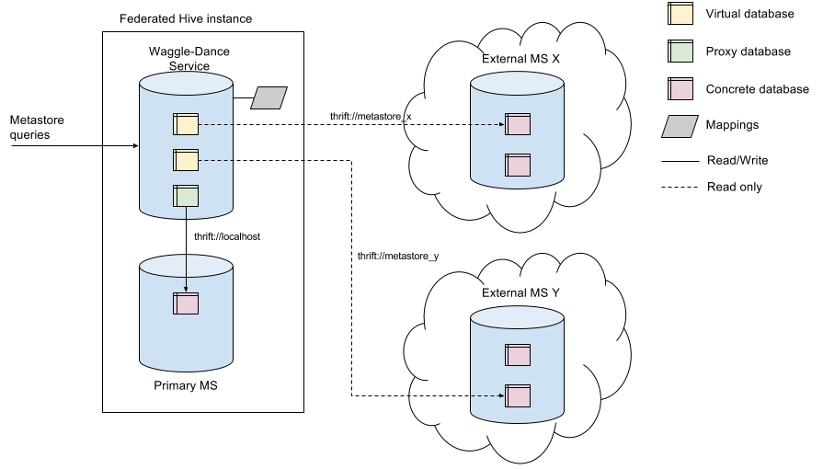
Waggle Dance Overview
1
2

Slide 14
Multi-Region Federated Cloud Data Lake
Federate
US_WEST_2
US_WEST_2
Replicate
Replicate
US_EAST_1
US_EAST_1

Slide 15
Federated Cloud Data Lake Best Practices
Expose read-only endpoints to “external” users
Separate critical path infrastructure
Federate data for access within a region
Replicate data for access in a different region
1
2

Slide 16
Federated Cloud Data Lake Alternative
Presto – distributed SQL query engine for big data
Federate Hive, MySQL, PostgreSQL and many others
https://github.com/prestodb/presto
OR
https://github.com/prestosql/presto
?
1
2

Slide 17
Apiary - Cloud Data Lake Components
https://github.com/ExpediaGroup/apiary
Various components for a federated cloud data lake
Docker images for all services
Terraform deployment scripts
Ranger for authorization
Various optional extensions
1
2

Slide 18
Apiary – Metadata Events
https://github.com/ExpediaGroup/apiary-extensions/tree/master/apiary-metastore-events
Events for tables/partitions CRUD operations
Hive MetaStoreEventListener implementations
Kafka
AWS SNS
Enable downstream data processing use cases
ETL, Governance, Lineage etc
1
2

Slide 19
Problem – rewriting data at scale
Changes to existing data
Read isolation for long running queries
Always create new folders for updates
Repoint Hive data locations
How to expire “orphaned data”?
1
2

Slide 20
Beekeeper – orphaned data cleanup
https://github.com/ExpediaGroup/beekeeper/
Hive table parameter: beekeeper.remove.unreferenced.data=true
Apiary event listener
Detects data re-writes
Schedules old data for deletion in future
Periodically performs the data deletions
1
2

Slide 21
Consistent CRUD alternatives
http://hive.apache.org/ - Hive 3.1.x with ACID
https://iceberg.incubator.apache.org/ - Iceberg
https://delta.io/ - Delta Lake
https://hudi.apache.org/ - Hudi
1
2

Slide 22
Don’t forget to test
https://github.com/klarna/HiveRunner/ - Hive SQL unit tests
https://github.com/HotelsDotCom/mutant-swarm/ - Code coverage for HiveRunner
https://github.com/HotelsDotCom/beeju - Unit tests for Thrift Hive metastore service and HiveServer2
1
2

Slide 23
Where to next?
Hybrid cloud
best of both worlds but increased complexity
Multi-cloud
best of breed but increased complexity
Docker + Kubernetes
Reduce vendor lock-in
Massive scale without too much effort
Minimal changes for on-prem/EKS/GKE/AKS etc

Slide 24
Open Source Data Lake Components
Hive Replication
https://github.com/HotelsDotCom/circus-train
https://github.com/ExpediaGroup/shunting-yard
Hive Federation
https://github.com/HotelsDotCom/waggle-dance
Hive Cleanup
https://github.com/ExpediaGroup/beekeeper
Cloud Data Lake
https://github.com/ExpediaGroup/apiary

