Slide 1
Automating Programming and Development of Heterogeneous SoCs with LLVM Tools
Joshua Mack, Nirmal Kumbhare

Slide 2
Who are we?
Notes:
List of all universities (logos), leads, students, industry
More from an acknowledgement perspective
highlight the key players in this work (there are other people not up here who made this talk happen)

Slide 3
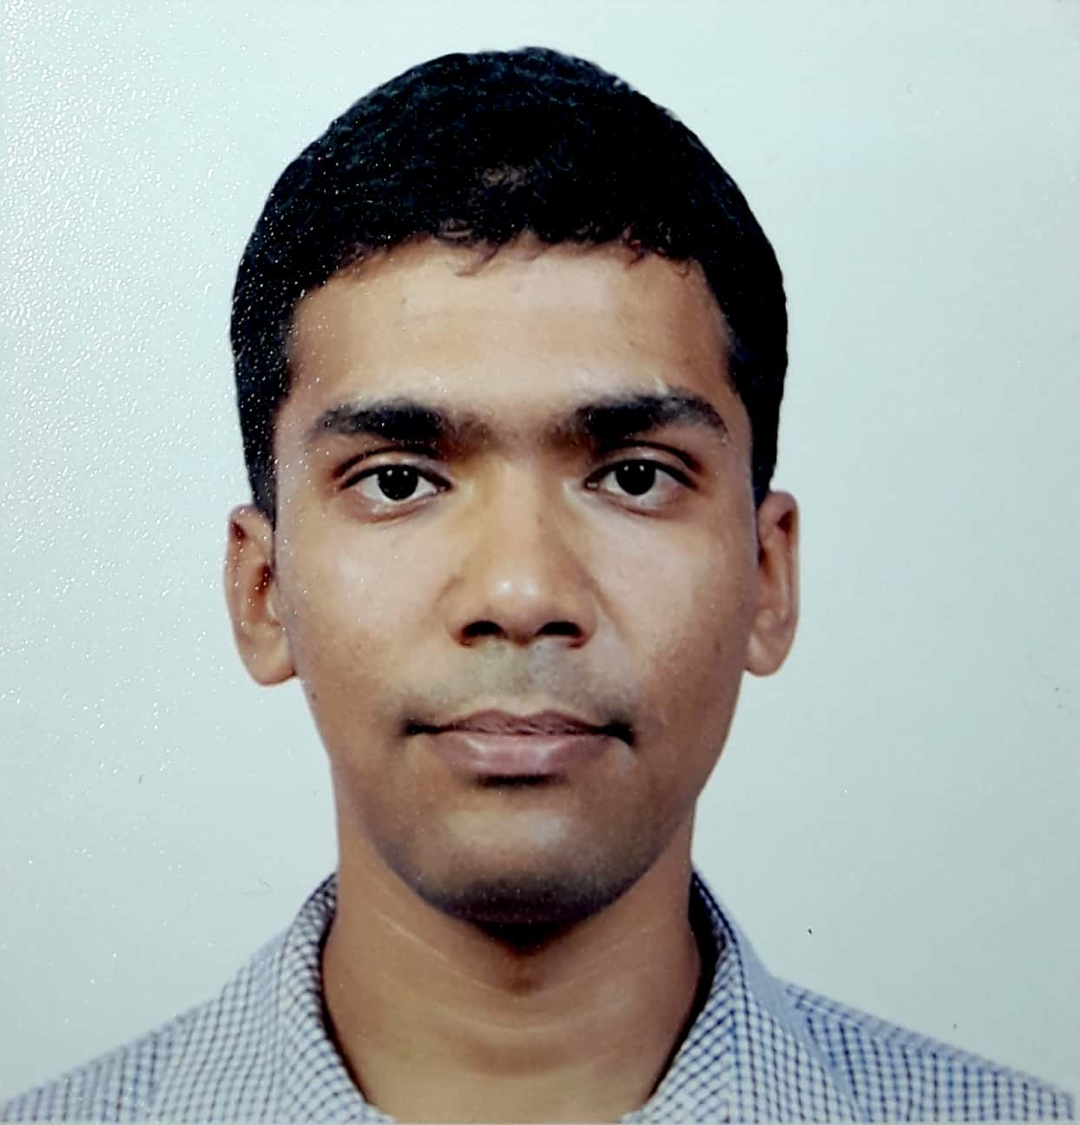
Who are we?
Joshua Mack
Advisor:
Ali Akoglu
Richard Uhrie
Advisor:
John Brunhaver
Aporva Amarnath
Advisor: Ron Dreslinski
Nirmal Kumbhare
Advisor:
Ali Akoglu
Anish NK
Advisor:
Umit Ogras
Samet Arda
Advisor:
Umit Ogras
Liangliang Chang
Advisor:
Chaitali Chakrabarti
Notes:
Students who were directly involved in making this work happen

Slide 4
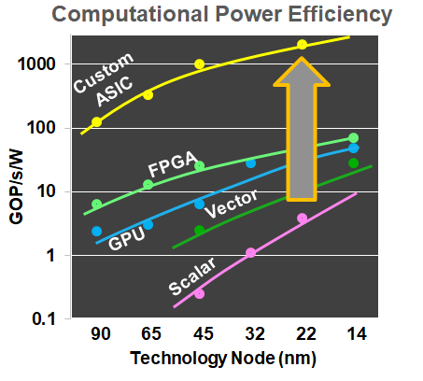
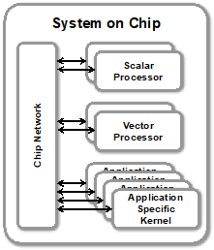
Motivation
“General Purpose” heterogeneous chip? No
Domain specific; focus on tooling & ease of use
A methodology for designing DSSoCs
Notes:
It’s really easy to build a complicated system that performs great but no one wants to use
“General purpose heterogeneous” is a bit of an oxymoron -- it’s not going to happen.
Mobile devices in particular have strict perf/watt requirements and are an excellent target for increasing heterogeneity
The space of all heterogeneous programs is large, but if you restrict to a domain, then particular optimization opportunities may open up, and we want to explore/are exploring those
Heterogeneous system design challenges from software point of view

Slide 5
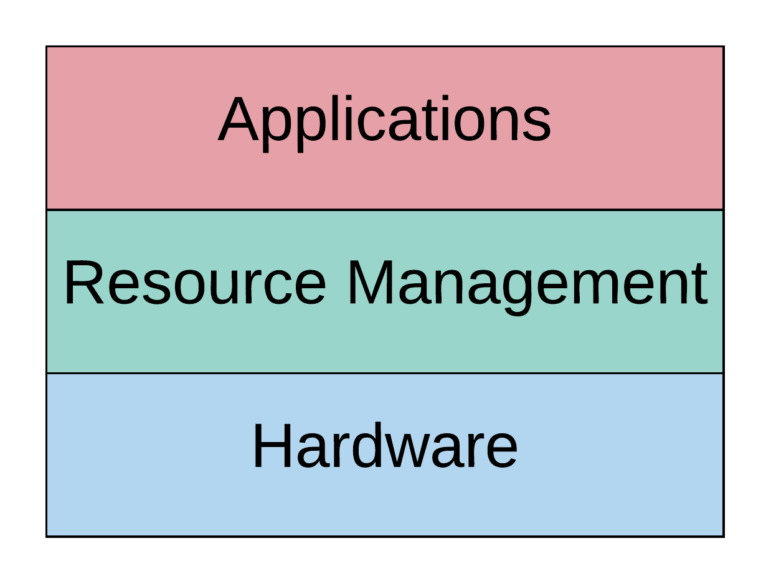
Challenges of DSSoCs
How do we integrate new applications?
How do you debug accelerators?
What are we scheduling?
How do we launch work on accelerators?
What accelerators?
Notes:
From a software developer’s point of view, it’s broadly speaking been possible to view computing as the interaction of three distinct components: the hardware, an overlay program that manages the hardware and provides nice interfaces (typically the operating system), and the user applications running on top of that. We think this is a good model -- we don’t want to get rid of it -- but when you think about this in the context of building a DSSoC, you can find yourself asking a lot of questions
What accelerators?: what processors do you want to have for your applications of interest, and how do you want to connect them all together? Is is going to be an on-chip network? How do you transfer data between nodes? Direct transfer? DMA access intermediated by DRAM?
How do we launch work on accelerators?: with all the accelerators defined, how do you actually provide work to them in some normalized way?
What is our unit of scheduling?: operating systems are built around threads and execution contexts as their baseline schedulable unit. An accelerator doesn’t even necessarily have a program counter or stack pointer or any coherent unit of execution context. How do we deal with that?
How do we integrate new applications?: CPUs have been wildly abstracted away from users at this point, but for general purpose accelerators, not so much. A traditional approach might be to just give the hardware to the user, give them a complex datasheet, and they’ll give up. How can we provide meaningful software interfaces with our DSSoC that abstract away difficulties without hindering its capabilities?
How do we package application binaries?: in a general purpose environment where the execution platform isn’t known statically at compile time, binaries need to be built a bit differently
Compilation of binaries for incompatible/widely varied architectures is difficult.
(What debugging look like in this? - maybe at the end in future work)
Why are we here? We want to contribute to the community

Slide 6
Overview of this work
How do we integrate new applications?
Notes:
In this work we’re looking to address only one of these questions, and we are proposing a methodology based on dynamic tracing that builds on LLVM and seeks to decrease the integration effort of
DSSoC Hypothesis: initial effort will need to be made to discover and craft accelerators for kernels, but this effort will pay off and accelerate adoption of your platform in the long run
DASH Overview - Big picture of how we envision DSSoC
Highlight the pieces to be emphasized in this work (TraceAtlas, Fat Binary generation, runtime from a validation point of view)
Motivate the “no compiler directives” aspect of our heterogeneous programming vision and tie it to “domain specific” as a requirement

Slide 7
TraceAtlas - Dynamic Tracing
Inject TraceAtlas tracer through LLVM opt pass
Produces a complete dynamic application trace
Dynamic trace compression increases ability to trace complex applications
Built on zlib compression
2-1000X reduction in tracing time vs SoA
2X reduction in on-disk trace size vs SoA
https://github.com/ruhrie/TraceAtlas/
https://arxiv.org/abs/2001.09995
Notes:
Any (other) interesting comparisons that we should make with state of the art?
Are the numbers on this slide representing our capabilities accurately?
We cropped the figure from QPR slide but it might be good to drop “Tik Formal IR” for the purposes of this work

Slide 8
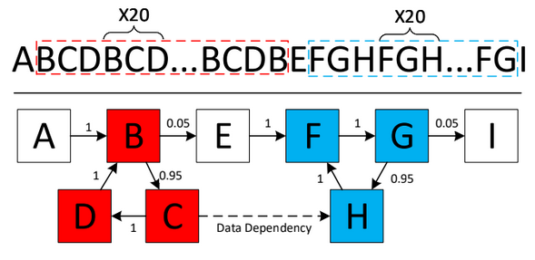
TraceAtlas - Kernel Detection
Kernels:
Basic blocks that cluster temporally; recur many times; can be executed in parallel
Kernel affinity
Probability that any one basic block occurs within range of another basic block
Segment basic blocks by temporal affinity
Produces a series of collections of basic blocks
Notes:
Should we include details about grouping of child kernels in their parent kernels?
Should we include any of the algorithmic details on the slide or just explain verbally? (the probabilistic summing, window size, hot code threshold, etc)

Slide 9
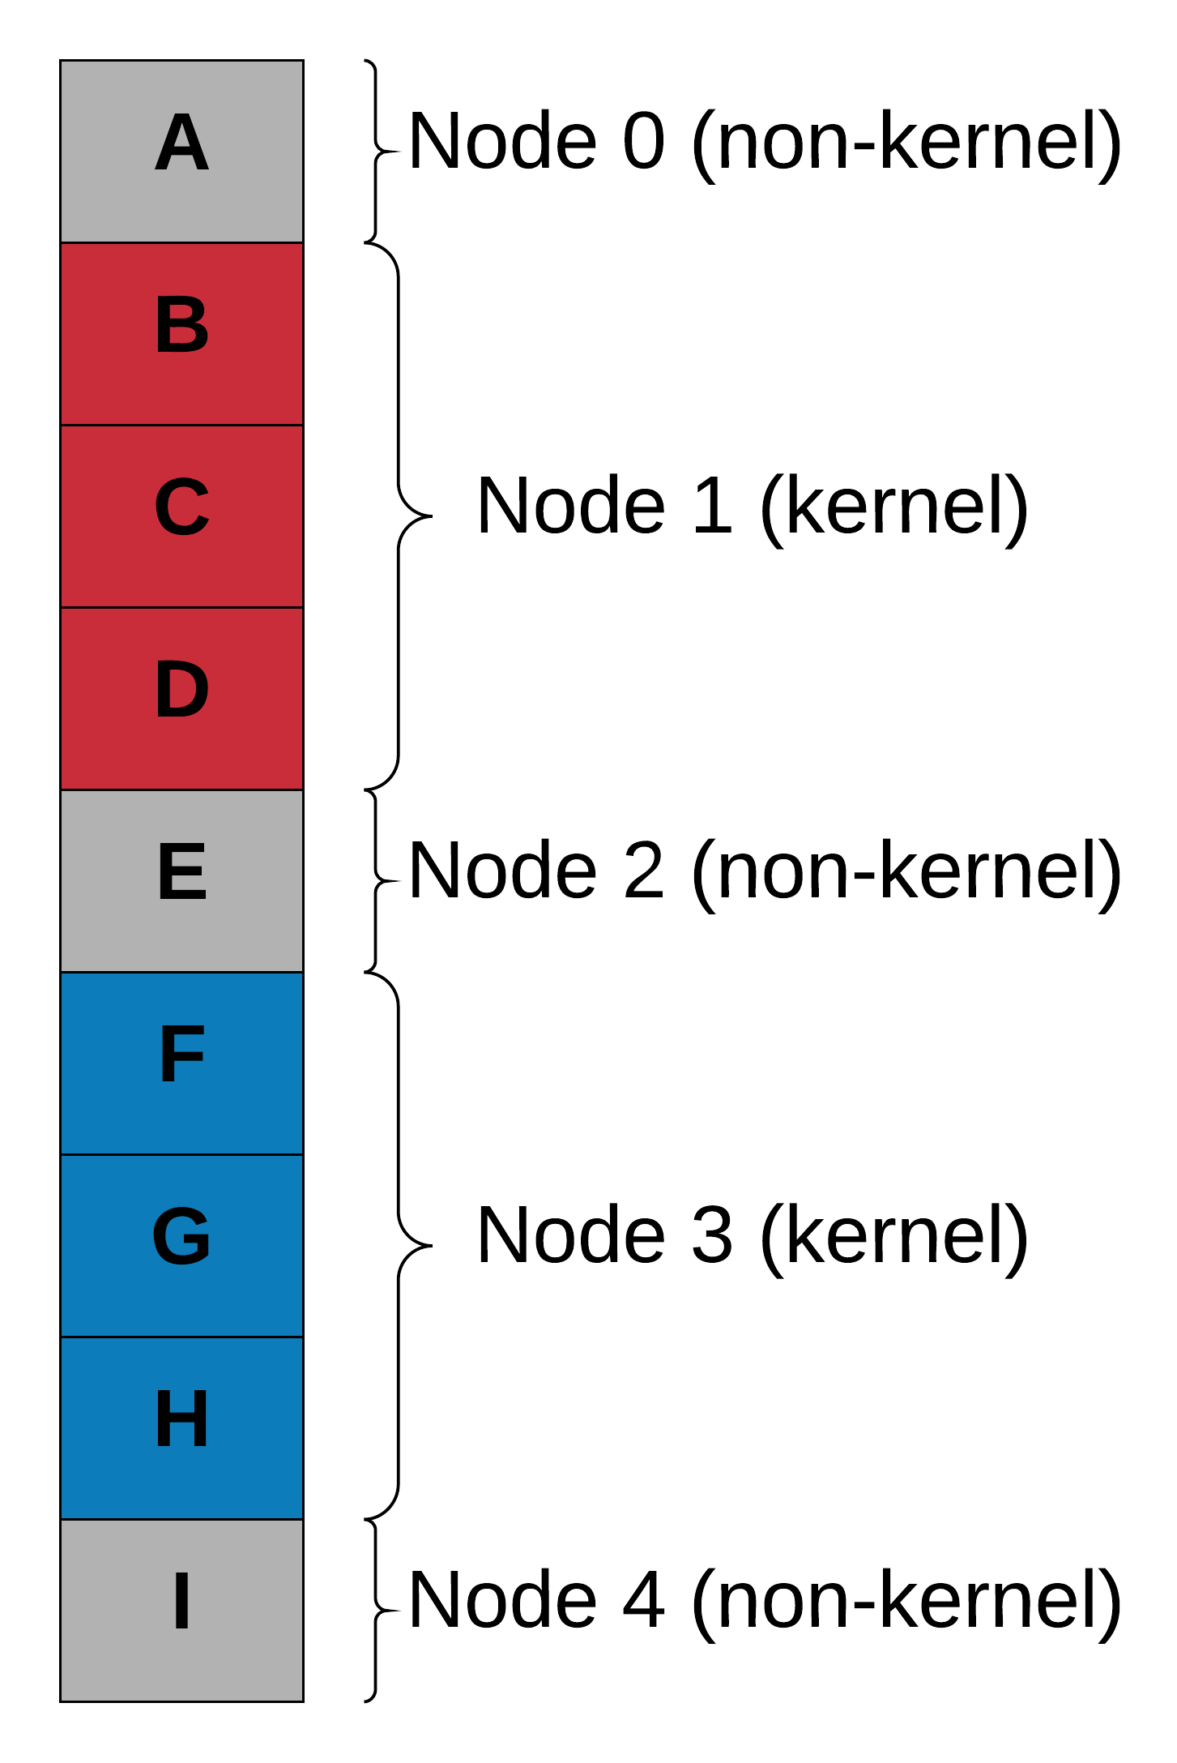
DAG Representation & Binary Generation
Notes:
Diagram that illustrates algorithmically the kernel/non-kernel labeling of basic blocks & function outlining
Analysis of memory requirements in base application
Discuss fat binary generation as a step on this

Slide 10
DAG Representation & Binary Generation
Notes:
Diagram that illustrates algorithmically the kernel/non-kernel labeling of basic blocks & function outlining
Analysis of memory requirements in base application
Discuss fat binary generation as a step on this

Slide 11
DAG Representation & Binary Generation
Notes:
Diagram that illustrates algorithmically the kernel/non-kernel labeling of basic blocks & function outlining
Analysis of memory requirements in base application
Discuss fat binary generation as a step on this

Slide 12
DAG Representation & Binary Generation
Notes:
Diagram that illustrates algorithmically the kernel/non-kernel labeling of basic blocks & function outlining
Analysis of memory requirements in base application
Discuss fat binary generation as a step on this

Slide 13
DAG Representation & Binary Generation
Notes:
Diagram that illustrates algorithmically the kernel/non-kernel labeling of basic blocks & function outlining
Analysis of memory requirements in base application
Discuss fat binary generation as a step on this

Slide 14
DAG Representation & Binary Generation
Notes:
Diagram that illustrates algorithmically the kernel/non-kernel labeling of basic blocks & function outlining
Analysis of memory requirements in base application
Discuss fat binary generation as a step on this

Slide 15
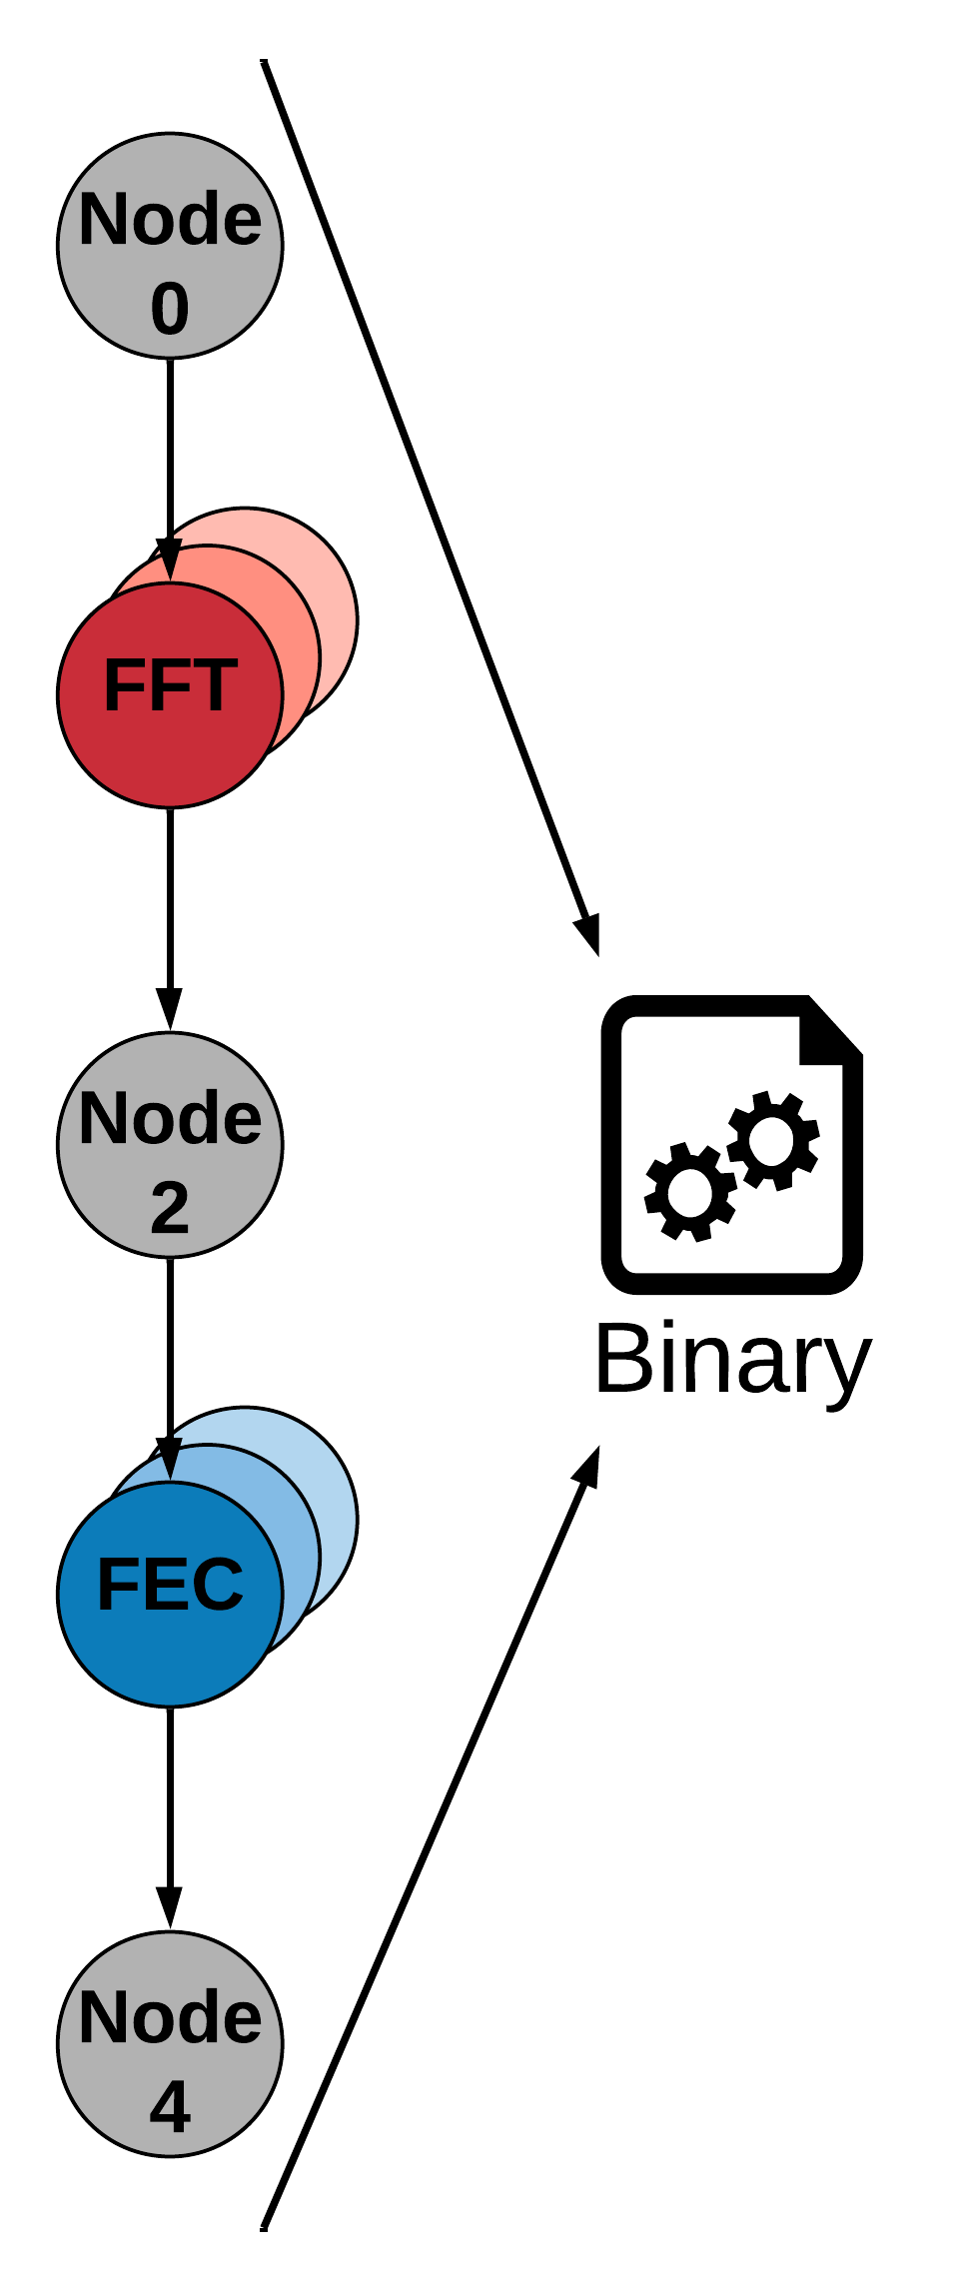
DAG Representation & Binary Generation
Notes:
Diagram that illustrates algorithmically the kernel/non-kernel labeling of basic blocks & function outlining
Analysis of memory requirements in base application
Discuss fat binary generation as a step on this

Slide 16
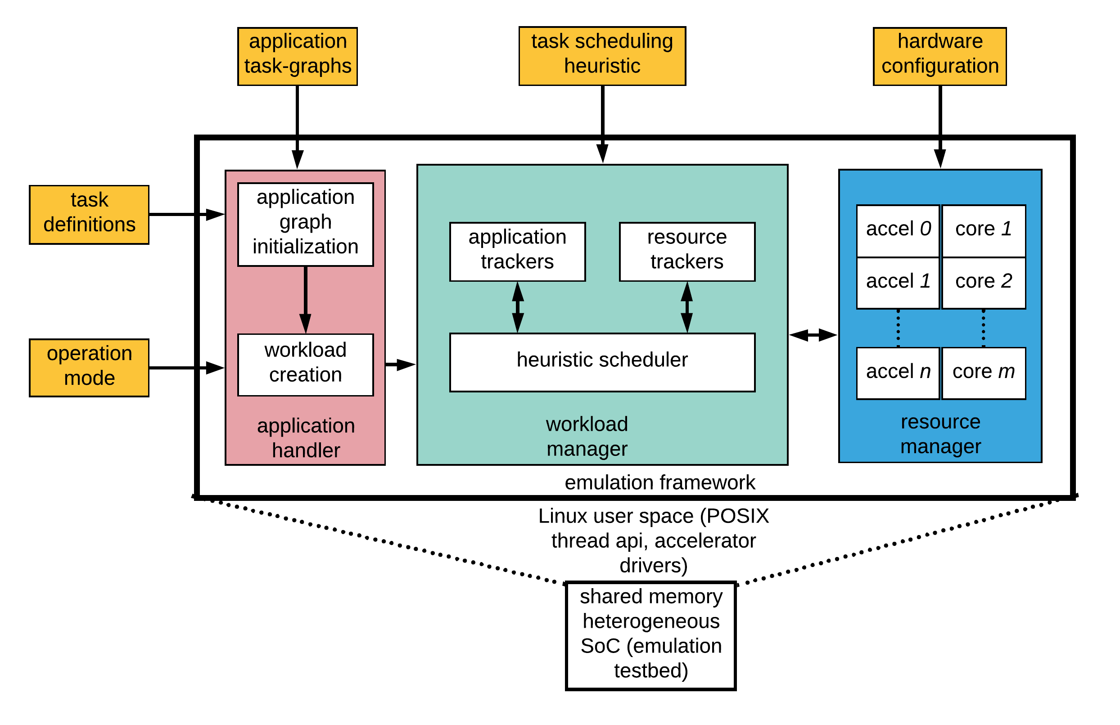
Linux Userspace Runtime
Linux userspace runtime application
pthread = schedulable resource
Manage a ready queue of tasks
Use custom resource management techniques to assign work to pthread handles
Why in userspace?
Immediately compatible across nearly all linux platforms (esp. x86/ARM)
Lower turnaround time
Easy accelerator integration
Enables rapid validation of
Application functionality
Scheduler design
Accelerator interfaces
https://github.com/mackncheesiest/DSSoCEmulator/
Notes:
What did we do? (pthreads, userspace runtime, custom schedulers, …)
Why did we do this? The linux kernel exists (but we didn’t know how to program it) and it has the benefit of lower turnaround time/iteration time.
Additionally, being in user space means immediate compatibility across nearly all linux-compatible platforms

Slide 17
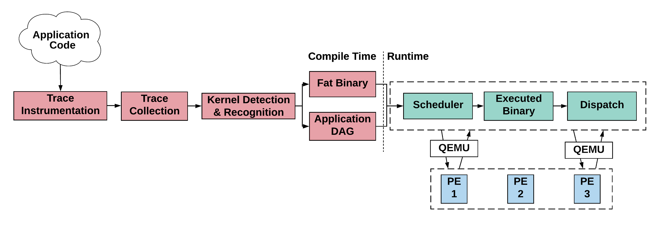
Linux Userspace Runtime
Notes:
High level diagram of the application to runtime flow

Slide 18
Linux Userspace Runtime
"Variables": {
"w": {
"bytes": 8,
"Val": [71, 225, 122, 20,
174, 40, 64,50]
},
...
}
"DAG": {
"0": {
"arguments": ["x", "y"],
"predecessors": [],
"successors": [{"name": "2"}],
"platforms":
[{ "name": "cpu",
"runfunc": "test_app_3_node0"}]
},
"1": {
"arguments": ["w", "dbl_array"],
"predecessors": [],
"successors": [{"name": "3" }],
"platforms":
[{ "name": "cpu",
"runfunc": "test_app_3_node1"}]
},
...
}
void test_app_3_node0(int* x, int* y) {
*x = *x + 5; *y = *y + 2;
}
void test_app_3_node1(double* w, double** dbl_array) {
*w = *w + 12.34f;
for (int i = 0; i < 10; i++) { (*dbl_array)[i] = 1.1f * i; }
}
void test_app_3_node2_platform1(int* x, int* y, int* z) {
printf("I am node 2 platform 1. I am running on the CPU\n");
*z = *y * *x;
}
void test_app_3_node2_platform2(int *x, int *y, int *z) {
printf("I am node 2 platform 2. I am running on an accelerator\n");
*z = *y * *x;
}
void test_app_3_node3(double* w, int* x, int* y, int* z,
double** dbl_array) {
printf("test_app_3 finished execution. ");
printf("output: {w: %f, x: %d, y: %d, z: %d}\n", *w, *x, *y, *z);
}
Notes:
To begin with, we started out developing all the applications by hand to really get a handle on what we wanted our toolchain to essentially output. As it turns out, this is a very tedious process, but it illustrates what we’re trying to do quite well at a high level.
This is a simple four node application written in C++ along with an accompanying JSON representation of what the dependency graph should look like. The application contains all the logic of the program grouped into kernels of some kind, and ideally these kernels should themselves be completely stateless, with all state being passed in through the arguments, and the behavior thus deterministic for identical inputs. The JSON, then, captures the execution structure of the program in an easy to understand way with a minimal set of information about the dependency relationships between kernels and what arguments they accept. Additionally, it encodes what function needs to be called in order to execute this node, and this hook is one location where we can start to really integrate some cool optimizations in that any function that has the same signature can be called in the place of the original node simply by changing that string.
Preparation of applications for this runtime
Compilation of the tik kernels into shared objects & DAG preparation

Slide 19
Application Compilation Example
int main(void) {
int i=0, j=0, x=1, y=2, z=3;
double w=1;
int* ptr = (int*) calloc(1, sizeof(int));
long long num_doubles = 10;
double* ptr2 = (double*) malloc(num_doubles *
sizeof(double));
for(i = 0; i < 10000; i++) {
w += 1.07;
x += y + z;
}
for(j = 0; j < 1000; j++) {
w -= 0.255;
}
for (i = 0; i < 10; i++) {
z += 1;
ptr2[0] = 88.88f;
}
printf("{i: %d, w: %f, x: %d, "
"y: %d, z: %d, ptr2[0]: %f}\n",
i, w, x, y, z, ptr2[0]);
}
./myapp.out
{i: 10,
w: 10446.000000,
x: 50001,
y: 2, z: 13,
ptr2[0]: 88.879997}
Notes:
We don’t want to rewrite our applications to be well compartmentalized functional applications, though -- we want the compiler to do that for us
This is the simple test application we’ll be working through on the slides if only because it’s compact enough to fit

Slide 20
Initial LLVM Compilation
int main(void) {
int i=0, j=0, x=1, y=2, z=3;
double w=1;
int* ptr = (int*) calloc(1, sizeof(int));
long long num_doubles = 10;
double* ptr2 = (double*)malloc(num_doubles *
sizeof(double));
for(i = 0; i < 10000; i++) {
w += 1.07;
x += y + z;
}
for(j = 0; j < 1000; j++) {
w -= 0.255;
}
for (i = 0; i < 10; i++) {
z += 1;
ptr2[0] = 88.88f;
}
printf("{i: %d, w: %f, x: %d, "
"y: %d, z: %d, ptr2[0]: %f}\n",
i, w, x, y, z, ptr2[0]);
}
clang-9 -S -flto -static \
-fuse-ld=lld-9 myapp.c \
-o output-myapp.ll
...
16: ; preds = %27, %0
%17 = load i32, i32* %2, align 4
%18 = icmp slt i32 %17, 10000
br i1 %18, label %19, label %30
19: ; preds = %16
%20 = load double, double* %6, align 8
%21 = fadd double %20, 1.070000e+00
store double %21, double* %6, align 8
%22 = load i32, i32* %4, align 4
%23 = load i32, i32* %5, align 4
%24 = add nsw i32 %22, %23
%25 = load i32, i32* %3, align 4
%26 = add nsw i32 %25, %24
store i32 %26, i32* %3, align 4
br label %27
...
Notes:
Our process begins by simply compiling the target application to an intermediate LLVM representation
We any code that we want to trace needs to be available and included at this step

Slide 21
Basic Block Renumbering
...
16: ; preds = %27, %0
%17 = load i32, i32* %2, align 4
%18 = icmp slt i32 %17, 10000
br i1 %18, label %19, label %30
19: ; preds = %16
%20 = load double, double* %6, align 8
%21 = fadd double %20, 1.070000e+00
store double %21, double* %6, align 8
%22 = load i32, i32* %4, align 4
%23 = load i32, i32* %5, align 4
%24 = add nsw i32 %22, %23
%25 = load i32, i32* %3, align 4
%26 = add nsw i32 %25, %24
store i32 %26, i32* %3, align 4
br label %27
...
opt-9 -load ./AtlasPasses.so -EncodedAnnotate output-myapp.ll
-S -o output-myapp-annotate.ll
...
BB_UID_1: ; preds = %BB_UID_3, %BB_UID_0
%15 = load i32, i32* %1, align 4
%16 = icmp slt i32 %15, 10000
br i1 %16, label %BB_UID_2, label %BB_UID_4
BB_UID_2: ; preds = %BB_UID_1
%17 = load double, double* %5, align 8
%18 = fadd double %17, 1.070000e+00
store double %18, double* %5, align 8
%19 = load i32, i32* %3, align 4
%20 = load i32, i32* %4, align 4
%21 = add nsw i32 %19, %20
%22 = load i32, i32* %2, align 4
%23 = add nsw i32 %22, %21
store i32 %23, i32* %2, align 4
br label %BB_UID_3
...
Notes:
We pass this LLVM through a custom opt pass that annotates the original LLVM by renumbering the basic blocks.
You can see an example of the renumbered basic blocks from the previous slide shown in red.
We keep that file available for later

Slide 22
Dynamic Tracing Instrumentation
...
16: ; preds = %27, %0
%17 = load i32, i32* %2, align 4
%18 = icmp slt i32 %17, 10000
br i1 %18, label %19, label %30
19: ; preds = %16
%20 = load double, double* %6, align 8
%21 = fadd double %20, 1.070000e+00
store double %21, double* %6, align 8
%22 = load i32, i32* %4, align 4
%23 = load i32, i32* %5, align 4
%24 = add nsw i32 %22, %23
%25 = load i32, i32* %3, align 4
%26 = add nsw i32 %25, %24
store i32 %26, i32* %3, align 4
br label %27
...
opt-9 -load ./AtlasPasses.so -EncodedTrace output-myapp.ll
-S -o output-myapp-trace.ll
...
BB_UID_1: ; preds = %BB_UID_3, %BB_UID_0
call void @BB_ID_Dump(i64 1)
%25 = bitcast i32* %1 to i8*
call void @LoadDump(i8* %25)
%26 = load i32, i32* %1, align 4
%27 = icmp slt i32 %26, 10000
br i1 %27, label %BB_UID_2, label %BB_UID_4
BB_UID_2: ; preds = %BB_UID_1
call void @BB_ID_Dump(i64 2)
%28 = bitcast double* %5 to i8*
call void @LoadDump(i8* %28)
%29 = load double, double* %5, align 8
%30 = fadd double %29, 1.070000e+00
...
Notes:
Then, we annotate the original LLVM with the calls for our dynamic tracing infrastructure. These tracing passes instrument and collect things such as basic block entry, memory loads, memory stores

Slide 23
Trace Collection
...
BB_UID_1: ; preds = %BB_UID_3, %BB_UID_0
call void @BB_ID_Dump(i64 1)
%25 = bitcast i32* %1 to i8*
call void @LoadDump(i8* %25)
%26 = load i32, i32* %1, align 4
%27 = icmp slt i32 %26, 10000
br i1 %27, label %BB_UID_2, label %BB_UID_4
BB_UID_2: ; preds = %BB_UID_1
call void @BB_ID_Dump(i64 2)
%28 = bitcast double* %5 to i8*
call void @LoadDump(i8* %28)
%29 = load double, double* %5, align 8
%30 = fadd double %29, 1.070000e+00
...
clang-9 -static -fuse-ld=lld-9 \
-lpthread -lz ./lib/libAtlasBackend.a \
output-myapp-trace.ll \
-o myapp-tracer.out
myapp-tracer.out
output.trc
Notes:
With the basic blocks renumbered and the dynamic tracing infrastructure in place, we compile an executable that we will run to collect the trace.
We compile our modified LLVM, we include the backend for our tracing infrastructure that contains the definitions for all the calls that have been inserted, and we run the output executable to collect the trace dump.

Slide 24
Kernel Detection
output.trc
./cartographer -i raw.trc \
-k kernels.json
{"0":[1,2,3],
"1":[5,6,7]}
{"ConsumerMap":[[1,[0]]],
"KernelInstanceMap":
[[0,"0"],[1,"1"]]
}
./dagExtractor -t raw.trc \
-k kernels.json -o dag.json
Notes:
With the execution trace dumped, we run two tools from the TraceAtlas suite to extract information about this trace
The first tool, cartographer, identifies all the kernels from our original application by analyzing the trace and identifying temporally correlated basic blocks. In this case, it finds two kernels that it calls “0” and “1”, and these kernels consist of basic blocks [1, 2, 3] and [5, 6, 7] from our original code.
Then, the second tool, dagExtractor, uses this information about the extracted kernels along with the execution trace to identify the producer-consumer relationships between all the kernels in the application.
We analyze the trace and extract the kernels

Slide 25
Application Refactoring
{"ConsumerMap":[[1,[0]]],
"KernelInstanceMap":
[[0,"0"],[1,"1"]]
}
Annotated LLVM
{"0":[1,2,3],
"1":[5,6,7]}
./kwrap -a output-myapp-annotate.ll \
-k kernel.json \
-d dag.json \
-o output-myapp-extracted.ll -o2 myapp-x86.json
Notes:
We use the original annotated LLVM (with basic blocks numbered) along with the kernel map and consumer relationship DAG to refactor the code

Slide 26
Application Refactoring
int main(void) {
int i=0, j=0, x=1, y=2, z=3;
double w=1;
int* ptr = (int*) calloc(1, sizeof(int));
long long num_doubles = 10;
double* ptr2 = (double*)malloc(num_doubles *
sizeof(double));
for(i = 0; i < 10000; i++) {
w += 1.07;
x += y + z;
}
for(j = 0; j < 1000; j++) {
w -= 0.255;
}
for (i = 0; i < 10; i++) {
z += 1;
ptr2[0] = 88.88f;
}
printf("{i: %d, w: %f, x: %d, "
"y: %d, z: %d, ptr2[0]: %f}\n",
i, w, x, y, z, ptr2[0]);
}
Attempting to outline blocks 1 2 3 (kernel)
Successfully outlined region as main.Node_0
Attempting to outline blocks 4 (non-kernel)
Successfully outlined region as main.Node_1
Attempting to outline blocks 5 6 7 (kernel)
Successfully outlined region as main.Node_2
Attempting to outline blocks 8 9 10 11 12
(non-kernel)
Successfully outlined region as main.Node_3
Node 0
Node 2
Node 3
Notes:
What this code does is label the kernels that have been detected as such, and it finds all basic blocks that are not considered kernels.
These get interleaved with the kernel execution calls so that we recreate the proper application behavior

Slide 27
Application Refactoring
AllocaInst: %5 = alloca i32, align 4
Was determined to be a variable with the following attributes: {
name: _var_5
size_in_bytes: 4
val_bytes: [3, 0, 0, 0]
AllocaInst: %6 = alloca double, align 8
Was determined to be a variable with the following attributes: {
name: _var_6
size_in_bytes: 8
val_bytes: [0, 0, 0, 0, 0, 0, f0, 3f]
AllocaInst: %7 = alloca i32*, align 8
Was determined to be a variable with the following attributes: {
name: _var_7
size_in_bytes: 8
val_bytes: []
is_ptr: true
ptr_alloc_bytes: 4
Notes:
We use the original annotated LLVM (with basic blocks numbered) along with the kernel map and consumer relationship DAG to refactor the code

Slide 28
Application Refactoring
codeRepl: ; preds = %BB_UID_0
call void @main.Node_0(i32* %1, double* %6,
i32* %4, i32* %5, i32* %3) #5
br label %codeRepl1
codeRepl1: ; preds = %codeRepl
call void @main.Node_1(i32* %2) #5
br label %codeRepl2
codeRepl2: ; preds = %codeRepl1
call void @main.Node_2(i32* %2, double* %6) #5
br label %codeRepl3

Slide 29
Binary Generation
{ "DAG": {
"FuncCall_0": {
"arguments": ["_var_1", "_var_6", "_var_4", "_var_5", "_var_3"],
"platforms": [{ "name": "cpu", "runfunc": "main.Node_0" }],
"predecessors": [],
"successors": [{ "name": "FuncCall_1" }]
},
"FuncCall_1": {
"arguments": ["_var_2"],
"platforms": [{ "name": "cpu", "runfunc": "main.Node_1" }],
"predecessors": [{ "name": "FuncCall_0" }],
"successors": [{ "name": "FuncCall_2" }]
},
...
},
"Variables": {
...
"_var_5": { "bytes": 4, "is_ptr": false, "ptr_alloc_bytes": 0, "val": [3, 0, 0, 0]},
"_var_6": { "bytes": 8, "is_ptr": false, "ptr_alloc_bytes": 0, "val": [0, 0, 0, 0, 0, 0, 240, 63]},
"_var_7": { "bytes": 8, "is_ptr": true, "ptr_alloc_bytes": 4, "val": []},
…
} ...
}

Slide 30
Linux Userspace Runtime
Outlined LLVM
clang-9 -shared -fPIC \
output-myapp-extracted.ll
-o file-x86.so
Userspace Runtime
Application
Shared Object
Application
JSON

Slide 31
Linux Userspace Runtime
"validation_config": {
"myapp-x86": 5
}
./userspace_runtime -c config.json application_folder
2020-01-18 22:00:40.321 INFO [20670] [runValidationMode@51] Will enqueue 5 instances of myapp-x86
2020-01-18 22:00:40.321 INFO [20670] [runValidationMode@60] Performing application initialization
{i: 10, w: 10446.000000, x: 50001, y: 2, z: 13, ptr2[0]: 88.879997}
{i: 10, w: 10446.000000, x: 50001, y: 2, z: 13, ptr2[0]: 88.879997}
{i: 10, w: 10446.000000, x: 50001, y: 2, z: 13, ptr2[0]: 88.879997}
{i: 10, w: 10446.000000, x: 50001, y: 2, z: 13, ptr2[0]: 88.879997}
{i: 10, w: 10446.000000, x: 50001, y: 2, z: 13, ptr2[0]: 88.879997}
2020-01-18 22:00:40.322 INFO [20670] [runValidationMode@138] Exit condition met. Terminating runtime
./myapp.out
{i: 10,
w: 10446.000000,
x: 50001,
y: 2, z: 13,
ptr2[0]: 88.879997}
Notes:
And as we can see in the command line output, the functionality of each instance of our given application is unchanged from the standalone command line output.

Slide 32
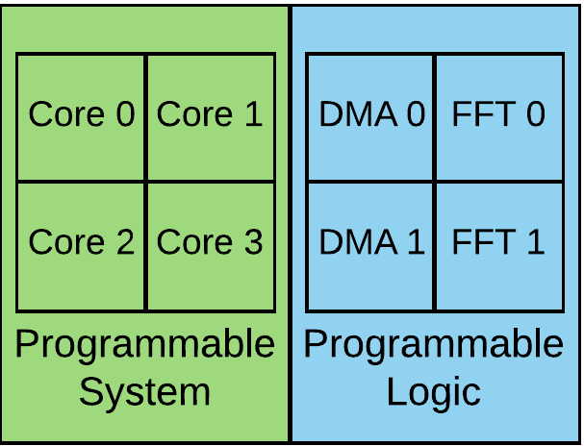
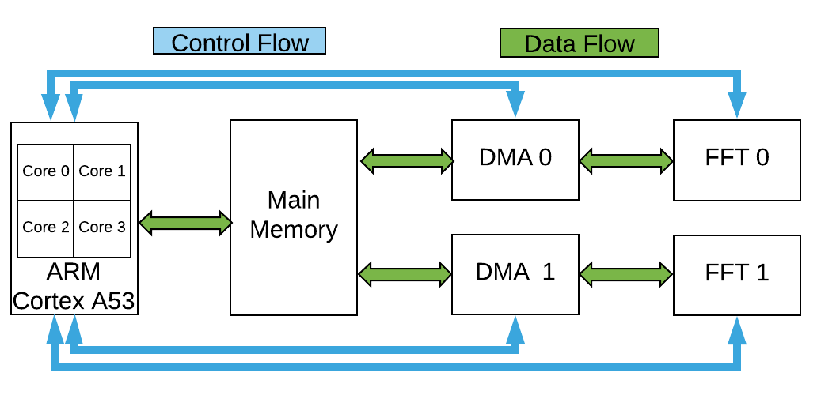
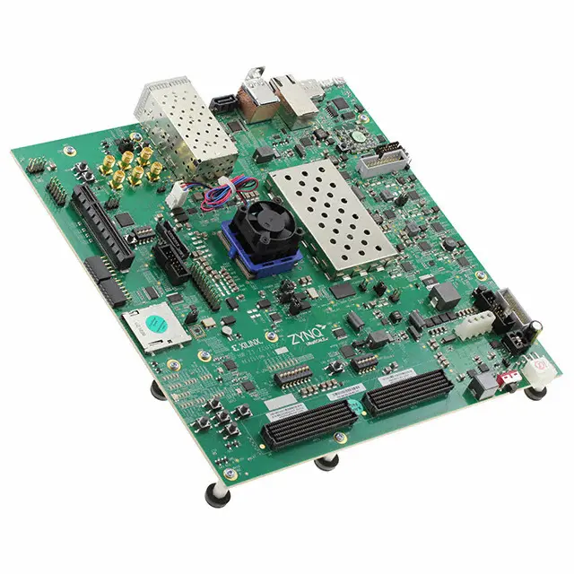
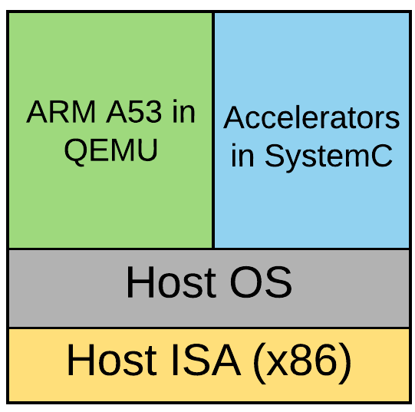
Target Design Flow and Validation Platforms
ZCU102
Rapid evaluation on COTS platforms
Framework portability
Trade-offs
Xilinx-Qemu
https://xilinx-wiki.atlassian.net/wiki/spaces/A/pages/18842109/QEMU+SystemC+and+TLM+CoSimulation
Notes:
Purpose: The purpose of our proposed framework is to enable developers to rapidly test out their hardware and software implementations for the target-DSSoC using COTS solutions.
Because our framework operates in the user-space, it can be rapidly ported across different hardware and virtual platforms.
Today’s evaluation: For today’s evaluation, we use the data flow shown in your left hand side as the target DSSoC data flow.
The target DSSoC is composed of two FFT accelerators and a quad core ARM CPU. We use DMA interface for bulk data transfer between accelerators and CPU and memory-mapped interface to program and monitor accelerators.
We use our framework to emulate this design on ots virtual platform and real-hardware platform to perform functional validation and derive performance estimates, respectively.
We emulate this design on a real FPGA on ZCU102. It is composed of a quad core arm CPU and programmable logic. We implement accelerators and DMA blocks of the target design on the programmable logic and use the quad-core ARM processor integrated in the xilinx MPSoC. We use this platform for performance evaluation and validating the implementations of the accelerators.
We use xilinx QEMU to conduct functional validation of our framework and also to demonstrate its portability. QEMU is used to run the applications and OS design for a target ISA on a host ISA. For our work, the host linux runs on x86 architecture and QEMU is used to emulate the system running on ARMv8. We write systemC codes to implement accelerators and DMA. QEMU and systemC implementation runs as independent processes.

Slide 33
Validation Approaches - QEMU (Functional Validation)
Standard C code
TraceAtlas
Fat Binary
Compilation
Execution
User-space Framework
Notes:
We begin by performing functional validation on the QEMU. ON your left hand side, we show the compilation and execution of a traditional monolithic C code of radar correlator and its execution on the CPU.
Next, we send this code though pur toolchain of kernel detection in TraceAtlas, code refactoring and fat binary generation and then user-space framework.
We run the use-space framework on the QEMU environment discussed earlier and compare the results with traditional execution.

Slide 34
Experimental Setup
Test Platform: ZCU102 board composed of Zynq Ultrascale+ MPSoC
Benchmarks: WiFi RX/TX, radar pulse doppler, and range detection
Emulation framework operation modes:
Validation: Simultaneously inject all the instances of test benchmarks
Performance: Time separated injections of test benchmarks
Periodic arrival with user-specified injection probability and period
User specified input tracefile
Resource pool: Three CPU cores and two FFT accelerators
Floating point FFTW library on the CPU side
Xilinx FFT IPs on the PL side
Notes:
For hardware evaluation, here we present our experimental setup.
As discussed earlier our test platform is ZCU102, It has xilinx MPSoC.
We generate realistic workload that is composed of four real applications. Wifi rx/tx, range detection and pulse doppler.
Our framework can operate in validation and performance mode.
In validation mode: we generate workload by simultaneously injecting multiple instances of real benchmarks.
In performance mode: workload is created by injecting benchmarks in serial but time separated manner. User can use the random workload generation feature inbuilt in the framework or provide a manual trace file.
Our resource pool is composed of three CPU core and two FFT accelerators as discussed earlier.

Slide 35
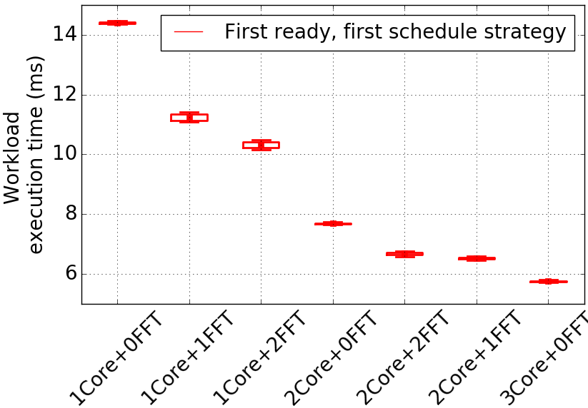
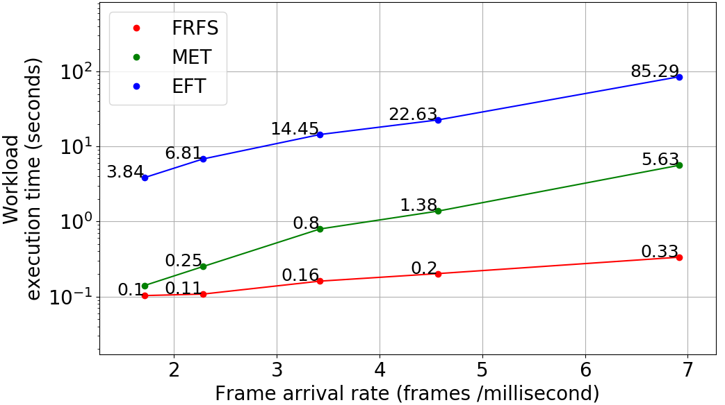
Performance Estimates on Zynq MPSoC
Target SoC Configuration Exploration in the validation mode
Scheduling Algorithm Exploration in performance mode
Notes:
Entire software stack coupled with the FPGA based SoC , now we demonstrate how we can quickly conduct design space exploration experiments to converge to a final hardware configuration for various workload scenarios and evaluate various scheduling strategies for the target DSSoC configuration. For this we first show the hardware configuration sweeping experiments where we change the number of cores and accelerators and measure execution time based on a simple scheduler. In the second experiment we change the job injection rate (define here) and evaluate various scheduling heuristics.

Slide 36
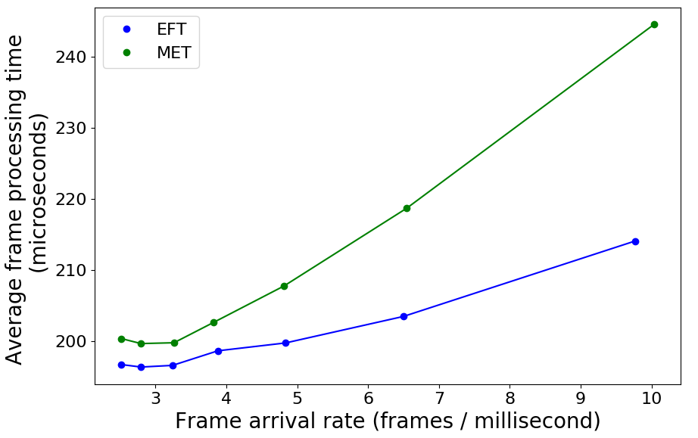
DS3 (Domain-Specific Systems-on-Chip Simulation Framework)
Discrete event simulator to simulate a DSSoC environment in the absence hardware platform to run the emulation framework
Enables the development of:
Scheduling algorithms
Dynamic thermal and power management policies
Design space exploration for energy and area trade-offs
https://github.com/segemena/DS3.git
https://dl.acm.org/doi/abs/10.1145/3349567.3351719
Notes:
In the absence of applications and above platforms, we also have a simulation tool DS3 that can be used to design and evaluate scheduling algorithms, power management policies and perform design space exploration for energy-performance and area trade-offs.

Slide 37
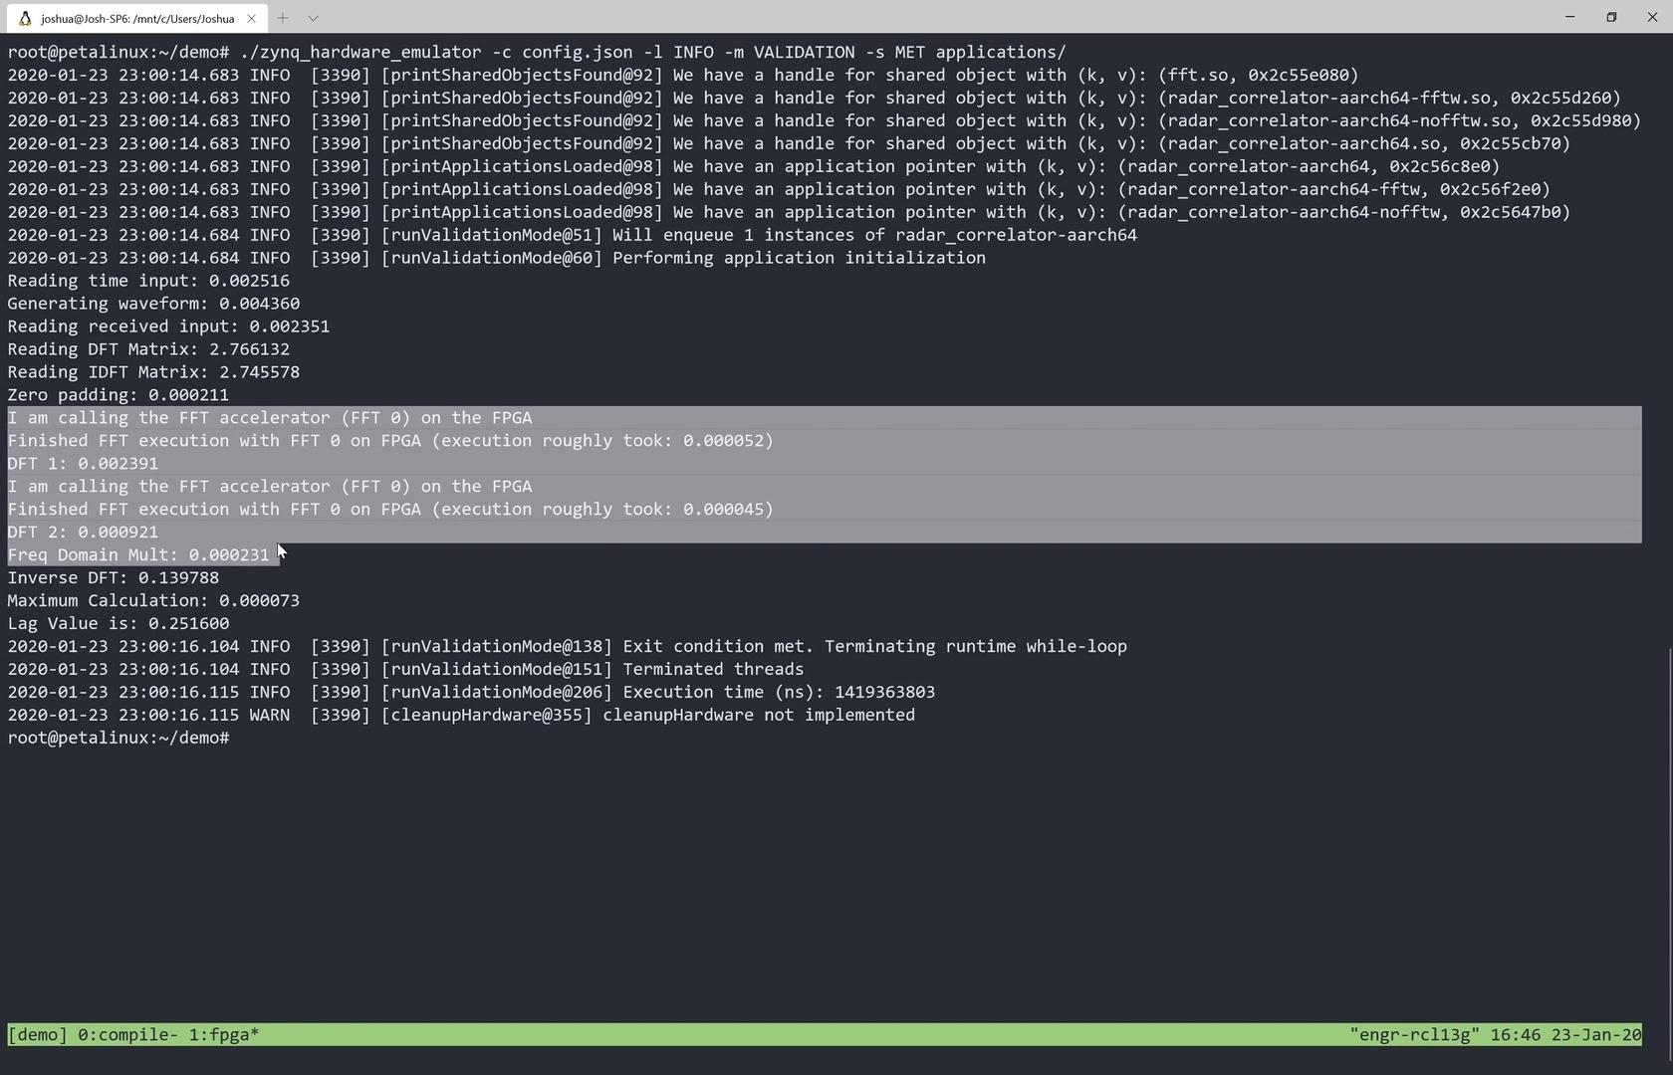
Demo
Notes:
Start with range detection C code show it
Show command line tracing, kernel extraction, compilation to shared object
Copy shared object to the zynq board where we have the user space run time available and just put the applications into the folder
And run and validate the output for fixed scheduler, fixed architecture one instance of range detection
Mention how we modify to run various workloads

Slide 38
Conclusions, & Future Work
Accomplishments & Current State:
Vertical integration of DSSoC prototyping platform
Next Release Goals:
More advanced applications
Stable integration of accelerator models and FPGA accelerators

Slide 39
Thank You!
Github Links:
TraceAtlas: https://github.com/ruhrie/TraceAtlas/
Linux Userspace Runtime: https://github.com/mackncheesiest/DSSoCEmulator/
Xilinx SystemC TLM Demo: https://github.com/Xilinx/systemctlm-cosim-demo/
DS3 Python Simulator: https://github.com/segemena/DS3
Paper Links:
TraceAtlas: https://arxiv.org/abs/2001.09995
DS3: https://dl.acm.org/doi/abs/10.1145/3349567.3351719

Slide 40
Backup

Slide 41
TraceAtlas - Kernel Detection
Algorithmic parameters
Window radius: sliding window used to define “relatedness” of basic blocks
Code coverage threshold: mutual affinity of basic blocks in a set
Hot code threshold: number of times a basic block should be executed to be considered “hot” and worth categorizing as a part of a kernel

Slide 42
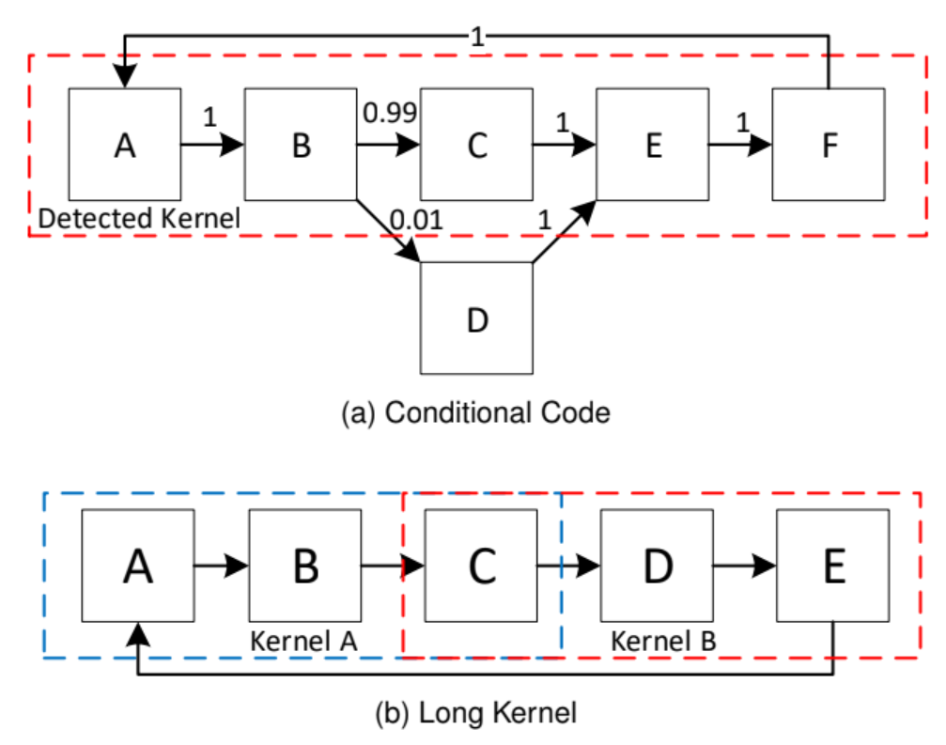
TraceAtlas - Kernel Legalization
Include rarely-executed conditionals in their related kernels
Merge long, uninterrupted sub-kernels into single kernels
Notes:
Is there a succinct way we can explain kernel legalization algorithmically or should we just stick to these examples that explain what its goals are?

