Slide 1
HPVM: Performance, Portability, Programmability and Approximation for Heterogeneous Parallel Systems
Vikram Adve
With:
Maria Kotsifakou, Hashim Sharif, ♣ Prakalp Srivastava, Adel Ejjeh, Akash Kothari, Benjamin Schreiber, Yifan Zhou
Sarita Adve and Sasa Misailovic
University of Illinois at Urbana-Champaign
♣Google Brain
Supported by: NSF, DARPA, SRC, ONR, Intel, Amazon

Slide 2

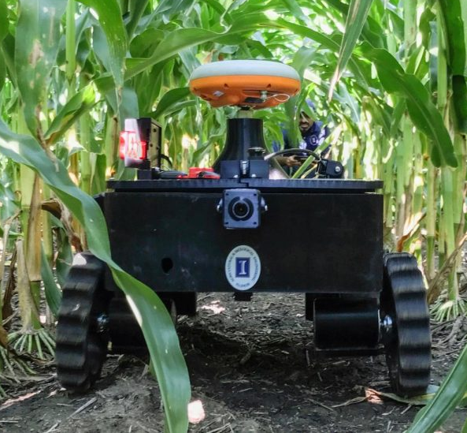

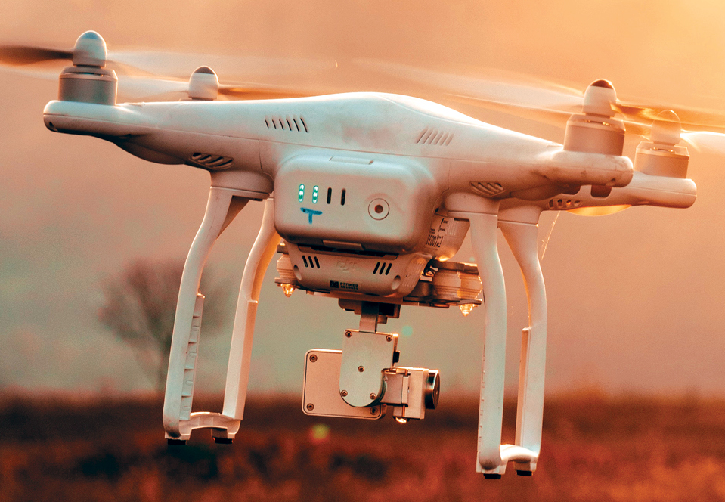
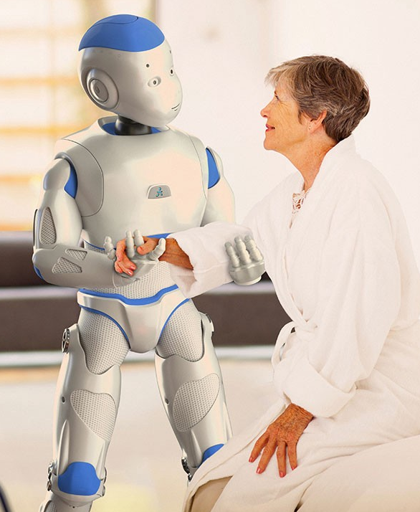
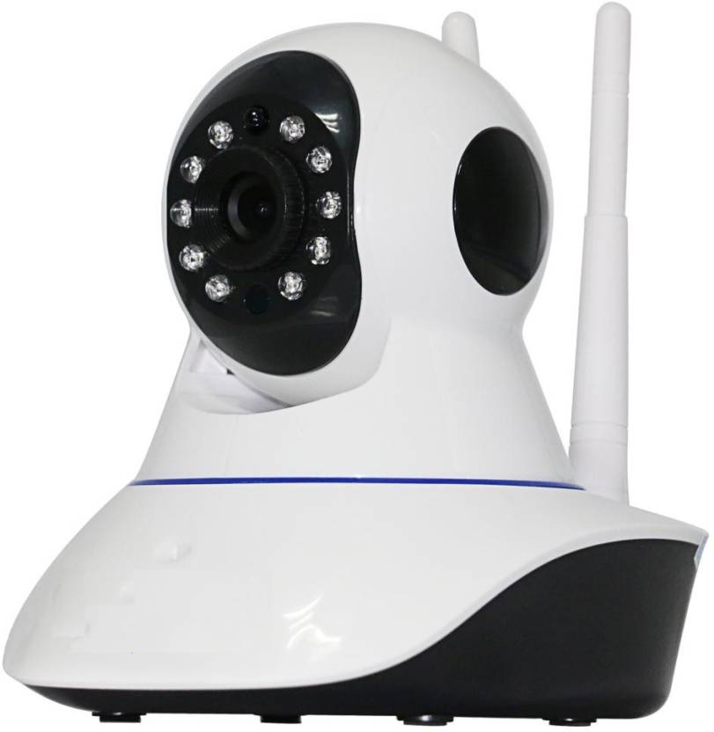
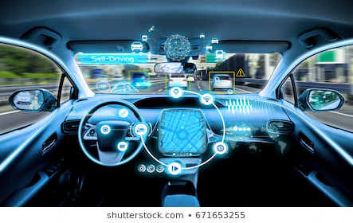
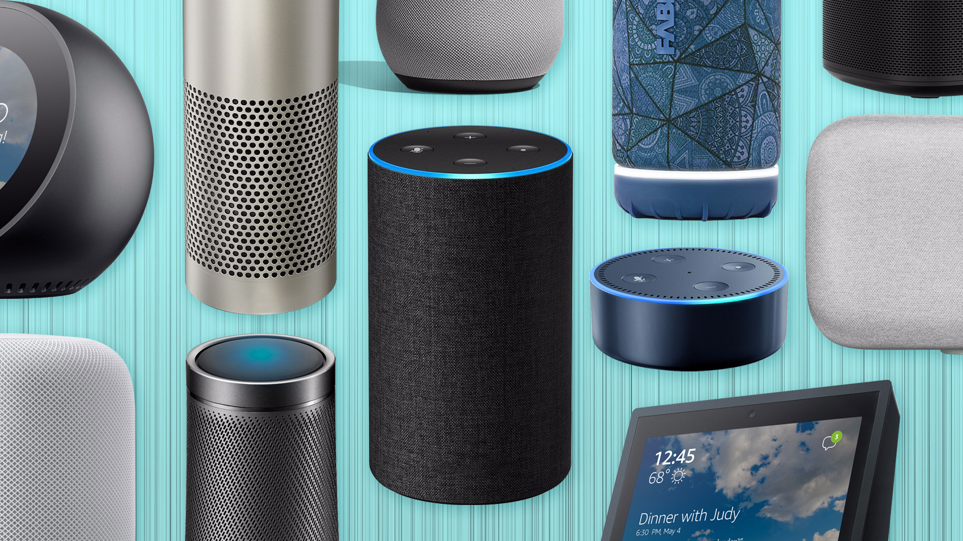
Heterogeneous SoCs are Ubiquitous
Heterogenous parallelism and specialization are critical for energy efficiency, performance

Slide 3
IBM EPOCHS Project: Autonomous Car SoC
DSSoC’s Full-Stack Integration
HPVM for
Programmability

Slide 4
Example: A Modern Mobile SOC
Incompatible memory systems
different hardware ISAs
Modem
CPU
CPU
GPU
Vector
Vector
A/V Hardware Accelerators
GPS
L1 Cache
L1 Cache
DSP
DSP
DSP
Multi-media
L2 Cache
Interconnect
different parallelism models
Main Memory
And different SoCs have different combinations of such hardware!
Key to Programmability and Portability:
Common abstractions for heterogeneous parallel hardware

Slide 5
Interface Levels and Key Benefit
App. productivity
Domain-specific prog. language
TensorFlow, MXNet, Halide, …
App. performance
General-purpose prog. language
CUDA, OpenCL, OpenAcc,
OpenMP, Python, Julia
Language innovation
Language-level Compiler IR
Delite DSL IR, XLA, TVM, …
Compiler investment
Language-neutral Compiler IR
Delite IR, HPVM, MLIR, OSCAR
Object-code portability
Virtual ISA
IBM’s MIR , PTX, HSAIL,
HPVM, SPIR
Hardware innovation
"Hardware" ISA
GPU ISAs, SIMD ISAs, TPU,
Domain-specific accelerators, …
…
CPUs + Vector SIMD Units
DSP
FPGA
GPU
Domain-specific Accelerators

Slide 6
At What Level Should We Abstract Away
Heterogeneous Parallelism?
Domain-specific prog. language
Too diverse
to define a
uniform interface
TensorFlow, MXNet, Halide, …
CUDA, OpenCL, OpenAcc,
OpenMP, Python, Julia, …
General-purpose prog. language
Delite DSL IR, XLA IR, TVM, …
Language-level Compiler IR
Delite IR, HPVM, MLIR, OSCAR
Language-neutral Compiler IR
Much more
uniform
IBM’s MIR, PTX,
HSAIL, SPIR, HPVM
Virtual ISA
GPU ISAs, SIMD ISAs, TPU,
Domain-specific accelerators, …
Hardware ISA
Also too diverse …
…
CPUs + Vector SIMD Units
DSP
FPGA
GPU
Domain-specific Accelerators

Slide 7
Existing Solutions for Heterogeneous Systems
General-purpose parallel languages lack high-level abstractions
  Designed for parallel computing experts
  OpenMP 4.5, OpenACC, …
“SIMT” prog. languages are GPU-friendly but expressivity is limited
  CUDA, OpenCL
DSLs attractive but still too technical for domain specialists
  TensorFlow, MXNet, Halide, …
Virtual ISAs enable portability and performance
  But current ones have expressivity problems of CUDA, OpenCL
  PTX, HSAIL, SPIR

Slide 8
LLVM Derivatives for Parallel Systems
System | Focus
LLVM | Short SIMD: SSE, AVX, Neon …
Polly | Polyhedral transforms, scheduling
Tapir | Homogeneous SMPs
OpenMP, OpenCL, CUDA | GPUs
LegUp | FPGAs
TensorFlow XLA | TPU, GPU
MLIR | Tensors, polyhedral transforms
None attempt to capture diverse heterogeneous parallelism

Slide 9
The HPVM Program Representation
A common parallel abstraction
Compiler IR + Virtual ISA + Run-time scheduling
hpvm.cs.Illinois.edu

Slide 10
Heterogeneous Parallel Virtual Machine
Goal: Programmability for Heterogeneous Parallel Systems
Keras
Halide
Other
DSLs
C+HPVM
TensorFlow
Use HPVM for:
Portable object code
Retargetable parallel compiler IR and system
Run-time scheduling
Front ends
HPVM
Virtual ISA
Translators
Runtime Scheduler
…
CPUs + Vector SIMD Units
DSP
FPGA
GPU
Domain-specific Accelerators
Kotsifakou et al., PPOPP 2018

Slide 11
Abstraction of Parallel Computation
Vector
Hierarchical
Dataflow Graph
with side effects
V_{A} = load <L4 x float>* A
V_{B} = load <L4 x float>* B
…
V_{C} = fmul <L4 x float> V_{A}, V_{B}
or
Graph nodes – coarse-grain or fine-grain computational tasks
Graph edges – explicit data transfer between nodes
Loads and stores – implicit communication via shared memory
Hierarchical – multiple levels of nested parallelism

Slide 12
HPVM Node Parallelism
Static Dataflow Graph
Dynamic Dataflow Graph (conceptual)
Node instantiation
[N]
1
2
N
Similar to instances of a CUDA or OpenCL kernel body
HPVM supports 1-3 dimensional grids: 1D, 2D, 3D, …
Notes:
A graph node represents a static computation, and any such node can be “instantiated” in a rectangular grid of dynamic node instances, representing independent parallel instances of the computation (in which case, the incident edges are instantiated as well, as described later).
The hierarchical dataflow graphs naturally capture all the important kinds of coarse- and fine-grain data and task parallelism in heterogeneous systems. In particular, the graph structure captures coarse-grain task parallelism (including pipelined parallelism in streaming computations); the graph hierarchy captures multiple levels and granularities of nested parallelism; the node instantiation mechanism captures either coarse- or fine-grain SPMD-style data parallelism; and explicit vector instructions within leaf nodes capture fine- grain vector parallelism (this can also be generated by automatic vectorization across independent node instances).
We also believe it maps well to FPGA and semi-custom hardware accelerators. We currently have two projects in the pipeline – one where we are using HPVM for code generation on FPGAs and another where we are compiling HPVM to a very novel mixed signal accelerator for ML
Essentially the hierarchical DFG abstraction of HPVM allows us to capture N different parallelism models through a single unified parallelism model

Slide 13
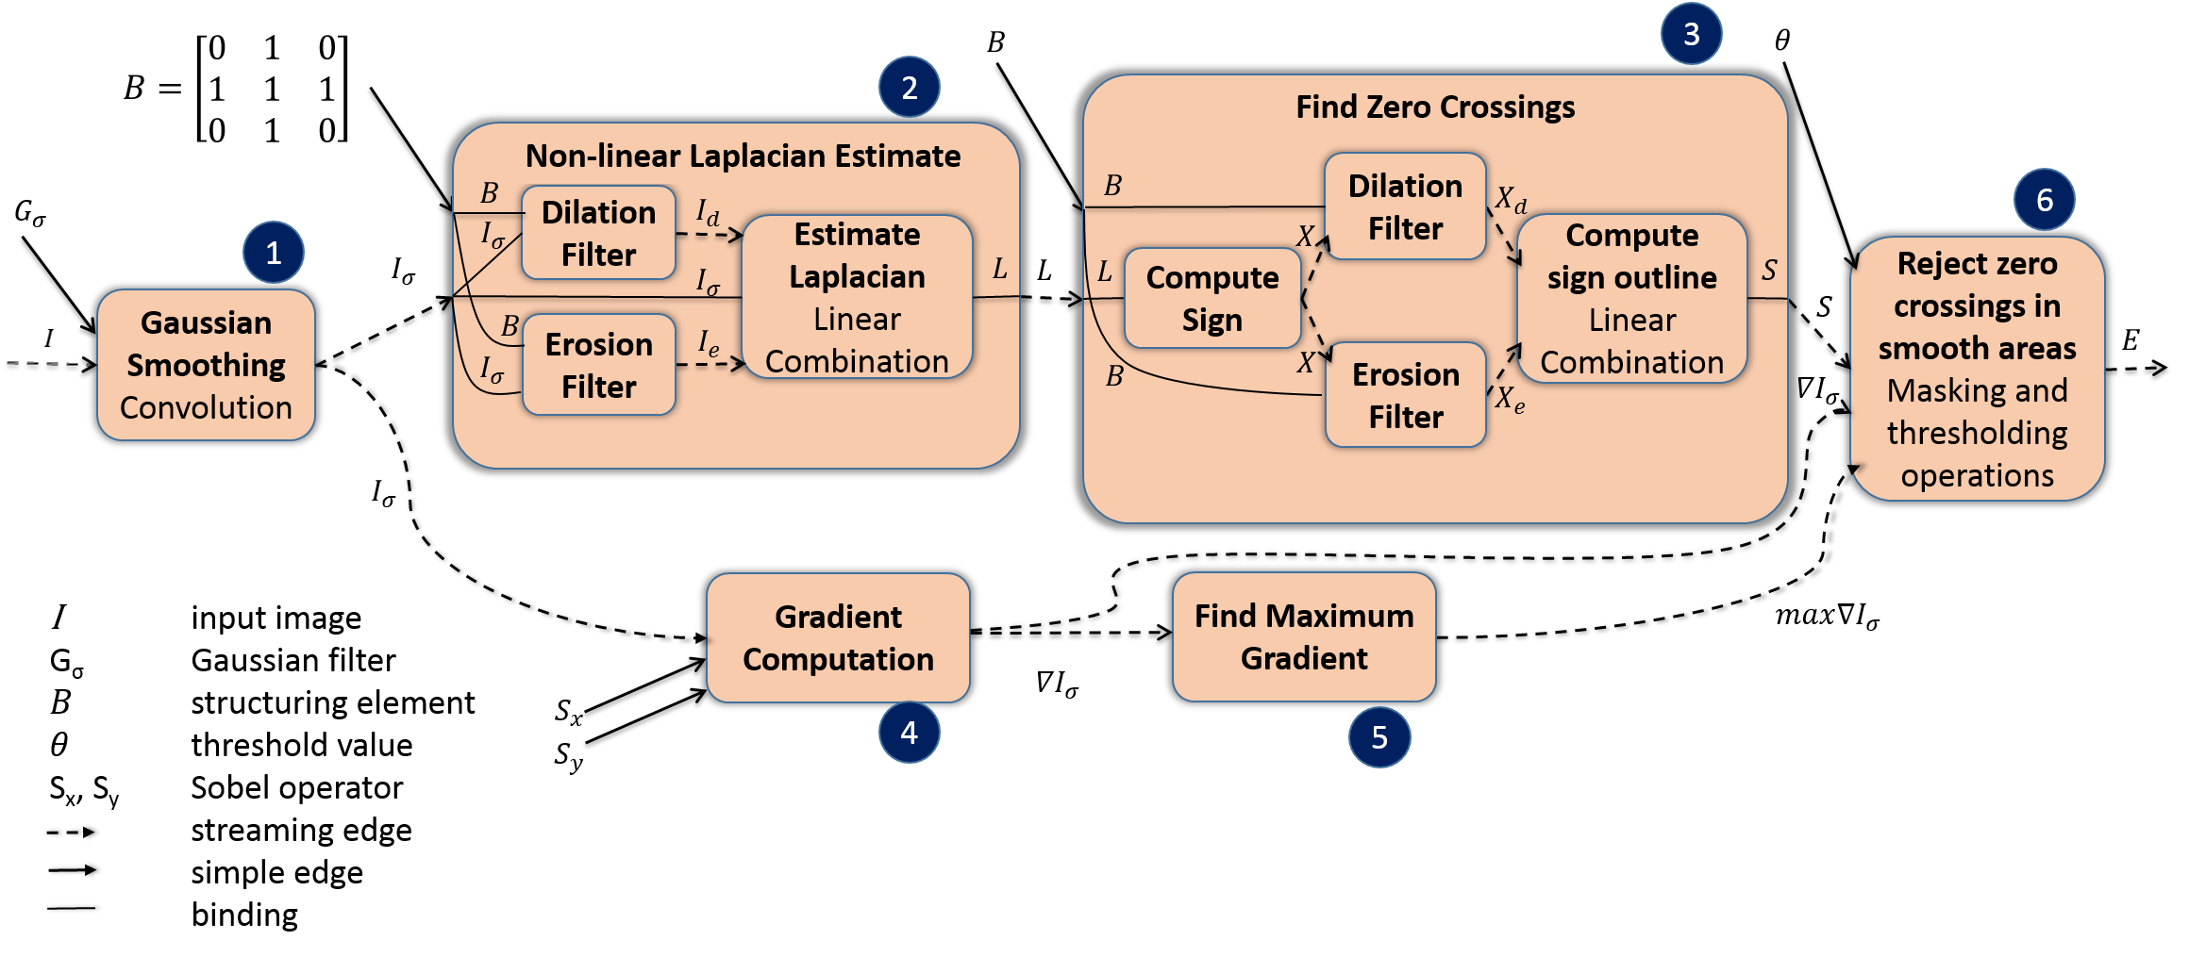
E.g., Edge Detection in Images
Pipelined (task) parallelism with streaming input images
Medium-grain data parallelism within pipeline stages
Fine-grain data parallelism in most stages

Slide 14
Extension of LLVM Virtual Instruction Set
  Express new instructions as LLVM intrinsic functions
Intrinsics for Constructing Graphs
i8* llvm.hpvm.createNode1D(i8* F, i32 n) | Create node with n dynamic instances executing node function F (similarly, llvm.hpvm.createNode2D/3D)
i8* llvm.hpvm.createEdge(i8* Src, i8* Dst, i1 ReplType, i32 sp, i32 dp, i1 isStream) | Create edge from output sp of node Src to input dp of node Dst.
void llvm.hpvm.bind.input(i8* N, i32 ip, i32 ic, i1 isStream) | Bind input ip of current node to input ic of child node N; similarly llvm.hpvm.bind.output
Intrinsics for Quering Graphs
i8* llvm.hpvm.getNode() | Return a handle to the current dataflow node
i8* llvm.hpvm.getParentNode(i8* N) | Return a handle to the parent of node N
i32 llvm.hpvm.getNumDims(i8* N) | Return the number of dimensions where N is replicated.
i64 llvm.hpvm.getNodeInstanceID.[xyz](i8* N) | Get index of current dynamic instance of node N in dimension x, y, or z
i64 llvm.hpvm.getNumNodeInstances.[xyz](i8* N) | Get number of dynamic instances of node N in dimension x, y, or z
Intrinsics for Memory Allocation and Synchronization
i8* llvm.hpvm.malloc(i64 nBytes) | Allocate a clock of memory of size nBytes and return pointer to it
i32 llvm.hpvm.atomic.xchg(i8* m, i32 v), i32 llvm.hpvm.atomic.add(i8* m, i32 v) … | Atomic swap, atomic fetch-and-add, etc on shared memory locations
void llvm.hpvm.barrier() | Local synchronization barrier across dynamic instances of current leaf node

Slide 15
Extension of LLVM Virtual Instruction Set
  Express new instructions as LLVM intrinsic functions
Intrinsics for Constructing Graphs
i8* llvm.hpvm.createNode1D(i8* F, i32 n) | Create node with n dynamic instances executing node function F (similarly, llvm.hpvm.createNode2D/3D)
i8* llvm.hpvm.createEdge(i8* Src, i8* Dst, i1 ReplType, i32 sp, i32 dp, i1 isStream) | Create edge from output sp of node Src to input dp of node Dst.
void llvm.hpvm.bind.input(i8* N, i32 ip, i32 ic, i1 isStream) | Bind input ip of current node to input ic of child node N; similarly llvm.hpvm.bind.output
Intrinsics for Quering Graphs
i8* llvm.hpvm.getNode() | Return a handle to the current dataflow node
i8* llvm.hpvm.getParentNode(i8* N) | Return a handle to the parent of node N
i32 llvm.hpvm.getNumDims(i8* N) | Return the number of dimensions where N is replicated.
i64 llvm.hpvm.getNodeInstanceID.[xyz](i8* N) | Get index of current dynamic instance of node N in dimension x, y, or z
i64 llvm.hpvm.getNumNodeInstances.[xyz](i8* N) | Get number of dynamic instances of node N in dimension x, y, or z
Intrinsics for Memory Allocation and Synchronization
i8* llvm.hpvm.malloc(i64 nBytes) | Allocate a clock of memory of size nBytes and return pointer to it
i32 llvm.hpvm.atomic.xchg(i8* m, i32 v), i32 llvm.hpvm.atomic.add(i8* m, i32 v) … | Atomic swap, atomic fetch-and-add, etc on shared memory locations
void llvm.hpvm.barrier() | Local synchronization barrier across dynamic instances of current leaf node
Intrinsics for Interacting with the Host
i8* llvm.hpvm.launch(i8* F, i8* args, i1 isStream) | Launch graph with function F asynchronously.
void llvm.hpvm.wait(i8* GraphID) | Wait for completion of graph GraphID
void llvm.hpvm.push(i8* GraphID, i8* args) | Push args as streaming input of graph GraphID
i8* llvm.hpvm.pop(i8* GraphID) | Read next streaming output of graph GraphID

Slide 16
Optimization and Code Generation
Source
program
Front
end
.ll (with HPVM intrinsics)
Developer site
User site
buildDFG module pass
Key:
any node
any device
reuse vendor
back ends
HPVM graph optimizer
Code-gen: Bottom-up on graph hierarchy
HPVM-to-
LLVM
HPVM-to-
SPIR
HPVM-to-
NVPTX
HPVM-to-
OpenCL
LLVM
X86-64
code-gen
Intel
AVX
code-gen
LLVM
PTX
code-gen
Altera
AOC
HLS tool
Intel Xeon E5 core i7
CPU
Intel
AVX
nVidia GeForce
GTX 680 GPU
Altera
FPGAs

Slide 17
Code Generation Strategy – HPVM to NVIDIA PTX
  Graph structure determines
    kernel function
    meaning of HPVM query intrinsics
Leverage NVPTX back-end
Kernel Code
Host Code
Leaf node function f
  Calls to OpenCL runtime
    kernel setup and call
  Encapsulate in node genFunc
  Expose to x86 backend
HPVM query intrinsics to
OpenCL function calls
Link with libclc
NVVM
NVPTX backend
PTX kernel

Slide 18
Code Generation Strategy – HPVM to OpenCL
  Graph structure determines
    kernel function
    meaning of HPVM query intrinsics
Leverage OpenCL back-end
Kernel Code
Host Code
Leaf node function f
  Calls to OpenCL runtime
    kernel setup and call
  Encapsulate in node genFunc
  Expose to x86 backend
HPVM query intrinsics to
OpenCL function calls
LLVM with OpenCL calls
OpenCL backend
OpenCL kernel
Notes:
Alternative version. For alternative path, targeting OpenCL backend

Slide 19
HPVM-C Front End
  Source to LLVM
hpvm.h
Declarations of HPVM
C/C++ functions
main.{c,cc}
clang
main.ll
HPVM-C source program,
containing HPVM function calls.
  LLVM to HPVM
Text representation of HPVM.
main.ll
opt -GenHPVM
main.hpvm.ll
Module Pass that converts the
HPVM-C function calls to HPVM intrinsics.

Slide 20
HPVM Compilation Steps
  Code Generation: HPVM to LLVM
Generated Host Module
main.hpvm.ll
opt -BuildDFG
[-LocalMem
-DFG2LLVM_NVPTX]
-DFG2LLVM_X86
-ClearDFG
main.host.ll
main.kernels.ll
Module Pass that converts the text representation
to the internal HPVM graph representation.
If GPU target is selected. Generates GPU kernel
for nodes executing on GPU and CPU host code
to launch the kernels in the host module.
Generated Kernel Module
Module Pass that generates either all, or
the remainder of the host module.
Module Pass that deletes the internal HPVM
representation from memory and the node
functions from the host module.
Notes:
(LocalMem is an analysis pass - returns information about the allocation nodes to the DFG2LLVM_NVPTX pass.)

Slide 21
HPVM Compilation: Final Linking
  Host Pre-link
Generated with clang
files.ll
Linked Host Module
llvm-link
main.host.linked.ll
main.host.ll
hpvm-rt.bc
HPVM runtime
  Final Code Generation (e.g., GPU)
main.host.linked.ll
clang (X86 backend)
main.host.linked
main.kernels.ll
llvm-cbe
main.kernels.cl

Slide 22
Flexible Node-to-Device Mapping
N graph nodes
K devices
Static or dynamic
mappings
Static: Single HPVM program permits K^{N} mappings
Dynamic: Modify mappings at run-time per node launch

Slide 23
Evaluation: Goals and Methodology
Multicore: Intel Xeon E5 core i7
Vector ISA: AVX
GPU: nVidia GeForce GTX 680 GPU; 1536 cores; 2GB
Comparisons with separate hand-tuned codes
  OpenCL (Parboil): SPMV, sgemm, stencil, lbm, bfs, tpacf, cutcp
  Hand-tuned for GPU: opencl_nvidia (5), opencl_base (2)
  Hand-tuned for AVX: Same version as GPU except stencil, bfs

Slide 24
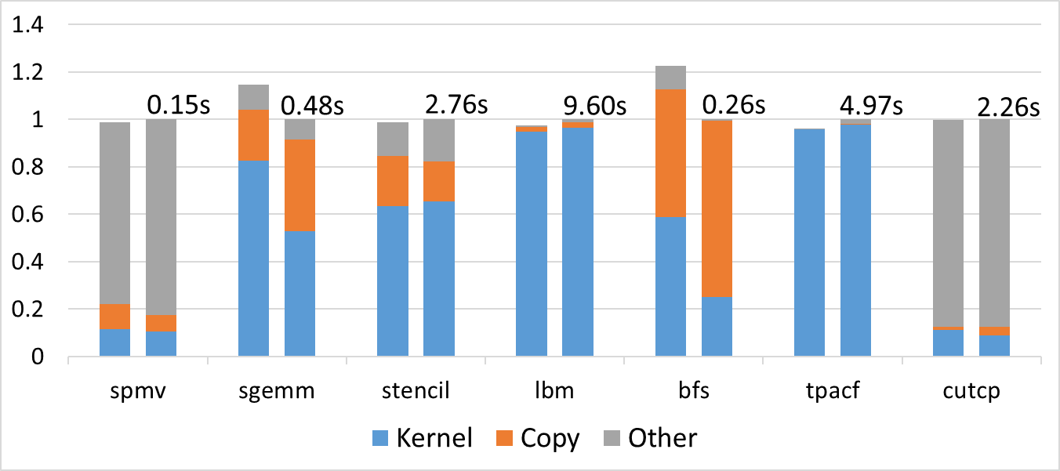
HPVM vs. Hand-tuned for GPU
Normalized Execution Time (left: HPVM; right: OpenCL baseline=1.0)
Lower is better
Within 22% of hand-tuned

Slide 25
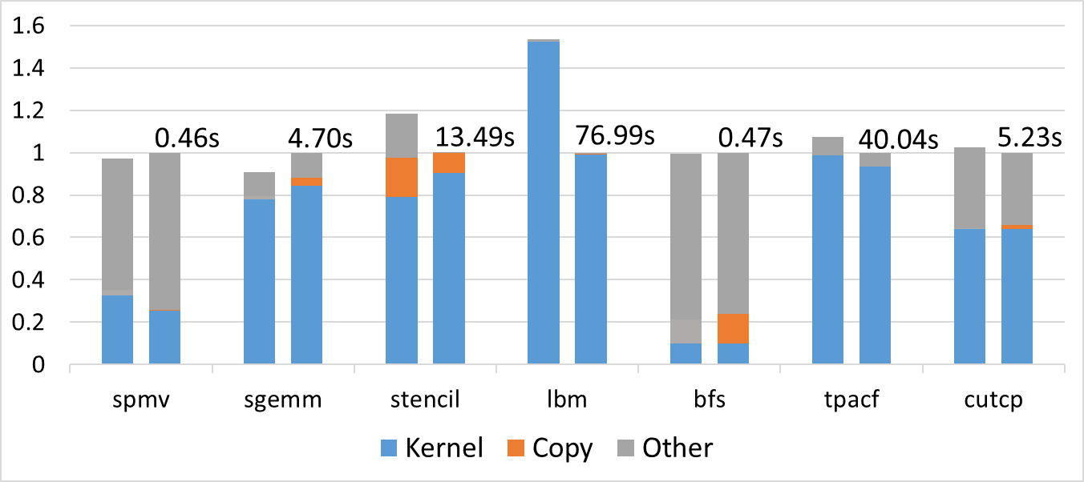
HPVM vs. Hand-tuned for Intel AVX
Normalized Execution Time (left: HPVM; right: OpenCL baseline)
Lower is better
Within 20% of hand-tuned except lbm

Slide 26
Evaluation: Goals and Methodology
Multicore: Intel Xeon E5 core i7
Vector ISA: AVX
GPU: nVidia GeForce GTX 680 GPU; 1536 cores; 2GB
Comparisons with separate hand-tuned codes
Flexible static scheduling
  Edge detection in grayscale images
  Map 6 pipeline stages to 3 PEs: Scalar, GPU, Vector
  3⁶ = 729 possible mappings from one program

Slide 27
Example: Static Scheduling of Graph Nodes
Map 6 pipeline stages to 3 hardware units: Scalar, GPU, Vector
3⁶ = 729 pipeline configurations from a single HPVM code
Bars show 7 of 729 configurations. Higher is better.
2
3
6
1
4
5
…
Frames / sec

Slide 28
Evaluation: Goals and Methodology
Multicore: Intel Xeon E5 core i7
Vector ISA: AVX
GPU: nVidia GeForce GTX 680 GPU; 1536 cores; 2GB
Comparisons with separate hand-tuned codes
Flexible static scheduling
Flexible dynamic scheduling

Slide 29
Example: Dynamic Scheduling of Instances
Scheduling granularity:
  Per (offloaded) node per data item
Data available to runtime policies:
  Node ID
  Data item number
  Any system monitor information available
Three example scheduling policies:
  Static Node Assignment Policy
  Static Data Item Assignment Policy
  Dynamic, on GPU when available (emulated)

Slide 30
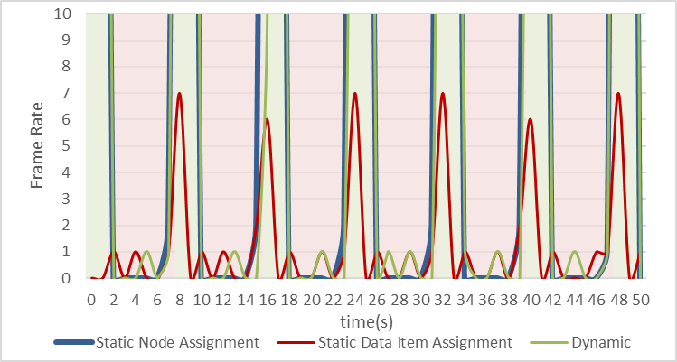
Dynamic Scheduling of Instances
Video stream of 1280 x 1280 grayscale frames
(By emulation) GPU availability alternates ON / OFF
ON
OFF

Slide 31
Dynamic Scheduling of Instances
Instantaneous frame rate for grayscale edge detection
ON
OFF
Flexible offline and online scheduling across hardware
Single performance-portable code representation
Expressive: several kinds of parallelism

Slide 32
Evaluation: Summary
Vector ISA: Intel Xeon E5 core i7 + AVX
GPU: nVidia GeForce GTX 680 GPU; 1536 cores; 2GB
Benchmarks: Parboil: SPMV, sgemm, stencil, lbm, bfs, tpacf, cutcp
Baseline: Separately hand-tuned OpenCL versions
HPVM performance comparable to hand-tuned codes
Flexible static scheduling: P^{N} static mappings for HPVM program of N nodes
Flexible dynamic scheduling: Can reassign DFG nodes flexibly under changing load
Notes:
Evaluation on PPOPP paper, i.e. NVPTX and SPIR, dynamic scheduling.

Slide 33
Open Source Release: HPVM v0.5
  https://gitlab.engr.illinois.edu/llvm/hpvm-release
HPVM IR + verify pass
LLVM-9 patches: v. small
Lowering: HPVM-C to DFG
Back-ends:
  NVIDIA GPU via OpenCL
  Intel / AMD host
Future: Intel AVX, Altera FPGAs
HPVM IR spec.
HPVM-C spec.
Installation guide
Test cases:
  Regression tests
  Unit tests
  Parboil
  Edge-detect image pipeline
  CAVA camera pipeline

Slide 34
Main Updates for Release
Port to LLVM 9.0
New LLVM-to-OpenCL back end using revived C back-end (from Julia project)
Better testing framework
HPVM graph optimizer
Code-gen: Bottom-up on graph hierarchy
HPVM-to-
SPIR
HPVM-to-
LLVM
HPVM-to-
OpenCL
Intel
AVX
code-gen
LLVM
X86-64
code-gen
NVIDIA
PTX
code-gen
Intel AVX
Intel Xeon E5 core i7
CPU
nVidia GeForce
GTX 680 GPU

Slide 35
Ongoing and Future Work
Ongoing 1: HPVM-to-FPGA code generation
Goal: Hardware-agnostic programming of FPGAs
Ongoing 2: Approximate computing support
Goal: Make accuracy-aware optimizations easier to use
Future 1: New DSL front-ends
Goal: Interoperable DSLs for complete edge applications
Future 2: MLIR integration
Goal: New back-ends for MLIR; polyhedral opts for HPVM

Slide 36
Possible Step: HPVM in MLIR
What is MLIR?
Multi-level IR: Framework for multiple interoperable IRs
Emphasis: Dense array, tensor operations
MLIR dialects
Dialects: namespaces with associated ops
Examples: “affine”, “llvm”, “linalg”, “gpu”, etc.
HPVM dialect:
goals
HPVM would benefit from polyhedral opts,
HPVM may get new front-ends (very few today)
MLIR may get more back-ends, e.g., FPGA, NPU
MLIR would get accuracy-aware optimizations

Slide 37
Summary
HPVM: portability + performance for heterogeneous systems
  virtual ISA
  compiler IR
  runtime representation
Questions?

Slide 38
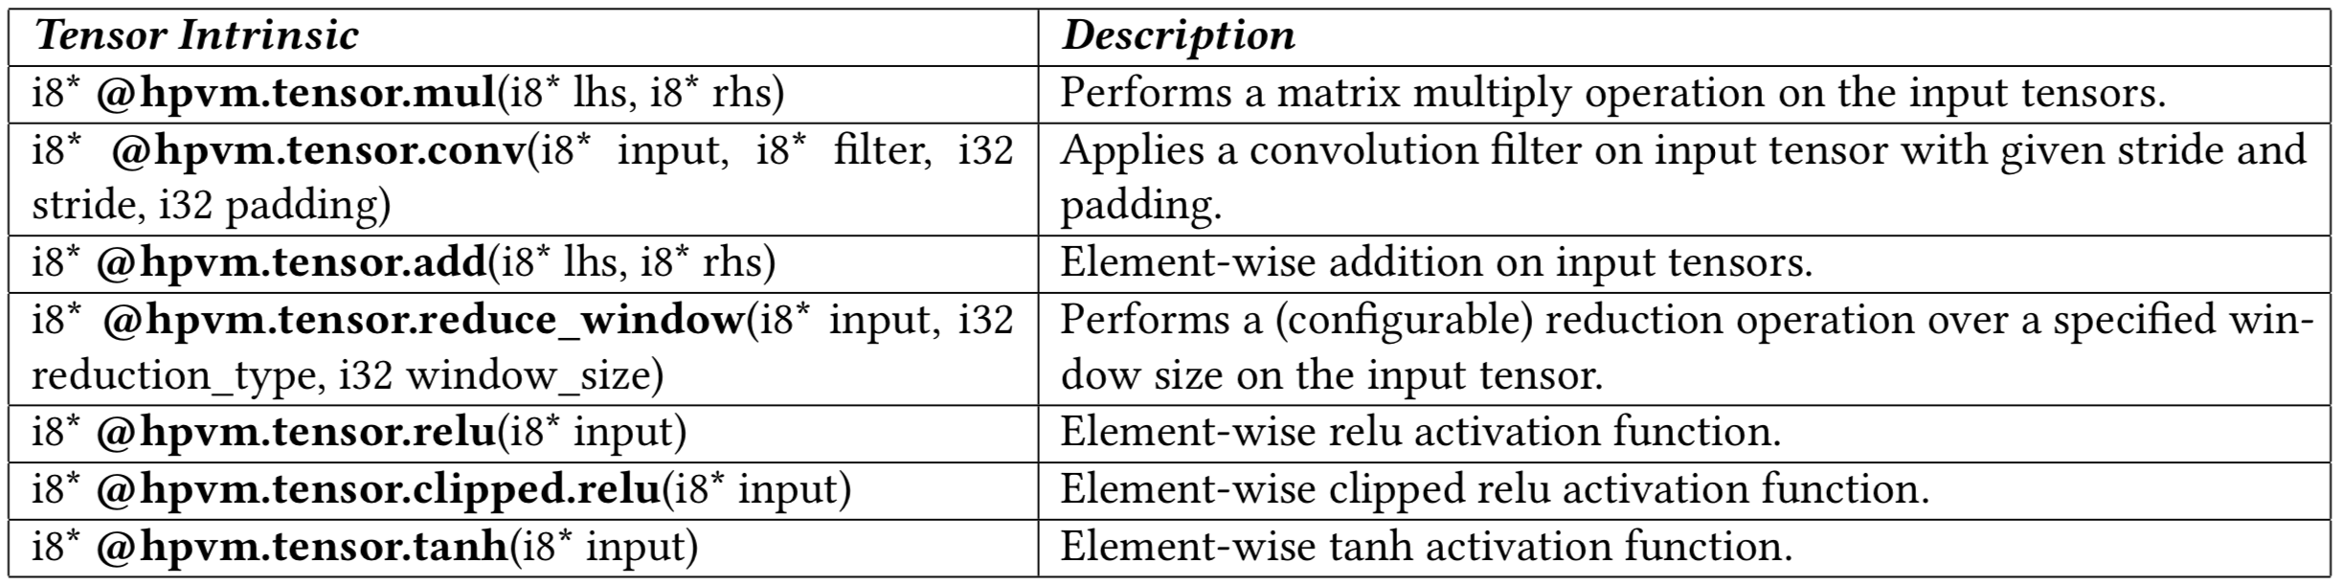


ApproxHPVM IR: Intrinsics & Quality Metrics
ApproxHPVM IR Tensor Intrinsics:
L₁ Error:
$$L_{1}^{e}= \frac{L_{1}(A −G)}{L_{1}(G)}$$
ApproxHPVM IR Portable
Quality metrics:
L₂ Error:
$$L_{2}^{e}= \frac{L_{2}(A −G)}{L_{2}(G)}$$

Slide 39
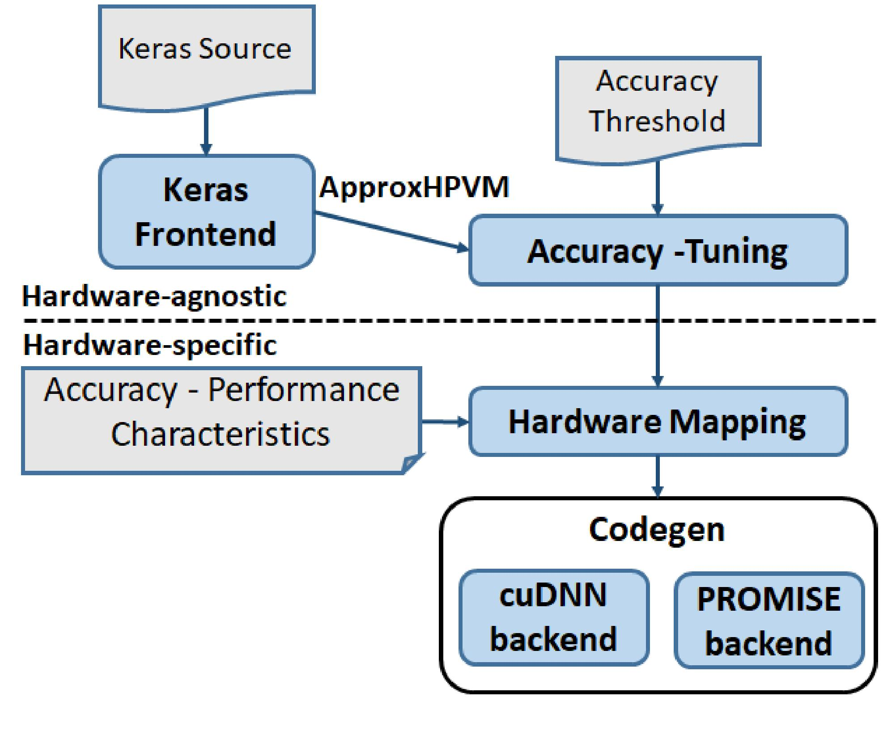
Keras Compiler Workflow

