Slide 1
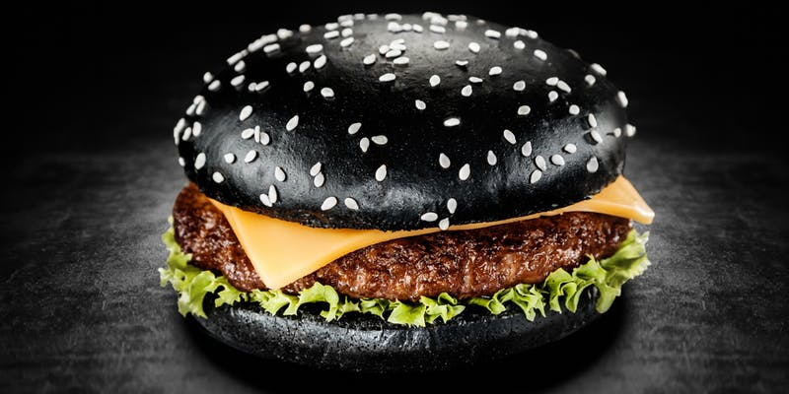
The Ultimate Guide
to HTTP Resource Prioritization
Robin Marx
@programmingart
FOSDEM 2020

Slide 2
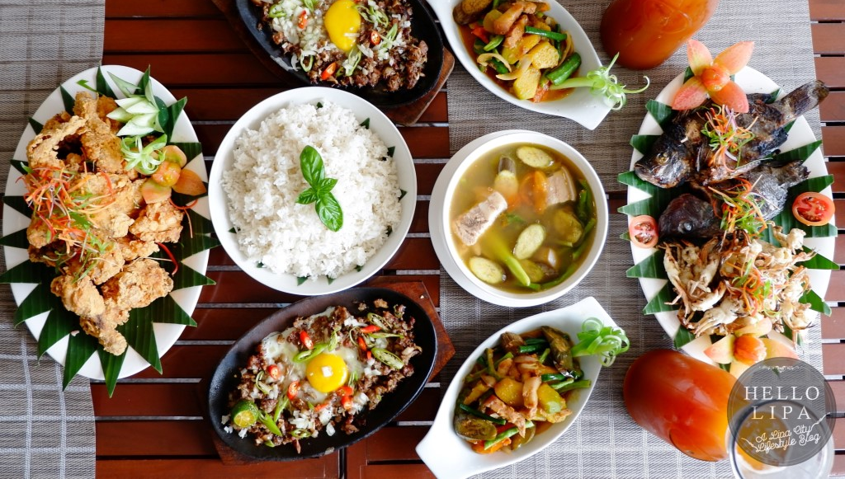

Slide 3
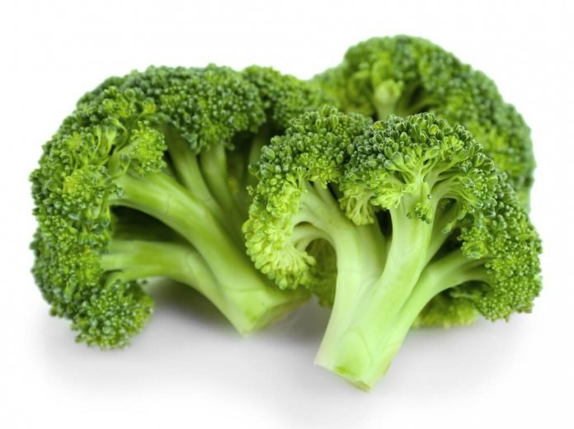
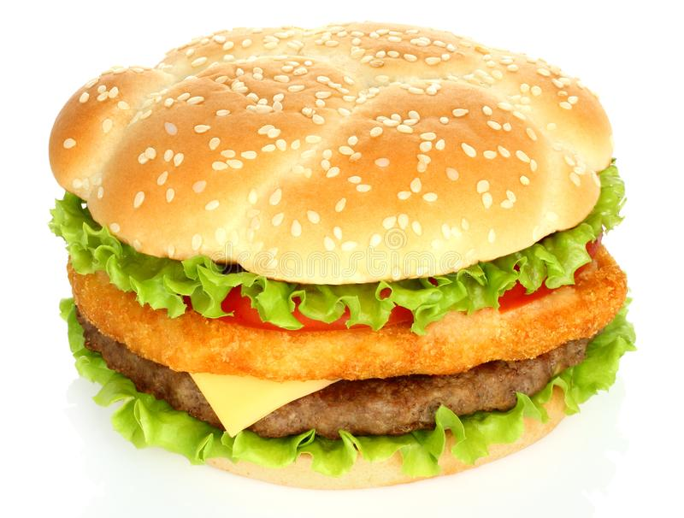
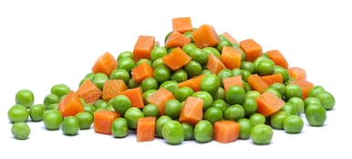
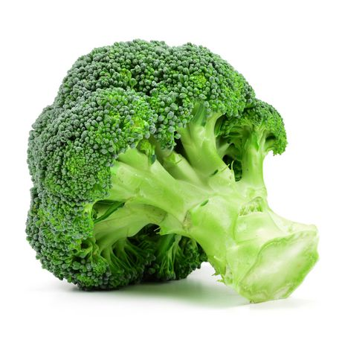
A healthy, well-balanced meal
time
me

Slide 4
A healthy, well-balanced meal
time
me
girlfriend

Slide 5
A healthy, well-balanced meal
time
me
girlfriend
sister

Slide 6
A healthy, well-balanced meal
time
me
girlfriend
sister
dad (aka: the lord of chaos)

Slide 7
HTML
JavaScript
CSS
Images
index.html
style.css
HTTP/1.1 (TCP)
parallel
script.js
image.jpg
HTTP/2 (TCP)
HTTP/3 (QUIC)
multiplexed
Notes:
- H2 and H3 use a single underlying connection: can’t send stuff at the same time, needs to somehow be ordered on the wire

Slide 8
Problem 1:
What is the best multiplexing approach?

Slide 9
HTML
JavaScript
CSS
Images
time
arrives first
arrives last
Sequential
Fair Round-Robin
Unfair Round-Robin
Combinations

Slide 10
HTML
JavaScript
CSS
Images
time
<head> <script src=“script.js” />
<link rel="stylesheet" href=“style.css” />
</head>
<body>
<img src=“progressive1.jpg” />
<img src=“progressive2.jpg” />
</body>
Render blocking
Notes:
JS and CSS render blocking, nothing is shown until they are in, so they go in full and first

Slide 11
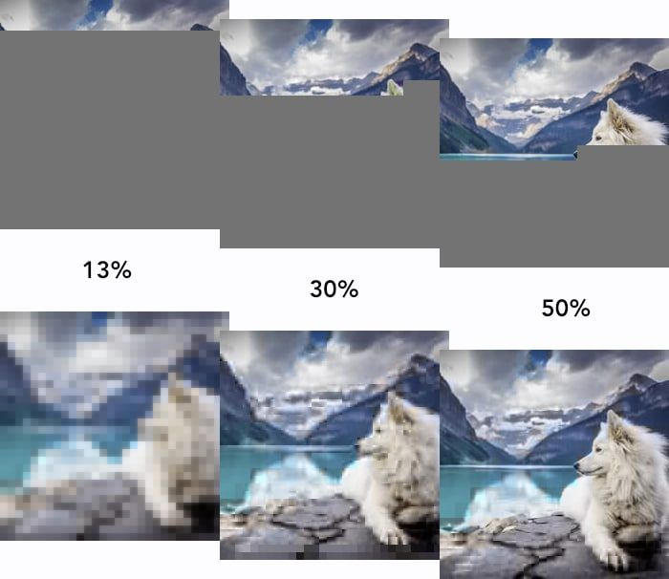
Progressive jpeg example
normal (scanline)
progressive
https://blog.cloudflare.com/parallel-streaming-of-progressive-images/ https://tobias.is/blogging/even-faster-images-using-http2-and-progressive-jpegs/

Slide 12
HTML
JavaScript
CSS
Images
time
<head> <script src=“script.js” />
<link rel="stylesheet" href=“style.css” />
</head>
<body>
<img src=“progressive1.jpg” />
<img src=“progressive2.jpg” />
</body>
Render blocking
done
done
Best if progressive (~25%)
Best if not (~75%)
(~70 million jpegs in HTTP archive) https://twitter.com/programmingart/status/1222545046651785216?s=20
Notes:
Images are progressive, so can round robin (question: what if they cannot be rendered progressively though… no way for the browser to really know)
It gets worse

Slide 13
HTML
JavaScript
CSS
Images
time
<head> <script src=“script.js” />
<link rel="stylesheet" href=“style.css” />
</head>
<body>
<img src=“progressive1.jpg” />
<img src=“progressive2.jpg” />
</body>
Render blocking
done
Notes:
What do we do with HTML? Can’t render it until JS and CSS are done, so maybe that’s the best option.
However, browsers do have a look-ahead parser to discover other resources (like the images), so… maybe best to fetch HTML first before rest?

Slide 14
HTML
JavaScript
CSS
Images
time
<head> <script src=“script.js” />
<link rel="stylesheet" href=“style.css” />
</head>
<body>
<img src=“progressive1.jpg” />
<img src=“progressive2.jpg” />
<script src=“later.js” async />
</body>
Render blocking
Notes:
W

Slide 15
HTML
JavaScript
CSS
Images
Data
time
<head> <script src=“script.js” />
<link rel="stylesheet" href=“style.css” />
</head>
<body>
<img src=“progressive1.jpg” />
<img src=“progressive2.jpg” />
<script src=“later.js” async />
</body>
Render blocking
fetch(“data.json”)
RE-PRIORITIZATION
Notes:
Can also happen during page load: user scrolls down, images that are now visible should for example get higher priority

Slide 16
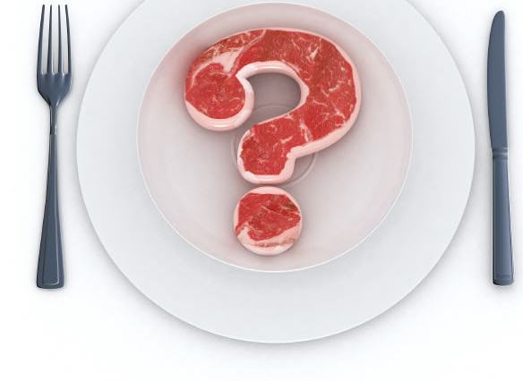
Browser doesn’t know
Size of resource
If the resource can be used progressively
What the resource will actually do
If the resource references other resources
The “critical path”
http://web.mit.edu/polaris/
https://www.usenix.org/system/files/conference/nsdi13/nsdi13-final177.pdf
https://www.usenix.org/system/files/conference/nsdi16/nsdi16-paper-wang-xiao-sophia.pdf https://hacks.mozilla.org/2017/09/building-the-dom-faster-speculative-parsing-async-defer-and-preload/

Slide 17
Browser doesn’t know
Size of resource
If the resource can be used progressively
What the resource will actually do
If the resource references other resources
The “critical path”
So it has to guess
Mime-type
Position in the document
How it hopes developers use things like async, defer, preload, …
http://web.mit.edu/polaris/
https://www.usenix.org/system/files/conference/nsdi13/nsdi13-final177.pdf
https://www.usenix.org/system/files/conference/nsdi16/nsdi16-paper-wang-xiao-sophia.pdf https://hacks.mozilla.org/2017/09/building-the-dom-faster-speculative-parsing-async-defer-and-preload/

Slide 18
Browser heuristics
highest
HTML, CSS, fonts | HTML | HTML
JS before img 1, fetch | JS, CSS | CSS, <head> JS
visible img | fonts, fetch | fonts
JS after img 1 | img | img
invisible img, async, defer |  | fetch, <body> JS
lowest
https://css-tricks.com/the-critical-request/
https://speeder.edm.uhasselt.be/www18/files/h2priorities_mwijnants_www2018.pdf
https://medium.com/reloading/preload-prefetch-and-priorities-in-chrome-776165961bbf
Notes:
General trends, but some differences, as expected. Especially Fetch is interesting, fonts as well.

Slide 19
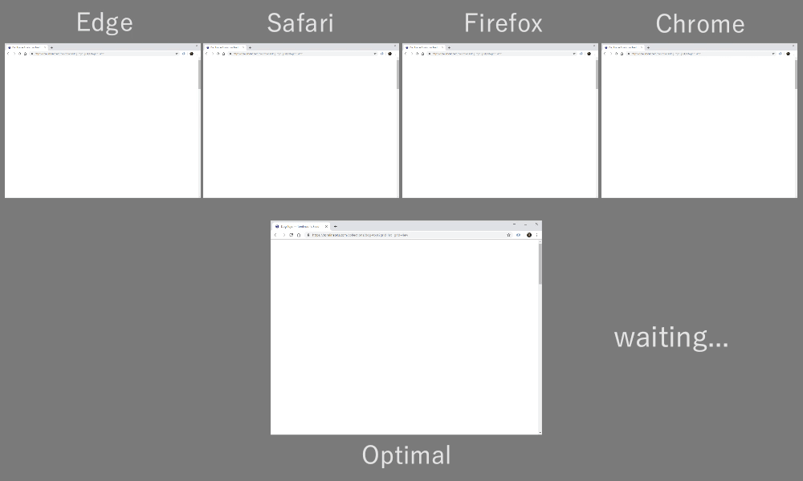
Which one is best?
https://blog.cloudflare.com/better-http-2-prioritization-for-a-faster-web/
Notes:
Very simple answer, just look at this! Clearly right to left, but small differences in chrome vs firefox

Slide 20
Browser heuristics
highest
HTML, CSS, fonts | HTML | HTML
JS before img 1, fetch | JS, CSS | CSS, <head> JS
visible img | fonts, fetch | fonts
JS after img 1 | img | img
invisible img, async, defer |  | fetch, <body> JS
lowest
sequential
naïve unfair RR
complex unfair RR
fair RR (H2 default)
Notes:
However, real differences show up in how they actually want these things to be sent… only chrome is sequential, rest has quite a lot of RR…
This is weird, since in our example, we used RR only for progressive images…

Slide 21
Round-Robin is bad!
parse + compile
EXECUTE
parse + compile
EXECUTE

Slide 22
Round-Robin is bad!?
parse + compile
EXECUTE
parse + compile
parse + compile
parse + compile
parse + compile
EXECUTE
parse + compile
EXECUTE
https://v8.dev/blog/v8-release-78
https://medium.com/reloading/javascript-start-up-performance-69200f43b201

Slide 23
Is Round-Robin bad?
done
done
Notes:
If wildly differing sizes : smaller ones will get in early (depends on situation if that’s good)
if not, things can get stuck behind big resources, browser doesn’t know (andy davies blogpost: preloading a large video)
The other way around: if similar size and RR-ing between them: hero images can be delayed…
Better if site creators mess up accidentally (e.g., preload that ginormous video)
Final reason: see end of the presentation

Slide 24
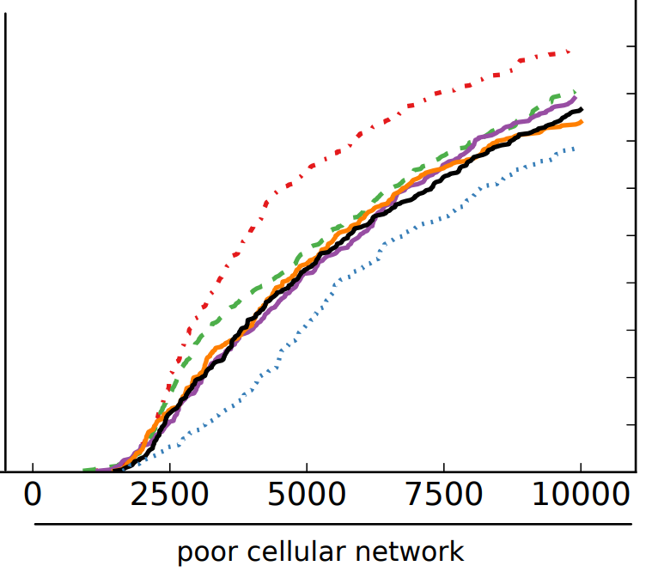
Heuristics = on average
FASTER
N = 40
Everything else
Fair Round-Robin
SLOWER
https://h3.edm.uhasselt.be/ https://speeder.edm.uhasselt.be/www18
Notes:
Of course, that was not very nuanced… other webpages look differently, have different requirements -> need to look at how heuristics perform on-average across many sites

Slide 25
Heuristics = on average
FASTER
N = 40
Average speedup factor for Above-the-fold resources
BETTER
x2.3
SLOWER
x2
x1.5
x1.22
Fair Round-Robin
x1
https://h3.edm.uhasselt.be/ https://speeder.edm.uhasselt.be/www18

Slide 26
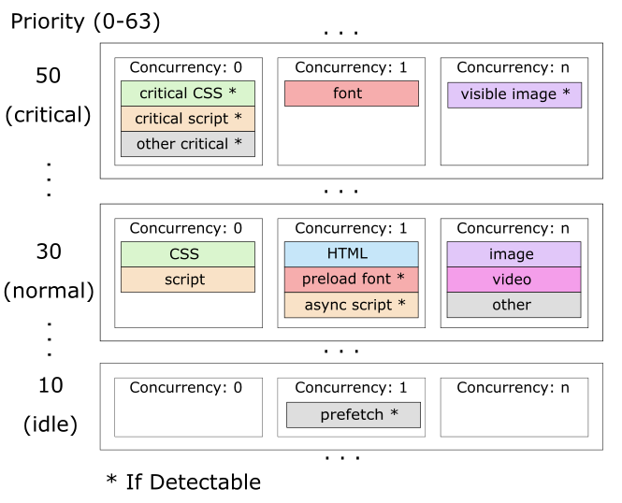
Heuristics = on average
Sequential for CSS/Script
+ Complex Weighted RR for rest
https://blog.cloudflare.com/better-http-2-prioritization-for-a-faster-web/

Slide 27
Heuristics = on average
Sequential for CSS/Script
+ Complex Weighted RR for rest
“ 50% faster by default, particularly for Edge and Safari is not unusual
”
https://blog.cloudflare.com/better-http-2-prioritization-for-a-faster-web/

Slide 28
Heuristics = on average
N = 96
“The prioritizing scheduler beat the random scheduler on only 31% of pages tested
N = ?
“ Chrome’s approach is better than fair RR, but only up to 2.69%
”
2016
”
“ Maximum benefit was 3.1%, even compared to LIFO
”
2019
https://datatracker.ietf.org/meeting/106/materials/slides-106-httpbis-sessa-priorities-00.pdf https://docs.google.com/document/d/1oLhNg1skaWD4_DtaoCxdSRN5erEXrH-KnLrMwEpOtFY
Notes:
So no big differences. Might explain why e.g., chrome isn’t doing RR or others haven’t updated their schemes to something more complex
See conclusion at the end.

Slide 30
How can you find out if you have a problem?
Test your pages webpagetest.org

Slide 31
Some (imperfect) client-side options
1. Async, Defer
2. Preload
But:
Bugs! (too aggressive)
Browser support
https://wicg.github.io/priority-hints/ https://web.dev/native-lazy-loading/
https://bugzilla.mozilla.org/show_bug.cgi?id=1405761 https://twitter.com/domfarolino/status/1221803122638508032?s=20 https://andydavies.me/blog/2019/02/12/preloading-fonts-and-the-puzzle-of-priorities/
Notes:
Irony: browser that generally does best, is the one with the most options for changing stuff…
Examples from priority-hints
Carousel images
I have seen one site that set the hero image as a CSS background-image with CSS on the bottom of the page…
Brilliant if intentional! Quite bad if wasn’t…
Can also lazy-load e.g., CSS via custom hacks

Slide 32
Some (imperfect) client-side options
1. Async, Defer
2. Preload
But:
Bugs! (too aggressive)
Browser support
3. Priority hints
But:
Possibly not fine-grained enough
Browser support
https://wicg.github.io/priority-hints/ https://web.dev/native-lazy-loading/
https://bugzilla.mozilla.org/show_bug.cgi?id=1405761 https://twitter.com/domfarolino/status/1221803122638508032?s=20 https://andydavies.me/blog/2019/02/12/preloading-fonts-and-the-puzzle-of-priorities/
Notes:
Irony: browser that generally does best, is the one with the most options for changing stuff…
Examples from priority-hints
Carousel images
I have seen one site that set the hero image as a CSS background-image with CSS on the bottom of the page…
Brilliant if intentional! Quite bad if wasn’t…
Can also lazy-load e.g., CSS via custom hacks

Slide 33
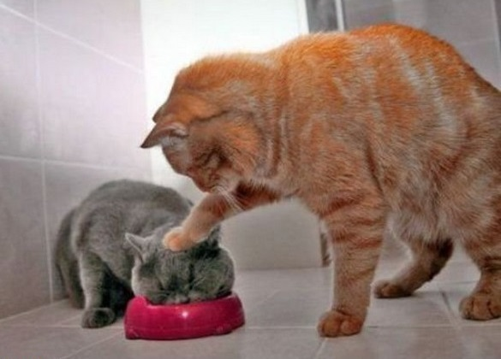
Server-side overrides
https://www.shimmercat.com/blog/coordinated-image-loading.html
https://blog.cloudflare.com/parallel-streaming-of-progressive-images/
https://blog.cloudflare.com/better-http-2-prioritization-for-a-faster-web/
https://h2o.examp1e.net/configure/http2_directives.html#http2-reprioritize-blocking-assets

Slide 34
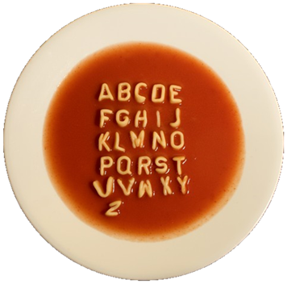
Problem 2: How to communicate this to the server?

Slide 35
origin
Please serve resources
in this order
Notes:
How do you communicate this to the server concretely?

Slide 36
8 PRIORITY LEVELS
Possible mapping
highest
0 | HTML
1 | CSS
2 | JavaScript
3 | fonts
4 | fetch
5 | images
6 | async and defer JS
7 | video
lowest
origin
Please serve resources
in this order
Notes:
SPDY’s simple model doesn’t work:
How to specify sequential vs round robin?
How to specify unfair round robin?
How to support re-prioritization effectively?
How to specify Server Push priorities?
How to work around unfairness for multiplexed connections? (see next slides)

Slide 37
fair
0
1
1
2
4
6
CDN
origin
https://tools.ietf.org/html/draft-chan-http2-stream-dependencies-00
https://lists.w3.org/Archives/Public/ietf-http-wg/2013JanMar/0554.html
https://lists.w3.org/Archives/Public/ietf-http-wg/2013JanMar/0560.html
https://lists.w3.org/Archives/Public/ietf-http-wg/2019AprJun/0113.html

Slide 38
unfair
0
0
0
0
1
2
“everything is of highest priority”
CDN
origin
https://tools.ietf.org/html/draft-chan-http2-stream-dependencies-00
https://lists.w3.org/Archives/Public/ietf-http-wg/2013JanMar/0554.html
https://lists.w3.org/Archives/Public/ietf-http-wg/2013JanMar/0560.html
https://lists.w3.org/Archives/Public/ietf-http-wg/2019AprJun/0113.html

Slide 39
fair but useless
“everything is of highest priority”
0
0
0
0
0
0
“everything is of highest priority”
“everything is of highest priority”
origin
CDN
https://tools.ietf.org/html/draft-chan-http2-stream-dependencies-00
https://lists.w3.org/Archives/Public/ietf-http-wg/2013JanMar/0554.html
https://lists.w3.org/Archives/Public/ietf-http-wg/2013JanMar/0560.html
https://lists.w3.org/Archives/Public/ietf-http-wg/2019AprJun/0113.html

Slide 40
HTTP/2 : The Dependency Tree Awakens
HTML
CSS
200
100
2:1 RR ratio
Hero Image
JavaScript
https://tools.ietf.org/html/draft-chan-http2-stream-dependencies-00

Slide 41
HTML
JavaScript
CSS
GET this file and
add as child of CSS, with weight 100
200
Hero Image
origin
Please serve resources
in this order
Notes:
How do you communicate this to the server concretely?

Slide 42
CDN
fair and useful
100
100
100
HTML
HTML
HTML
CSS
CSS
Hero Image
JavaScript
CSS
JavaScript
Hero Image
JavaScript
Notes:
Even solves the fairness issue in an elegant way! Nice!

Slide 43
BUT: isn’t actually used that way
Notes:
Isn’t actually used at scale this way.
Many CDNs still use HTTP/1.1 to the origin and those that do use HTTP/2, don’t mess with priorities.

Slide 44
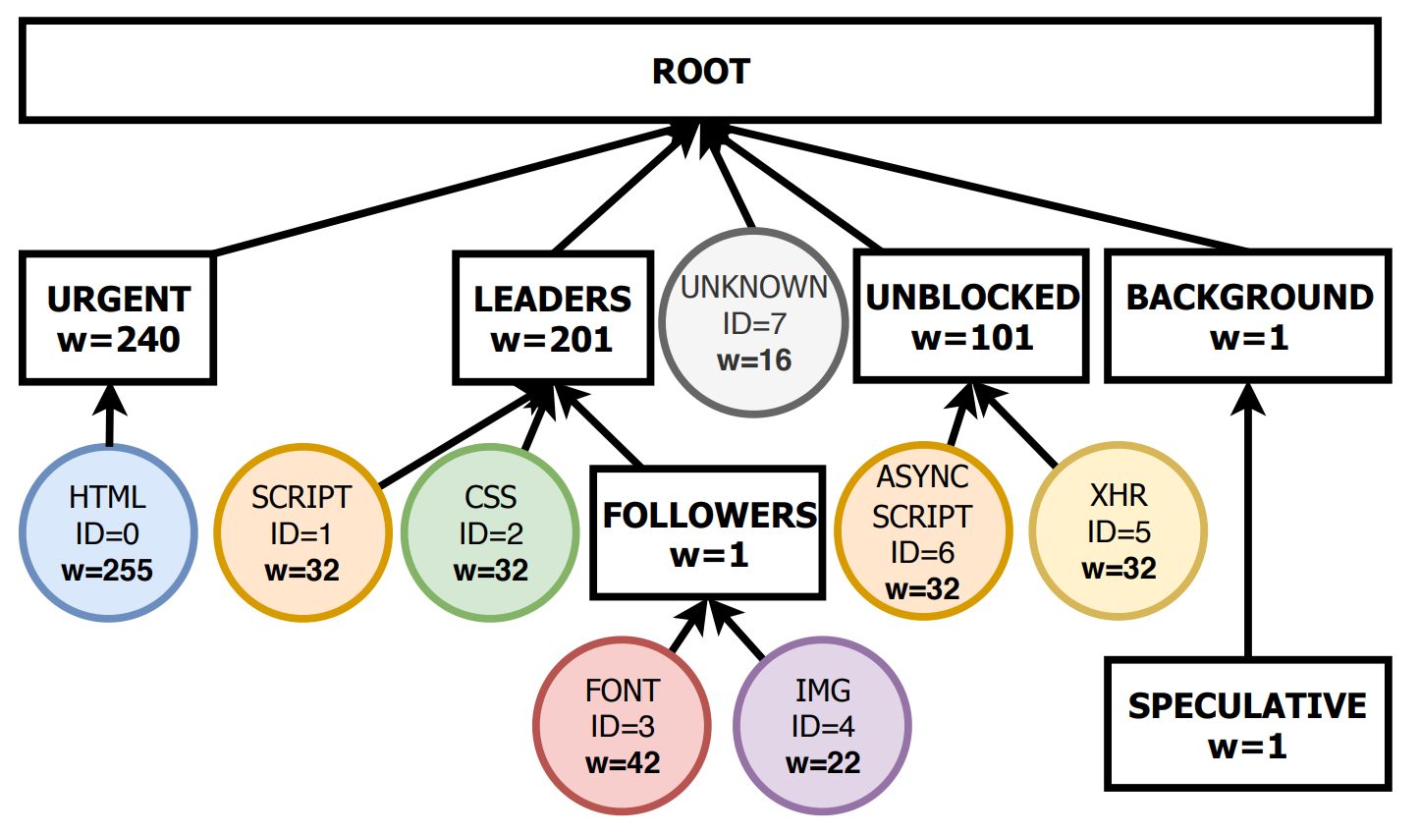
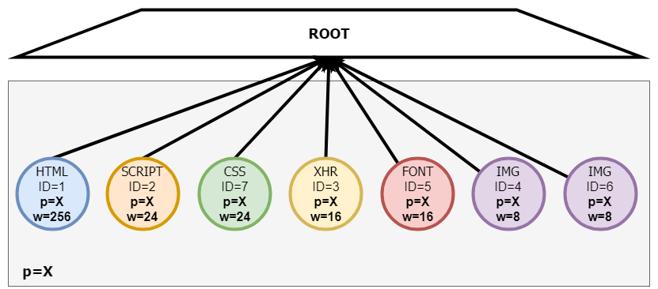
BUT: only firefox uses a real tree
No siblings
Only siblings
Siblings with ``placeholders’’
https://speeder.edm.uhasselt.be/www18
http://bitsup.blogspot.com/2015/01/http2-dependency-priorities-in-firefox.html

Slide 45
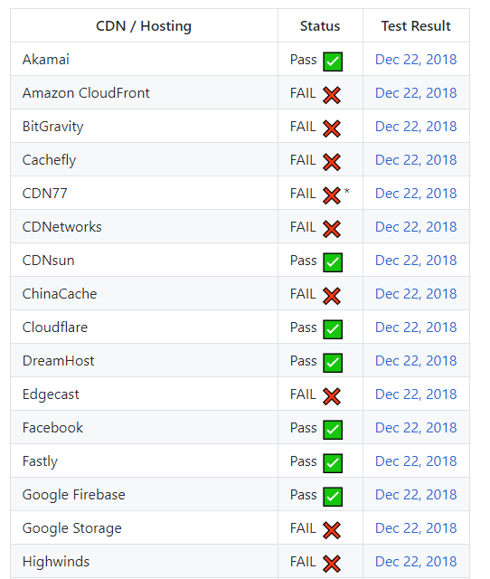
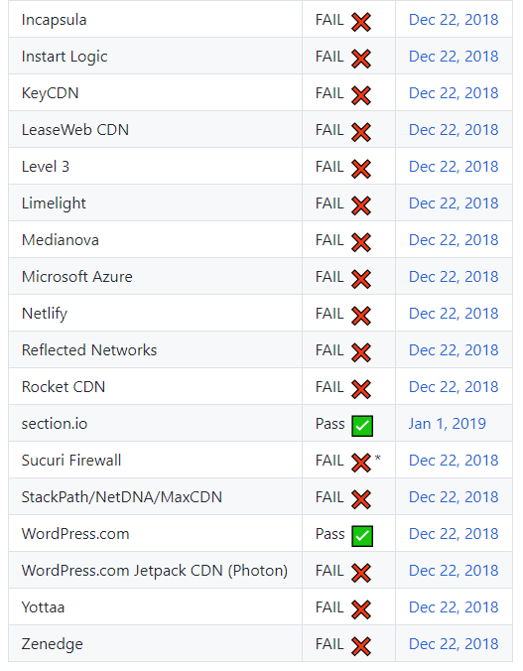
BUT: servers implement badly or not at all
9 / 34 deployments pass
https://www.youtube.com/watch?v=ct5MvtmL1NM
https://github.com/andydavies/http2-prioritization-issues
https://www.slideshare.net/patrickmeenan/http2-in-practice
https://discourse.haproxy.org/t/http-2-prioritization/4578/3 https://twitter.com/bagder/status/1222143040577589248?s=20 https://medium.baqend.com/chromes-service-workers-break-http-2-priorities-649c4e0fa930
Notes:
Other advanced use cases also don’t get used in practice or many servers (and also clients!) simply don’t support HTTP/2 prioritization
Seen Internet Explorer, HAProxy doesn’t support it, neither does Varnish. Curl doesn’t use it actively.
Also some bugs, like with Service Workers loosing info (since fixed)

Slide 46
BUT: difficult to do a server-side override
Find best parent
As sibling with high weight
As sibling under correct placeholder with some weight
Notes:
Three different ways… need to do user agent sniffing
This is why e.g., Cloudflare chooses their own setup

Slide 47
Server-overrides ~= redo the whole thing
Look at browser’s PRIORITY messages
Guess which browser
Put resources into fully new server-side scheme
not on , revert to mime-type
https://twitter.com/programmingart/status/1222550479168733186?s=20

Slide 49
Current HTTP/3 proposal under consideration: Back to SPDY basics
urgency
highest
0 | Prerequisite
1 | Default
2 | Supplementary SERVER
3 | Supplementary CLIENT
4 | Supplementary CLIENT
5 | Supplementary CLIENT
6 | Supplementary SERVER
7 | Background
lowest
https://github.com/httpwg/http-extensions/blob/master/draft-ietf-httpbis-priority.md

Slide 50
Current HTTP/3 proposal under consideration: Back to SPDY basics
urgency
highest
0 | Prerequisite
1 | Default
2 | Supplementary SERVER
3 | Supplementary CLIENT
4 | Supplementary CLIENT
5 | Supplementary CLIENT
6 | Supplementary SERVER
7 | Background
Easy server-side overrides
lowest
https://github.com/httpwg/http-extensions/blob/master/draft-ietf-httpbis-priority.md

Slide 51
Current HTTP/3 proposal under consideration: Back to SPDY basics
urgency
incremental
highest
0 | Prerequisite
1 | Default
2 | Supplementary SERVER
3 | Supplementary CLIENT
4 | Supplementary CLIENT
5 | Supplementary CLIENT
6 | Supplementary SERVER
7 | Background
0 | Sequential
1 | Can be Round-Robined
Easy server-side overrides
lowest
https://github.com/httpwg/http-extensions/blob/master/draft-ietf-httpbis-priority.md

Slide 52
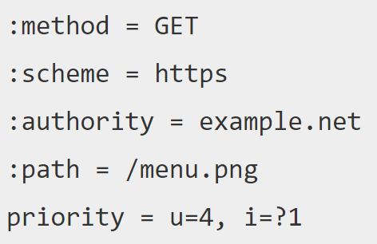
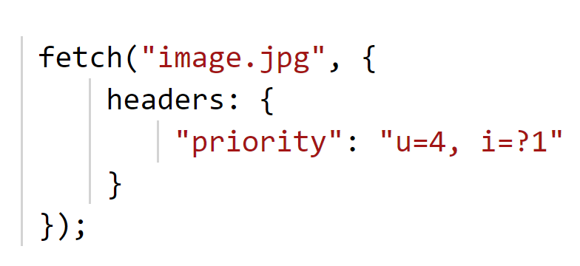
Current HTTP/3 proposal under consideration: Back to SPDY basics
Using an HTTP header:
Easy to debug
Easy to track
Easy to reason about
https://github.com/httpwg/http-extensions/blob/master/draft-ietf-httpbis-priority.md

Slide 53
Many open questions…
How to handle round-robin in practice?
urgency = 3
Incremental =
1 1 0 1 1 1
https://github.com/kazuho/draft-kazuho-httpbis-priority/issues/94
https://github.com/httpwg/http-extensions/blob/master/draft-ietf-httpbis-priority.md https://github.com/httpwg/http-extensions/issues?q=is%3Aissue+is%3Aopen+label%3Apriorities

Slide 54
Many open questions…
How to handle round-robin in practice?
urgency = 3
Incremental =
1 1 0 1 1 1
Note: unfair Round-Robin no longer really possible
https://github.com/kazuho/draft-kazuho-httpbis-priority/issues/94
https://github.com/httpwg/http-extensions/blob/master/draft-ietf-httpbis-priority.md https://github.com/httpwg/http-extensions/issues?q=is%3Aissue+is%3Aopen+label%3Apriorities

Slide 55
Many open questions…
Many people don’t like using HTTP headers for this
Headers also cannot be used for changing priorities
Exposing this to JavaScript had lots of push-back
Are 8 levels enough? Do they really need semantics?
What about the fairness issue?
https://github.com/httpwg/http-extensions/blob/master/draft-ietf-httpbis-priority.md https://github.com/httpwg/http-extensions/issues?q=is%3Aissue+is%3Aopen+label%3Apriorities

Slide 56
Problem 3:
There is more than one protocol layer

Slide 57
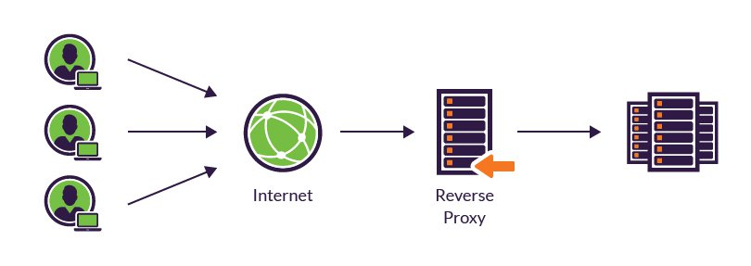
Bufferbloat
Caching
Origin
uncached.js?v=xyz
uncached.js?v=xyz
data.json
data.json
picture1.jpg
picture2.jpg
Expected:
Actual:
https://www.youtube.com/watch?v=pq_xk_Pecu4
https://www.youtube.com/watch?v=ct5MvtmL1NM

Slide 58
TCP Head-of-Line blocking
HTTP/2
HTTP
1
2
3
4
TRANSPORT
1
2
3
4
TCP
https://h3.edm.uhasselt.be/

Slide 59
TCP Head-of-Line blocking
HTTP/2
HTTP
1
2
3
4
TRANSPORT
1
2
3
4
TCP
Waiting for retransmit of packet 2
TCP
1
2
3
4
https://h3.edm.uhasselt.be/

Slide 60
QUIC has no more Head-of-Line blocking!
HTTP/2
HTTP/3
HTTP
1
2
3
4
1
2
3
4
TRANSPORT
1
2
3
4
1
2
3
4
TCP
QUIC
https://h3.edm.uhasselt.be/

Slide 61
QUIC has no more Head-of-Line blocking!
HTTP/2
HTTP/3
HTTP
1
2
3
4
1
2
3
4
TRANSPORT
1
2
3
4
1
2
3
4
TCP
QUIC
Waiting for retransmit of packet 2
QUIC
1
3
4
2
3 and 4 can be delivered to browser before 2
https://h3.edm.uhasselt.be/

Slide 62
Has QUIC really solved Head-of-Line blocking?
Waiting for retransmit of packet 2
QUIC
1
3
4
2
https://h3.edm.uhasselt.be/

Slide 63
Has QUIC really solved Head-of-Line blocking?
Waiting for retransmit of packet 2
QUIC
(Round Robin)
1
3
4
2
QUIC
(Sequential)
Waiting for retransmit of packet 2
1
2
3
4
Waiting for retransmit of packet 2
TCP
1
2
3
4
https://h3.edm.uhasselt.be/

Slide 64
Multiple other challenges in QUIC
Retransmits, multipath, flow control, scheduling APIs,…
Please read our paper: https://bit.ly/quicH3
(no one else will)

Slide 65
Problem 4:
There is no problem

Slide 66
Incompatible results
Edge 50% slower
Max 3.1% difference
9/34 deployments broken
Haven’t seen large scale complaints…

Slide 67
Incompatible results
Edge 50% slower
Max 3.1% difference
9/34 deployments broken
Haven’t seen large scale complaints…
Web Performance isn’t important
Robin has wasted his life

Slide 68
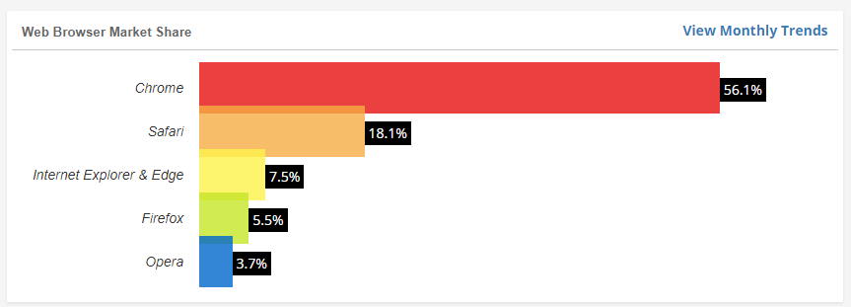
Personal conclusion
Most important for complex pages on slow networks
Network often isn’t the bottleneck anymore… (single thread JS)
If things break, they break hard, and are fixed
People might not identify problems as being priority-related
Uneven browser usage shares across platforms
https://www.w3counter.com/globalstats.php

Slide 69
Personal conclusion
QUIC will highlight some long-standing and new issues
Proposed HTTP/3 scheme isn’t going to solve all problems
But it will be easier to debug, understand, reason about
It can also be retrofitted onto HTTP/2!!!
https://qvis.edm.uhasselt.be/

Slide 70
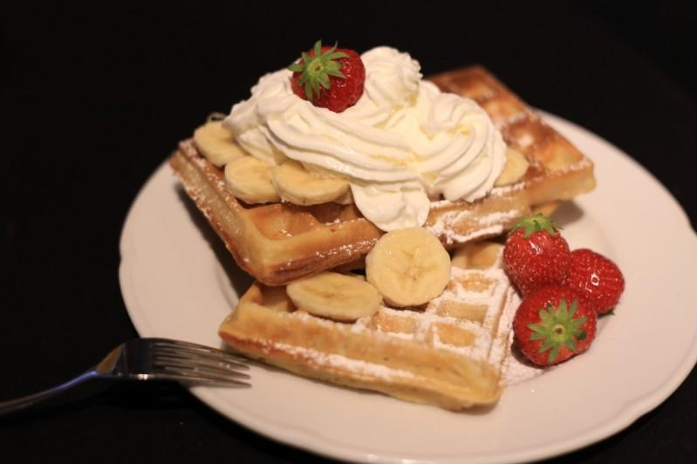

Slide 71
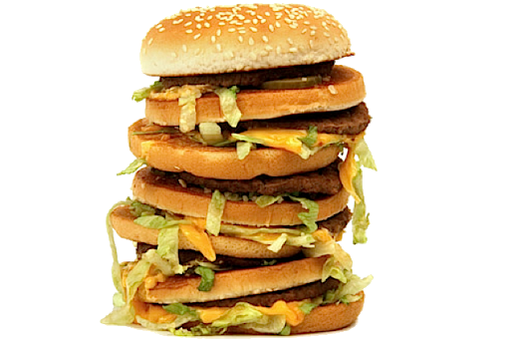
Problem 5:
Too many slides, not enough time

Slide 72
Browser doesn’t know
Size of resource
If the resource can be used progressively
What the resource will actually do
If the resource references other resources
The “critical path”
So it has to guess
}
Mime-type
Position in the document
How it hopes developers use things like async, defer, preload, …
More than the server typically knows
Notes:
Server –could- know more, but that’s not the way we build servers: they often only know the mime-type, not the other things, let alone more in-depth stuff

Slide 73
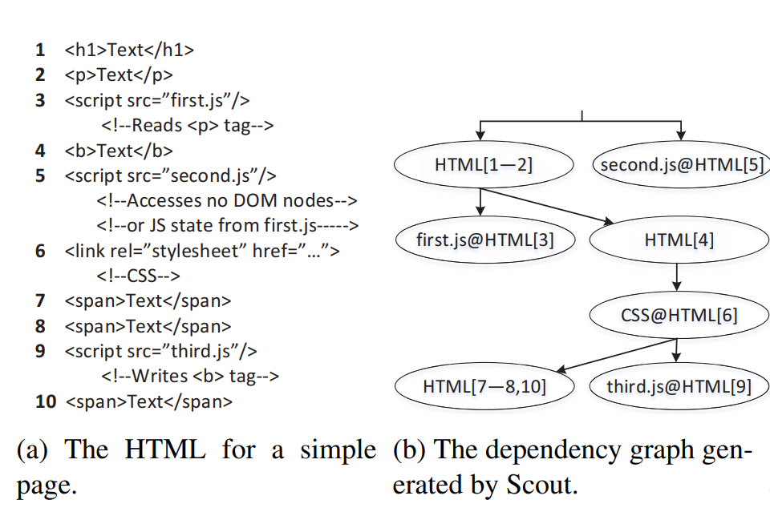
Server could know…
http://web.mit.edu/polaris/
https://www.usenix.org/system/files/conference/nsdi13/nsdi13-final177.pdf
https://www.usenix.org/system/files/conference/nsdi16/nsdi16-paper-wang-xiao-sophia.pdf
Notes:
There are projects that derive the critical path from a single page load, but difficult to use in practice, haven’t seen this in production anywhere

Slide 74
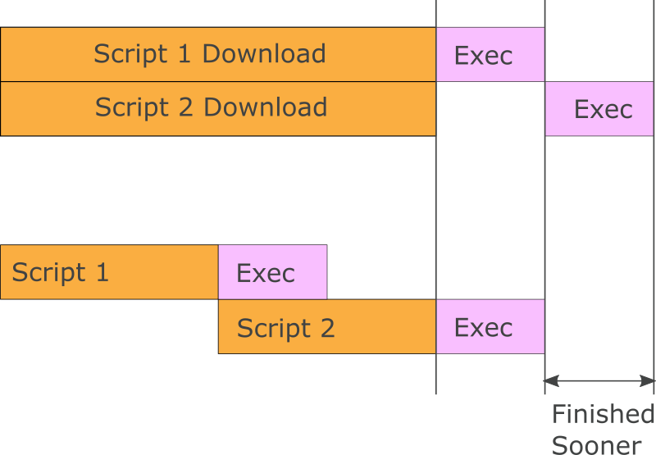
Another aspect: pipelined executions on main thread
https://blog.cloudflare.com/better-http-2-prioritization-for-a-faster-web/
Notes:
Can only execute one script at a time. Loading sequentially allows pipelining execution

Slide 75
parse + compile
EXECUTE
RTT
RTT
RTT
Congestion control warm-up
parse + compile
parse + compile
parse + compile
EXECUTE
parse + compile
EXECUTE
parse + compile
parse + compile
parse + compile
parse + compile
EXECUTE
https://v8.dev/blog/v8-release-78
https://medium.com/reloading/javascript-start-up-performance-69200f43b201
Notes:
If you have a streaming compiler, it also helps for sequentially sent content, due to TCP’s congestion warm up and RTTs between batches of data at the start of the connection (if later in the connection, still helps for large files, if they don’t fit in 1 cwnd)

Slide 76
Is Round-Robin bad?
HTTP/1.1 (TCP)
HTTP/2 (TCP)
HTTP/3 (QUIC)
Bandwidth
Notes:
Round-robin is similar to what happens on HTTP/1.1 : there, data also comes in staggered, just with much less orchestration

Slide 77
Which resources can/should be Round-Robined?
HTML : can : if not too big
JS : partly : not blocking, rest could be ok
CSS : no : not blocking, rest could be ok
Video: no : please don’t
Fonts : no : please don’t
Images: some : useful for size metrics (but then: use CSS / <img> attributes please) but generally serious doubts about usefulness progressive JPEGs (see next slide)

Slide 78
On the need for progressive JPEGs
Main downside in chrome is not taking advantage of progressive jpgs… personal opinion: don’t matter that much https://tobias.is/blogging/even-faster-images-using-http2-and-progressive-jpegs/ http://blog.patrickmeenan.com/2013/06/progressive-jpegs-ftw.html https://blog.radware.com/applicationdelivery/wpo/2014/09/progressive-image-rendering-good-evil/ : progressive JPEG is worse than normal… https://twitter.com/kornelski/status/1222618103873441793?s=20 : limited proof it works
https://www.davidtnaylor.com/eyeorg.pdf : speedindex is badly correlated with user opinions (See also https://www.mediawiki.org/wiki/Wikimedia_Performance_Team/Perceived_Performance: “Existing RUM metrics like onload, TTFP as well as SpeedIndex correlate very poorly with user-perceived page load time”)
Maybe will change in future with AV1, but…
Also: webp is smaller, so what matters more: file size or blocky previews?
Preloadscanner: doesn’t always know an image will be off-screen at that point -> will have to change priorities down the line (Chrome does do this)

Slide 79
2 PRIORITY Messages Between Client and Server
Add CSS as child of HTML
HTML
Hero Image
JavaScript
https://h3.edm.uhasselt.be
Notes:
Two main messages are used in HTTP/2

Slide 80
2 PRIORITY Messages Between Client and Server
Add CSS as child of HTML
HTML
HTML
Hero Image
JavaScript
Hero Image
JavaScript
CSS
Non-exclusively
https://h3.edm.uhasselt.be
Notes:
Two main messages are used in HTTP/2

Slide 81
2 PRIORITY Messages Between Client and Server
Add CSS as child of HTML
HTML
HTML
HTML
OR
CSS
Hero Image
JavaScript
Hero Image
JavaScript
CSS
Non-exclusively
Hero Image
JavaScript
Exclusively
https://h3.edm.uhasselt.be
Notes:
Two main messages are used in HTTP/2

Slide 82
HTTP/3 : PRIORITY messages should be ordered…
Add Image as child of HTML
HTML
HTML
HTML
Hero Image
CSS
OR
Add CSS as child of HTML
CSS
Hero Image
https://h3.edm.uhasselt.be/files/HTTP3_Prioritization_extended_3jul2019.pdf
Notes:
Can end up with priority inversion because of QUIC’s non-total ordering

Slide 83
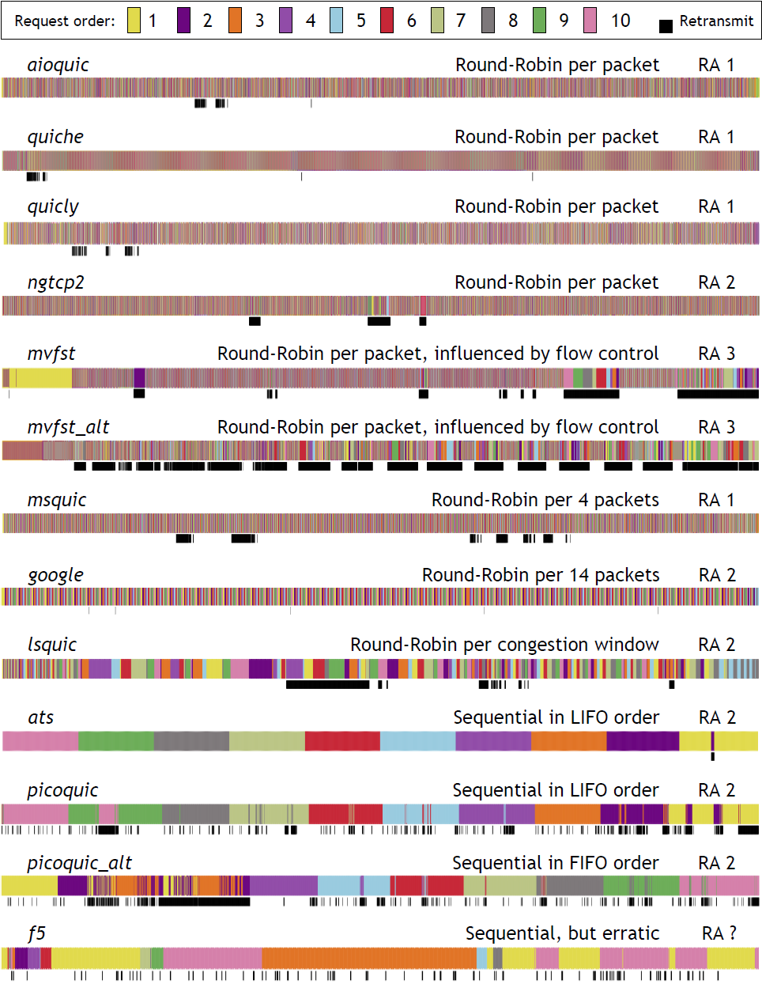
QUIC: introduces new problems: retransmission!
https://h3.edm.uhasselt.be

Slide 84
Welcome to the jungle
https://h3.edm.uhasselt.be
Notes:
Depends on page which one is best
Browsers don’t know up front: want to use best on average
Didn’t test, but GUESSED what that would be…
All guessed differently?!?

Slide 85
Image sources
https://teurastamo.com/wp-content/uploads/2015/10/blackfood_burger.png
https://upload.wikimedia.org/wikipedia/commons/e/ea/Oreo_biscuits_%28transparent_background%29.png
https://pngimg.com/uploads/m_m/m_m_PNG10.png
https://hellolipa.com/wp-content/uploads/2018/10/ZBP5.jpg
https://www.walmart.ca/en/ip/broccoli-stalks/6000016950304
https://media.istockphoto.com/photos/vegetables-carrot-isolated-on-white-background-picture-id519684644?k=6&m=519684644&s=612x612&w=0&h=lILeiVzaD-3uxvPxaAP5myTsFGURIavCRaBT-tZX99Y=
https://thumbs.dreamstime.com/b/big-hamburger-white-background-big-hamburger-white-background-close-up-99672617.jpg
https://media.istockphoto.com/photos/potatoes-fries-isolated-on-white-background-fast-food-picture-id496313136?k=6&m=496313136&s=612x612&w=0&h=_IUh7QgCF2nzIb4_5-TSz3D9L-mT1fZtFwRkbC4BCTI=
https://image.shutterstock.com/image-photo/green-chicks-carrots-boxes-shadow-260nw-672226147.jpg
http://www.barrestaurant-devrienden.nl/wp-content/uploads/2016/01/12.jpg
https://scontent-cdt1-1.cdninstagram.com/v/t51.2885-15/e35/66218838_942468512777551_4547401241838710995_n.jpg
https://www.unilad.co.uk/wp-content/uploads/2015/10/UNILAD-question-mark-mystery-meat36659-584x426.jpg
https://s3.amazonaws.com/wowfilters/content-images/the-three-mouths-instagram-filter-1.jpg
https://pnghunter.com/search/waiter
https://www.stickpng.com/assets/images/580b57fcd9996e24bc43c567.png
https://2.bp.blogspot.com/-C3TpcrQ0s20/UW7zBvLq2SI/AAAAAAAAAbA/SgKjXVHLGVE/s1600/Alphabet+Soup.png
https://lh3.googleusercontent.com/proxy/x749arvZG1YKUSZ1UeH_Yw6wHOnW9IxahES5ITmMiXKWRU-Zc-uKr4mk4yZKfio-cqKl5vV4GyJfSNckyApqy9r6Jco-HQ72wHCXp2LmsR1RqMZpyF78RBCf0AhlsCjpb5VGDa4
Capitalize on low hanging fruit to identify a ballpark
Collaboratively administrate empowered markets via plug-and-play networks.

Slide 86
Image sources
https://i.pinimg.com/originals/99/e9/68/99e9689aa6a7a68d846ae942b401eacd.jpg
https://2.bp.blogspot.com/-7ED7iessIXU/WmLu04G6HWI/AAAAAAAAKec/yslLVyakN-cL2D0CKD23IZUEUsdIFa13QCLcBGAs/s1600/Chrome_win_browser_wars.png
https://www.waffleworkshop.com/waffle-workshop6.jpg
Capitalize on low hanging fruit to identify a ballpark
Collaboratively administrate empowered markets via plug-and-play networks.

