Slide 1

Hybrid Cloud Open Source DBaaS with Kubernetes
Peter Zaitsev,
CEO, Percona
FOSDEM,
February 2021
Keeping Control of your data

Slide 2
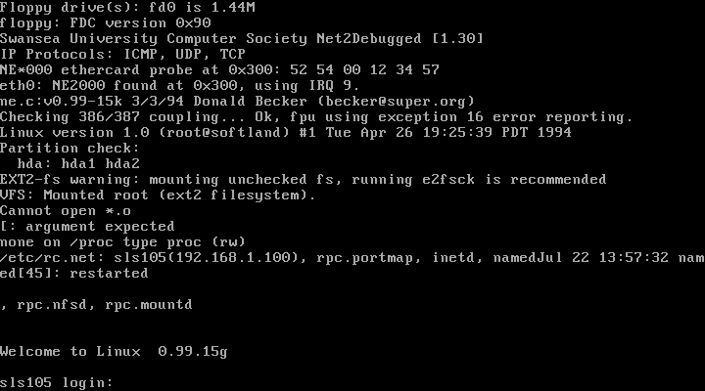
Early Days of Modern Open Source

Slide 3

Never Ending Move towards Simplicty

Slide 4

DBaaS “state of art” simplicity for databases

Slide 5
Putting Open Source in DBaaS
Interface – Deploy full Database Cluster with single API Call, Including Backups, Self Healing, Self Patching, Self Tuning Etc
  Well Suited for Database Software
  This is what Open Source DBaaS is
Management – When (not of) software fails the team to resolve exceptions
  Can’t be entirely “Open Source”

Slide 6
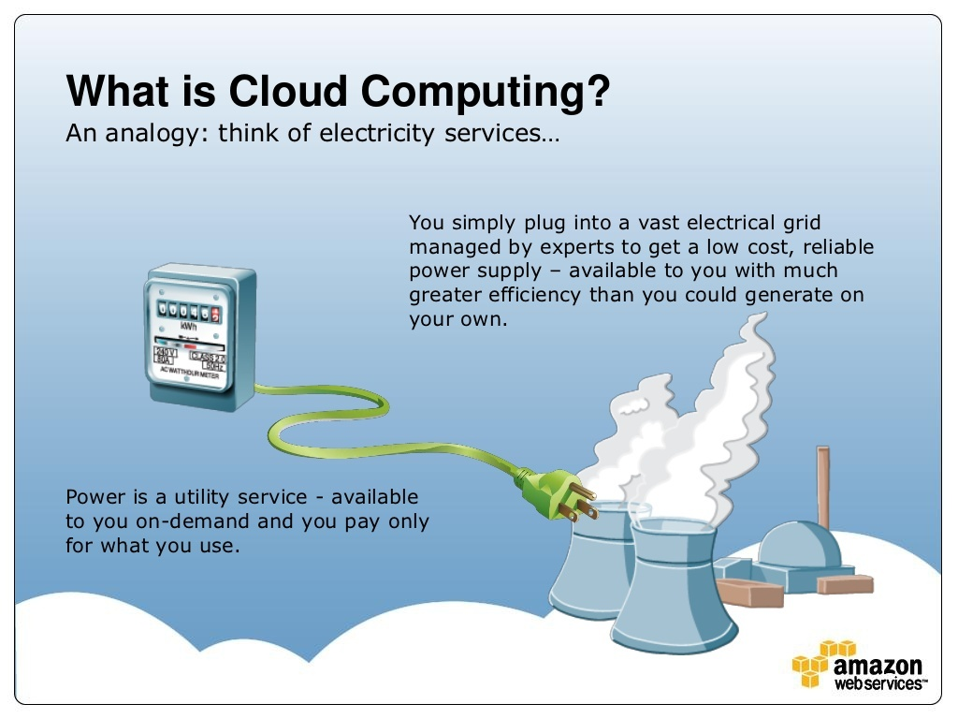
The Cloud

Slide 7
Cloud Reality
Cloud Vendors, who compared clouds to Commodity Electricity
Want to Lock you in by advising most proprietary solutions of their platform

Slide 8
Choose your Cloud
You Have the Power to choose the way of Serfdom or way of Freedom

Slide 9

Way of Freedom

Slide 10
Kubernetes
“Operating System” but for Cluster, rather individual hosts
Has a lot of Momentum
Universally Supported in Public, Private, Hybrid Cloud

Slide 11






Kubernetes

Slide 12
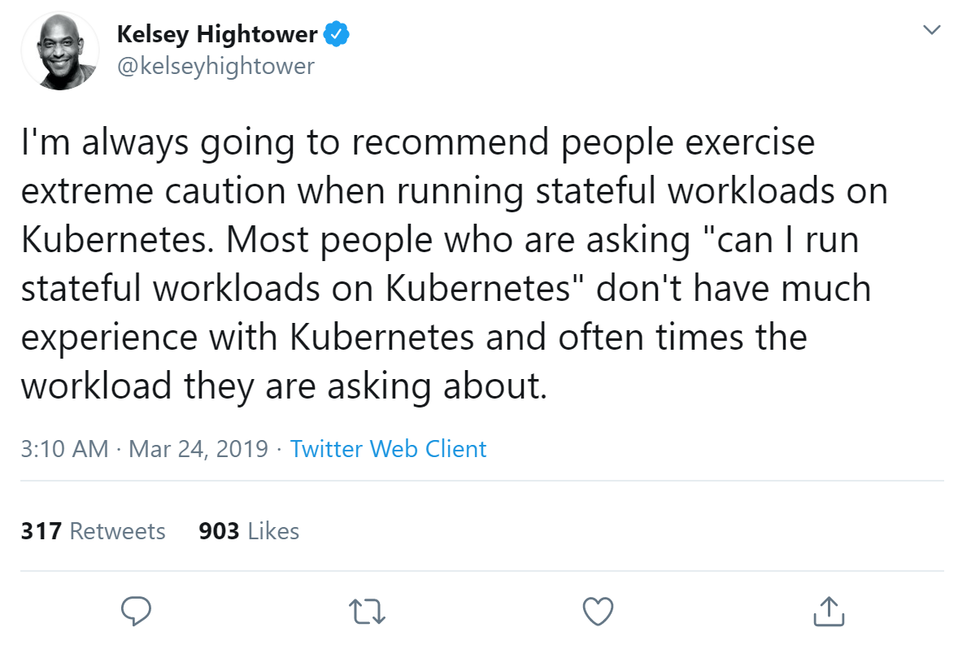
Stateful Applications and Kubernetes

Slide 13
Kubernetes
Stateful Sets
Persistent Volumes
Operator Framework

Slide 14



Kubernetes Powered Public DBaaS

Slide 15


Percona’s Work

Slide 16
Kubernetes Users
Direct users of Kubernetes Operators
Users of the Service which happen to run Kubernetes on Backend

Slide 17
Percona DBaaS CLI
Experimental Solution for those who wants to Get Open Source DBaaS without deep Kubernetes Understanding
https://www.percona.com/doc/dbaas-cli/index.html

Slide 18
Spinning up the Cluster
# percona-dbaas mysql create-db example
Starting.........................................[done]
Database started successfully, connection details are below:
Provider: k8s
Engine: pxc
Resource Name: example
Resource Endpoint: example-proxysql.my-namespace.pxc.svc.local
Port: 3306
User: root
Pass: Nt9YZguajW7nfVXTTrP
Status: ready

Slide 19
Connecting
Establish Port Mapping
  kubectl port-forward svc/example-proxysql 3306:3306 &
Connect with Your Favorite Client
  mysql -h 127.0.0.1 -P 3306 -uroot -pNt9YZguajW7nfVXTTrP

Slide 20
Advanced: Exposing the Database
# percona-dbaas mysql create-db exposed --options="proxysql.serviceType=LoadBalancer"
Starting...........................[done]
Database started successfully, connection details are below:
Provider: k8s
Engine: pxc
Resource Name: exposed
Resource Endpoint: 104.154.133.197
Port: 3306
User: root
Pass: k0QVxTr8EVfgyCLYse
Status: ready
To access database please run the following command:
mysql -h 104.154.133.197 -P 3306 -uroot -pk0QVxTr8EVfgyCLYse

Slide 21
Advanced: Set your own Password
# percona-dbaas mysql create-db withpw --password=mypassword
Starting.......................................................[done]
Database started successfully, connection details are below:
Provider: k8s
Engine: pxc
Resource Name: withpw
Resource Endpoint: withpw-proxysql.my-namespace.pxc.svc.local
Port: 3306
User: root
Pass: mypassword
Status: ready

Slide 22
Advanced: Single Node Deployment
# percona-dbaas mysql create-db singlenode --options="proxysql.enabled=false,allowUnsafeConfigurations=true,pxc.size=1"
Starting............[done]
Database started successfully, connection details are below:
Provider: k8s
Engine: pxc
Resource Name: singlenode
Resource Endpoint: singlenode-pxc.my-namespace.pxc.svc.local
Port: 3306
User: root
Pass: 22VqFD96mvRnmPMGg
Status: ready

Slide 23
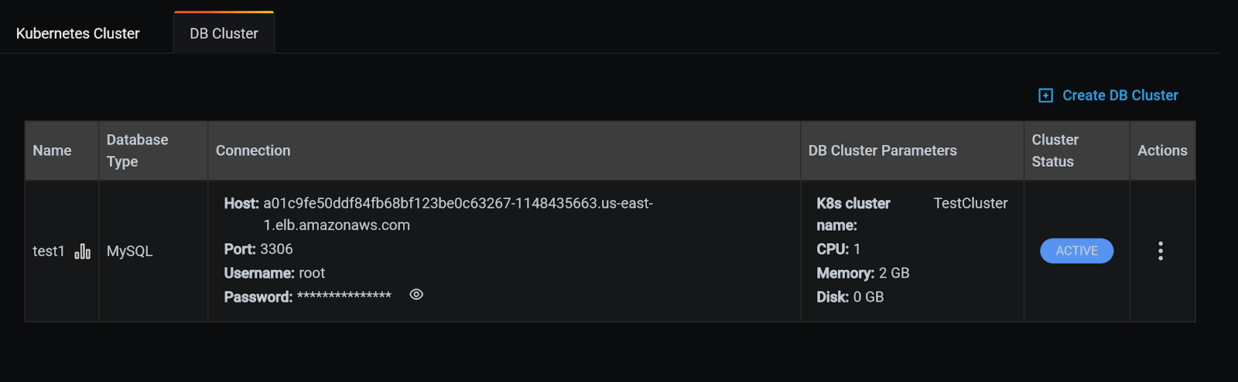
DBaaS Preview in PMM
https://www.percona.com/blog/2021/01/12/the-preview-of-database-as-a-service-dbaas-in-percona-monitoring-and-management-is-now-live/

Slide 24
Summary
With Percona DBaaS CLI you can get DBaaS Like Experience with Kubernetes
We’re continuing work to bring more features and extent usability all available in Open Source Software
Give it a try, provide your feedback or participate in development!

Slide 25

DBaaS has won
Unparallel convenience of using the database

Slide 26

Software Vendor Lock-in Sucks

Slide 27

Open Source to the Rescue

Slide 28
Thank you, Let’s Connect!
https://www.linkedin.com/in/peterzaitsev/
https://twitter.com/PeterZaitsev

