Slide 1
Open source PMCI stack implementation for add-in-card manageability
Sumanth Bhat – Feb 7, 2021

Slide 2
About the speaker
Sumanth Bhat – BMC Firmware Engineer @ Intel
5.5 years of embedded firmware development

Slide 3
Audience
Basic knowledge about
BMC
Satellite Management Controller (SMC)
Add-on/in card – PCIe slot (any expansion card)
Out of band manageability
DMTF Standards (PMCI, Redfish etc)

Slide 4
Agenda
Overview of platform architecture with AIC [Add-In-Card]
Add-in-card manageability: Existing mechanisms
Shortcomings of existing mechanisms
PMCI Architecture overview
PMCI for Add-In-Card manageability
External Interfaces
OpenBMC implementation
References

Slide 5
Architectural overview – Platform with card
Note: Components can be multiple / optional (not-present).

Slide 6
Existing AIC Manageability
Required manageability features:
Inventory Management
Thermal & Power Management
Firmware Updates
Telemetry & health monitoring

Slide 7
Existing AIC Manageability
Inventory Management: FRU
EEPROM in I2C Bus - Physical / emulated EEPROM accessible through I2C / SMBus (IPMI FRU Format).
IPMI FRU support - SMC FW support IPMI FRU commands accessible through IPMB protocol.
Thermal and Power monitoring: Sensors
Sensors in I2C Bus – Sensor devices accessible through I2C/SMBus register offsets.
IPMI support - SMC FW support IPMI sensor commands accessible through IPMB protocol. BMC can detect sensors, association & manage it dynamically (SDR).

Slide 8
Existing AIC Manageability
FW Update
IPMI support - SMC FW support using IPMI OEM FW update commands.
External exposure
Via BMC – BMC queries either by I2C/SMBus or IPMB protocol accordingly for FRU, Sensor and expose it to Datacenter management software.
Security
Private buses were considered secure; thus, no standard security protocol was in place.

Slide 9
Shortcomings
IPMI specification body is no longer functional; thus, new generation manageability requirements may not be met (ex: support for higher speed interfaces like i3c, sensor count > 255 etc.)
Firmware Updates of the card are vendor specific
No standard security mechanism
No plug and play solution – BMCs had to configured for the Add-In-Card they are going to manage.

Slide 10
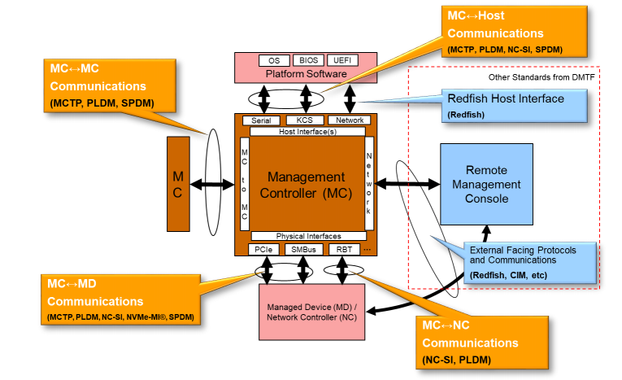
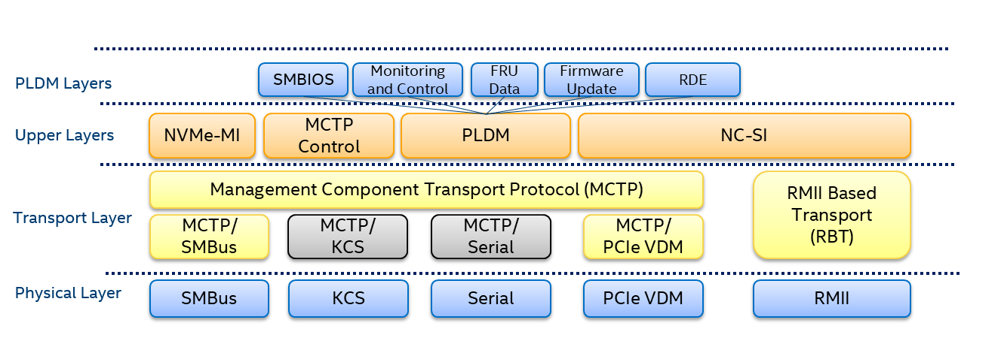
PMCI Architecture - overview
Platform management subsystem
Full PMCI stack
Source: PMCI architecture white paper (DSP2015)

Slide 11
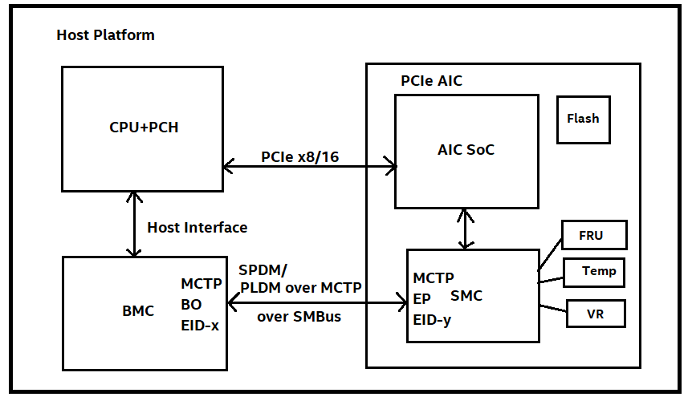
PMCI for Add-In-Card Manageability

Slide 12
PMCI for Add-In-Card Manageability
FRU
PLDM for FRU (DSP0257) - SMC FW supports PLDM FRU device accessible by BMC through MCTP Over SMBus / I2C. Follows own format (Not IPMI FRU). Provides entity association of FRU. No support for EEPROM directly over I2C / SMBus
Sensors
PLDM for Platform M & C (DSP0248) – SMC FW supports PLDM M & C exposing sensors, effecters, PDRs, events, support functions (including entity association for resource). BMC can read / update these sensors, effecters using PLDM sensor / effecter commands as per DSP0248. BMC can act as Event receiver and accordingly enable supporting devices.

Slide 13
PMCI for Add-In-Card Manageability
FW Update
PLDM FW Update (DSP0267) – Specification for FW device update in standard way across different vendors. Provides ability for BMC to discover FW devices, to which one or more component images can be transferred & updated.
Security
SPDM (DSP0274) - provides standard for card attestation.
Secured Messaging using SPDM (DSP0277) - provides standard for encrypted communication between BMC and SMC.

Slide 14
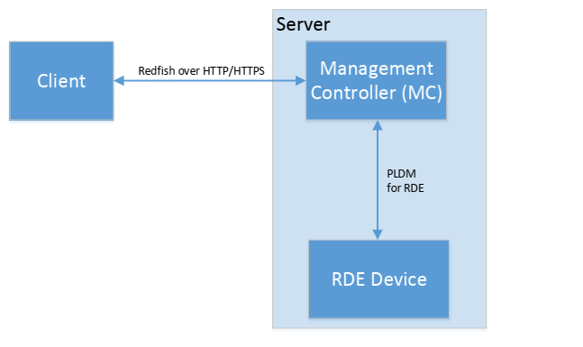
External Exposure
Redfish (DSP0266) provides a standard secure interface
for DataCentre Management tools to collect
manageability data.
Add-In-Card’s manageability can be exposed via Redfish
in two ways:
PLDM RDE (DSP0218) – BMC acts as a proxy between
Redfish client and RDE enabled Add-In-Card
2. Modelling PLDM M&C, FRU, FWU
components in Redfish
PLDM RDE

Slide 15
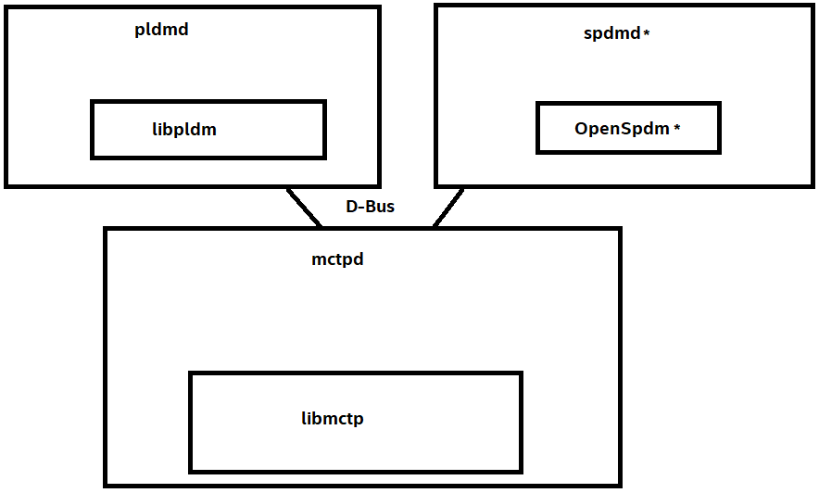
Open-Source implementation of PMCI stack
PMCI stack implementation for Add-In-Card Manageability is work in progress (IntelBMC repo)
Protocol daemons are written in C++, however the core is implemented as C libraries to encourage adaptation on both BMC and Device firmware.
https://github.com/Intel-BMC/pmci
PMCI protocol stack architecture
*Work in progress

Slide 16
Summary
Industry moving towards PLDM (both BMC & Add In Cards)
Backward compatibility - requires BMC & Add-In-Cards to support multiple protocol.
Products available in combinations in current market
E.g., Accelerator card (Alveo) support EEPROM FRU & PLDM M&C (Sensor)

Slide 17
Reference
IPMB Communication Protocol Specification
IPMI Specification
IPMI FRU Specification
DMTF PMCI Specifications
OpenBMC PMCI WG
Intel–PMCI implementation
Acknowledgement: Richard Marian Thomaiyar’s work on Add-In-Card modelling using PLDM (https://www.youtube.com/watch?v=Q7ygqGPyRSc&t=13s)

Slide 18
Q & A

