Slide 1




Optimization of SDR Applications on Heterogeneous Systems-on-Chip (SoCs)
Samet E. Arda¹, Anish Krishnakumar², A. Alper Goksoy²,
Nirmal Kumbhare³, Joshua Mack³, Anderson L. Sartor⁴,
Ali Akoglu³, Radu Marculescu⁵, and Umit Y. Ogras²
  ¹Arizona State University
  ²The University of Wisconsin–Madison
  ³The University of Arizona
  ⁴Carnegie Mellon University
  ⁵The University of Texas at Austin

Slide 2


Motivation
Domain-Specific Systems-on-Chip (DSSoC):
  General-purpose,
  Special-purpose, and
  Hardware accelerator cores
DSSoC
Better performance
Higher energy-efficiency
ARM LITTLE CPU
ARM LITTLE CPU
ARM
big
CPU
ARM
big
CPU
Acc-3
ARM LITTLE CPU
ARM LITTLE CPU
ARM
big
CPU
ARM
big
CPU
Acc-3
Acc-1
Acc-1
Acc-1
Acc-1
Acc-2
Acc-2

Slide 3

Approach
Full-System Simulation
Hardware Emulation
Slow
Faster
Low-level details
Significant developmental effort
Hard to analyze
No flexibility
No scalability
Limited scalability
System-Level Simulation
Very fast
Facilitates algorithmic
development
Controlled level of abstraction
Highly scalable
High degree of modularity

Slide 4
Proposed Solution: DS3 Framework
Resource Database
Resource types
Task Latencies
Resource state
Simulation Kernel
Implements schedule
Updates simulation state
Analytical Models
(Power, Thermal, Interconnect)
Design Space Exploration
Scheduler Algorithms
Evaluation of scheduling algorithms
Job / Task Generator
Stochastic job arrival
Domain applications
DTPM
Algorithms
Resource management algorithm studies
Scheduler & DTPM
Plug & play selection
Heuristic schedulers
Tabular schedulers
Hardware Profiling
Report
Power, Performance,
Energy, Schedule
DS3

Slide 5
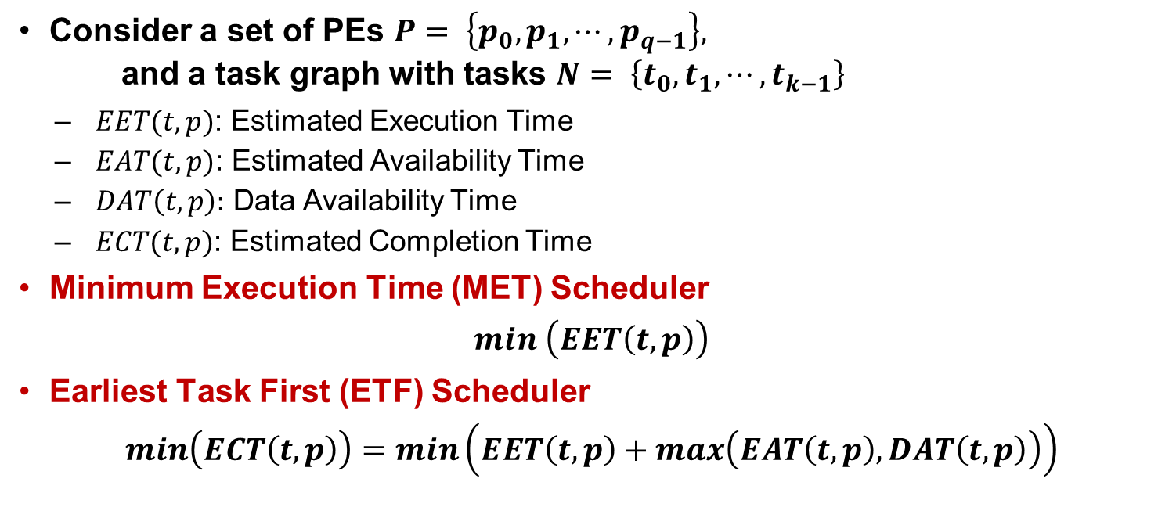
Built-in Schedulers: Heuristics
Consider a set of PEs $P= \left\{p_{0},p_{1},⋯,p_{q−1}\right\},$
and a task graph with tasks $N= \left\{t_{0},t_{1},⋯,t_{k−1}\right\}$
  $EET(t,p)$: Estimated Execution Time
  $EAT(t,p)$: Estimated Availability Time
  $DAT\left(t,p\right):$ Data Availability Time
  $ECT(t,p)$: Estimated Completion Time
Minimum Execution Time (MET) Scheduler
$$min \left(EET\left(t,p\right)\right)$$
Earliest Task First (ETF) Scheduler
$$min\left(ECT\left(t,p\right)\right)=min\left(EET\left(t,p\right)+max\left(EAT\left(t,p\right),DAT\left(t,p\right)\right)\right)$$

Slide 6
Built-in Schedulers: Constraint Programming
Constraint programming (CP) utilizes concepts of IBM ILOG CPOptimizer [1]
An interval variable x is a decision variable represent
  an activity, operation or a task
Constraints on an interval variable x:
  span(x,{x₁, ...,x_{n}}) states if x is present, it starts together with first present interval in {x₁, ...,x_{n}} and ends together with last one
  alternative(x,{x₁, ...,x_{n}}) models an exclusive alternative between {x₁, ...,x_{n}}: if interval is present then exactly one of intervals {x₁, ...,x_{n}} is present and x starts and ends together with chosen one.
  no_overlap({x₁, ...,x_{n}}) states permutation{x₁, ...,x_{n}} defines a chain of non-overlapping intervals
  end_before_start(x_{i},x_{j},delay) constrains at least given delay to elapse between end of x_{i} and start of x_{j}.
[1] Laborie, P. IBM ILOG CP Optimizer for detailed scheduling illustrated on three problems. Int. Conf. on AI and OR Techniques in Constraint Programming for Combinatorial Optimization Problems. 2009, pp. 148–162.

Slide 7
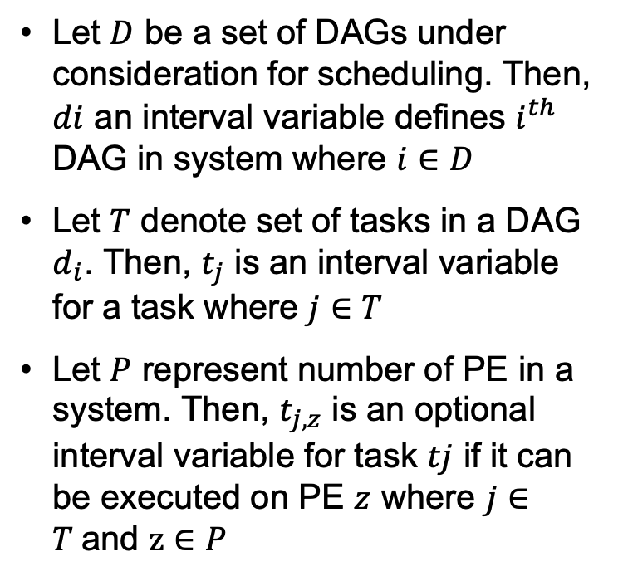
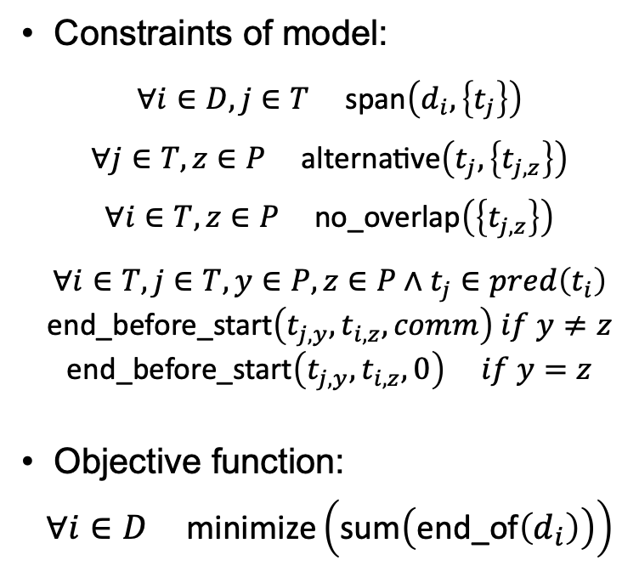
Built-in Schedulers: Constraint Programming
Let $D$ be a set of DAGs under consideration for scheduling. Then, $di$ an interval variable defines $i^{th}$ DAG in system where $i∈D$
Let $T$ denote set of tasks in a DAG $d_{i}$. Then, $t_{j}$ is an interval variable for a task where $j∈T$
Let $P$ represent number of PE in a system. Then, $t_{j,z}$ is an optional interval variable for task $tj$ if it can be executed on PE $z$ where $j∈T$and $z∈P$
Constraints of model:
  $$∀ⅈ∈D,j∈T \text{span}\left(d_{i},\left\{t_{j}\right\}\right)$$
  $$∀j∈T,z∈P \text{alternative}\left(t_{j},\left\{t_{j,z}\right\}\right)$$
  $$∀ⅈ∈T,z∈P \text{no}\text{_}\text{overlap}\left(\left\{t_{j,z}\right\}\right)$$
  $$∀ⅈ∈T,j∈T,y∈P,z∈P∧t_{j}∈pred\left(t_{i}\right) \\ \text{end}\text{_}\text{before}\text{_}\text{start}\left(t_{j,y},t_{i,z},comm\right) if y≠z \\ \text{end}\text{_}\text{before}\text{_}\text{start}\left(t_{j,y},t_{i,z},0\right) if y=z$$
Objective function:
$$∀ⅈ∈D \text{minimize}\left(\text{sum}\left(\text{end}\text{_}\text{of}\left(d_{i}\right)\right)\right)$$

Slide 8
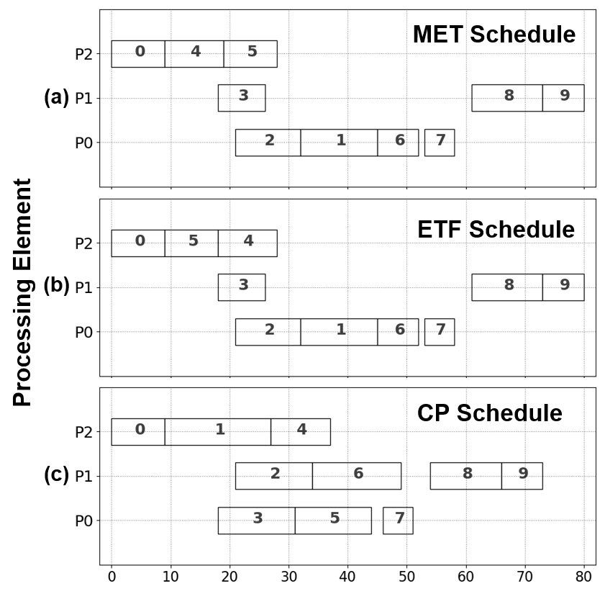
A Simple Scheduling Case Study
Schedule for a simple DAG with 3 different schedulers
Application DAG
Topcuoglu, H., Hariri, S. and Wu, M.Y., 2002. Performance-effective and low-complexity task scheduling for heterogeneous computing. IEEE transactions on parallel and distributed systems, 13(3), pp.260-274.
Task Profile
Execution time profile of tasks in the DAG on 3 different processing elements
Schedulers
MET ETF CP
Task | P0 | P1 | P2
0 | 14 | 16 | 9
1 | 13 | 19 | 18
2 | 11 | 13 | 19
3 | 13 | 8 | 17
4 | 12 | 13 | 10
5 | 13 | 16 | 9
6 | 7 | 15 | 11
7 | 5 | 11 | 14
8 | 18 | 12 | 29
9 | 21 | 7 | 16

Slide 9
SDR Applications – Block Diagrams
Wireless communication and radar systems
Wireless Communications
WiFi-A Transmitter & Receiver
Low-power single-carrier TX & RX
Radar Applications
Pulse Doppler
Radar Correlator
(a)
(b)

Slide 10
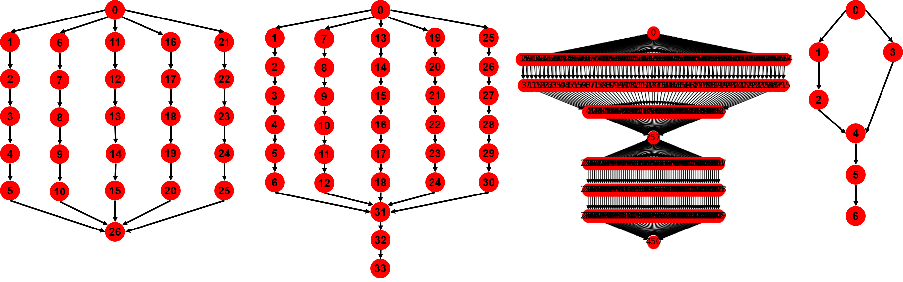
SDR Applications – DAG Representations
Wireless communication and radar systems
WiFi-A Transmitter
WiFi-A Receiver
Pulse Doppler
Radar Correlator

Slide 11
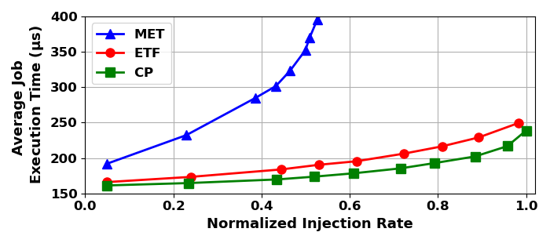
A Detailed Scheduling Case Study
Multiple streaming SDR applications executed simultaneously
Stochastic injection of applications based on various distributions
SoC Configuration
Scheduler Comparisons
Type of Processing Element | Number of Cores
Arm LITTLE architecture | 4
Arm big architecture | 4
Matrix multiplication hardware accelerator | 2
FFT hardware accelerator | 4
Viterbi decoder hardware accelerator | 2
Compare scheduler performance for simultaneous
streaming applications in DSSoCs

Slide 12
DTPM Case Study
Multiple streaming domain-specific applications executed simultaneously
Evaluate power and energy-based metrics
Obtain a pareto-energy frontier with different DTPM policies
Operating Points
DTPM Policy Comparisons
Type of Processing Element | Frequency
Arm LITTLE architecture | 0.6 GHz – 1.4 GHz
Arm big architecture | 0.6 GHz – 2.0 GHz
Compare energy and energy-delay product (EDP)
for simultaneous streaming applications in DSSoCs

Slide 13
Design Space Exploration
Identify number and types of PEs using early design space exploration
Workload-based data driven approach and a guided search
SoC Configurations
Design Space Exploration Results
Type of PE |  |  | Area (mm²) | Average Job Execution (μs) | Energy per Job (μJ/job)
ID | FFT | Viterbi
1 | 0 | 1 | 14.94 | 2606 | 1744
2 | 0 | 1 | 14.94 | 1824 | 1244
3 | 2 | 1 | 15.82 | 293 | 589
4 | 4 | 0 | 16.29 | 1212 | 957
5 | 4 | 1 | 16.56 | 274 | 584
6 | 6 | 3 | 19.29 | 264 | 582
Identify pareto-frontier using metrics such as energy, area and performance to choose the processing elements in a DSSoC

Slide 14

Example Video Demonstration
* Video accelerated for the purpose of demonstration

Slide 15
Closing Remarks
A Python-based system-level simulation framework for DSSoCs to:
  Compare scheduling algorithms
  Evaluate dynamic power-thermal management (DTPM) techniques
  Conduct extensive design space exploration studies
DS3 calibrated to Odroid-XU3 and Zynq ZCU-102 with an average error of 5%
Envision DS3 to pave the way for easy and rapid exploration of DSSoCs
DS3: A open-source tool that supports easy and rapid exploration of domain-specific systems-on-chip (DSSoCs)
https://github.com/segemena/DS3

Slide 16
Acknowledgement
This article is based on research sponsored by Air Force Research Laboratory (AFRL) and Defense Advanced Research Projects Agency (DARPA) under agreement number FA8650-18-2-7860. The U.S. Government is authorized to reproduce and distribute reprints for Governmental purposes notwithstanding any copyright notation thereon. The views and conclusion contained herein are those of the authors and should not be interpreted as necessarily representing the official policies or endorsements, either expressed or implied, of Air Force Research Laboratory(AFRL) and Defense Advanced Research Projects Agency (DARPA) or the U.S. Government.

