Slide 1
Contributors Guide to the Jakarta EE 10 Galaxy
Reza Rahman
Jakarta EE Ambassador, Author, Blogger, Speaker
reza_rahman@lycos.com
@reza_rahman

Slide 2


Jakarta EE
Java EE transitioned from JCP to Eclipse Foundation as Jakarta EE
Open governance, open source, open compatibility testing
Well defined specification process, clear IP flow, vendor-neutral open collaboration, level playing field
Key stakeholders maintained if not expanded including Oracle, IBM, Red Hat, Payara and VMware
Community participation and contribution key
https://jakarta.ee
Notes:
This is likely the biggest technology ownership transfer ever with the objective of greater openness, certainly for Java.
There are a few specific differences with the JCP and Java EE, all geared towards greater vendor-neutrality and openness.
The branding, intellectual property and copyrights in Jakarta EE are owned by the Eclipse Foundation, not any specific commercial entity.
Governance is completely open, no one has any special status or powers. Everything is driven by consensus down to the lowest level decisions.
The TCK is open source and compliance is self-reported.
There is at least one required implementation before a specification is released, but there is no reference implementation anymore.
Cryptic acronyms have been replaced by simpler names such as “Jakarta Persistence” instead of “JPA”.
It is up to all of us to make Jakarta EE successful. Greater participation was a key reason for the transfer.

Slide 3
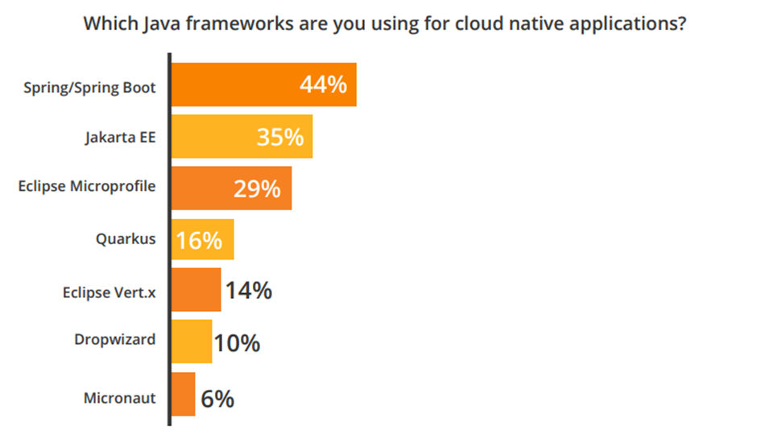
The Importance of Jakarta EE
Jakarta EE is an important part of the Java ecosystem and cloud
25-35% of Java applications run on Jakarta EE application servers
  WebLogic, WebSphere/Liberty, JBoss EAP, WildFly, Payara
70-80% of Java applications depend on at least one or more Jakarta EE APIs
  Tomcat, Hibernate, ActiveMQ, Jetty, MicroProfile, Spring, Quarkus
A healthy ecosystem continues to evolve, with a stable Jakarta EE core
Quarkus and MicroProfile are enjoying a notable increase in interest
2020 Jakarta EE Developer Survey: https://outreach.jakartaee.org/2020-developer-survey-report

Slide 4
Jakarta EE Evolution
EJB 3, JPA, JSF, JAXB, JAX-WS
Servlet, JSP, EJB, JMS
CMP, JCA
JAX-WS
JPE
J2EE 1.2
J2EE 1.3
J2EE 1.4
Java EE 5
Profiles, CDI, JAX-RS, Bean Validation
WebSocket, JSON, Concurrency, Batch, pruning
HTTP/2, SSE, Security, pruning
Open-source governance
Java EE 6
Java EE 7
Java EE 8
Jakarta EE 8
Namespace
transition
Community innovation
Jakarta EE 9
Jakarta EE 10
Notes:
The technology evolution that started many years ago with J2EE and then Java EE will continue with Jakarta EE.
Java EE 8 and Jakarta EE 8 are binary compatible. The real change is the move from the JCP to the Eclipse Foundation.
Updated APIs cannot use javax.*, they must use the jakarta.* namespace. As a result, all the APIs are moving to jakarta.* in Jakarta EE 9. Other than the Jakarta EE transition, there are no major API updates in Jakarta EE 9.
Jakarta EE 10 will have APIs changes. There are many important pending changes.
Trivia: Anyone know what JPE stands for? Answer: It is “Java Professional Edition”.

Slide 5
Jakarta EE 9/9.1
Jakarta EE 9 moves all relevant specifications from javax to jakarta namespace
Remove older technologies
Primarily aimed for ecosystem to adapt to Jakarta
Some implementations are in place already
You should begin testing!
Jakarta EE 9.1 will likely be released soon after adapting to Java SE 11 as opposed to Java SE 8
Your contribution is welcome and needed to get work done on time!
Jakarta EE 10 will likely be delivered some time in 2021
Notes:
The primary focus of Jakarta EE 9 is to “jakartasize” the technology as smoothly as possible for the entire ecosystem. Jakarta EE itself will not handle backwards compatibility but it is expected that implementations will provide a comfortable migration solution – most likely allowing the use of both namespaces together for some time.
Java EE 6 started pruning process for older technologies. Jakarta EE 9 continues that theme.
Java SE 9 removed JAXB and JAX-WS, so Jakarta EE 9.1 will bridge the gap by adding these technologies.
The work is on track, but this is a great opportunity for the community to contribute.

Slide 6

Ambassadors’ Jakarta EE 10 Contribution Guide
https://docs.google.com/document/d/1uZFBoIujXCc-gQhCzh_ZdlKEsrsV0yVVIHzBTI3usF8/edit?usp=sharing
Notes:
The Jakarta EE Ambassadors are an independent grassroots group of people committed to moving Jakarta EE forward. Anyone that sees the value that Jakarta EE brings to the ecosystem should consider joining the Ambassadors.
There are a number of things the Ambassadors do together including evangelizing Jakarta EE, tracking the progress of specification work and directly contributing to specifications. You can help the Jakarta EE Ambassadors do all these things and the Ambassadors can help you.
At the bare minimum, simply spreading word about the Jakarta EE Ambassadors goes a long way.

Slide 7
Jakarta EE 10 Themes
CDI Alignment
  @Asynchronous, @Schedule, @Lock, @MaxConcurrency in Concurrency, @MessageListener in Messaging, @RolesAllowed, @RunAs in Security
  Better CDI support in REST, Batch, Concurrency
Java SE Alignment
  CompletableFuture in Concurrency
  Bootstrap APIs for REST, Messaging
  Decoupling TCKs, modularization
Closing standardization gaps
  Security, Batch, Concurrency, Persistence, Transactions
  Microservices Profile
Innovation
  NoSQL, MVC, Configuration

Slide 8
Jakarta Concurrency
CDI based, modernized equivalents for @Asynchronous, @Schedule, @Lock
Adding @MaxConcurrency
Adding @ManagedExecutorServiceDefinition
Add support for CompletableFuture
CDI context propagation

Slide 9
@Asynchronous + CompletableFuture
@Asynchronous
public CompletableFuture<Confirmation> processPayment(Order order) {
...
Confirmation status = ...;
return
CompletableFuture<Confirmation>.completedFuture(status);
}
paymentService
.processPayment(order)
.thenAccept(
confirmation -> System.out.println(confirmation));

Slide 10
CDI Based @Lock
@ApplicationScoped @Lock(READ)
public class CountryInfoService {
...
public List<String> getStates(String country) {
return countryStatesMap.get(country);
}
...
@Lock(WRITE)
public void setStates(String country,
List<String> states) {
countryStatesMap.put(country, states);
}
}

Slide 11
@ManagedExecutorServiceDefinition + CompletableFuture
@ManagedExecutorServiceDefinition(
name = “java:app/concurrency/MyExecutorService”,
min-threads=“5”,
max-threads=“25”,
keepalive-time=“5000”,
hung-task-threshold=“60000”)
@Resource(name = "java:app/concurrency/MyExecutorService")
private ManagedExecutorService executor;
...
CompletableFuture<Long> stage = executor.newCompletableFuture()
.thenApply(function)
​.thenAccept(consumer);
stage.completeAsync(supplier);

Slide 12
@Service CDI Stereotype
@ApplicationScoped
@Transactional
@MaxConcurrency(DEFAULT)
@Lock(READ)
@Stereotype
@Target(TYPE)
@Retention(RUNTIME)
public @interface Service {}
@Service
public class DefaultBookingService
implements BookingService {

Slide 13
Jakarta Messaging
CDI based, modernized @MessageListener
Standalone bootstrap API
AMQP interoperability
Kafka interoperability

Slide 14
@MessageListener Example
@ApplicationScoped
@MaxConcurrency(10)
public class HandlingEventRegistrationAttemptConsumer {
@MessageListener(
destinationLookup="jms/HandlingEventRegistrationAttemptQueue",
selector="source = 'mobile'",
batchSize=10, retry=5, retryDelay=7000,
orderBy=TIMESTAMP)
public void onEventRegistrationAttempt(
HandlingEventRegistrationAttempt... attempts) {
...
}
}

Slide 15
Bootstrap API for Jakarta Messaging
JmsContainer container = JmsContainerFactory.newInstance();
...
JMSContext jmsContext = container.getJmsContext();
Destination handlingEventQueue = container.getDestination(
“jms/HandlingEventRegistrationAttemptQueue” true);
...
jmsContext.createProducer()
.setDisableMessageID(true)
.setDisableMessageTimestamp(true)
.setStringProperty("source", source)
.send(handlingEventQueue, attempt);
...
container.close();

Slide 16
Jakarta Security
CDI based, modernized equivalents for @RolesAllowed and @RunAs
OAuth 2.0, OpenID Connect, JWT support
EL enabled authorization annotation

Slide 17
Modern Security Providers
@OpenIdConnectIdentityStoreDefinition(
clientId=“${client.id}”, clientSecret=“${client.secret}”,
discoveryEndpoint=“https://.../openid-configuration”,
userNameAttribute=“preferred_username”)
@JwtIdentityStoreDefinition(
jwksUri="https://.../keys",
issuer="https://.../${tenant.id}/v2.0",
audiences="${client.id}",
userNameAttribute="preferred_username")
@OAuth2IdentityStoreDefinition(
clientId="${client.id}", clientSecret="${client.secret}",
tokenEndpointAuthMethod="client_secret_post",
authorizationEndpoint="https://.../authorize",
userNameAttribute="preferred_username",
website="https://.../authentication/")

Slide 18
EL Enabled Authorization Annotation
@Authorized("hasRoles('Manager') && schedule.officeHours")
public void transferFunds();
@Authorized("hasAttribute('directReports', employeeId)")
public double getSalary(long employeeId);

Slide 19
Other Possibilities
Jakarta Persistence
  Make persistence.xml optional/empty marker
  More SQL features in JPQL such as sub-selects
  JCache as a second-level cache provider
Jakarta REST
  @Inject instead of @Context
  Standalone bootstrap API
Jakarta Batch
  CDI alignment
  Java job definition API as alternative to XML
Jakarta Transactions
  Standardize common performance optimizations

Slide 20
Job Definition API Example
Job job = new JobBuilder(jobName).property("jobk1", "J")
.listener("jobListener1", new String[]{"jobListenerk1",
"#{jobParameters['jobListenerPropVal']}"},
.step(new StepBuilder(stepName)
.properties(new String[]{"stepk1", "S"},
new String[]{"stepk2", "S"})
.batchlet(batchlet1Name, new String[]{"batchletk1", "B"},
new String[]{"batchletk2", "B"})
.listener("stepListener1", stepListenerProps)
.stopOn("STOP").restartFrom(stepName).exitStatus()
.endOn("END").exitStatus("new status for end")
.failOn("FAIL").exitStatus()
.nextOn("*").to(step2Name)
.build())
...
.build();

Slide 21
Jakarta MVC
Standard action-based web framework
  Jakarta Faces continues to evolve separately
Model
  CDI, Bean Validation
View
  Facelets, Jakarta Server Pages
Controller
  Majority of work here
  Based on Jakarta REST

Slide 22
Jakarta MVC Example
@Controller
@Path("/")
@View("my-index.xhtml")
public class Bookstore {
@Inject private Models model;
@Inject private BookService service;
...
@GET
public void index() {
...
model.put(“books”, books);
}
}

Slide 23
Jakarta NoSQL
Specification for accessing NoSQL databases
Layers of flexible abstractions
  Communication API akin to JDBC
  Mapping/template API akin to JPA
  Repository API akin to DeltaSpike/Spring Data
API variants by NoSQL taxonomy
  Key-value pair, column family, document and graph
Bean validation, externalized configuration

Slide 24
Jakarta NoSQL Example
@Entity public class Order {
@Id private long id;
@Column @NotBlank private String description;
@Column @NotEmpty private List<OrderLine> orderLines;
@Column @NotNull private Customer customer;
@Column @NotNull private Address address;
template.insert(order);
...
DocumentQuery query = select().from("Order")
.where("description").like("^Pinball").build();
logger.info("Found orders for pinball: "
+ template.select(query).count());

Slide 25
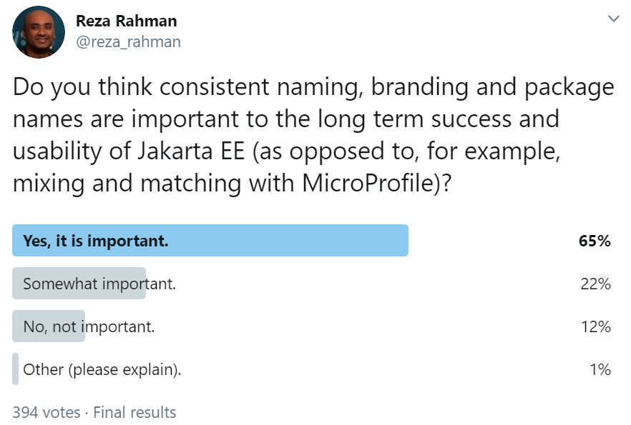
Configuration
Externalizing application configuration
Built-in stores
  Property files, Java system properties, environment variables
Extensible stores
  Kubernetes secrets
  Secure cloud storage
  NoSQL stores
@Inject into code
Reference in EL
Reference in XML
MicroProfile alignment

Slide 26
Configuration Examples
@Inject
@ConfigProperty(name = “admin.group”, defaultValue=“admin”)
private String adminGroup;
persistence.provider=org.hibernate.ejb.HibernatePersistence
persistence.datasource=java:app/jdbc/CargoTrackerDatabase
persistence.schema.generation.database.action=create
<data-source>
<name>java:app/jdbc/CargoTrackerDatabase</name>
<class-name>org.apache.derby.jdbc.EmbeddedDriver</class-name>
<url>jdbc:derby:${temp.dir}/cargo-tracker-database</url>
</data-source>

Slide 27
Ways of Contributing
Follow Jakarta EE technologies that interest you and share opinion
  https://jakarta.ee/connect/mailing-lists/
Advocate for a specific change or feature
  https://jakarta.ee/projects/
Help implement a change in API, specification, TCK or implementation
  Sign Eclipse Contributor Agreement
  https://www.eclipse.org/legal/ECA.php
  Becoming a committer comes much later
Engage an Ambassador if needed
  https://jakartaee-ambassadors.io

Slide 28
Beyond Jakarta EE 10
Persistence alignment with Java SE Records
JSON schema support
Reactive/NIO support
  Servlet, REST, MVC
  Persistence - requires reactive/NIO JDBC, ideally in Java SE
Making modularity and embedded runtimes required

Slide 29
Summary
Jakarta EE 8, 9, 9.1 very significant for the future of Java
Many possible important changes for Jakarta EE 10 and beyond
The time to get involved is now!
Notes:
Jakarta EE 9/9.1 another important critical step in the transition towards openness.
Jakarta EE 10 can bring important innovations that you can help shape and contribute to.

Slide 30
Resources
Jakarta EE Community alias
  https://accounts.eclipse.org/mailing-list/jakarta.ee-community
Jakarta EE Twitter handle
  @JakartaEE
Jakarta Tech Talks
  https://www.meetup.com/jakartatechtalks_
Notes:
The Jakarta Tech Talks has valuable content.
The Jakarta EE Community alias is a good entry point to discuss all things Jakarta EE.
The official Jakarta EE Twitter handle is a must for important updates on the technology.

Slide 31


