Slide 1
Performance Analysis and Troubleshooting Methodologies for Databases
Peter Zaitsev,
CEO, Percona
February, 2021

Slide 2
Databases and Performance
Databases are Frequent Troublemakers!

Slide 3
Why ?
Non Linear Scalability
Complex
Often Poorly Understood by Developers

Slide 4
Performance Related Tasks
Troubleshooting
Capacity Planning
Cost and Efficiency Optimization
Change Management

Slide 5
Two Points of View
Application Developer
Sees Database as Blackbox
Database Operations (DBA, DBRE etc)
Sees Database as a Whitebox

Slide 6
“Developer Point of View”
Database as a BlackBox
I can Connect to the database
I Query it from My Application
It Responds Quickly and Correctly

Slide 7
Ops Point of View
Load
Resource Utilization
Index Usage
Contention
System/Hardware Problems
Scaling/Capacity Planning

Slide 8
Specific Methodologies

Slide 9
Most Typical
Finding Solutions by Random Googling

Slide 10
Problems with Random Googling
Hard to Assure Outcome
Hard to Train People
Hard to Automate

Slide 11
There are Better Ways!
USE (Utilization, Saturation, Errors) Method by Brendan Gregg
RED (Rate, Errors, Duration) Method by Tom Wilkie
Golden Signals (Latency, Traffic, Errors, Saturations) Method by Rob Ewaschuk

Slide 12
USE Method

Slide 13
USE Metod Basics
Developed to Troubleshoot System Performance Issues
Resolve 80% of Problems with 5% of Effort
Operating System Specific Checklists Available

Slide 14
USE Method in one Sentence
“For Every Resource check Utilization, Saturation and Errors”

Slide 15
USE Method Terminology
Resource
all physical server functional components (CPUs, disks, busses, ...)
Utilization
the average time that the resource was busy servicing work
Saturation
the degree to which the resource has extra work which it can't service, often queued
Errors
the count of error events

Slide 16
Resources
CPUs
sockets, cores, hardware threads (virtual CPUs)
Memory
Capacity
Network Interfaces
And their buffers
Storage Devices
I/O, Capacity
Controllers
Storage, Network Cards,
Interconnects
CPUs, Memory, I/O

Slide 17
USE Method and Software
Same Basic Resources Apply
Additional Software Resources Apply
Mutex Locks
File Descriptors
Connections

Slide 18
USE Method Benefits
Proven Track Record
Broad Applicability
Detailed Checklists Available

Slide 19
USE Method Drawbacks
Requires a Good Understanding of System Architecture
Required Access to Low Level Resource Monitoring
Hard to Apply in “As-a-Service” Environments

Slide 20
USE Method and Linux
http://www.brendangregg.com/USEmethod/use-linux.html

Slide 21
Meet Percona Monitoring and Management (PMM)
Purpose Build Platform for Open Source Database Troubleshooting and Performance Optimization
100% Free and Open Source
Easy to Setup
Based on Leading technologies in Open Source Observability Space
http://per.co.na/PMM

Slide 22
CPU Saturation

Slide 23
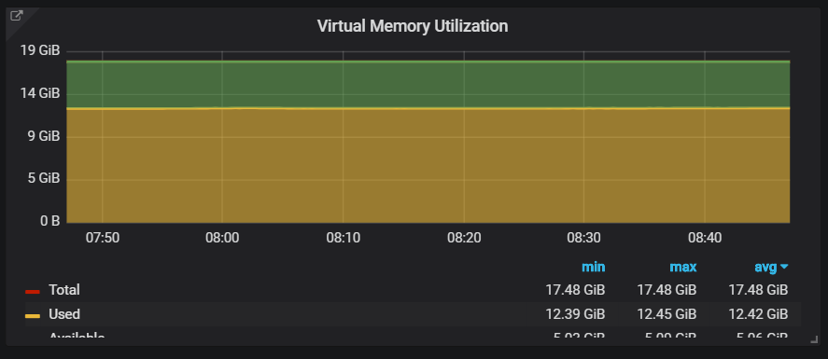
Memory Usage

Slide 24
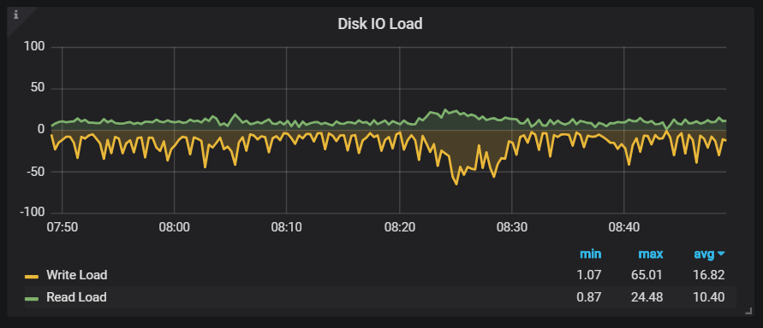
Disk Saturation

Slide 25
Disk Saturation through Latency Changes

Slide 26
MySQL Utilization

Slide 27
MySQL Saturation

Slide 28
RED Method

Slide 29
RED Method Focus
Microservices
“Cattle not Pets”
Mapping to Resources can be fluid
As-a-Service Model – Internal details may be unknown

Slide 30
RED Method
For every Service Request check these are within Service Level Objective (SLO)
Rate
Error (Rate)
Duration (Distribution)

Slide 31
Red Method for Databases
Looking at Service Level
Looking at Individual Database Server
Can be applied to Specific Applications/Users
Can be applied to Individual Queries/Transactions

Slide 32
RED Method Benefits
Easily Maps to what Developers Care About
1
Does not require as deep understanding of Architecture
2
Does not need access to low level resource monitoring
3

Slide 33
RED Method Drawbacks
Tools and checklists are less developed
More focused answering WHAT is wrong rather than WHY

Slide 34
Different Views

Slide 35
Custom RED Method Dashboard
https://grafana.com/grafana/dashboards/12470

Slide 36
Four Golden Signals

Slide 37
Focus
From “Monitoring Distributed Systems” Chapter in SRE Book
Can be used for Alerting, Troubleshooting, Trend Analyses

Slide 38
Four Golden Signals
Latency
Distribution not just Average; Latency for Successful requests vs Errors
Traffic
How much Demand is being placed on the System
Errors
Error Codes are Easy; Bad Content is hard
Saturation
How Full your system “capacity”. Forecast when Possible.

Slide 39
For Golden Signals And Databases
Latency
Query Response Time by Database Instance and Query Type
Traffic
Number of Queries of Specific Type Served
Errors
Connection Failures and Query Error Codes
Saturation
How much Load Database Can take vs Max ? Also Connections, Disk Space etc

Slide 40
Golden Signal Benefits
Methodology now well tested by SREs
Good Resource Book, Many Resources Available

Slide 41
Golden Signals Drawbacks
Framework for Monitoring first of all
No Specific Troubleshooting Checklists available

Slide 42
Take Aways
Multiple Methods are Available
Pick what Makes sense for your circumstances
Or invent your own Method combining those and others
Just do not settle for Random Googling

Slide 43
Thank you, Let’s Connect!
https://www.linkedin.com/in/peterzaitsev/
https://twitter.com/PeterZaitsev

