Slide 1
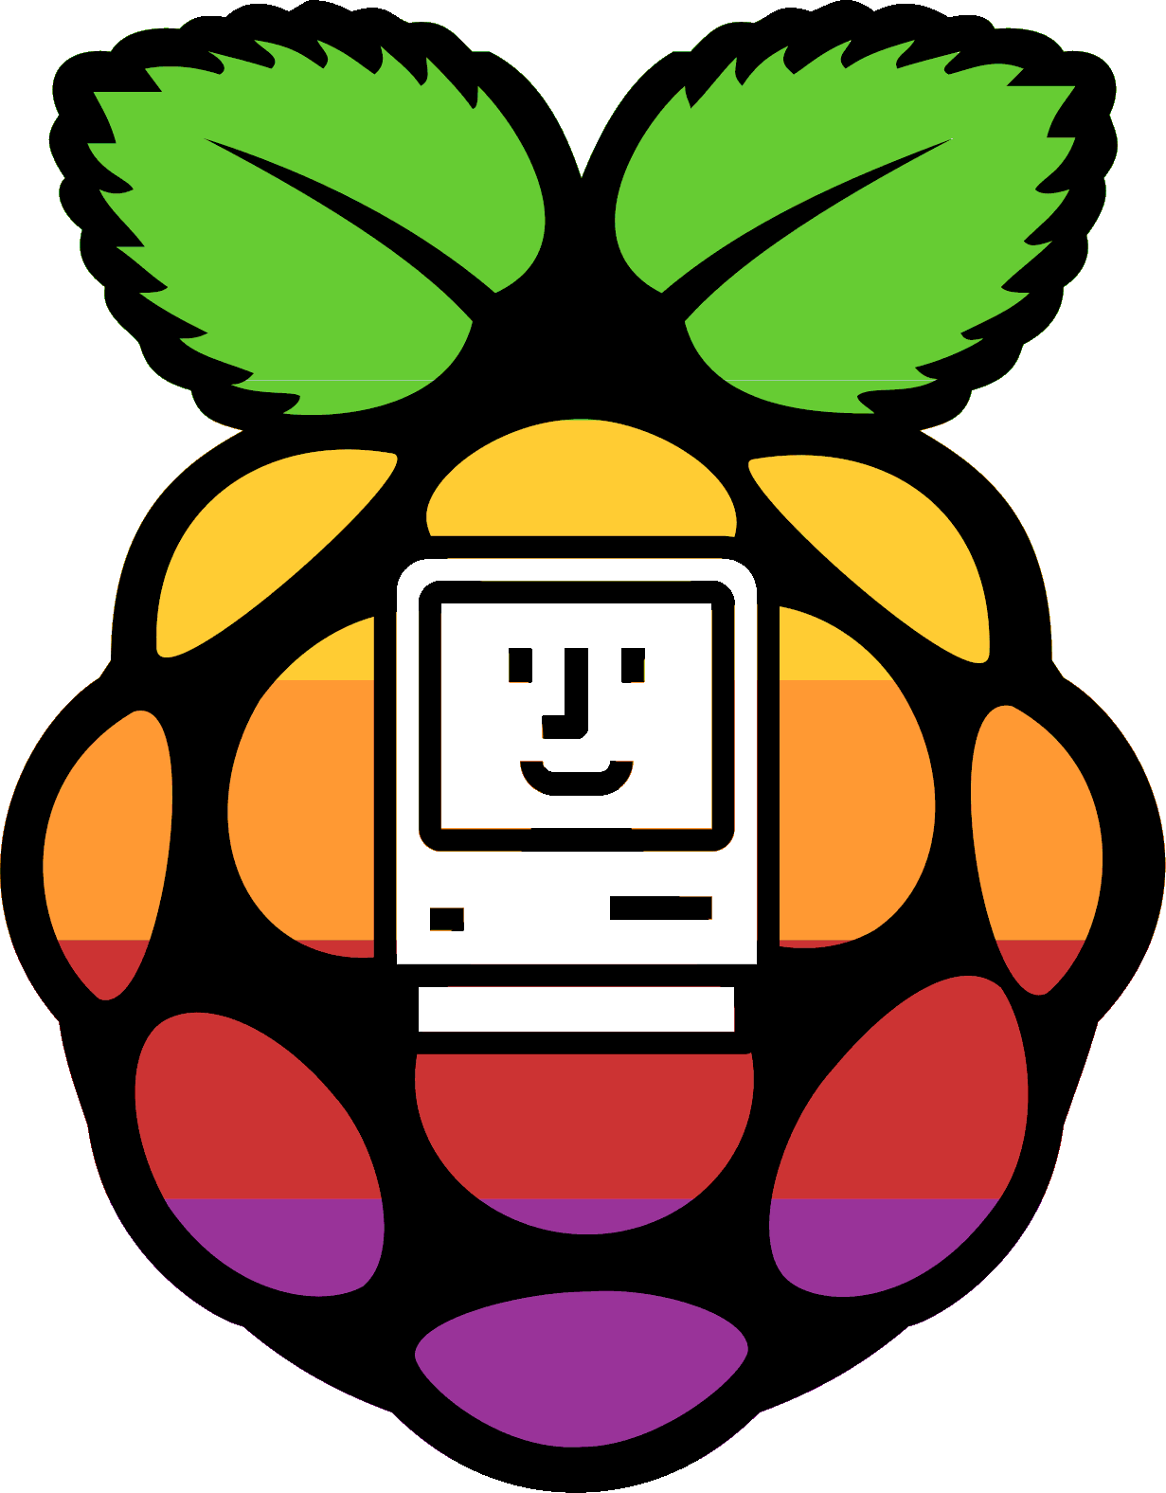
RaSCSI for 68k Macs Background, Current Status and Roadmap
FOSDEM 21
Tony Kuker
07-Feb-2020
Notes:
Welcome to the 2021 Free and Open Source Software Developers European Meeting
Today, walking about an open source project called RaSCSI…. We’ll give you some background on the project, share its current status and give you a peek at the roadmap for future development efforts
Introduction
Tony Kuker
Apple user since the 1980’s when my 4th grade teacher gave me a BASIC manual and an Apple IIe to program during recess on rainy days.
I’ve been an Apple user ever since
Day job as embedded systems / software engineer in the avionics domain. I’ve worked on a number of different embedded systems from safety critical avionics to in flight entertainment devices
Been a fan of Rasperry Pi’s since they first appeared on the market
During the pandemic, Picked up working RaSCSI Perfect marriage of interests

Slide 2
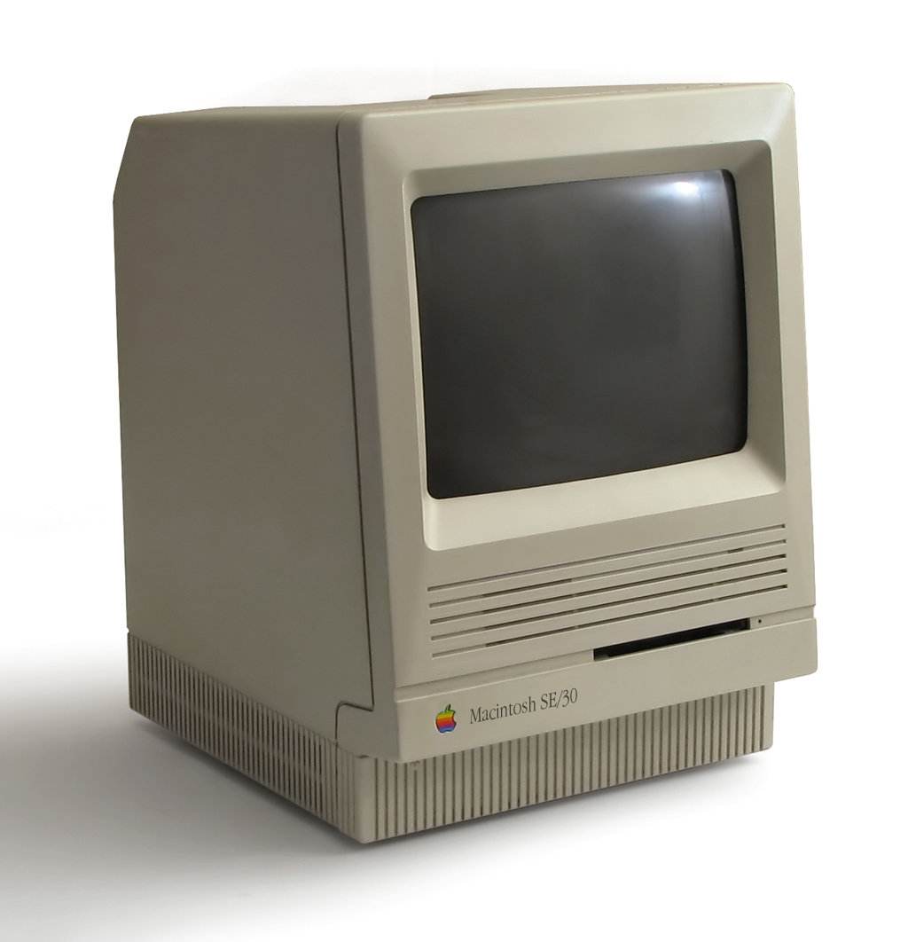
What is RaSCSI?
Raspberry Pi + Parallel SCSI = RaSCSI
RaSCSI Board
Mac SE/30 – CC BY SA 2.5 Danamania
SCSI Logo – Public Domain
Raspberry Pi Logo – Copyright Raspberry Pi Foundation
SCSI: Small Computer System Interface
Notes:
RaSCSI is:
Interface board that allows software on the Raspberry Pi to read/write signals on a SCSI 1 or SCSI 2 bus
Software service that runs on the Raspberry Pi that manages the communication
“Bit bangs” the SCSI data on the bus
SCSI isn’t extremely timing dependent
Request & Acknowledge signals allow for Raspberry Pi to communicate reliably
Based upon standard Linux distribution, so definitely NOT real-time

Slide 3
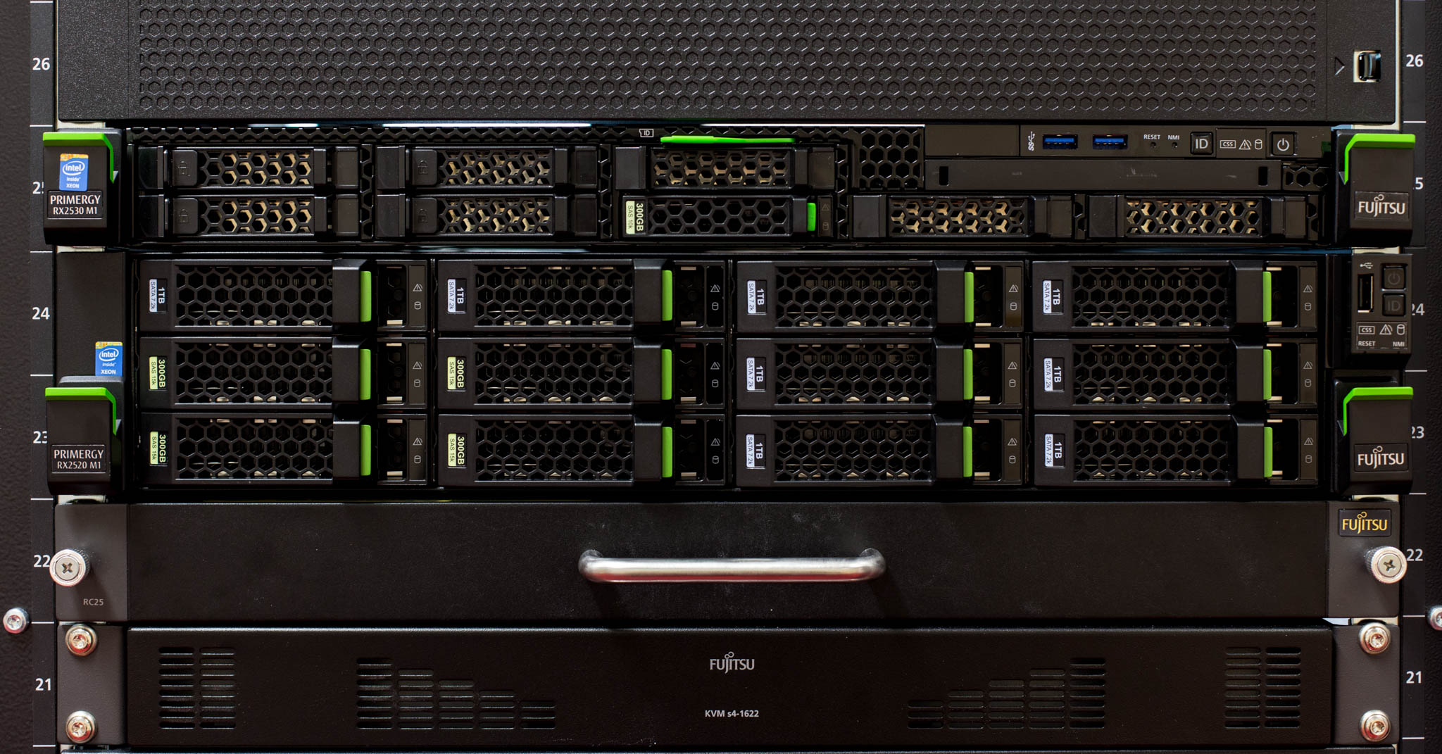
What use cases is RaSCSI *NOT* trying to fill?
Wide SCSI, high performance SCSI
Serial Attached SCSI (SAS)
Mission critical use cases
Server Rack Image – CC BY-SA 4.0 Trique303
Notes:
Built upon standard Linux Raspberry Pi OS
Performance is OK
Old SCSI devices relied on Z80 class processors
Gigahertz plus Raspberry Pi still does better
Current RaSCSI does not do Wide SCSI
Not enough GPIO
No Serial Attached SCSI
Not recommended for mission critical use cases
Its open source
It’s a hobby project

Slide 4
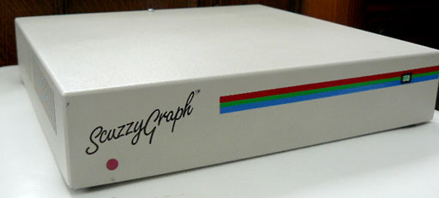
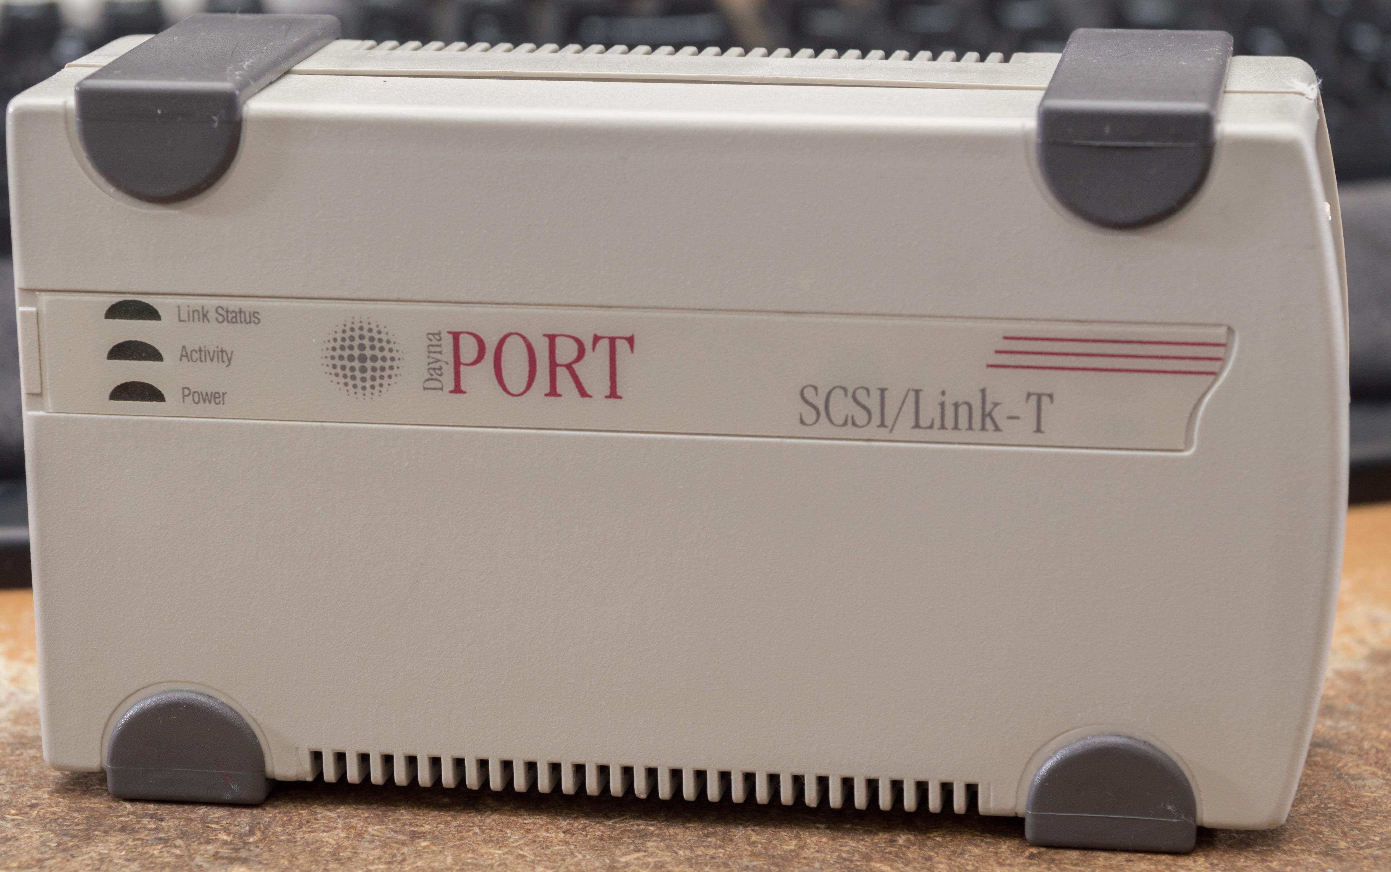
What use cases is RaSCSI trying to fill?
Replacement for failing vintage mechanical drives
Hard disks, CD-ROM, Magnetic Media
Emulation of rare vintage SCSI Peripherals
SCSI Ethernet Interface
SCSI Display Adapter (ex: Scuzzy Graph)
“Host Bridge” (X68000)
ScuzzyGraph – Fair use
DaynaPort – Fair use
Notes:
RaSCSI is not intended to be everything to everyone
Use cases include:
Replacement for failing vintage mechanical drives on vintage computers
Hard Disk, CD-Rom, Magneto-Optical drives
Emulating rare/unique vintage SCSI devices
SCSI Ethernet interfaces – made for a while for devices with SCSI
DaynaPort SCSI/Link-T, NuvoLink, Asante
DaynaPort also available on the AtariST “FreeMint” OS, using Roger Burrows driver
Roger did a fantastic job figuring out most of the DaynaPort functionality
Big benefit of using Raspberry Pi – You have a full Linux network stack and flexible file system management
Microcontroller based solutions are more deterministic, but don’t provide the swiss army knife for network configuration
Display adapters
Allowed a black and white Mac to use an external color display
Scuzzy Graphs are like unicorns – they are rumored to exist, but very very rare
Someday, hope to find one to emulate
“Host Bridge” for the Sharp X68000
Requires special driver written by Gimons
Currently only available for the Sharp X68000

Slide 5
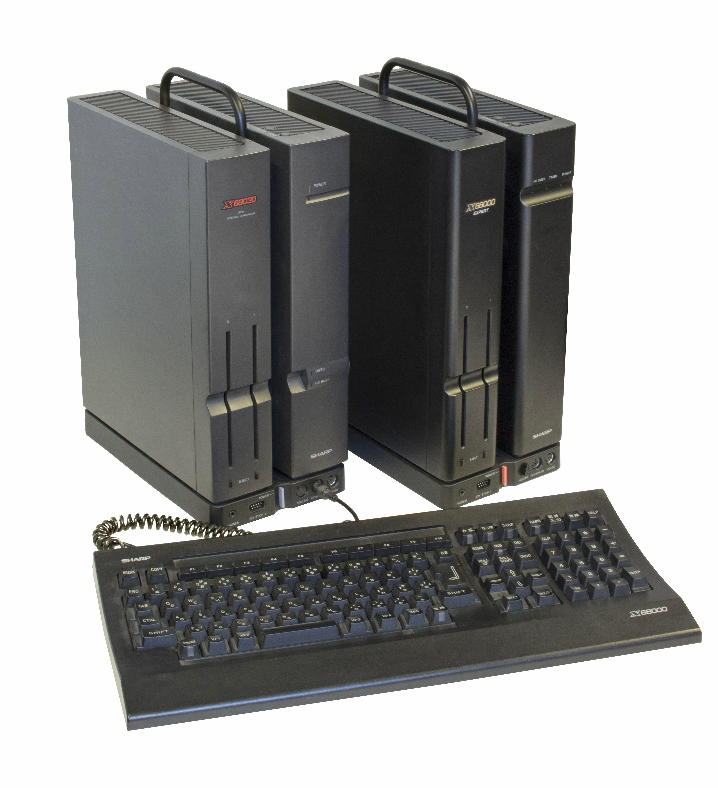
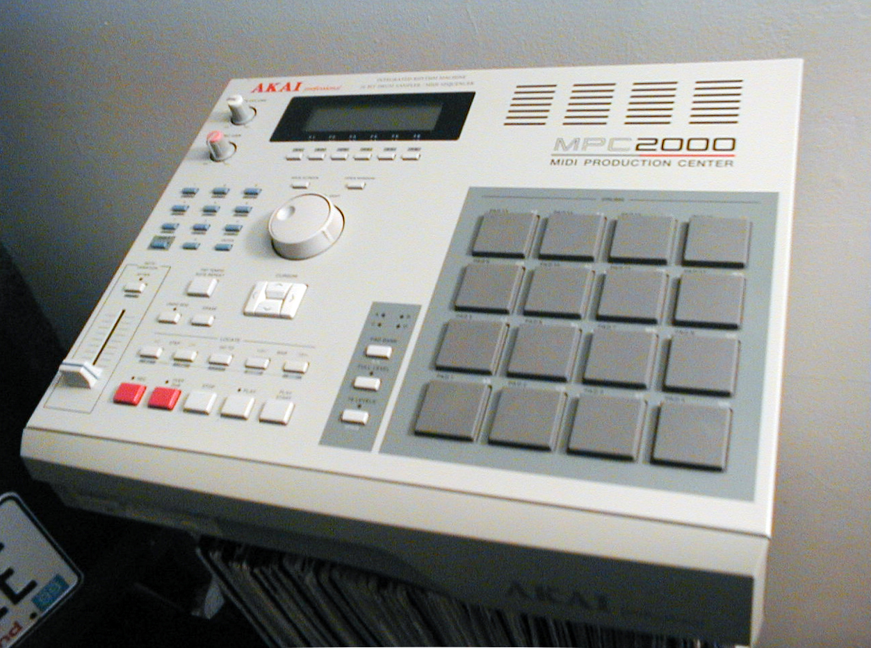
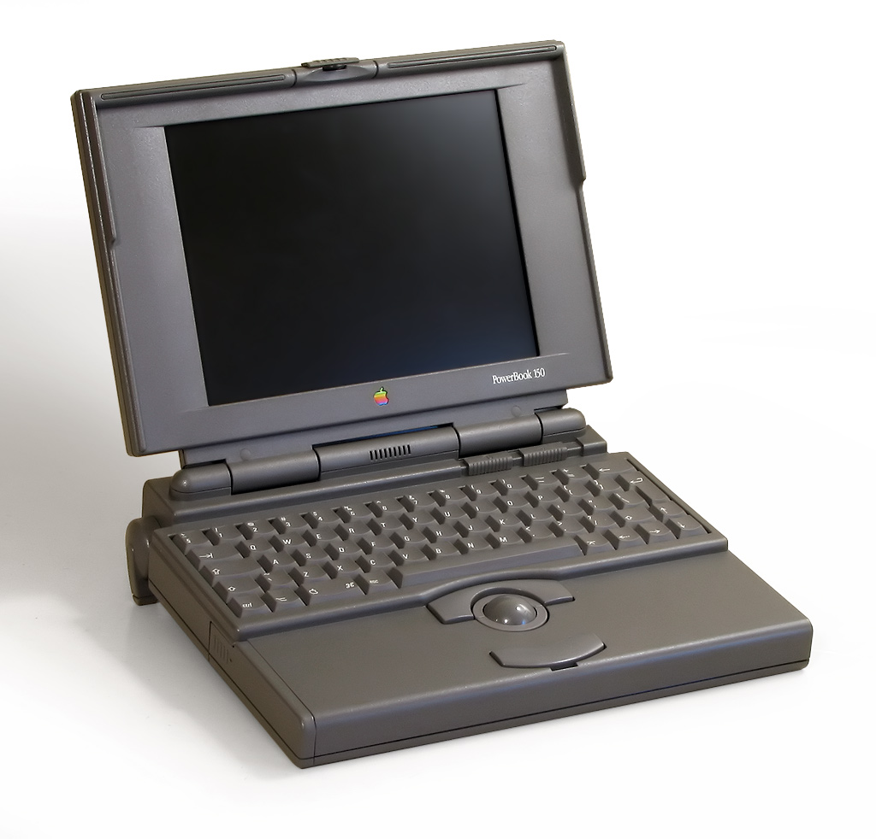
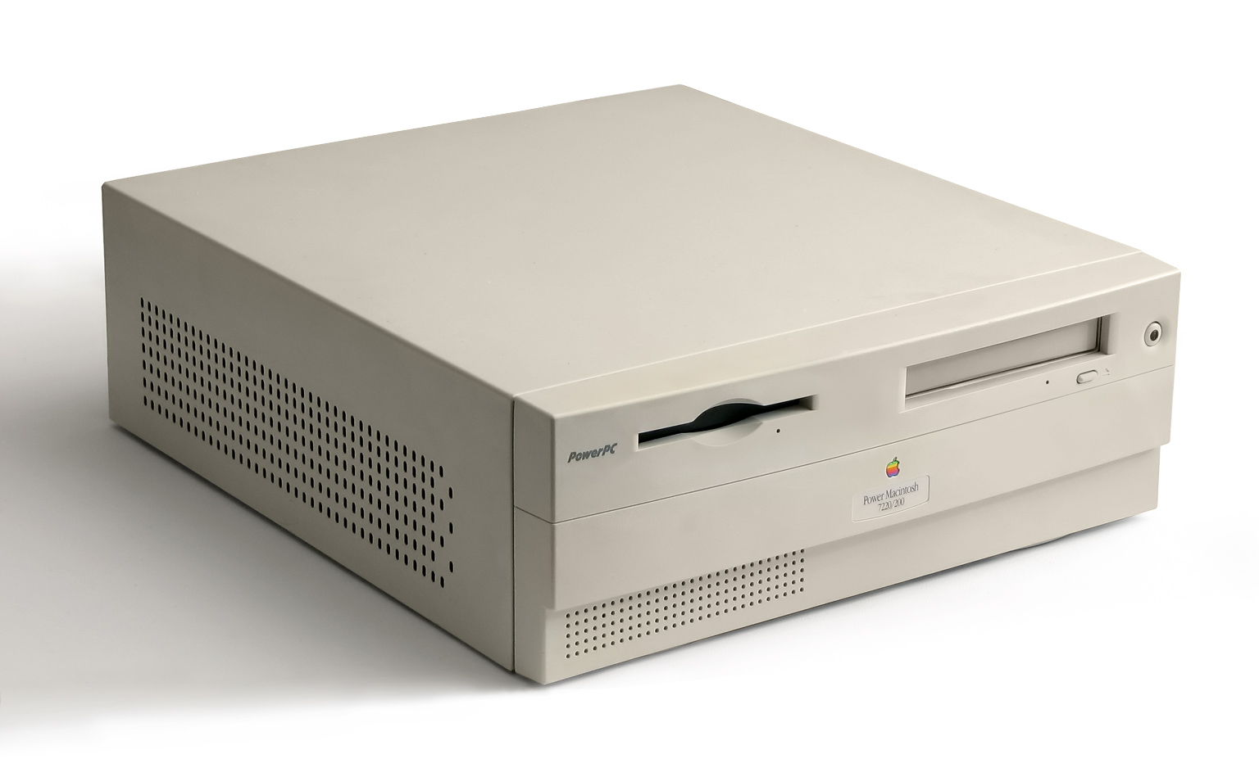
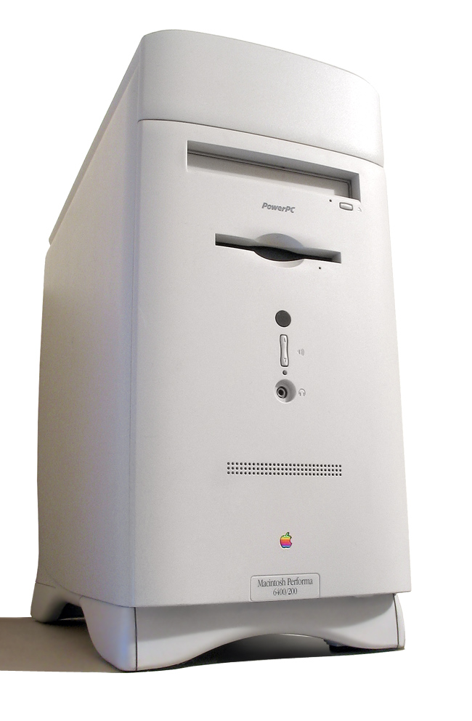
Where has it successfully been used?
https://github.com/akuker/RASCSI/wiki/Compatibility
Mac Images licensed under CC-SA by Danamania
X68000 image licensed under CC BY-SA by Manupkp
AKAI Sampler – Public Domain
Notes:
Where has RaSCSI been used?
Originally developed for the Sharp X68000
68kmla version is untested with Sharp X68000. One report that it does NOT work.
Many, many, many 68k and PowerPC Macintoshes
Mac Plus up to Power Mac G3
Mac Plus can not boot from RaSCSI, due to design of Mac Plus
Several SE/30 users
Akai Samplers
Ubuntu Intel i3 w/ PCI SCSI card
List of tested systems on the wiki

Slide 6
How does it work?
Resistor: CC BY 2.0 – Sparkfun
SN74LS641 – © Texas Instruments, Fair Use
SCSI Port – CC BY-SA 3.0 Charles Bunnell CB1226
Raspberry Pi – CC BY-SA 4.0 Butix, based on works by Lucasbosch and Cmykey
Notes:
Basic requirement for SCSI is that each end of the bus must have termination
Two options – Active or Passive
RaSCSI uses passive. 220ohm 5v pull-up and 330 ohm pull down resistor on each signal line
Around 3v on each signal while idle
RaSCSI is built around the SN74LS641 bus transceiver from TI
Open collector or tri-state outputs, based upon the “direction” of the transceiver
When direction is output
Low output - grounds the signal and must be able to sink at least 46mA of current
High output – open
When direction is input, RaSCSI can read the current state of the signal
RaSCSI GPIO is 3.3v logic

Slide 7
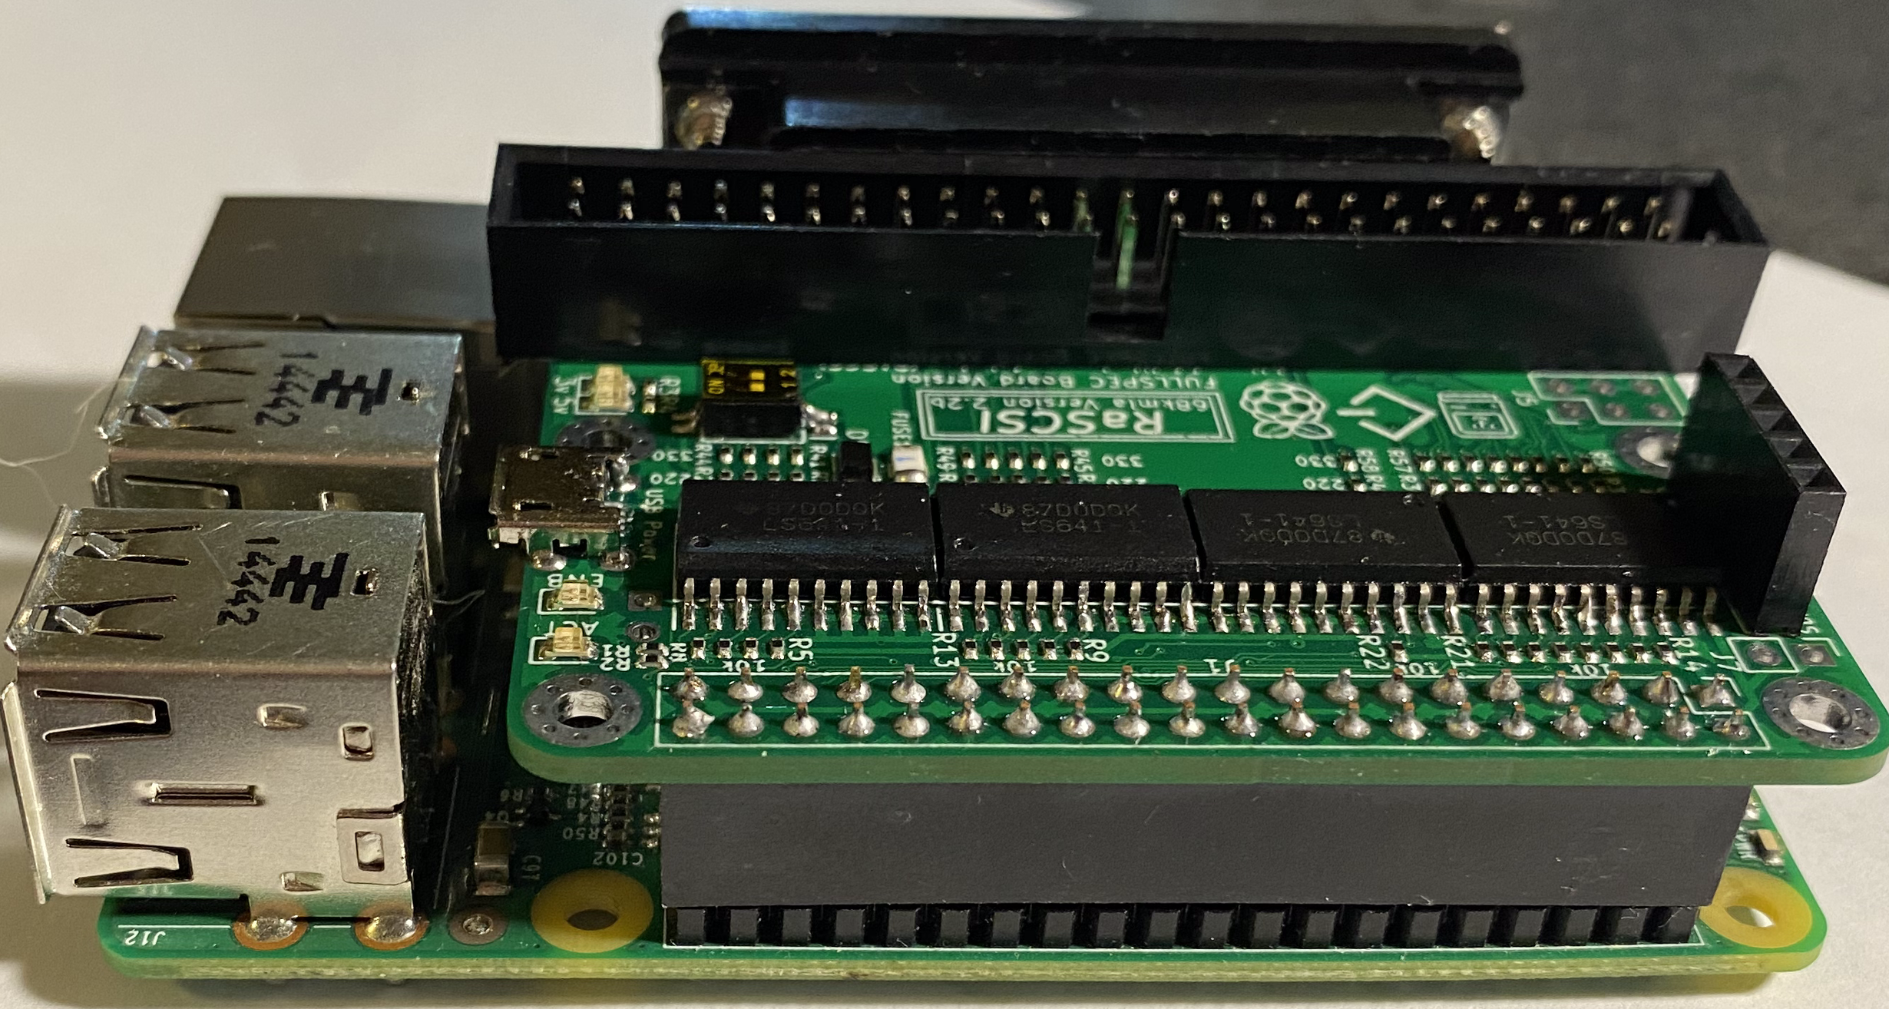
Types / Configurations
Direct Link
Target Only
Full spec
No transceivers
Directly connect Pi GPIO to SCSI
Cable & PCB versions
Potential for long-term damage to Pi
Operates as SCSI Target Only
Direction of data lines hard-wired to IO signal
Supports SCSI Target or Initiator modes
Able to create disk images
Notes:
Direct Link
Easiest/simplest way to do connect RaSCSI
No transceivers – just connect the Raspberry Pi GPIO
Circuit boards are available, or just hard-wire a connector
Voltages of the signal/data lines are typically 0v or 3v, so this should work with Raspberry Pi GPIO
However, SCSI Spec requires 48 mA of current sink. Raspberry Pi is designed for ~18mA
Potential for damage to the Raspberry Pi, since using it outside of its design limits
Target Only
Uses the 74LS641 transceivers
Direction of the transceivers is directly tied to the IO SCSI signal
Can only act as a “Target”
Can NOT initiate transactions
The Initiator needs to ask for data
Full Spec
Similar to Target Only, but with more flexible transceiver direction control
Allows RaSCSI to “initiate” transactions
RaSCSI can act as a “host” and read drives
Most RaSCSIs are Full Spec – should say on the board
Different software is needed, depending upon which type you have
RaSCSI prints this out when it starts up

Slide 8
Comparison to other SCSI emulator devices
 | RaSCSI (68kmla edition) | RaSCSI (GIMONS) | BlueSCSI | SCSI2SD | MacSD
Hard Disk | ✅ | ✅ | ✅ | ✅ | ✅
CD-ROM | ✅ | ✅ | ❌ | ✅ | ✅
Floppy Disk | ❌ | ❌ | ❌ | ✅ | ❌
Magneto-Optical | ✅ | ✅ | ❌ | ✅ | ❌
Ethernet | ✅(Beta) | ✅ | ❌ | ❌ | ❌
CD Audio | ❌ | ❌ | ❌ | ❌ | ✅
Cost | $45 ($30 kit) + Pi Approx €37 (€25) | 7,200 JPY + Pi Approx $65 Approx €57 | $25 (complete kit) Approx €20 | $62 Approx €51 | $129 Approx €107
Notes:
Different SCSI emulators have different benefits
RaSCSI
Energized developer community
Fully open source
Full Linux software stack available to add new features
BlueSCSI – fork of ArdSCSino-stm32
Very low cost solution to replace failing hard disks
Fully open source
Collaboration with the RaSCSI community
If you need 20 of them, BlueSCSI is your best option
SCSI2SD – Proven, stable, mature product
Been around for years
No current path to support Ethernet
Older versions were open source
SCSI2SD v6 has great performance, but closed source
MacSD – relatively new
Supports CD Audio
Easy setup
Great documentation
Active developers adding new features.
Closed source

Slide 9
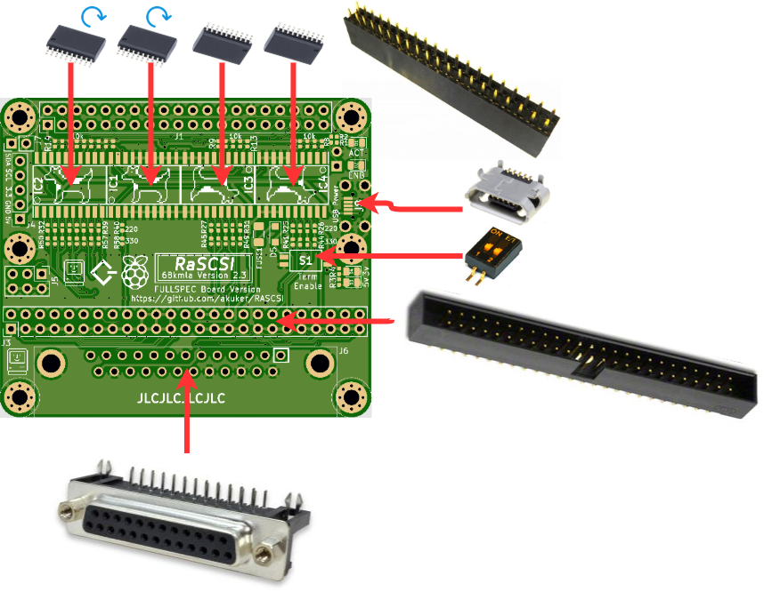
Assembly
Assembly demonstration:
https://youtu.be/tUgxcchH2yg
Kits from Tindie have small surface mount resistors, LEDs, fuse and diode pre-installed
Notes:
RaSCSI available pre-built or in kit form
From Tindie, the 0402 resistors, LEDs fuse and diode are all pre-populated
Basically, whatever SMT parts JLCPCB has available
Through-hole parts, connectors and transceivers are included with the kit
Allows for flexibility in how you assemble everything
PotatoFi has a video walking you through the process of assembling them
Notice that IC1 and 2 are reversed from IC3 and 4
Everything is fully open source – you can have your own PCBs made
Would not recommend manually soldering the 0402 resistors (unless you’re brave)
Could also modify board to use through-hole or just skip them completely and not have termination
Would need external terminator

Slide 10
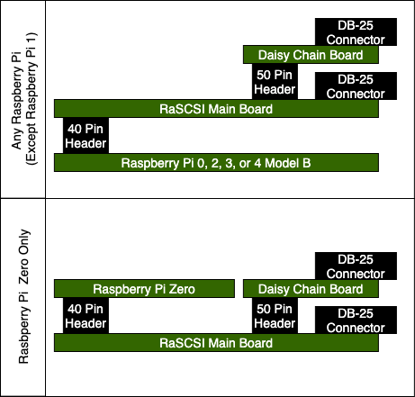
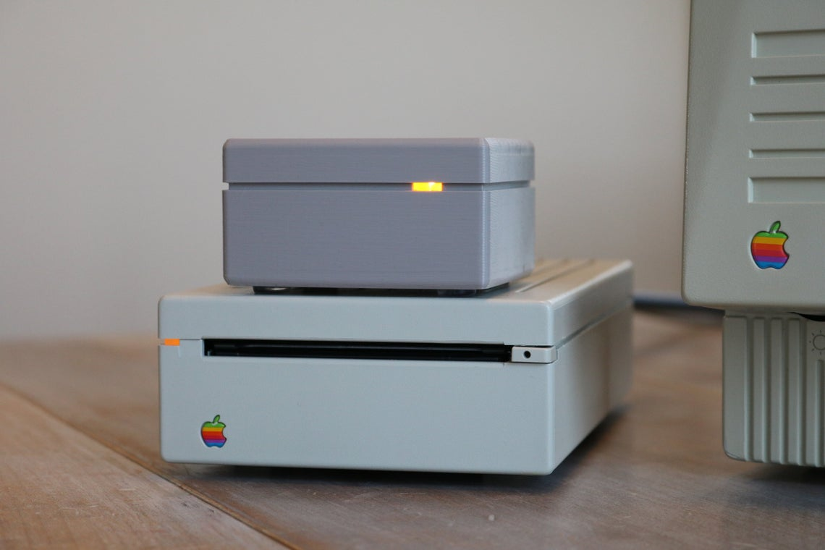
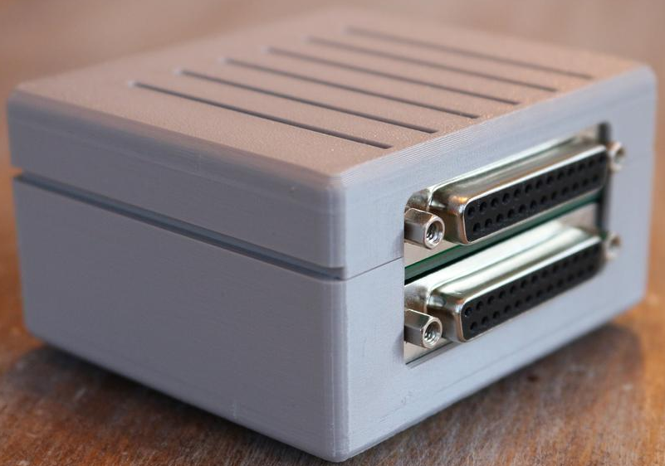
Assembly Options
Standard Configuration
3D Printed case
https://www.etsy.com/shop/PotatoFi
Compact Configuration
Notes:
With the kit, if you have a Raspberry Pi Zero without the header pre-soldered, you can install it above the RaSCSI board
This allows for compact size but…
Prevents access to HDMI and power connector – Can use connector on RaSCSI to power everything
Will not work with other Raspberry Pis (without getting creative)
Pre-build boards are all assembled in “Standard” configuration
PotatoFi has created a 3D-Printable enclosure for the Compact configuration
Available on Etsy for a great price – he even includes an LED
Or…. Coming soon, the model will be available for download to print your own

Slide 11
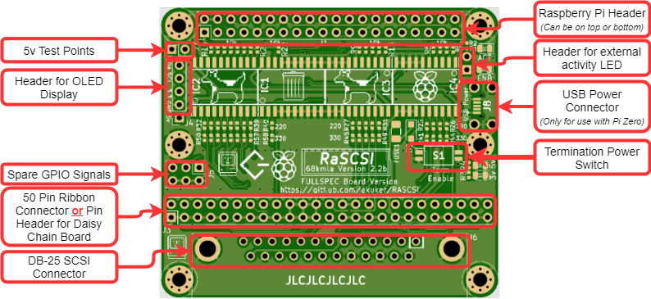
Anatomy of a RaSCSI
Notes:
The RaSCSI board has a lot crammed onto a small board
At the top – header for connecting to the Raspberry Pi
Standard Raspberry Pi GPIO pinout
Should work with other DIY boards with compatible pinouts
Header of OLED display
Optional piece for showing which drives are installed
50 pin ribbon connector
Can be used inside the computer as an internal drive
Or, can have the daisy-chain add-on board connected to it
25 pin SCSI connector
Standard SCSI connector used on most Macintosh desktop computers
Termination Power Switch
Allows you to turn on/off termination power
Both switches should be turned ON or OFF
USB Power Connector
For compact configuration, this is needed to power the Raspberry Pi
The Pi Zero’s connector can be blocked by the Daisy Chain board
Not needed for standard configuration
External activity LED header

Slide 12
How to Control RaSCSI
Web Interface
Command Line Utility
Netscape 4 Compatible
Notes:
RaSCSI can be controlled/configured two different ways – Web interface or command line
Web interface is compatible with Netscape 4
Allows you to control directly from the device
Also works with newer browsers
You can upload disk images directly, download them, attach them
Allows for directly downloading a file from an abandonware site and copying it to an “ISO” that can be read by the Mac
Rasctl is the command line utility that allows you to do the same functions as the web interface
Behind the scenes, the web interface is still using rasctl
Separate application – does not require root access
When you run it, it connects to a socket that is opened by the RaSCSI service
Rasctl sends the command and receives the response
Unfortunately, no network security in place right now
Anyone that can access the Pi can change its SCSI configuration
Only recommended for use on closed networks

Slide 13
Benchmarks
Test platform:
Macintosh Quadra 840av
68040 Processor at 40MHz
128MB RAM
1MB VRAM
Seagate ST3600N 500MB HD w/stock Apple firmware
MacOS 8.1
Drive cache configured at 128KB
Norton System Info 3.5
Notes:
Different versions of Raspberry Pis do seem to have an impact on performance
Norton System Info was used to test different Raspberry Pi models, along with SCSI2SD v5 (because that’s all I have on hand)
Raspberry Pi 4 currently has the highest benchmarks
Even Raspberry Pi 0 had better performance than the stock Seagate spinning disk
Tests with SCSI2SD v6 were much higher. @nulleric recorded a score of 247 on a PowerMac G3 with a SCSI2SD v6.
The higher score was likely influenced by a much faster computer, as well as a much faster SCSI device
On slower machines with 68030 and slower processors, the SCSI device isn’t going to be the bottleneck
If you’re using a Macintosh SE, a Raspberry Pi Zero is plenty fast

Slide 14
History
2017 – Original RaSCSI version created by Gimons
Support for Hard disks, Magneto-Optical, CD-ROM and X68000 Host Interface
2017 - K55 started thread on 68kmla.org
2020 – Created version with DB-25 and 50-pin SCSI connectors (akuker)
2020 – Code translated to English and uploaded to Github (akuker)
2020 – rascsi.com wiki page created & organized (phrax0, nulleric, akuker)
2020 – OLED status display added (akuker)
2020 – Python-based rascsi-web control interface (nulleric)
2020 – Easy install script created (sonique6784 & nulleric)
2020 – System 6 screen mirroring proof of concept (jcs)
2021 – Beta SCSI Ethernet functionality released (akuker)
Notes:
All credit for the hard work goes to Gimons. Original architect of the project
Published in 2017, maybe earlier?
Schematics and source code made available on his website
Originally intended for the Sharp X68000 computers
Developed the “host bridge” functionality
Allows X68000 to directly access Raspberry Pi’s file system
Also allows Ethernet access for the X68000
Also in 2017, K55 started thread on 68kmla.org
Built a couple boards and provide that this could be used with vintage Macs
In 2020 – I jumped in
Laid out board with DB-25 and 50 pin header connectors for more flexibility
Made daisy chain daughter board
“Forked” the code on Github
Gimons had released source code as zip files on his site
Initial version based on 1.47
Translated the C++ code comments to English – with lots of help from Google Translate
Simple python script to show the currently installed SCSI devices on a cheap OLED display
Translated ZTTO’s rascsi-php web interface to English
Phrax and Nulleric joined in
Pulled together some fantastic documentation on github
Nulleric created a Python-based web interface to control the configuration of RaSCSI
This allows direct control of the drives from the Mac
You can open Netscape 4, connect to the Raspberry Pi to:
Insert/eject CDs
Attach/detach drives
Check the status of the RaSCSI software
You don’t need a separate device/interface to control RaSCSI
October 2020 - Sonique and Nulleric created an easy install script. You can set up a new RaSCSI device with only a couple commands
October of 2020 Joshua Stein created a screen mirroring proof of concept
2021 - DaynaPort SCSI/Link emulation released in beta form

Slide 15
Plans for 2021
Release Ethernet over SCSI into production build
PowerBook compatible hardware version
Add support for un-patched Apple CD-ROM driver
Better support for different disk image formats
.toast .img
Configuration & Logging improvements
Notes:
2021 – Keep the momentum going!
Clean up DaynaPort SCSI/Link emulation and improve documentation
Create setup tools/instructions for wired and wireless networking
Pull software into main release build
Improved regression test suite
Release version with high density 40 pin connector for PowerBooks
3D printable mounting mechanism
Add zip drive emulation – I love my zip drive
Allow using standard Apple CD driver
Right now, you need to use a patched version
Support more image formats
Toast, Apple IMG files
Improved configuration and logging
Method to save existing configuration so that it restores after a Pi reboot
Move to a GitFlow branching model and establish version numbering

Slide 16
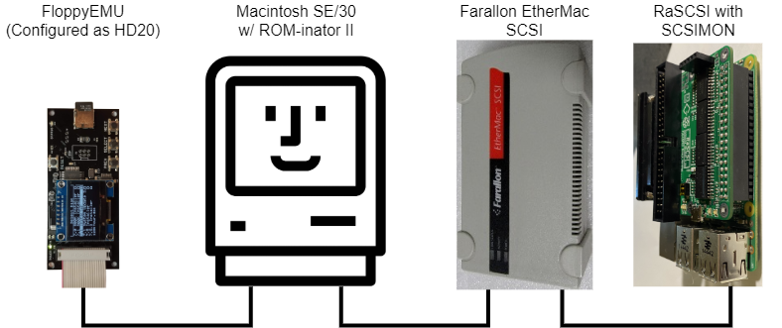
Reverse Engineering - SCSIMON
Note: Farallon EtherMac SCSI is a rebranded DaynaPort SCSI/Link
Special thank you to @PotatoFi for generously loaning out his Farallon EtherMac SCSI for this project!
ROM-inator II – BMOW
Floppy EMU – BMOW
Farallon EtherMac – PotatoFi
GTKWave – GTKWave Project
Notes:
Implementing Ethernet emulation required a way to monitor the SCSI bus traffic
Budget didn’t allow for a fancy logic analyzer
It did allow for a second RaSCSI
Developed SCSIMON tool
Command line tool that monitors the SCSI bus – read only
While its running, caches the data in memory
As soon as you stop, dumps the data in to a “VCD” file – value change dump
VCD can be opened with GTKWave to analyze the data
Went through a few iterations, but got down to ~80ns accuracy on the bus using a Raspberry Pi 4
Another issue – booting from a SCSI drive introduced A LOT of extraneous traffic on the SCSI bus
Solution – Floppy EMU
Floppy EMU is able to emulate a HD20 hard disk, which connect via the floppy drive port
For the SE/30, this only works if you replace the stock ROM with ROM-inator
Able to boot from Floppy Emu with only the DaynaPort on the SCSI bus
Note: Farallon EtherMac is just rebranded DayanPort SCSI Link. EtherMac firmware even reports itself as a DaynaPort SCSI Link
No extraneous traffic!
Using this setup, was able to capture the DaynaPort’s traffic and compare it to RaSCSI’s emulated DaynaPort traffic
2005 Roger Burrows provided excellent documentation of how this interface works
Was written from the perspective of the driver
Missing some critical details about how the hardware side was implemented
Once I had an actual device (Thanks PotatoFi), I was able to capture a lot of data and fill in the missing pieces

Slide 17
How can I get involved?
Build your own
Schematics, Gerber files, bill of materials available on Github
Order one from Tindie – Kit or Pre-Assembled
If out of stock – more will be coming in late February
Join us on Discord - https://discord.gg/et8ENMGU3X
Join the discussion on 68k Mac Liberation Army
Try it out on your vintage hardware!
Notes:
To get involved
All of the design files are on Github
You can have your own boards fabricated using the existing design
Make updates to the design and have custom boards made
Please share improvements with the community
Order from Tindie
Kit version is only partially assembled, but includes everything you need to get started
You provide your own solder and tools
Assembled version is ready to go
International shipping – if your country is missing, let me know. I’ll add it
Price structure is intended to get RaSCSI into the hands of as many people as possible.
Hang out on discord
Support channel to get help
Developers channel to talk low level techie stuff
Off-topic channel to talk about whatever is on your mind
Channels for other SCSI-related projects – BlueSCSI, 68net, scuznet (Nuvolink emulator)
Help us test RaSCSI on different hardware
There are a lot of vintage platforms that support SCSI
We’d love to learn how well RaSCSI works with Nextstation, SPARCstation, AtariST, Amiga, Apple II, etc

Slide 18
Thank you!

