Slide 1
How to Start a Language on Mozilla Common Voice?
A case study for under-resourced Turkish Language
Bülent Özden
Computer Engineer (MSc), Harikalar Kutusu
Mozilla Common Voice Turkish Language Representative (2021-2022)
FOSDEM’22, 5th February 2022
Notes:
Hi, thank you for joining the session.
I’m Bülent Özden,
A computer engineer and
currently Common Voice Turkish Language Representative

Slide 2
Goal
«A Crash Course for Dataset Caretakers»
Lessons learned…
Notes:
I wanted to share the knowledge we accumulated in the last year while working on Common Voice Turkish dataset.
Turkish has been an under-resourced language and the dataset is problematic in many aspects.
There were individuals recording, but no language community, so we wanted to volunteer.
Most of the work I’ll be presenting will relate to Turkish, but these can directly be applicable to other languages.
I will try to keep the presentation simple, not academic or very technical except some pointers.

Slide 3
Take care of your dataset!
…or it will get biased!
Bias => BAD
Notes:
Let me state our most important finding first:
You should take care of your dataset!
----
Or it most probably will get biased
And Bias is a bad thing for machine learning!

Slide 4
Introduction
General view
Important to know
Notes:
As part of the introduction I’ll try to emphasize some handpicked information to show what is important.

Slide 5
CV processes are like a conveyor belt!
Add Sentences
Sentence Control 2 x Yes or No
Record Sentences
Listen to Sentences
2 x Yes / No
Text Corpus
Voice Corpus
If one fails, production rate/quality drops!
You need: Monitoring, Dedication, Time & a Crowd
It is a marathon !
Notes:
One must realize that the Common Voice processes are like a conveyor belt in a factory.
----
It consists of two main parts, Text Corpus and Voice Corpus, which are both fed into AI training.
----
And each part has two sub processes. The colors here indicate the easiness of the sub-process, light green means «easy», red «means» tough in terms of work needed.
----
Like in a factory, if one process fails, the production rate or quality drops. For example your dataset might become biased.
----
Therefore, as I mentioned before, «you need to take care of your dataset». Monitor it, dedicate some time, and find a crowd, as this is a crowd-sourced project.
----
If you cannot find the crowd required, you may find yourself in a position, where you are recording and validating many many sentences.
----
And don’t expect quick results, it will take time, it is a marathon!

Slide 6
Important to know!
Alphabet!
Conversational text / speech
CV is general purpose, not specific to application/method/model
It is not a «clean» dataset => Already somewhat «augmented»
Text Corpus: Max 14 words (default), keep it ~100 chars max
Voice Corpus: Min 1.5 sec, max 14 sec recording
Notes:
Your alphabet is important, it should be the same throughout the pipeline.
Conversational text / speech is preferred in the text corpus and it must be CC-Zero or Public Domain.
These are hard to find, but being public domain also means that you can modify the original.
Common Voice is a general purpose dataset.
Although it started with Mozilla Deepspeech, it can be used with many models, so we can relax the rules set previously by Deepspeech.
Common Voice dataset is not a clean dataset, it is not recorded in a studio environment.
With all different devices and background noises, it is already somewhat augmented.
This might be important to know while training your AI.
By default, Sentence Collector uses English rules, but you can define your own rules via a Pull Request in github.
The default English rules limit the sentences to 14 words.
There is no hard limit on the length of the sentences, but you should try not to go above 100-110 characters.
It becomes hard to read and error prone.
Also currently the recording is limited to 14 seconds, some slow speakers might hit that limit.

Slide 7
Bias
Deep Learning is a black-box
It is mostly data driven
Resulting AI is least interpretable
Bias => Near equal distribution / diversity!
Equal Gender & Age
Different Accents
Large # Speakers
Large # Sentences => Vocabulary
«Contamination» or «unbalance» cannot be reversed easily
Postprocess
Re-balance
Notes:
Deep Learning models are black-boxes, resulting AI is the least interpretable among alternative AI models.
You feed the data, and test the resultant AI. It is mainly data-driven.
----
And therefore, it can easily get biased in an uncontrolled crowd-sourced environment – which happened for Turkish.
In Common Voice, bias can arise from many places:
Gender
Age
Accent
Low number of speakers or a single speaker recording too much
Low number of sentences recorded too many times where AI gets biased to that vocabulary
Ideally, you will need equal distribution for best results, so you need to «know the dataset» and «take care of it».
----
If the dataset gets «contaminated» or «unbalanced», you have two options:
Post process the dataset and remove the contamination – which requires a lot of work
Or - Take corrective actions and re-balance it in the next dataset.

Slide 8
How much is needed?
This is for full training.
Depends on application
Fortunately we have transfer learning!
100 h ?
300 h ?
1000 h ?
2000 h ?
CER
WER
Real world performance
Notes:
What is your goal for a working Voice AI? How much data is needed?
It depends on the application and your corpus quality.
These are the numbers given on Common Voice website.
Let us do a simple calculation: If you can get 1 hour validated recording each day, it would take more than 27 years to reach 10.000 hours.
----
That much might be required for English, but fortunaly we –other languages- have «transfer learning» where we can use pretrained models of English as a starting point and train more rapidly, with much less data, on more common hardware AND with lower carbon footprint.
In our marathon, we will reach all these milestones, train our AI, measure the performance with Character Error Rate and Word Error Rate, implement it in an application and test it in the wild.
How much data will you need? That can only be anwered after you reached your specific goal.

Slide 9
Starting a language
Requirements
Resources on CV
Notes:
You want to start a language or get your hands on your orphan dataset?

Slide 10
Requirements to start a language
Add 5000+ CC-0 / Public Domain sentences
Translate 75% of the UI
Request the language in Discourse/github
For Turkish it was easier
We already had a working language/dataset
UI was at 83% => translated the remaining
Localization of examples!!!
Sentence Collector translations
Notes:
You need at least 5000 public domain sentences.
You can extract them from old works which became public domain, but they must have current vocabulary and be conversational.
Or just open a chat with the community and converse.
You can add the sentences through Sentence Collector.
You need to translate 75% of the User Interface on Mozilla’s translation tool Pontoon.
Afterwards you request your language in Discourse or github.
We’ve been lucky for Turkish, as we already had a started dataset.
We translated the remaining, but you also need localization.

Slide 11
Criteria page localization
Notes:
For localization of language specific examples and rules, you need to work more.
For example I listened to thousands of sentences and took notes on common mistakes, generated examples specific to Turkish before translating these on Pontoon.

Slide 12
Prepare more examples for the public
Notes:
While doing it, keep the list large. Two lists for text-corpus and voice-corpus will be ideal.
I summarized all the information I collected or generated on the Turkish sub-Discourse.
These will be very handy for your campaigns. It is easier for people to understand by examples.

Slide 13
Resources
Main CV (About, FAQ, Terms, Criteria, Community Playbook, Campaign Guide) (commonvoice.mozilla.org)
Sentence Collector (commonvoice.mozilla.org/sentence-collector/)
Pontoon for UI translations (pontoon.mozilla.org)
Discourse (forum - discourse.mozilla.org)
Common Voice
Check language sub forums
Deepspeech
Matrix (chat)
Common Voice, Speech & Machine Learning, Coqui-ai/community
Coqui website & docs & Gitter
Github
Notes:
There are many resources and if you are actively working in a language community, you might want to know all these information.
Main Common Voice pages, Sentence Collector, Pontoon, Discourse forums, Matrix chats.
If you will work with Coqui STT go there and learn.
And if you program, use github, post issues and PR’s.

Slide 14
Good to know!
Native speaker – ask for a sub-Discourse, be translator on Pontoon
Regular people will not come to Discourse/Matrix
Regular people will not read technical jargon or long information
Time / duration values on CV are approximations, no real statistics (yet)
Volunteers must be >=20 years old or must have consent
There is a «staging server» to check translations
https://commonvoice.allizom.org/sentence-collector/#/tr/
Metadata for datasets are helpful
https://github.com/common-voice/cv-dataset
Francis Morton Tyers’ repos are very helpful
https://github.com/ftyers/commonvoice-utils
https://github.com/ftyers/commonvoice-docker
Notes:
Some additional random points:
You need to be a native language speaker to guide. Ask for a sub-Discourse, become a translator on Pontoon – But beware: You need to dedicate some time!
Regular people will not come to Discourse/Matrix and Common Voice backbone does not provide tools for building a community, so you may need to build it elsewhere.
Regular people will not read technical jargon or long information, you might need to re-summorize the existing summories.
Time / duration values on Common Voice website are approximations, there are no real statistics yet.
Volunteers must be 20 years or older or must have consent
There is a «staging server» to check translations
Metadata for datasets under Common Voice repos are helpful
Common Voice Utils repo is very helpful if you want to start training an AI.

Slide 15
Dataset Analysis, Campaign & Monitoring
Dataset analysis
Set goals
Design a social media campaign
Monitoring
Results for Turkish
Notes:
OK, you started to work on your language, but you need to get volunteers to donate their time and voices.
During the pandemic era, we could only do social media campaigns.
But what will be your campaign goals? Would you just say «come and record»?
To determine your campaign goals, you need to know where you stand, so you need to analyze your dataset.

Slide 16
Dataset analysis
validated.tsv
invalidated.tsv
other.tsv
train.tsv
dev .tsv
test.tsv
reported.tsv
For all Validated / Train / Dev / Test
Demografic bias/diversity?
Gender
Age
Voice bias? (recs/person)
Sentence bias? (recs/sentence)
Are rightfuly invalidated?
2 YES, 1 NO in validated?
Reported rightfully?
Notes:
Let us do a simple analysis.
Get your latest dataset, expand it, and find the tab delimited files.
----
You will see validated and invalidated ones, along with «other» which are not fully validated or invalidated at that time.
----
Train, dev and test files are used in AI traning. They will be a subset of the validated.
----
Reported are those sentences which are reported during recording/listening by the volunteers.
----
Examine your files for the following – I used Excel for this.
How is diversity? Will it be probably biased when trained?
Are people recording too much?
Did same sentences got recorded too many times?
----
You can go ahead and check more, also listening to a sample of the clips.
Check the reported ones for your future text corpus.

Slide 17
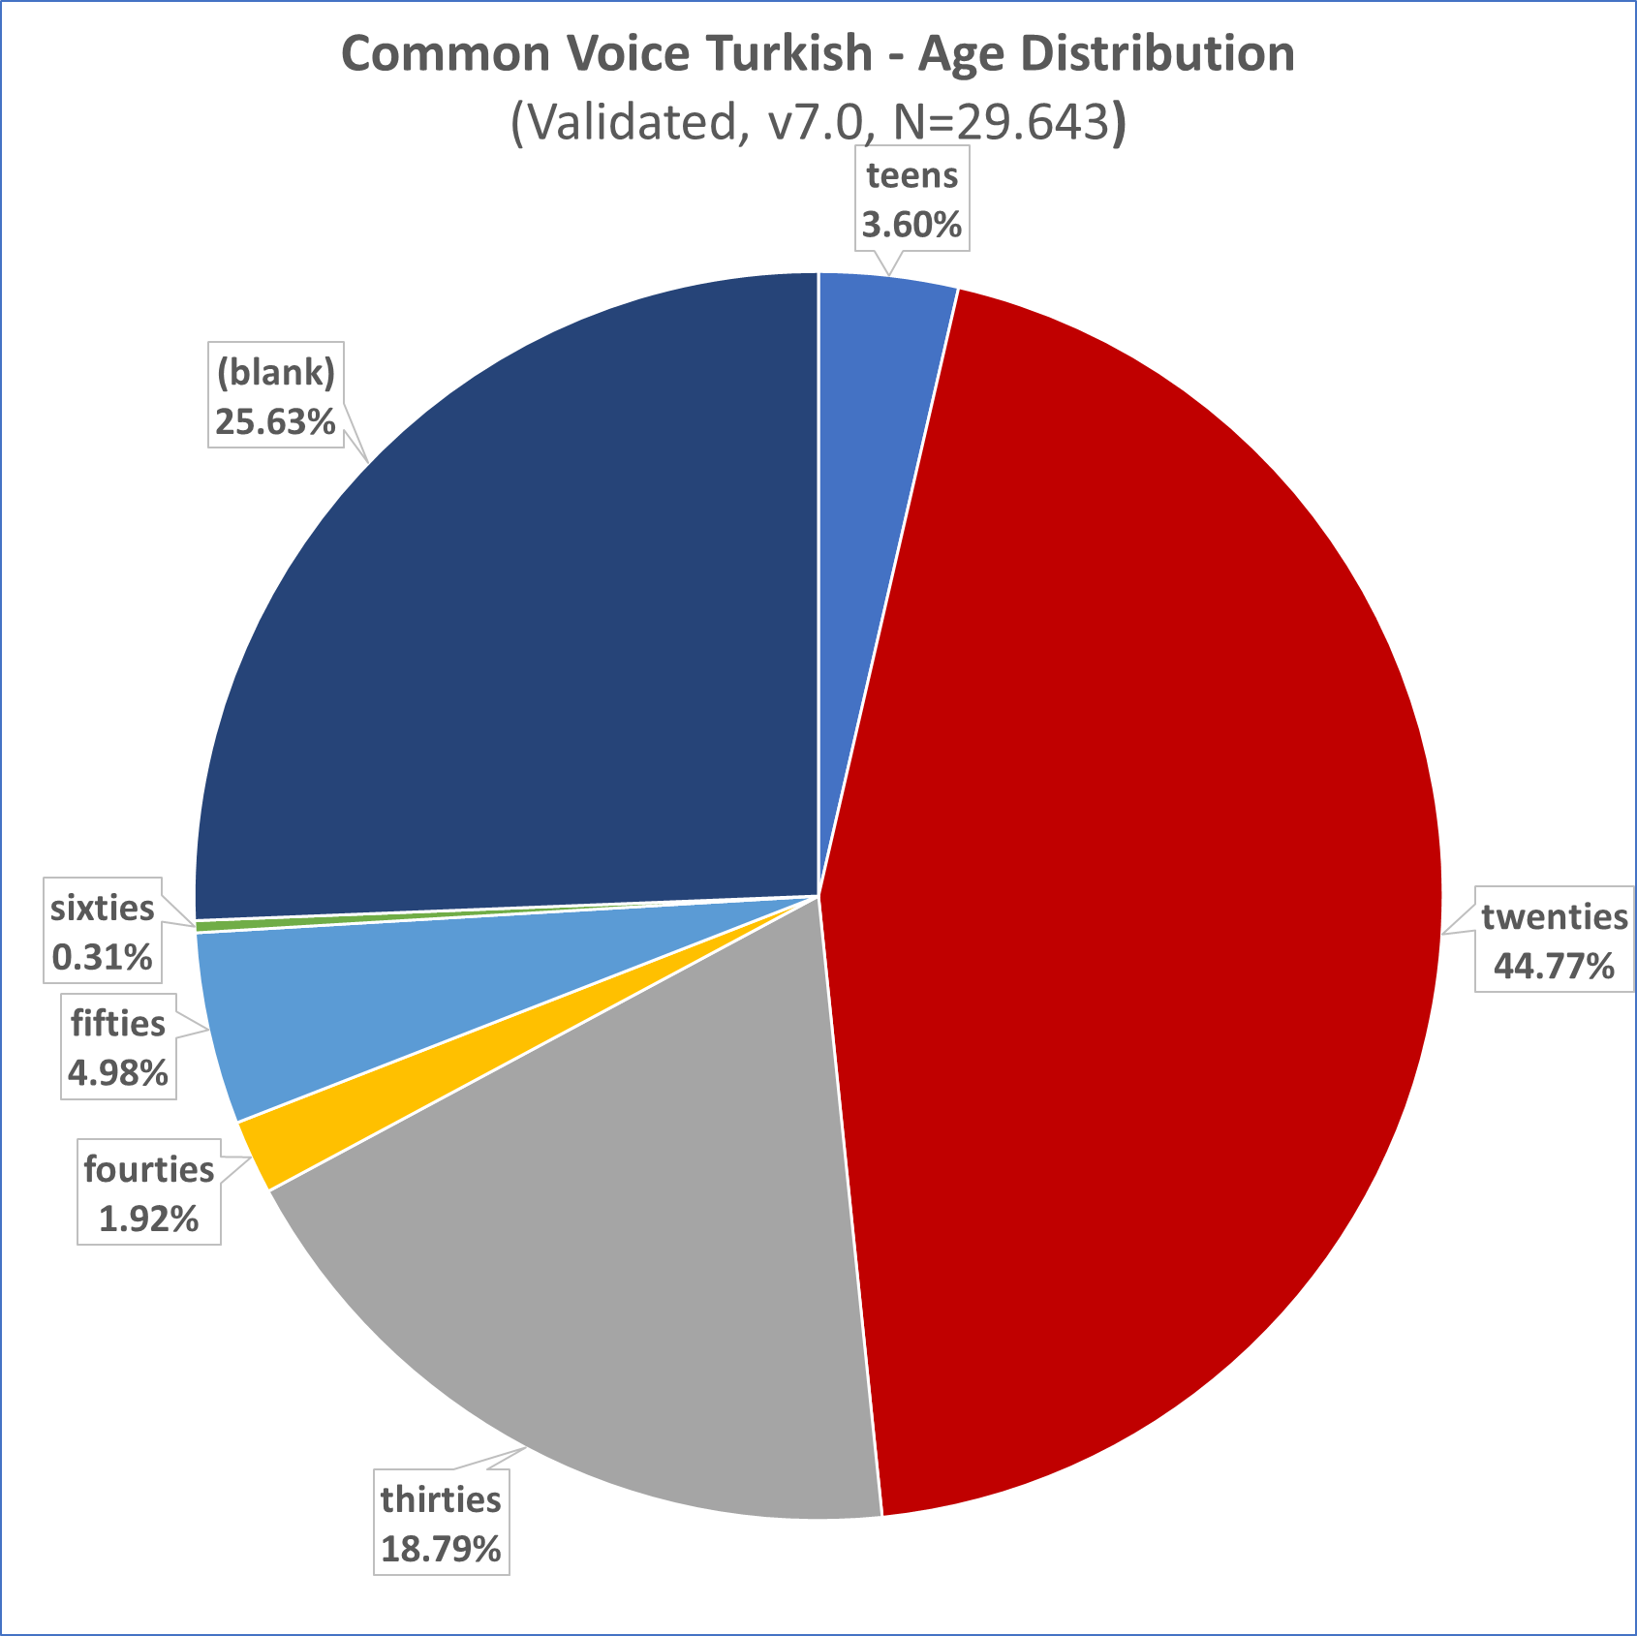
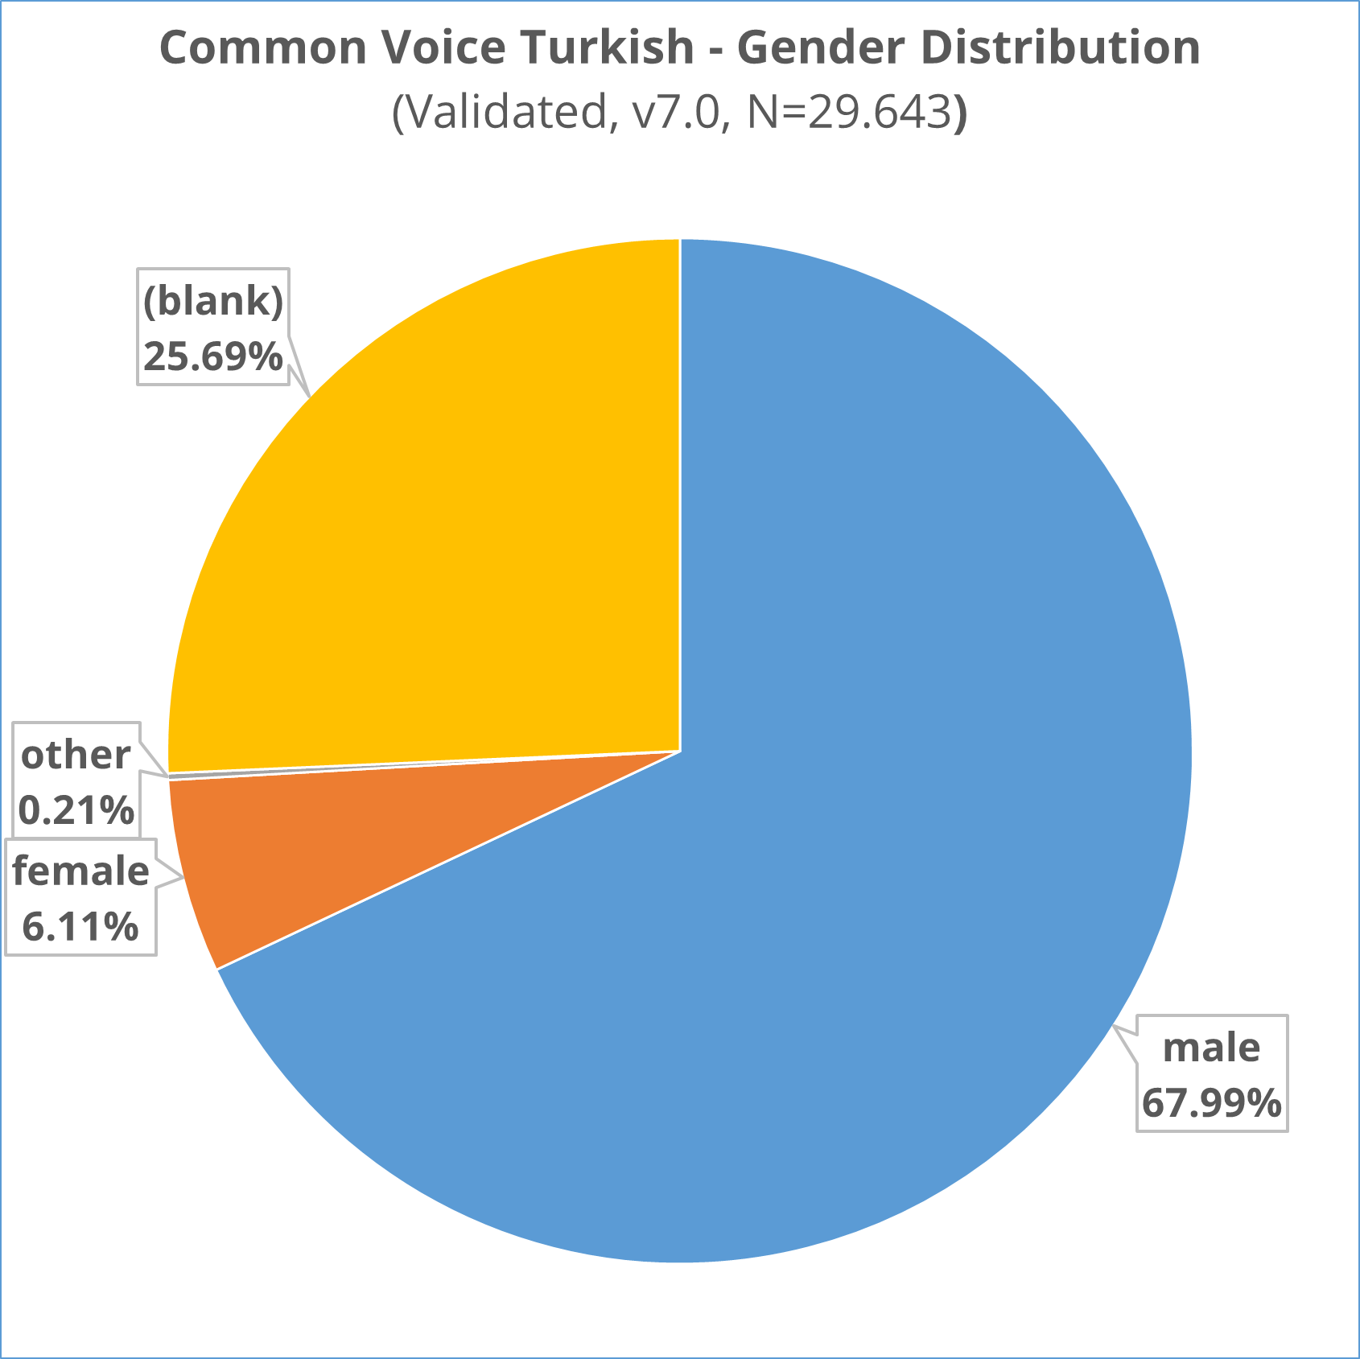
TR v7.0 validated - Diversity
Gender & Age
Notes:
These are my findings in v7.0 Turkish dataset.
As you can see, the data is concentrated in one demographic slot: Young males!
----
Recordings by male voices are 11 times more then female voices!
It is obvious that the dataset is biased to male voices.
----
Same for the age, most data comes from young people.
Probably most of the languages will have similar status to a degree.
----
As you can see, another peek is under «blank».
These are people recording without registration or logging in, or not prefer to give their demographic info.
Although this is not good AI traning, this is a fact with current privacy laws and rules.
You may like to emphasize the importance of the demographic information in your campaigns.

Slide 18
TR v1 – v7.0
Text Corpus
# Contributors
Notes:
One other problem with Turkish was the text corpus.
Until version 6.1 there was only one text-corpus added at the start of the project: SETimes with 5.077 sentences.
These were translated news from Balkans, with many proper names in Machadonian, Sirbian etc.
And of course they are not conversational.
Although the number of voices increased in time, these sentences kept being recorded over and over with different voices.
This would certainly bias the AI.
In early 2021 we could add some new text-corpus, hoping to remedy this and added much more in the second half.

Slide 19
TR v7.0 validated - CorpusCreator
Recordings per sentence
Recordings per person
Notes:
If we dig deeper and get a distribution of recordings per sentence, you will see these multiple recordings.
----
Sentences recorded only one time are most probably from the recently added text-corpus.
----
On the other hand, the default corpus creator program, which creates splits for the traning, will take one recording per sentence to prevent sentence/vocabulary bias.
So, for version 7 dataset, only one-third of the already small data will be used in training, unless you create your own training splits.
----
When we look at the distribution of recordings per person, things get more interesting.
----
First of all, although the dataset download page states that there are 960 voices, the actual number in validated is 851.
----
Secondly, around two-thirds of people just visited, recorded a couple of sentences and went away.
This is important for your campaigns. You need to make them record more nad get into the community.
----
Third, there are some people who recorded many sentences.
They are young males of course, and this will make the dataset more and more biased.
We will see their biasing effect in the training results, in the next part of the presentation.

Slide 20
Set goals for the campaign
Current State
Desired State / Goal
Quantitative
Low Text Corpus
Low number of recordings
Increase Amount
Add more Text Corpus
Convince people to record
(100-300 recordings/person)
Qualitative
Low female/male Ratio
Young male prominant
Reduce Bias
More female voices
More elderly (females)
(bias caused by single young male with accent)
(> 1000 recordings for some)
Notes:
Now we know that the health of our dataset is NOT good at all!
In our campaign, we tried to correct it both quantitatively and qualitatively…
We have low text-corpus and low number and recordings and we want to increase them both.
To prevent further bias we first set a rule and asked people to record minimum 100, maximum 300 sentences.
This means we expected 1 to 3 hours of volunteer time.
----
We designed the campaign to reach female voices.
As we are not young anymore, our friends are mostly over 40 also, this was a plus.
----
During the campaign we also trained some AI and recognized that a single young male with accent drops the performance of the AI considerably.
So, we raised the expectations to 1000+ recordings and invited some people to balance this individual.

Slide 21
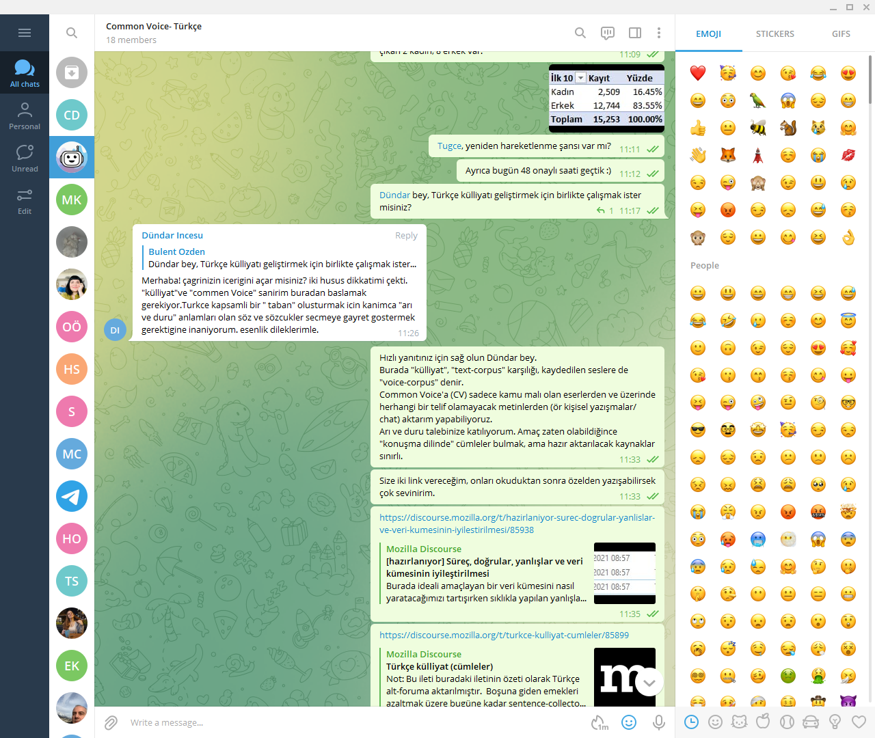
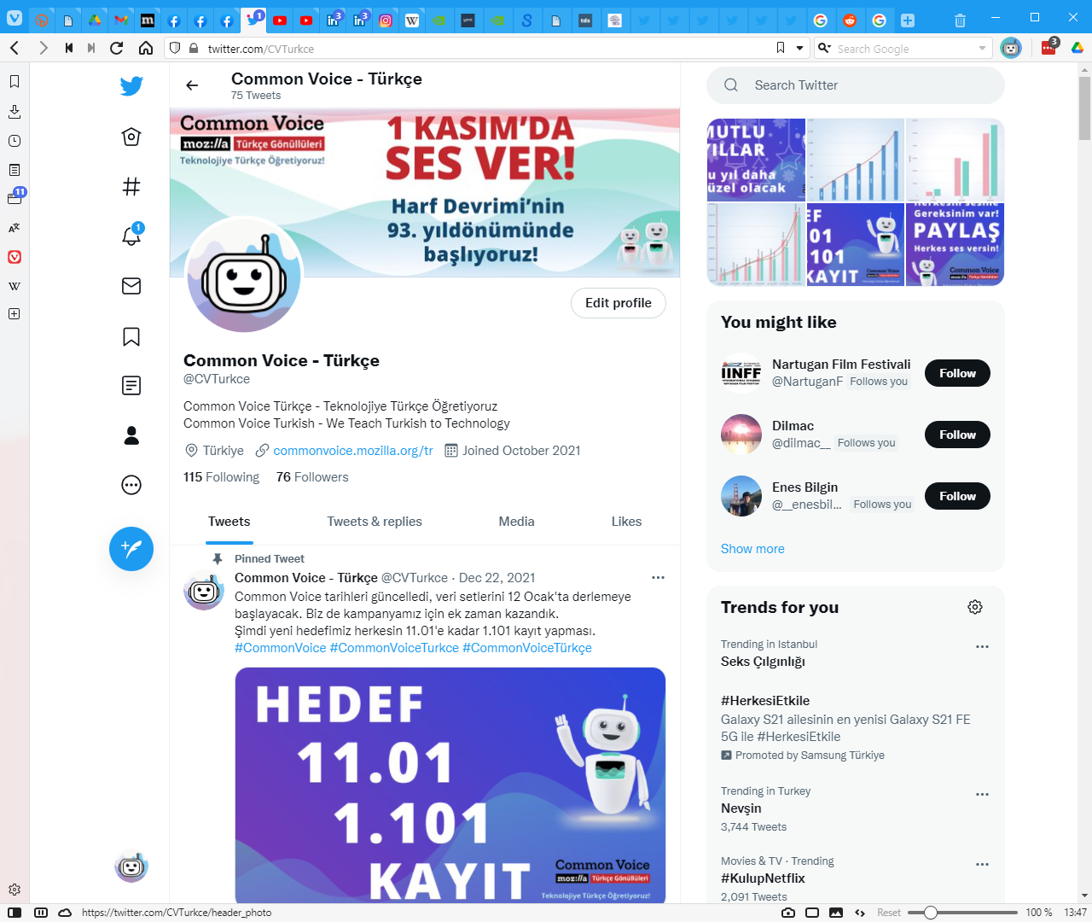
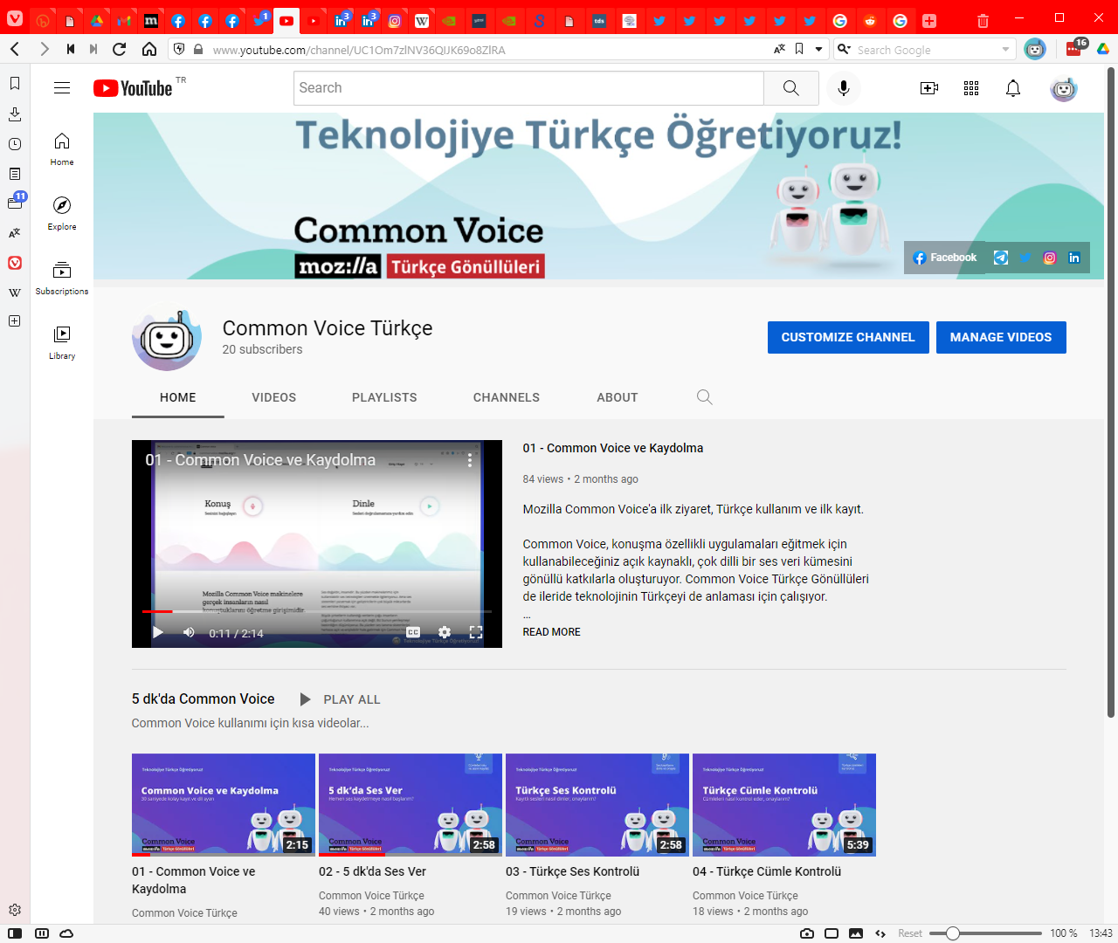
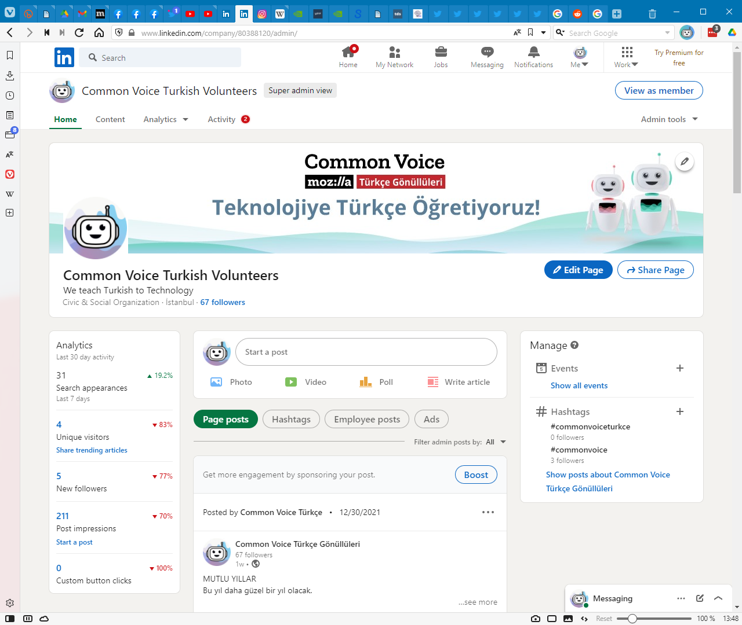
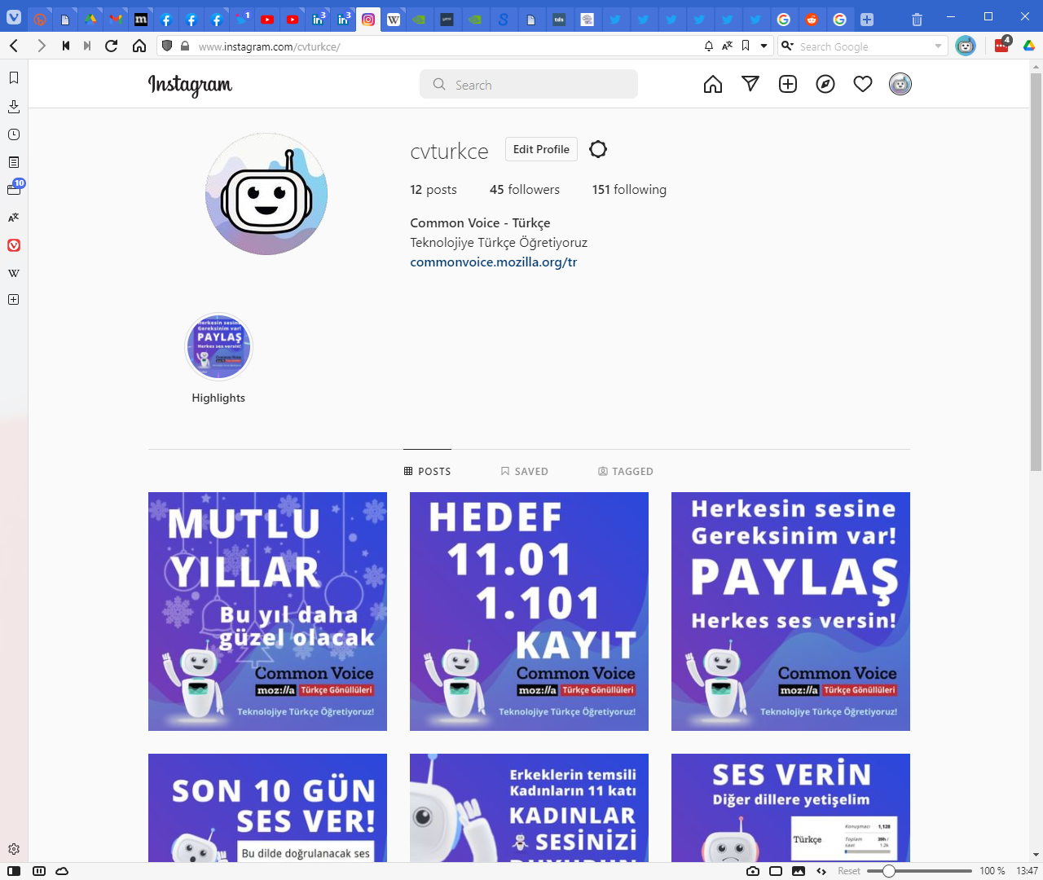
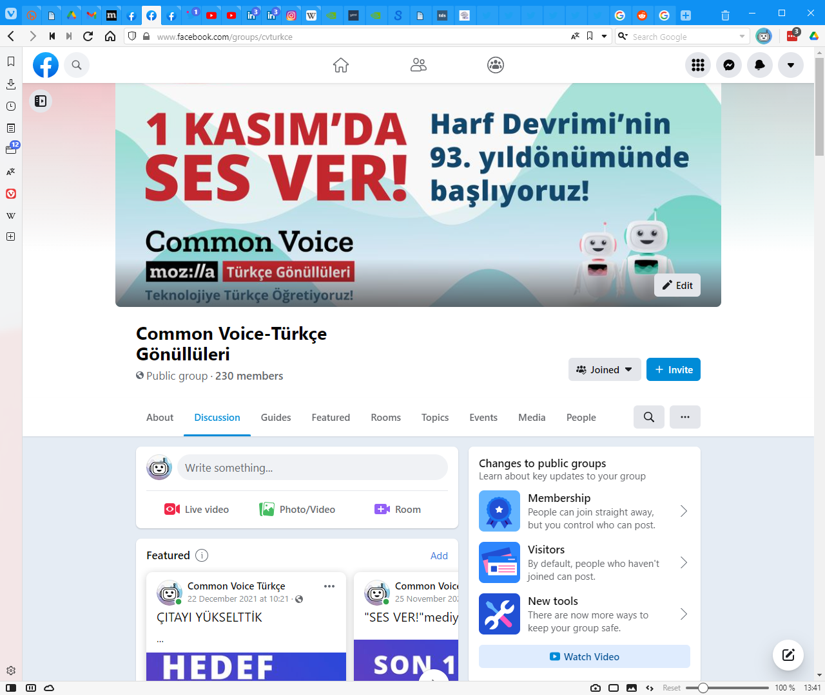
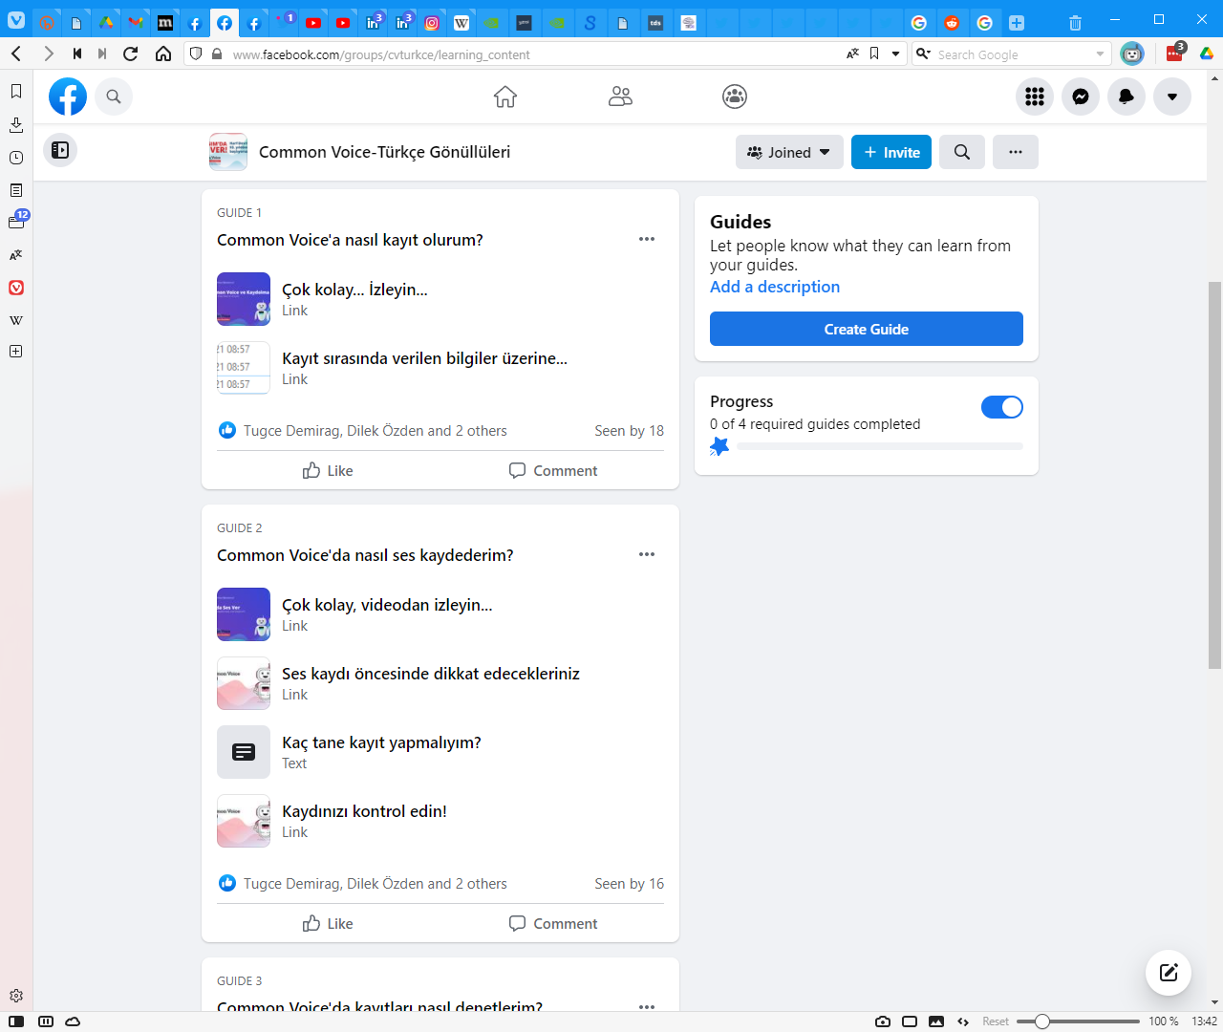
Design a Social Media Campaign
Two goals
Quantity & Quality
Build a community
Multi Channel Campaign
Facebook (base & guides)
Youtube for guides
Telegram for instant support
+ Twitter
+ Instagram
+ LinkedIn
(Domain/Website)
Bitly to get feedback
Notes:
We designed a multi-channel social media campaign to reach our goals.
----
Facebook as community base
----
and to provide guides
----
Youtube for video guides
----
Telegram for instant support
----
Plus Twitter ---- Instagram ---- and LinkedIn for announcements
----
We’ve got a domain name for future work and used shortened links to get click numbers where appropriate.

Slide 22
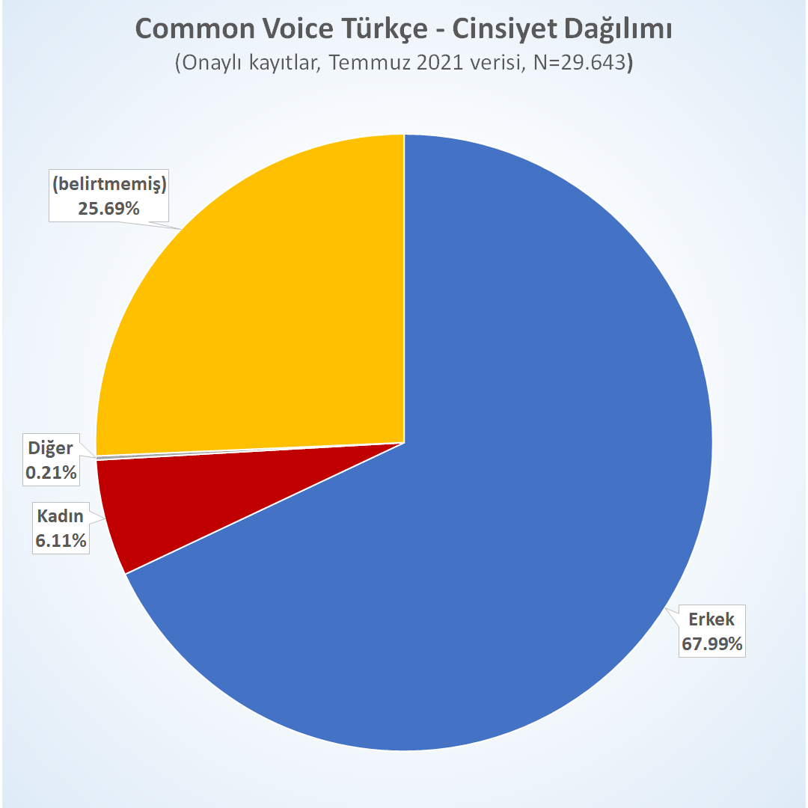
Prepare slogans, designs & messages
Teasers
Technical information
Feedback from the campaign, dataset or trainings
Call for female voices
New year celebration
Notes:
Prepare you slogans, designs and messages.
Teasers
Technical information
Feedback from the campaign, dataset or training results
This one is a call for female voices
This one is for new year celebration

Slide 23
Prepare text-corpus!
Notes:
And most importantly, you should have prepared new text corpus resources before the campaign.
Do simple math to find how many you will need for your goals.
We prepared these offline with our core group, checked every sentence 3-4 times.
We pre-analyzed these resources and randomly mixed short utterences with longer descriptive ones before posting.
For example, the left one here is Turkish proverbs, the right one is from a book by Sabahattin Ali.

Slide 24
Notes:
We monitored the advances daily and fed the system with text-corpus when needed – these are the green columns.
It took one month to prepare all these and we started the campaign on the first of November.
We were thinking about a month, but the dataset release date kept pushing further and we pushed more…
You can see the results of our campaign effors –meaning social media posts- as red peaks.
You can also see that we tried to keep validation –the blue lines- in pace with recordings – otherwise it would be impossible to keep up.

Slide 25
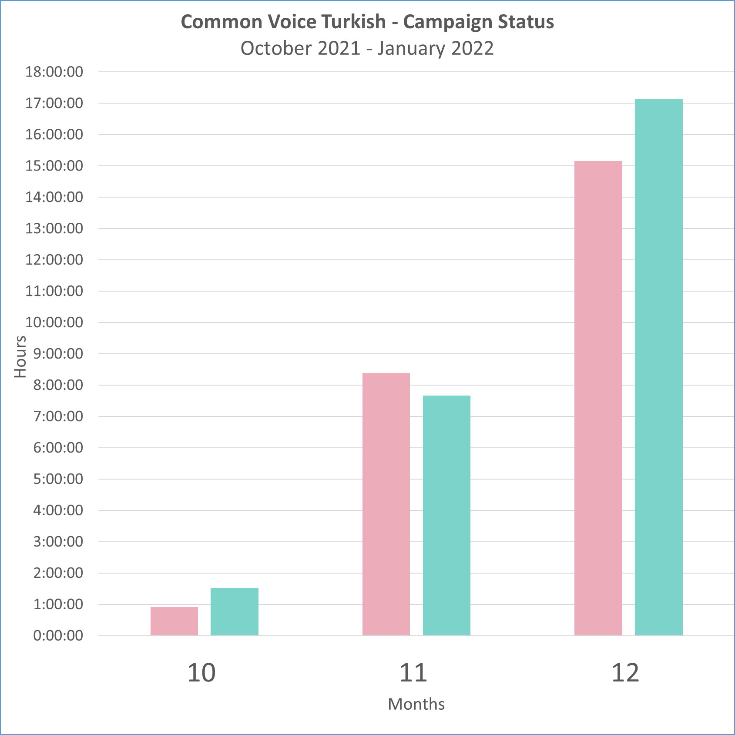
As of 31/12/2021
Campaign started November 1st
November: Wide 100-300 recs/person
December: «Group work» (1000+ recs)
Notes:
So, at the end of the year we’ve got this…
On November our goal was 100 to 300 recordings per person with wide posting.
After mid-December we started to work with small groups to reach many more.

Slide 26
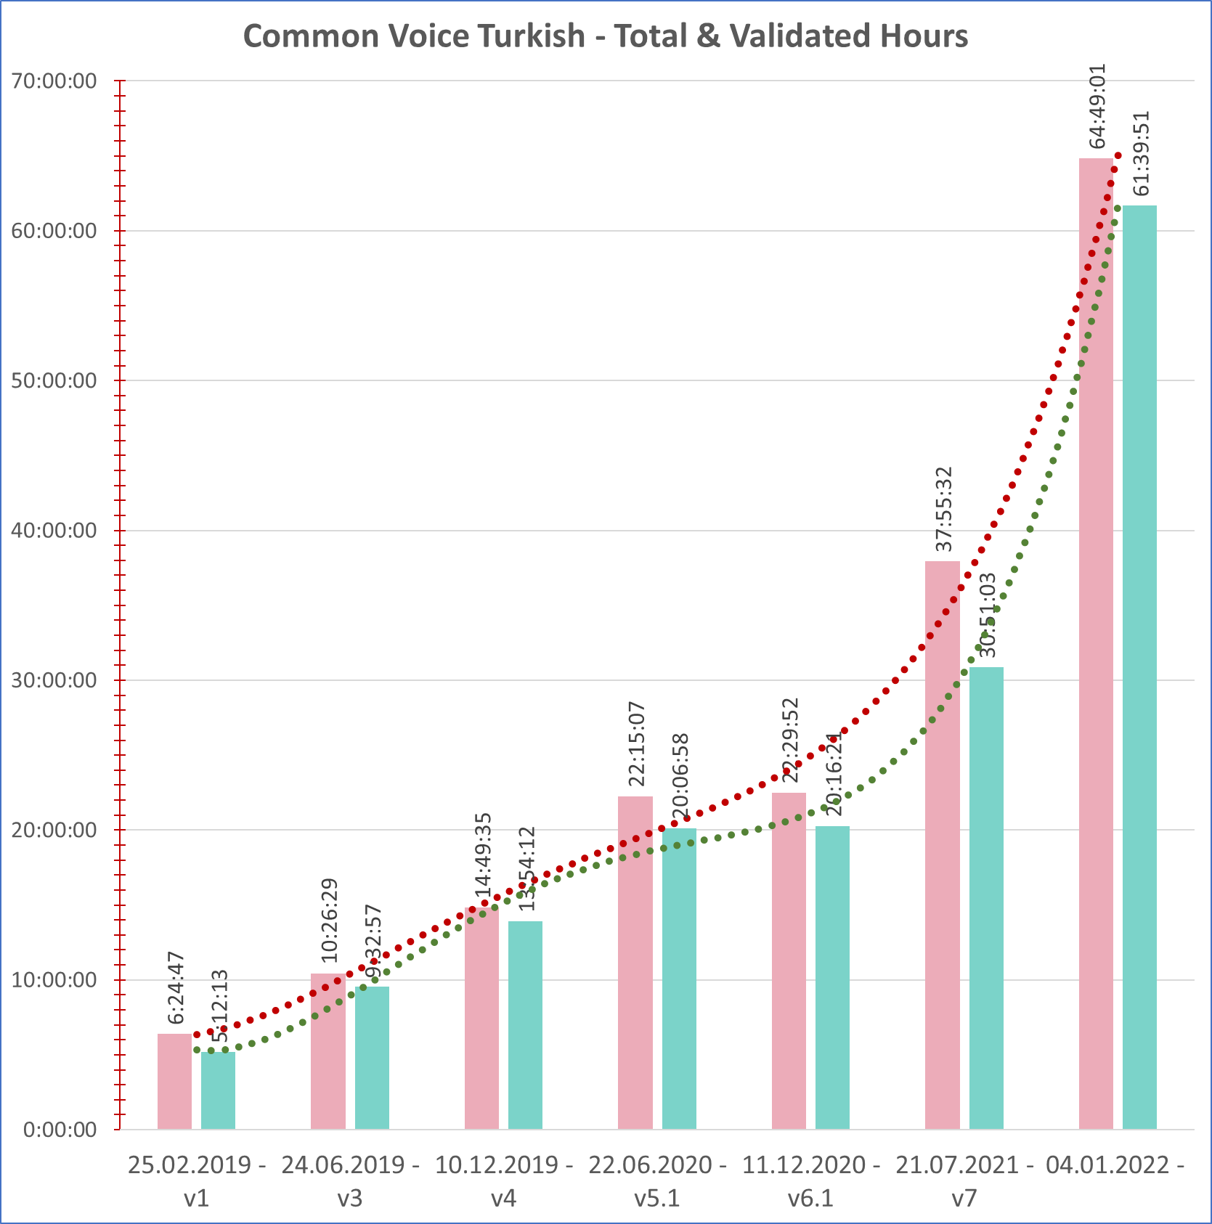
As of 31/12/2021
From v7
27+ hours total (71%+ increase)
31+ hours validated (100%+ increase)
From v6.1
>190% increase in total
>205% increase in validated
Notes:
This is also by the end of the year.
As you can see we had a big jump, more than 100% increase.
Although we could not reach our initial goal of 100 hours validated.
As of this presentation recording, we see more than 65 hours of validated recordings…

Slide 27
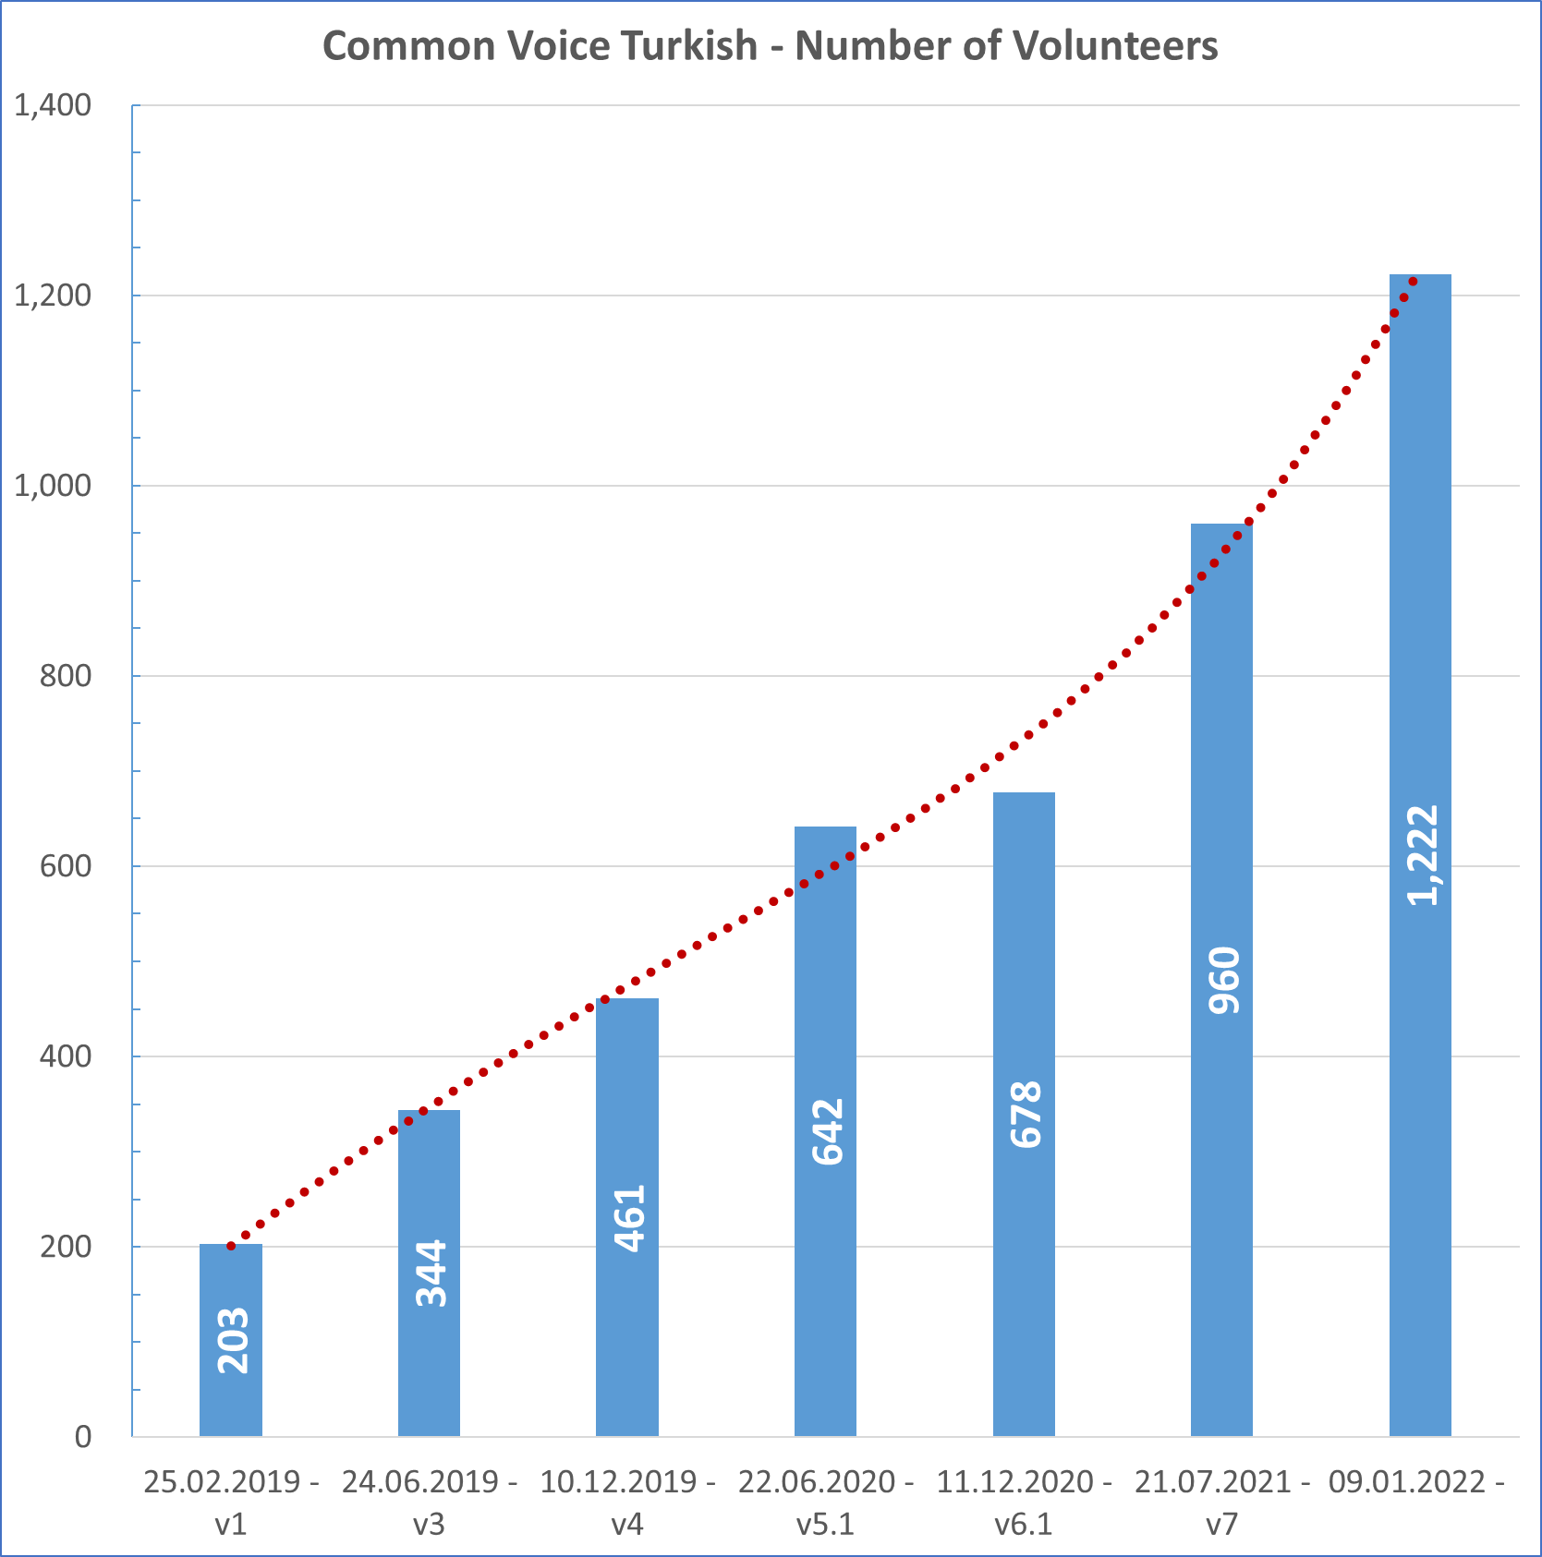
Notes:
We were not that succesful with the voice diversity thou.
Number of volunteers are better than if we left the dataset alone, but not enough.

Slide 28
Diversity?
Notes:
We cannot see the diversity changes yet, but if we look at the first 20 people in the hall-of-fame, we can have an idea.
Female voices has been around 6% in the last dataset we can see that it will be more balanced in the next dataset.
We hope we could get a better training results with new sentences, female voices, elderly voices.

Slide 29
Lessons learned
Widespread posting => low return
Better: Targeted posts to relatives/friends
Build 3-5 person groups and educate/support them
All record - All validate - One support them
Social Media Algorithms are bad for your campaign.
Best response from Twitter - young AI/Data Science experts
Be prepared to give extensive technical support and spending time on validating recordings.
Mic connection problems
Login problems (e.g. elderly people)
Problems caused by mobile apps (e.g. WebView limitations)
Notes:
Let me give you some pointers.
Widespread posting is good for creating awareness about the project, but may not result in recordings.
For us, it has been better when we asked our friends and relatives one by one.
----
If you can build 3 to 5 person groups and support them directly, you will get best results.
They will record and validate in their closed groups.
----
It is hard to overcome the social media algorithms, we found ourselves liking/sharing each other.
We’ve got best response from Twitter by reaching local AI & Data science related groups, but of course this is not enough to reach common population.
----
One last thing: You must be prepared to validate many recordings to check for problems and give one-by-one technical support if necessary.
Most common problems we faced are the following:
Microphone related problems, such as bad cracks or low recording levels
Registration / login problems, especially for elderly / non-tech-savy people
And problems caused by WebView type limited browsers in mobile apps. You cannot record in a WebView, so you need to ask people to copy-paste the link into a browser. This is a bummer for a social media campaign of course.
In a nutshell: Social Media did not work well for us – but it is the only means to reach large crows.
We must re-think our approach in later campaigns.

Slide 30
Training a Voice AI
Coqui + Google Colab
Trained v1-v7
Results for Turkish
Notes:
In this part I want to give a basic introduction to Voice AI traning and our findings for Turkish.
These experiments are carried out after we started the campaign and took about a month with learning and debugging.

Slide 31
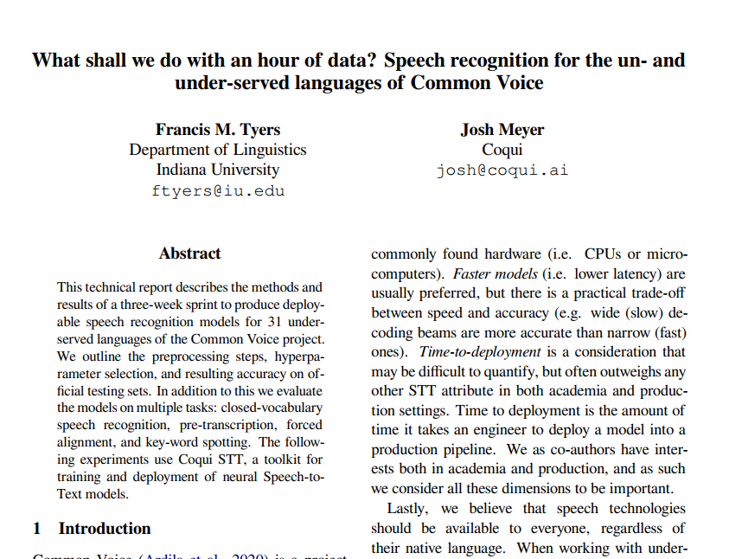
Base: Tyers & Meyer 2021
What shall we do with an hour of data?
Speech recognition for the un- and under-served languages of Common Voice
https://arxiv.org/abs/2105.04674
April 2021
Based on Coqui 0.9.3
Dataset v6.1 roundup
3-RUNS
Baseline (short training)
Parameter sweep => longer training
Add Language Model
Notes:
Our experiments are based on the technical paper by Tyers and Meyer published on April 2021 which analyzed many low-resource languages systematically,
using version 6.1 of the dataset and using Coqui 0.9.3.
They had three runs,
First, a short training with defaults, to build a baseline for Acoustic Model
Secondly, a parameter sweep run to find best parameters followed by a longer training to reach a better Acoustic Model
Third, addition of a language model.
I will not rephrase the information which is already in that paper but give you what I changed.
In addition to these three runs, I had to add another fourth as you will see.

Slide 32
WER
Baseline: 95.32
Long run: 89.26
+LM: 57.19
Notes:
With the low resource in hand and with default splits, Turkish had high word-error-rate even with the language model.
I started with v6.1 to get at least similar results with this paper and then extended it to other datasets.
My goal was to form a baseline for the next dataset release - on which we worked really hard - with all the analysis and campaign I explained.

Slide 33
Decisions
Use Coqui to replicate the experiment
Alternatives (more costly)
Local Linux machine with powerful GPUs (chip shortage!)
Cloud instances & Docker
Use Google Colab (low-cost)
Interactive notebooks (good for learning)
Powerful GPU’s
No «that powerful» local linux machine, VM are no go
Free tier (K80 ~ 10x+ wrt CPU) => Colab Pro (P100 ~ 3x+)
Roundup => Disk space! => 100GB Google Drive
Download problems/slow download
Notes:
As I wanted to replicate the technical paper, I used Coqui which is the successor of Mozilla Deepspeech.
Coqui runs on low end devices like raspberry pi or android, produces smaller models and has real time inference using only CPU.
At that time Coqui version 1.0.0 was out with pre-trained English model from v7.0 dataset.
My fourth run is based on Coqui version 1.1.0
You will really need a powerful Linux machine with powerfull GPUs for training.
My windows machine was a no-go and I had to eliminate more costly alternatives.
I decided on Google Colab Free tier for preparation and trials, then moved to a Pro account for the real runs.
The interactive notebook based interface on Colab was really good for experimenting and learning.
As it was a round-up, I also needed more space on my Google drive.

Slide 34
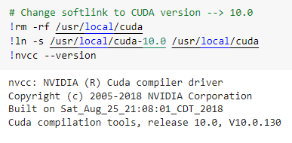
Coqui STT on Colab
+ Tensorflow 1.5.4 (GPU)
Current Default Colab
Ubuntu 18.04.5 LTS
Intel Xeon @2.30 GHz, 13G RAM
Python 3.7.12
Tensorflow CPU 2.x
Cuda 11.2
CuDNN 7.6.5
Notes:
Although there are example notebooks in the Coqui repos, they do not work out of the box.
----
Coqui prerequisites reguire you downgrade.
Because finding the solutions took some time for me, I want to mention them here
----
First you need to tell Colab that you want to use v1 of Tensorflow
----
Secondly, you need to switch to CUDA 10.0, fortunatelly it is already installed in Colab and you just need to link to it.
----
Third, you need to install the required tensorflow-gpu version, otherwise you will be stuck with CPU which will be much much slower.

Slide 35
Workflow
Importer
Acoustic Model
Train
Test
Export
Google Drive
Inference Engine
(Application)
Alphabet
converted
dataset
Turkish
checkpoints
TFLite
Model
validate_label
TFLite
Model
English
checkpoints
CV dataset
Optimized
Scorer
Language Sources
Corpus
Scorer
Optimized
Scorer
Prepare
Corpus
Language Model
KenLM Scorer
Optimizer
Optimized
Scorer
Test
Notes:
Let me explain the whole workflow for Coqui Transfer Learning first.
I’ve put the Google Drive in the middle to show data flow.
There are four main actions.
Two of them, Importer and Corpus Creation can be run offline, they do not require GPU.
Acoustic Model and Language Model creation need to use GPU, especially with larger datasets.
----1
First we create language specific alphabet and importer script and we already have our Common Voice dataset.
----2
We feed them to the importer
----3
The importer converts mp3 and tsv files into WAV and csv, which is required in following steps.
----4
As we will be using transfer learning we also need English checkpoints, which is provided by Coqui.
----5
We feed them to the training
----6
And get best Turkish checkpoints.
----7
We test it, repeat the process by fine-tuning our parameters if necessary.
----8
Then we export it into a TensorFlow-Lite Model.
----9
For Language model, we first find public sentence resources.
----10
We combine them into a corpus for further processing.
----11
I used KenLM scorer which generates a 5-gram language model.
----12
This model keeps probabilities of a word following another.
----13
The process needs some parameters which we can only guess thou.
Therefore Deepspeech/Coqui has an optimizer which repeatedly quesses some values and shows you best results.
----14
Then you can use the KenLM scorer again with these best values to get a more optimized language model.
----15
Of course you need to test the results
----16
We finished model generation and want to use it in an application, which includes an inference engine.
----17
We move the TFLite model and our scorer to the device where the application resides.
This is all…

Slide 36
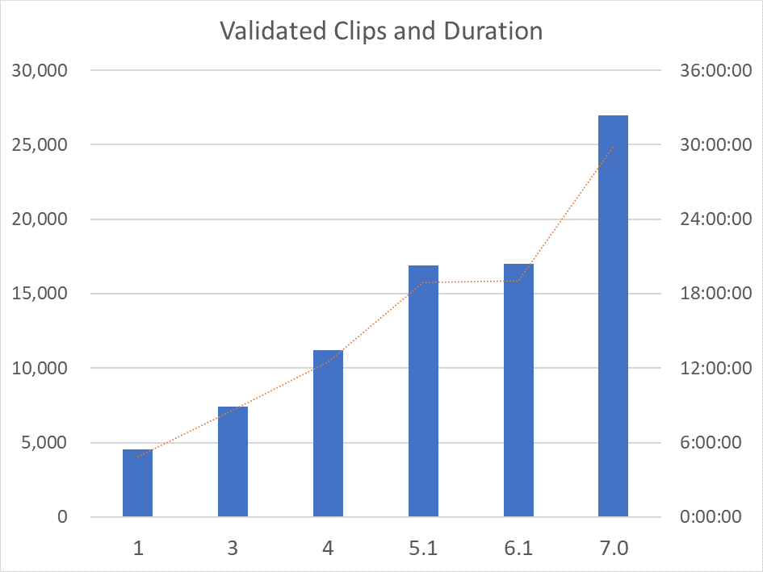
Common Voice Turkish Coqui v1.0.0 Import Results
Datasets |  | Clips |  |  | Duration
Ver | Set | Recs | Skip | Net | Initial | Final | Dur/Rec
1 | Validated | 4,807 | 245 | 4,562 | 5:06:21 | 4:51:08 | 3.829
 | Train | 1,209 | 56 | 1,153 | 1:17:34 | 1:14:16 | 3.865
 | Dev | 982 | 57 | 925 | 1:00:28 | 0:56:57 | 3.694
 | Test | 1,069 | 43 | 1,026 | 1:11:48 | 1:08:40 | 4.016
3 | Validated | 8,157 | 714 | 7,443 | 9:22:59 | 8:37:20 | 4.170
 | Train | 1,600 | 202 | 1,398 | 1:51:20 | 1:38:58 | 4.247
 | Dev | 1,463 | 157 | 1,306 | 1:38:56 | 1:28:48 | 4.080
 | Test | 1,521 | 100 | 1,421 | 1:54:25 | 1:47:00 | 4.518
4 | Validated | 11,787 | 577 | 11,210 | 13:08:12 | 12:31:00 | 4.020
 | Train | 1,729 | 94 | 1,635 | 1:52:27 | 1:46:54 | 3.923
 | Dev | 1,538 | 86 | 1,452 | 1:46:20 | 1:40:19 | 4.145
 | Test | 1,564 | 65 | 1,499 | 1:58:33 | 1:53:20 | 4.536
5.1 | Validated | 17,714 | 830 | 16,884 | 19:49:14 | 18:55:20 | 4.035
 | Train | 1,729 | 92 | 1,637 | 1:57:46 | 1:51:58 | 4.104
 | Dev | 1,548 | 90 | 1,458 | 1:51:48 | 1:45:28 | 4.340
 | Test | 1,576 | 63 | 1,513 | 2:02:06 | 1:56:54 | 4.636
6.1 | Validated | 17,851 | 834 | 17,017 | 19:57:42 | 19:03:23 | 4.031
 | Train | 1,738 | 93 | 1,645 | 1:58:23 | 1:52:31 | 4.104
 | Dev | 1,556 | 91 | 1,465 | 1:52:25 | 1:46:04 | 4.344
 | Test | 1,585 | 62 | 1,523 | 2:03:36 | 1:58:29 | 4.668
7.0 | Validated | 28,300 | 1,343 | 26,957 | 31:22:32 | 29:55:26 | 3.996
 | Train | 3,810 | 169 | 3,641 | 3:10:00 | 3:01:39 | 2.993
 | Dev | 3,045 | 164 | 2,881 | 3:37:29 | 3:25:58 | 4.289
 | Test | 3,060 | 149 | 2,911 | 3:59:49 | 3:48:12 | 4.704
Notes:
These are the import results for each dataset
----
Some of the clips are skipped by the importer:
Those which have characters not existing in the alphabet
Clips longer than 10 seconds
----
You can see the average clip duration is around 4 seconds
----
But there is also an anomaly in version 7 training, where clip duration is shorter.
This was alarming.

Slide 37
Acoustic Model - Baseline
BASELINE: TYERS, MEYER, 2021 - CV v6.1 Turkish Dataset
Run | Batch | Epocs | Spk. | Clips | WER | CER | LOSS
Acoustic Model Baseline | 32 | 25 | 77 | 1,739 | 95.32 | 35.73 | 54.26
AM w. Parameter Search | 32 | 25 | 77 | 1,739 | 89.26 | 30.84
AM + Language Model | 32 | 100 | 77 | 1,739 | 57.19 | 29.62
Common Voice - Coqui 1.0.0 Training Results (default splits, Acoustic Model Baseline)
TRAINING |  |  |  |  |  | PROCESS TIME |  |  | RESULTS
Ver | Run | GPU | Batch | Epocs | Best E. | T-TRAIN | T-TEST | T-TOTAL | WER | CER | LOSS
1 | 1-BL | K80 | 32 | 25 | 10 | 0:20:22 | 0:26:56 | 0:47:18 | 0.915615 | 0.337848 | 57.549976
3 | 1-BL | K80 | 32 | 25 | 7 | 0:31:15 | 0:45:41 | 1:16:56 | 0.903781 | 0.325954 | 53.830456
4 | 1-BL | K80 | 32 | 25 | 9 | 0:28:36 | 0:50:31 | 1:19:07 | 0.864571 | 0.288360 | 46.893242
5.1 | 1-BL | K80 | 32 | 25 | 9 | 0:31:28 | 0:52:18 | 1:23:46 | 0.864006 | 0.281902 | 43.230740
6.1 | 1-BL | K80 | 32 | 25 | 8 | 0:29:31 | 0:48:50 | 1:18:21 | 0.879326 | 0.287137 | 44.182713
7.0 | 1-BL | K80 | 32 | 25 | 3 | 0:58:31 | 1:36:56 | 2:35:27 | 0.910997 | 0.325844 | 53.041386
Notes:
Our first roundup aimed to match the results of the aforementioned paper.
We used 25 epocs with 32 batch size as the original.
----
We got better results for v6.1 dataset, the difference is:
Coqui version 1 is used
English checkpoints from Coqui version 1 training is used which are based on dataset version 7.0
----
It was interesting to find out that Turkish v7.0 was worst performing dataset, nearly as bad as v1.
And best epoch was too early for it.
Thus a second alarm…

Slide 38
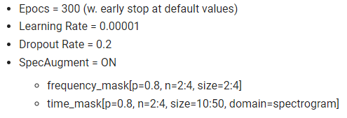
AM Fine Tuning & Augmentation
Notes:
In the second run we used proposed parameters from the paper. These helped us a lot for the starting point.
We kept batch size as 32 again.
----
As we saw that 100 epocs are not sufficient, we used 300 epocs with early stop.
----
You can also see that we can directly access the Google Drive for the data.

Slide 39
Saving intermediate results
Notes:
We saved all intermediate results, checkpoints, exported models etc back to Google Drive.
To overcome issues with Google Drive connection we used “shutil”, flushed, unmounted and remounted the drive to be safe.

Slide 40
Test
Notes:
And ran the testing part separately using “evaluate”.

Slide 41
Notes:
As you can see the loss function drops down very rapidly at the start, then searches the minima.
Whenever our dataset grows larger we will experiment more with the parameters to decrease the training time.

Slide 42
Adding a Language Model
Corpus | Lines | Words | Chars
Global Voices | 6,118 | 75,201 | 615,984
OpenSubtitles | 167,809,335 | 677,578,088 | 4,940,414,461
Tatoeba | 730,933 | 3,606,127 | 26,358,543
TED2013 | 121,044 | 1,407,257 | 10,998,574
TED2020 | 371,225 | 3,851,340 | 30,451,350
TOTAL | 169,038,655 | 686,518,013 | 5,008,838,912
Added optimization!
Notes:
For the third batch, we added the same resources as the original paper to our language model.
Then we used KenLM to produce a 5-gram language model with 500.000 words which include a bit over 99% of all words.
We saved this model and used it in all our runs.
We added the optimization script to our pipeline, which was not used in the original paper.

Slide 43
Language Model Optimizer
Notes:
Here, you generate your scorer with some arbitrary values.
----
Run the optimizer N times to calculate better default_alpha/default_beta values.
----
Put best results found back into the scorer generation program to get an optimized scorer.
And of course test it with evaluate.
It takes quite some time to process but you will get a better language model and better test results.

Slide 44
Character & Word Error Rates
Notes:
These are our final results for all dataset versions.
On the left Character Error Rate
On the right Word Error Rate
As you can see, best results are for v5.1 and in v7 the performance drops considerably, although it had 50% more recordings.
There had to be a problem.

Slide 45
Back to Analysis
Number of Client IDs
Ver | VAL | TRAIN | DEV | TEST
1 | 190 | 4 | 21 | 165
2 | 323 | 13 | 46 | 264
3 | 323 | 13 | 76 | 265
4 | 434 | 34 | 76 | 324
5.1 | 608 | 77 | 128 | 389
6.1 | 631 | 77 | 128 | 401
7.0 | 851 | 13 | 99 | 640
Gender - Female / Male Ratio
Ver | VAL | TRAIN | DEV | TEST
1 | 9.89% | 0.00% | 40.69% | 9.13%
2 | 16.24% | 22.02% | 5.87% | 8.51%
3 | 16.04% | 16.63% | 12.50% | 8.12%
4 | 17.28% | 16.35% | 7.40% | 5.51%
5.1 | 8.57% | 16.96% | 2.61% | 9.61%
6.1 | 8.57% | 16.81% | 2.82% | 10.33%
7.0 | 8.99% | 0.00% | 6.87% | 10.29%
Notes:
To find the reason, I had to go back to the analysis phase.
I analyzed default splits in every aspect and found the following:
----
Number of distinct voices in version 7 train set dropped considerably.
----
There are no female voices in version 7 train set, all voices are male.
So we were training with few male voices and testing with mixed.

Slide 46
Voices in Train & Dev
 | Row Labels | Count
1 | c3c204ffaebfc46c0265773376f9288a372694aa79f97afe224828033c28d6d2a90919aaf769bf14105cb4033650e10275760afe250490782eae15c1d1518799 | 2236
2 | 6c8743f86a41b2e1dd119942cf21633476a6185e3456098a6d4ad6c7849efb62733eb1c4c65040cae1fcaa26b5db66402cb3895c434b4f8ad4c911cecf5c7db7 | 579
3 | 9e752d5e672cb444e46093900db35c7ce913577ca5ee37202bd9e623ae47c00fcd8326862e5501836bd533857cef68cd6f904a80ccca3b392615783937dded32 | 358
4 | 4ea7534da9594c537caa422c93f0fc2e0fa0caaf75be3ae768de1369bb06765f246aa51e9161b7f0a9f4e21dffb1ceddfe27be1c81bcfed41343d5c3dc5d69d1 | 352
5 | dde1f0f45fb4024cd66cebcc97f398a371be0c50f6133e4abebd240702b9fc9a2204bc2b461f9029fce7362f641de4105b847cba49c45e4b46ae49bc2d4a7b45 | 211
6 | 60cee2235d7ec4cdeb89d601b8c373955b303c712ec729ed0affdabda8819908f51cefa990163d2bc4ac04c93e6dac2909cca67829211df4a2a17af2507dd50a | 142
7 | 25fdcdb28f13d4a31842aa3edb4da72e999080192e12df168123ac1012c88a96cc7db925618282f6d6c3e86d77ffcc4cb82b1ae7fa3e6791a0f6bc9277d15b63 | 51
8 | 33f649d48a5122b434291c85f109d9d7dac4d0486439d441a0b2979e54397bbd6e15c7515d44c5754377a83c9a1a88a3715d3382455f9150265ebafc8dba819d | 16
9 | 6d78740a48bccbfa2f70f6a10bb81e57ceb29ade055e8dbac9b87d5bb1f4512b1df070f0b0d4f93f38328fd181bf229b47eb933690ec03cc12c39947dd740ceb | 16
10 | 94c71f5af8e0dc3a94075137a518bb5fbf75c4818c2018610c6cefc0fcd62a3f2543727e74b0472683f11edd72d2032700479aaccc112c14f88395e5d3a1febc | 7
11 | 6dcca4df178f49130349c5756eee44028f4eb99937a60117c6629b8613032383c092d77433b00df7df887aed05aa734ef858e48837c95fcde9790725acdf8bcb | 4
12 | 0e03e4f6370c3e2952a880f4ffb50c08ce5932573d1bcb0bb83faeccb12cfdf420b7b37dbec04add639ede64c985d19652de332b31ad3ef892ab28678377f411 | 4
13 | 97ebc8329a0e86083942f65713a30826222ed10ab3db78f79979a2d9208865f678ddc297fef3225a6db99199aead9248a142530e3fde4915687765efd042a3d8 | 3
 | Total | 3979
 | Row Labels | Count
1 | c3c204ffaebfc46c0265773376f9288a372694aa79f97afe224828033c28d6d2a90919aaf769bf14105cb4033650e10275760afe250490782eae15c1d1518799 | 2417
2 | e93011699a08bdc6a27a7b50da5a6ed312322138c10135bf7d2d1aa8316373c10aff0f2cf8ef038990eb18e0b3c989ee37591f7c7deea0041498d22fbc4c9432 | 427
3 | f76ed0a17ffdb06fa37e68bad991b7eef235cdb2686fcec0d9a76a668c1ef1de13dadea046bfc0e30a69c8da3aa9e85cf5d0694a2e92d02dfcbf3bcbae6c725c | 278
4 | 0178454bf2224e584e03086ed55af64e4286e8122f2f3444b44538d96c40a8d0939eda91f94fb665c388ab3aa061b334ffd41e0f31710f3e483622bcef5c28ee | 121
5 | 0042924c9d0d1c87001e1720a1dbb8ef3954e4e3ca0fab2adba81d37f5d213f1a81ac8f8bbe95078b065cffd7c295453842629dcd9b742341874ffcce2f2484c | 116
6 | b168ff93eb790968fbe744a61f52432e011da19067af41ed27f274ea18f6e7b6a004db53087717c82728691e566520c807a1c42317b65977680226312c2c4087 | 104
7 | bd2fe2a027fec3faee255825d444737536b1b52ec14c4adb01b4c30950b1d7d7ff07706629dafe91f73dc09e641b407890efc8411fbe645f7dbe2fd896c087aa | 100
8 | be57ee50010b2c7f108b81ac1e20c2cfde966a257d91b4df4afce5898c990c96045330627c9543fd988173966b1e1aead01e947211f35c3d75e5ca36cb564e96 | 69
9 | 3310fc5e0414c88fa9bd95366867748cd7a4d6ea0d3472a98c692a1e0f5a22d4fd1f4f4b935612950a4932fdd5b72f69a033d9e1126b4fd6f3ba17daf53cc6df | 60
10 | 91e73150f71f02cc95d37175dbaad1580e9af4b0f19fda5b26c3fcbc1a4130dd63a6bda869349b53319c6747111b97bd9b6c6ce2982e36c7127c75d9c0128d45 | 58
Notes:
Digging deeper, I found out that a new young-male volunteer with some accent recorded many sentences lately.
That voice is prominent in both train and dev datasets.
And the Corpora Creator that generates the default splits does not take any biasing effect into consideration.
This is already an open issue in Corpora Creator in github.
When we saw this, we decided to update the campaign goals in order to balance male voices who recorded many.

Slide 47
Back to Corpora Creator
--strict-speaker: One speaker only lives in one file => ON
--strict-sentence: One sentence only lives in one file => ON
--strict-audio: Only a single recording per sentence => OFF
We ran v6.1 & v7.0 with –s 1 through –s 5
Coqui 1.1.0
We used batch size of 128 this time (~35% less time)
Notes:
The proposed solution by Francis is as follows:
One speaker only in one file
One sentence only in one file
Multiple recordings per sentence by different people allowed.
We applied this method and ran through v6.1 and v7.0 datasets,
Taking 1 through 5 recordings per sentence (if it exists) and tested the results.
We used Coqui 1.1.0 and batch size 128 this time.
By-the-way, the batch size is limited by your GPU and it is better to use higher batch sizes in these ranges.
It will run faster and it will generalize the voices better.

Slide 48
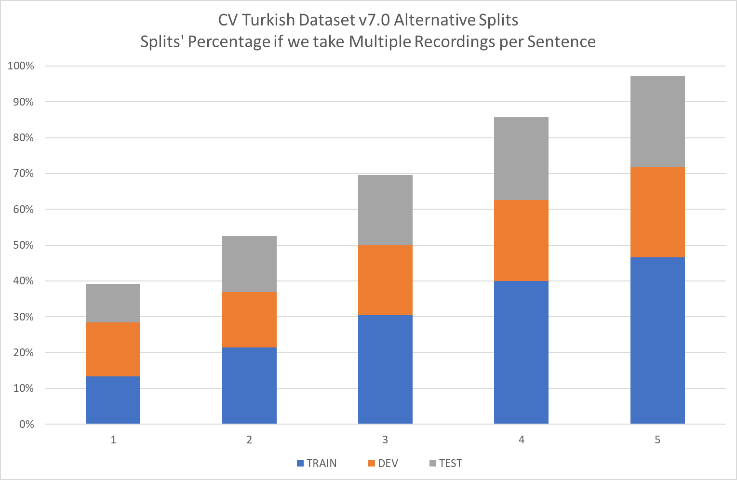
Notes:
When we take multiple sentences, mainly the train set increases
With 5 recordings per sentence we almost get the whole recordings.

Slide 49
For v7.0…
Number of Client IDs
-s | VAL | TRAIN | DEV | TEST
1 | 851 | 13 | 99 | 640
2 | 851 | 43 | 119 | 676
3 | 851 | 37 | 91 | 714
4 | 851 | 29 | 75 | 740
5 | 851 | 23 | 68 | 755
Gender - Female / Male Ratio
-s | VAL | TRAIN | DEV | TEST
1 | 8.99% | 0.00% | 6.87% | 10.29%
2 | 8.99% | 10.28% | 11.49% | 8.23%
3 | 8.99% | 9.39% | 17.15% | 7.32%
4 | 8.99% | 3.22% | 27.43% | 8.82%
5 | 8.99% | 2.96% | 20.00% | 12.69%
Notes:
As you see we get more diverse voices, and also female voices into training.

Slide 50
Results (Multiple Recordings/Sentence)
Notes:
These are our final results with alternative splits in Word Error Rate.
With v7 and with 5 recordings per sentence we could get the Word Error Rate a bit below 29%.
Remember, in the original paper this was around 57%.

Slide 51
Remaining questions
Will it be biased to Balkan News?
We know the following is best for 100.000 recordings:
1000 people 100 recordings/person
But if you only have 100 volunteers? Which is better?
100 people 100 recordings/person?
100 people 1000 recordings/person?
How many recordings per sentence is best?
Limited text corpus
Different voices speaking with different accents
Notes:
Remember we had these multiple recordings from the previous years where SETimes text corpus was the only one.
So, the resulting AI would most probably biased to Balkan News this time…
There is also the following question we have been discussing:
Is it wise to have many recordings per person?
We saw that if only a couple people do many recordings, it will result in bias.
We know it is best to have many people recording less, but what if we don’t have them around?
Isn’t it better to make existing ones record more?
A third question: How many recordings per sentence is best?
Larger number would decrease the requirement to hard to find text-corpus
Also wouldn’t having multiple speakers/gerders/pronunciations for the same sentence be better?

Slide 52
Final words
Notes:
As a conclusion, some final words.

Slide 53
Future Work
Train next dataset
More volunteers
More text-corpus
More voice-corpus
Expand language model
Measure real-world model performance
Limited vocabulary models/applications
Measure bias
Measure effect of many recordings/person
Other libraries/models: Transformers, Wav2Vec, etc
Notes:
Voice AI is a vast area, we only scretched the surface of it.
But to do more in this area we need a good, working dataset.
Our efforts as Common Voice Turkish Volunteers will continue to focus on the betterment of the dataset.
And we will also extend our knowledge to other libraries and models once we have a less biased dataset, hopefully this month.

Slide 54
Acknowledgements
Common Voice is a great project!
Thank you Common Voice!
Thank you community!
Special thanks to
Francis Morton Tyers
Hillary Juma
Michael Kohler
CV Turkish Core
Tuğçe
Dilek
Mansur
All CV Turkish Volunteers!
Notes:
Common Voice is a great project for democratizing the Voice AI.
Although there are some shortcomings and needed features for general purpose use, it is the only large scale multi-lingual open source voice dataset, which also became a benchmark.
So we need to thank Mozilla, Mozilla Foundation and the Common Voice staff for their work and dedication.
The whole community around Common Voice and Coqui is great, if you get stuck, you will find your answers there. Thank you community!
Special thanks go to Francis, Hillary and Michael for their patience and their help in the last year.
I also want to thank to my friends who helped most in our campaign, Tuğçe, Dilek and Mansur.
And biggest appreciation go to all Common Voice Turkish Volunteers for their participation.
Our campain happened during a socio-economic crises in Turkey, inspite of that you succeeded and pushed Turkish Voice AI to the next level.

Slide 55
Thank you
Questions & Answers
But before, Common Voice January 2022 Dataset Results
Notes:
Thank you for joining the session, I hope it will be useful for your future work.
If we have time in the questions and answers section, I want to present some slides on the new dataset and training results.
Fingers crossed…

