Slide 1
UPDATE FOR V8.0 DATASET How to Start a Language on Mozilla Common Voice?
A case study for under-resourced Turkish Language
Bülent Özden
Computer Engineer (MSc), Harikalar Kutusu
Mozilla Common Voice Turkish Language Representative (2021-2022)
FOSDEM’22, 5th February 2022
Notes:
Here are the updates with the v8.0 dataset showing what we accomplished.

Slide 2
CorporaCreator default splits
Notes:
The problem with CorporaCreator continues.
----
The train set has 13 distinct voices – again!
----
But this time gender distribution in the train set is nearly even.
Just by analyzing the datasets and directing the campaign we could get rid of the gender bias.
Real solution would be the betterment of the CorporaCreator of course…

Slide 3
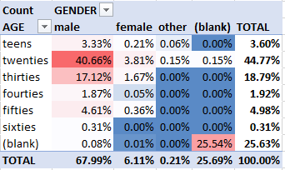
Dataset diversity
Gender & Age – v7.0
Gender & Age – v8.0
Notes:
Secondly, we could get a more balanced dataset, we could lighten the biasing effect of young males.
----
Female voices increased from 6.11% to 21.58%, this is more than 3.5 times increase.
----
Recordings from people above age 40 increased from 7.21% to 27.34%, this is about 3.8 times increase.
----
On the other hand, despite out efforts, people without demographic info kept increasing.
We think this is mainly caused by two things:
A bug was introduced where demographic info got reset.
We had server outages at the start of the campaign where people had to re-login many times, some might be kept out.
We calculated about half these can be corrected automatically, mostly women, so female voice percentage is higher than this…
People without demographic info are in reality about 15%.

Slide 4
Validated
Recordings per person
Recordings per sentence
Notes:
If we compare the last three datasets…
----
As you can see with the new added text-corpus which is more than 6 times, we’ve got much diverse sentences.
----
That would make the default splits more usable. We could reach 52.8% in v8.0.
----
And by taking 2 recordings per sentence it will become 77.5% of the dataset, with minimized effect of Balkan News.
----
Recordings per person data is not easy to change in short time peiods.
----
We have 308 new voices and we can see that nearly 20% of newcomers recorded less than 20 sentences.
----
We had some success in our target area, namely 100-300 sentences.
----
But major data increase came from dedicated people recording many sentences.
This was our second target.

Slide 5
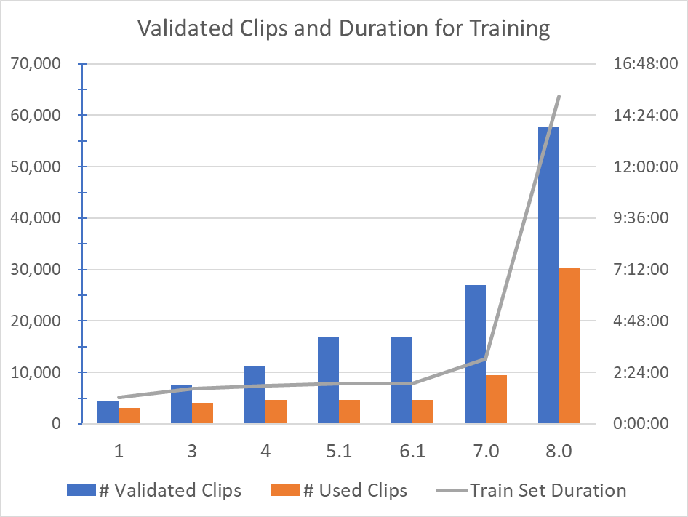
Increase in data
3.4x
5x
6.5x
6.5x
Notes:
Here you see the increase in three groups in the last year.
First group is size of the text-corpus – increased 6.5 times in the last year.
Second one is number of clips validated and cleaned, suitable for training. Increased 3.4 times, duration increase is 3.2 times.
Third group is sum of Train, Dev, Test set sizes. This also increased 6.5 times.
As you can see we could keep the conveyor belt running without any bottleneck.
----
The major jump is in the train set in the default splits, shown as the line and with the right vertical axis.
Although the number of voices is as low as 13, total duration of the train set increased from about 3 hours to more than 15 hours.

Slide 6
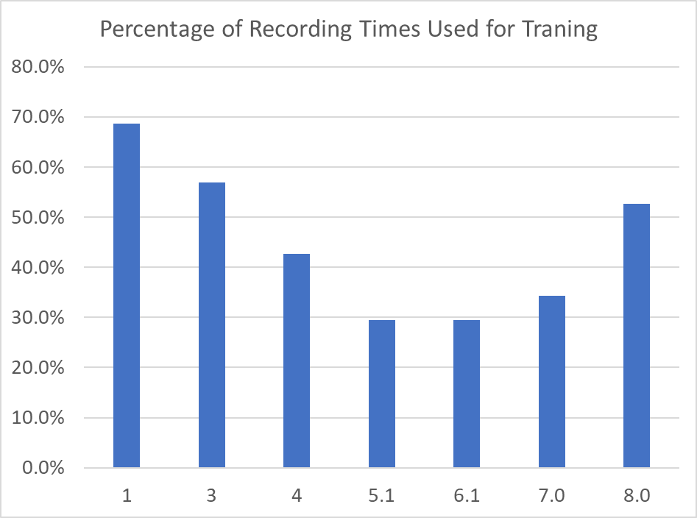

Slide 9
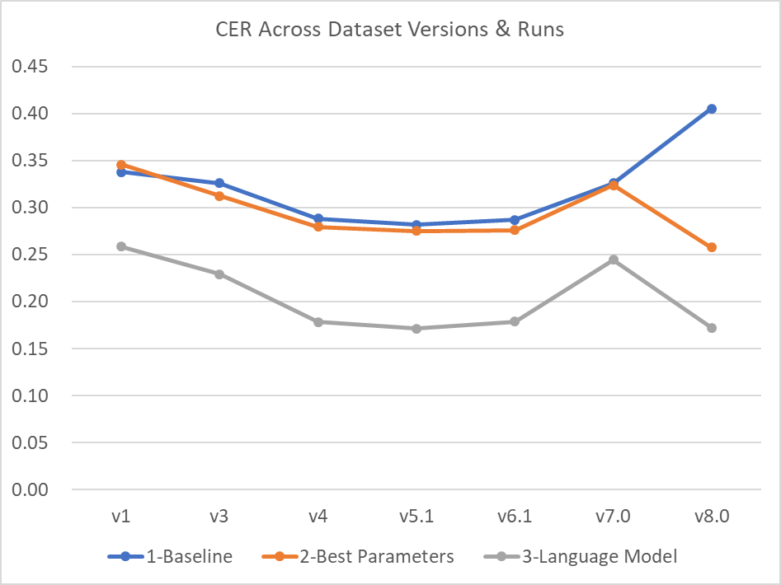
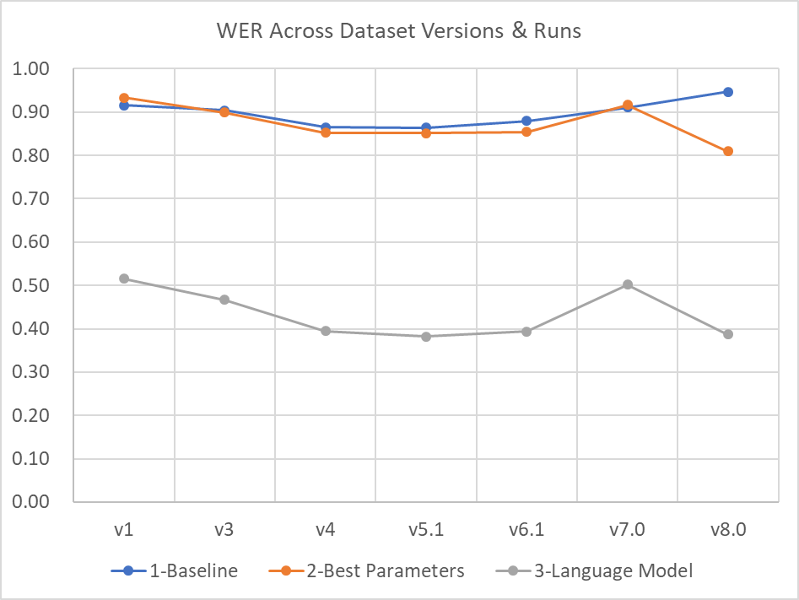
Character & Word Error Rates
Notes:
As you can see we could correct the performance, just by balancing the dataset.
In version 8 dataset, with default splits we have better Word Error Rate.
Acoustic only model reached around 80.9
With Language Model it became 38.7
But as the CorporaCreator again gave 13 voices into the train set, it is not better than v5.1.
We’ve just gained what we’ve lost…

Slide 10
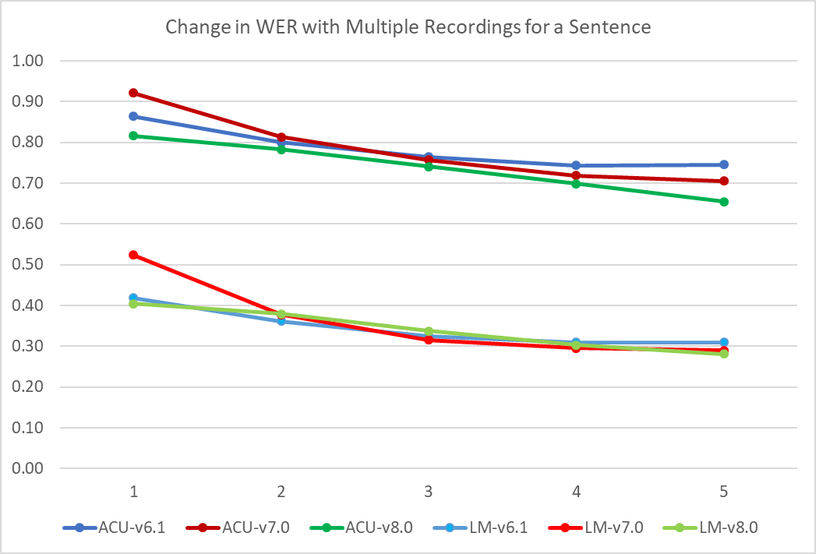
Best Values
For –s 5
Train: 36:17:40
AM Only
CER: 18.69%
WER: 65.43%
AM+LM
CER: 11.71%
WER: 28.11%
Better results!
-15% for AM only
-10% for AM+AM
Notes:
These are our final results with alternative splits in Word Error Rate.
With v8 and with 5 recordings per sentence we could get the Word Error Rate down to
65.43% with acoustic model only
28.11% with added language model

Slide 11
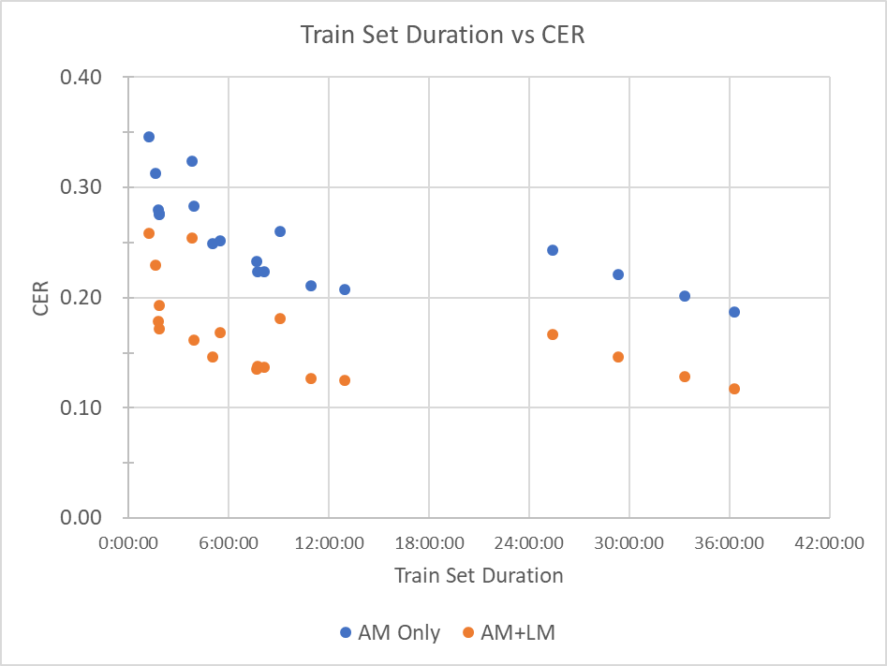
Notes:
This graph shows how Character Error Rate changes with the size of the train set in all experiments.
As expected, the more training data, the less error rate.
But this is not enough.
Data points on the right are from v8, and initially they are not better than previous data sets.
This seems to be caused by dataset quality, fewer individuals in the data set.

Slide 12
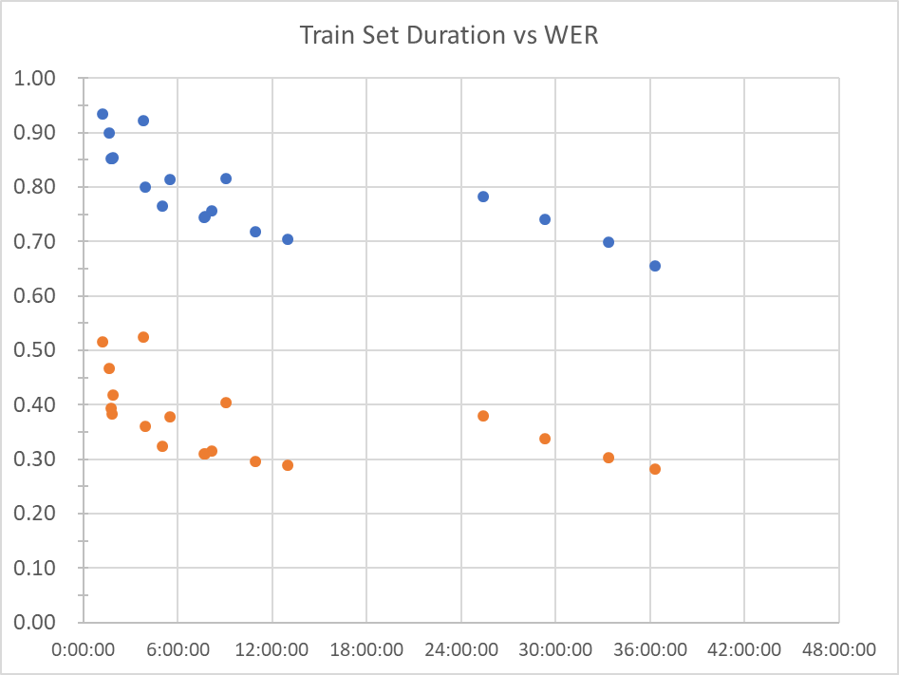
Notes:
If we put Character and Word Error Graphs side by side, we can see they are very much related.

Slide 13
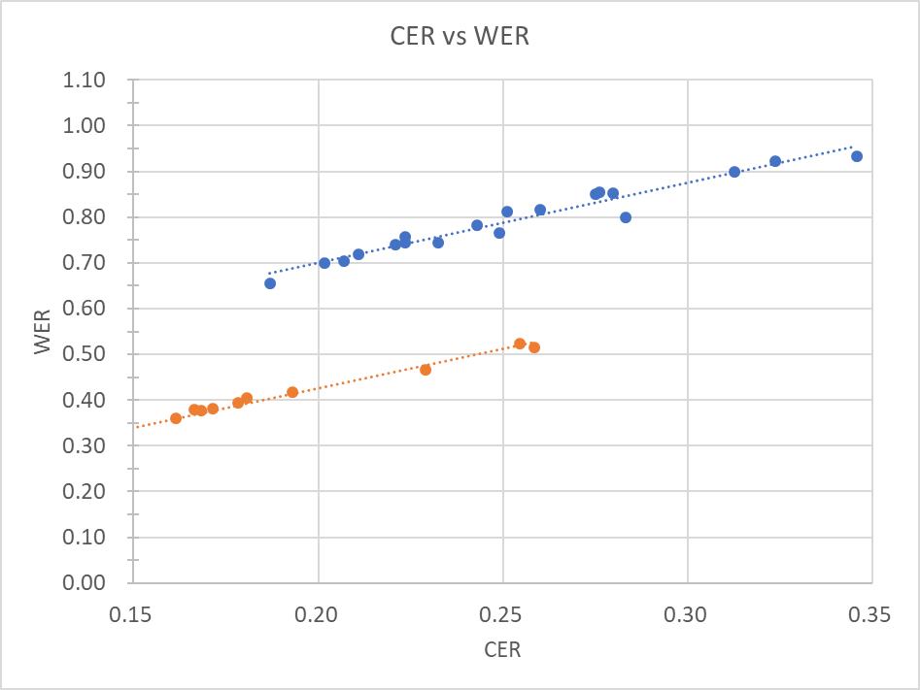
Notes:
Here you can see their relation with all experiment data points we calculated.
As a result we can say:
More data
More diverse data

