Slide 1
BrAPI: a standard API specification for plant breeding data FOSDEM 2022
Peter Selby
Cornell University
Notes:
Hello, I’m Peter Selby from Cornell University in New York. I am the BrAPI Project coordinator, and I’m here to tell you about the BrAPI Project, a standard API specification for plant breeding data.

Slide 2
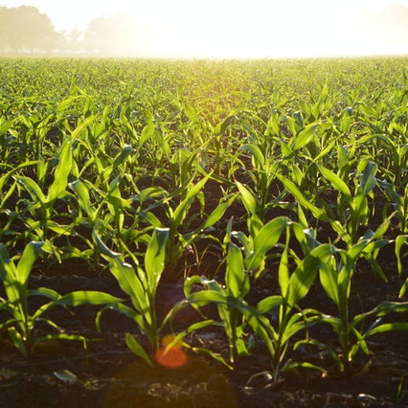
Notes:
Breeding is an area of agricultural research focused on developing better crops and live stock. Objectives can vary from higher yields, to better flavor, to resistance from drought or disease. But the overall goal is to improve the food we grow and to support the global population.
Public breeding research is in the middle of a digital renaissance. New open source applications for data collection, storage, and analysis are being built and used every day. But due to a lack of data standards, breeding programs are accumulating large silo’s of data with no efficient way to share that data with the rest of the global community.

Slide 3
More…
Less…
More automation of complex breeding processes
More data sharing and interoperability (FAIR data)
More shared software and computational resources
Less manual data management and busy work for breeders
Less data silos and restricted data access
Less duplicated software development efforts
Notes:
As public breeding keeps pushing its way into the modern era, we are facing more issues with software and data management.
We need more … (reiterate slide text)

Slide 4
Manual Data Transfer
Notes:
Many of the system integrations we see in todays breeding software domain rely on manual data transfer
Manually transferring data from one system or tool to another can take a lot of effort and is prone to human error
(explain diagram)
In this example of a manual data transfer, we can see a user is required to manually export data from the first Application, usually into an excel or CSV file. The user is then responsible for transporting that data file from one system to another. This usually involves an external piece of technology such as email, a shared file system, or even a thumb-drive to physically move the data. Finally, the user is required to import this data into the second application.
This process can be slow and error prone. There might be manual edits and format changes as each export file and import template may be slightly different.

Slide 5
What is BrAPI?
BrAPI is a …
Standardized
RESTful
Web Service
API
Specification
…for communicating plant breeding data
Notes:
The BrAPI Project was designed and built to improve the quality of data exchange and enhance software integration within the breeding community.
BrAPI is a Standardized, RESTful, Web Service, API, Specification for communicating plant breeding data.
This standardized specification solves the need for a semantic standard and a syntactic standard. The semantic piece is contained in a set of JSON Schema documents which define a set of standard data models. The syntactic piece is defined by a set of OpenAPI 3 documents that show how the standard data models can be manipulated using RESTful web services.
This means different groups of developers can easily follow a common communication protocol and exchange common data models as part of the same standard. The flexibility of RESTful HTTP means the BrAPI standard is programing language agnostic and can cover a wide range of possible use cases.

Slide 6
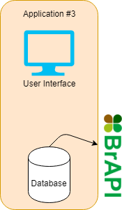
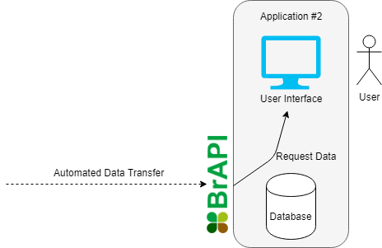
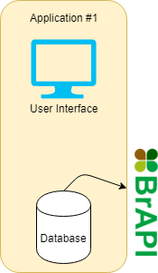
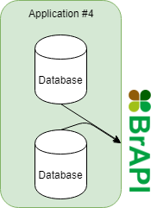
Automated Data Transfer
Notes:
Using BrAPI, we can automate the transfer of data quickly and safely between applications.
BrAPI provides a common language that all breeding applications can speak when transferring information. This means we can easily share data between many types of applications and organizations around the world.
Having a common language also means we can share existing tools and computational resources within the community. Open source tools that are developed to use the BrAPI standard can be easily integrated with other BrAPI compliant applications. This allows for much more code reuse and encourages collaborative software projects.

Slide 7
Notes:
BrAPI version 2 was released in March of 2020. Here is a high level map of all the different data structures BrAPI can handle, organized into 4 general modules.
BrAPI-Core deals with trial organization and management
BrAPI-Germplasm deals with germplasm and accession management
BrAPI-Phenotyping deals with trait and observation data
BrAPI-Genotyping deals with samples, markers, and sequence data
More details on the full specification are available at brapi.org

Slide 8
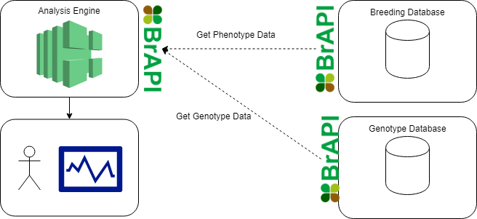
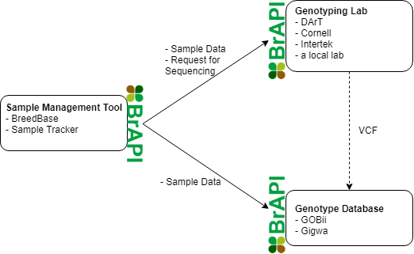
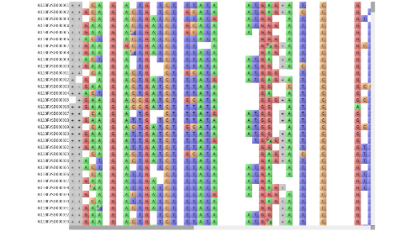
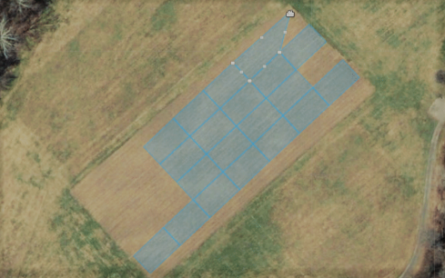
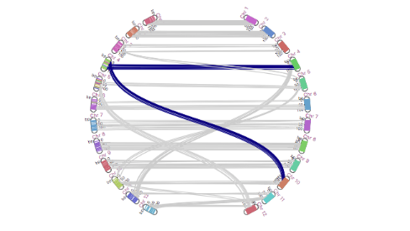
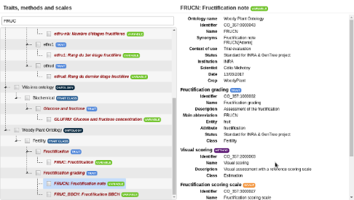
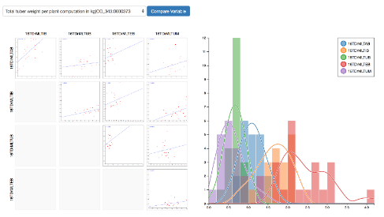
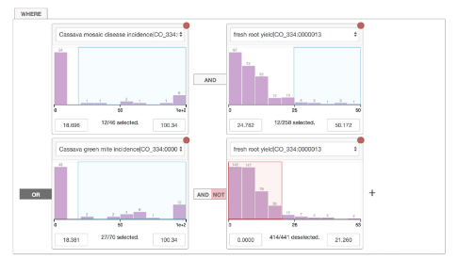
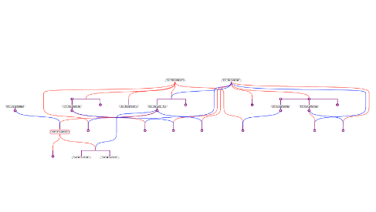
BRAPPs
Notes:
BrAPI is being used to solve many different use cases by many different groups around the world. Here are a few examples being actively developed within the BrAPI community (click)
With mobile data collection apps, like KSU Field Book, we can download plot layouts and traits directly from a BrAPI compatible database into a field device. Then, when data collection in the field is finished, we can upload observation data back to the database. (click)
When genotyping, we can automate sample data management between the breeding database and the genotyping lab. When the lab is finished processing the samples, genotype data can be automatically pulled into a genotype database. (click)
When preforming down stream analysis, data from multiple different sources can be pulled together using BrAPI. Because the analysis engine is using BrAPI standard data structures as input, it can re-used by any breeding program with a BrAPI compatible database. (click)
BRAPPs, or BrAPI Applications, are small tools and visualizations which can be easily shared and customized. On brapi.org, there is a growing library of BRAPPs available for anyone in the BrAPI community to add to their breeding system.
Each of these use cases allows breeders to focus more on breeding and less on data management, without losing the power of modern technologies.

Slide 9
How to use BrAPI
Review the documentation
GitHub maintains the source of truth in computer readable YAML files
Apiary is text based documentation, easier to read but not as much deep technical information
SwaggerHub has a human readable display with complete technical information
Notes:
At its core, the BrAPI project is just documentation. If someone wants to make their application BrAPI compliant, it is their responsibility to implement the specification. The specification documents are copied and hosted by 3 different services, GitHub, Apiary, and SwaggerHub. This give developers the option to choose their favorite style of documentation, or choose the style that best fits their needs. Links to all the documentation pages are available on brapi.org

Slide 10
How to use BrAPI
Client Application
Server Application
UI
Controller
Request Builder
HTTP Service
API Layer
Object Mapping Layer
Database Access Layer
Database
Response Handler
Notes:
In many cases, the most complex part of any BrAPI implementation is mapping proprietary application data to and from the BrAPI standard models. This diagram may look different for different programing languages, libraries, or frameworks, but the general recommendations are the same.
When implementing BrAPI in a client application, it is a good idea to add a request building layer and a response handling layer to the client code stack. The request builder is responsible for translating user actions into standard BrAPI service requests. The response handler is responsible for converting standard BrAPI data models into data structures the UI can interpret.
When implementing BrAPI in a server application, it is a good idea to add an object mapping layer to the server code stack. This layer is responsible for translating between the BrAPI standard models and the internal database models.
By adding these layers, applications can communicate using the standard models without contaminating existing, internal code.

Slide 11
Tools and Libraries
Tools
The BrAPPs Library
Public Server List
BRAVA (BrAPI Validator)
BrAPI Test Server
Libraries
JavaScript
R
Drupal (PHP)
Java
Python
Additional Libraries available through the SwaggerHub CodeGen tool
Notes:
To help groups develop their own implementations of the BrAPI standard, several helpful tools and libraries have been built. All of these tools and libraries are built and maintained by the BrAPI Community of open source developers.
The BrAPPs Library and the Public Server List present client and server applications that are pre-built and already BrAPI compatible. BRAVA and the BrAPI test server are testing frameworks designed to test brapi compliance in clients and servers.
Code libraries are maintained for JavaScript, R, Drupal, Java, and Python. These libraries are not full implementations, but they for a solid foundation to build from, making it easier to become BrAPI compliant.
Finally, SwaggerHub has a built in tool for generating code directly from the OpenAPI 3 documentation. This generated code is not perfect and often requires debugging, but they do provide over 25 different languages and frameworks to support a much wider pool of developers.

Slide 12
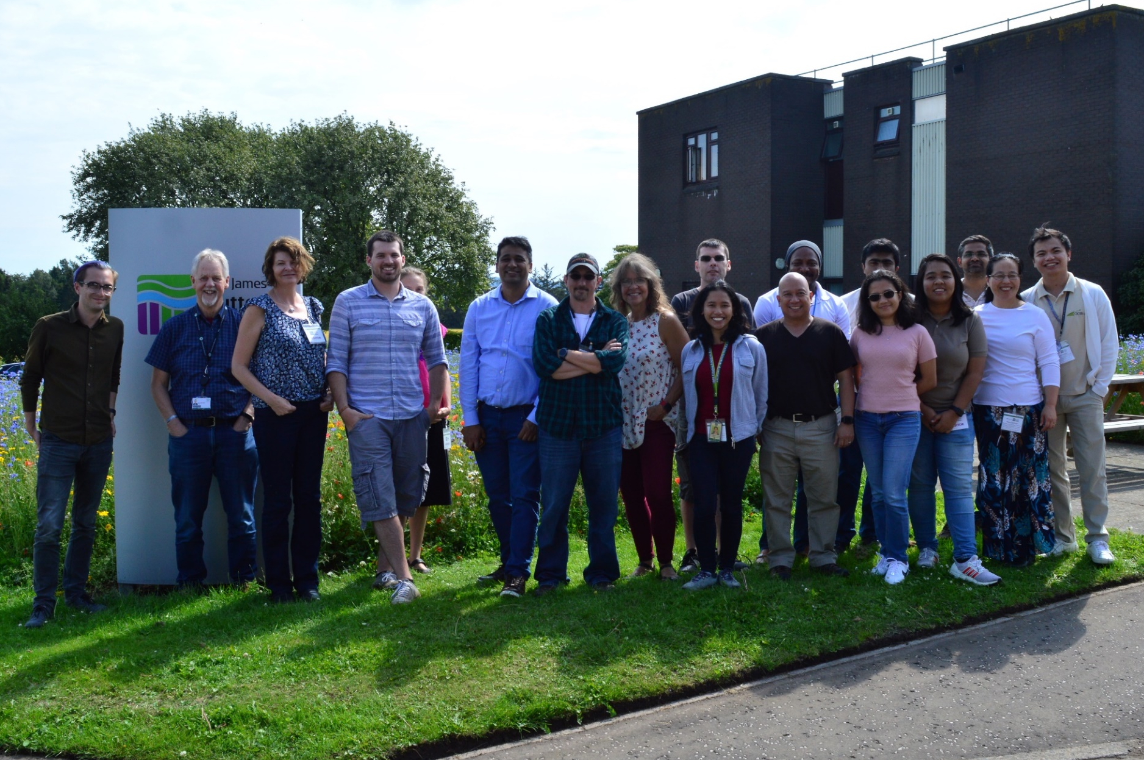
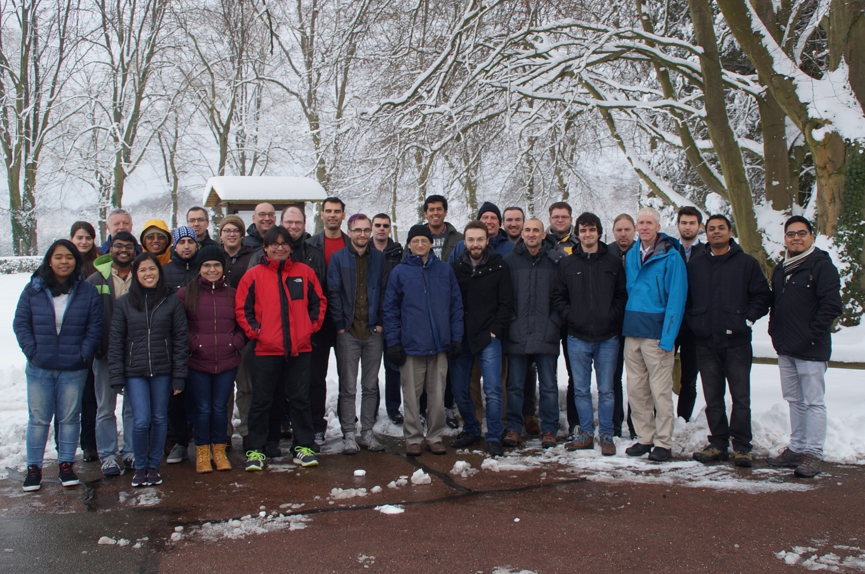
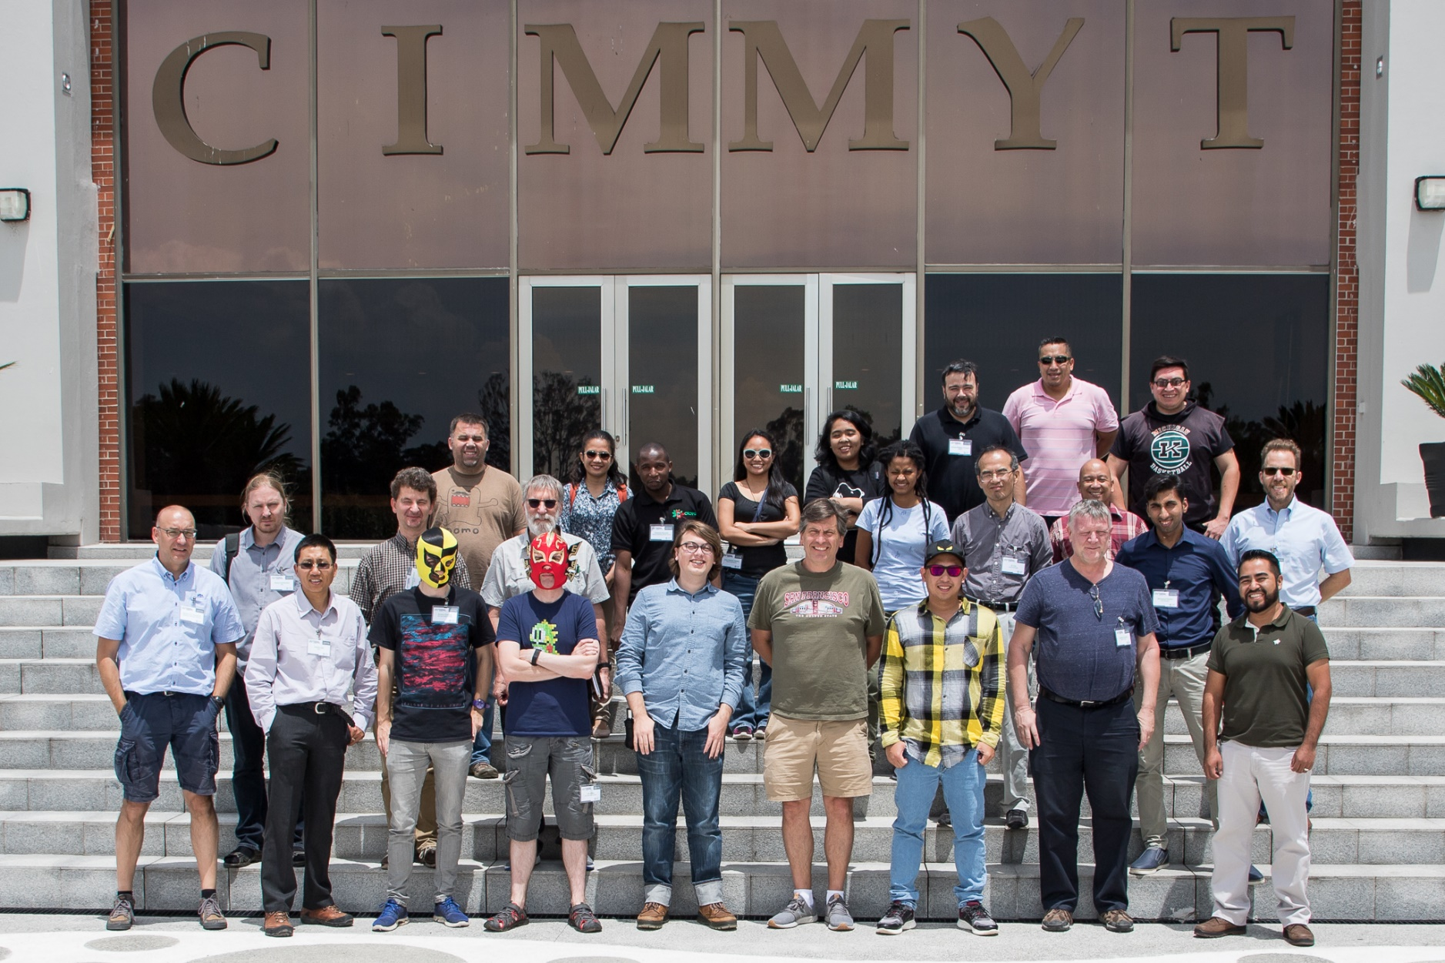
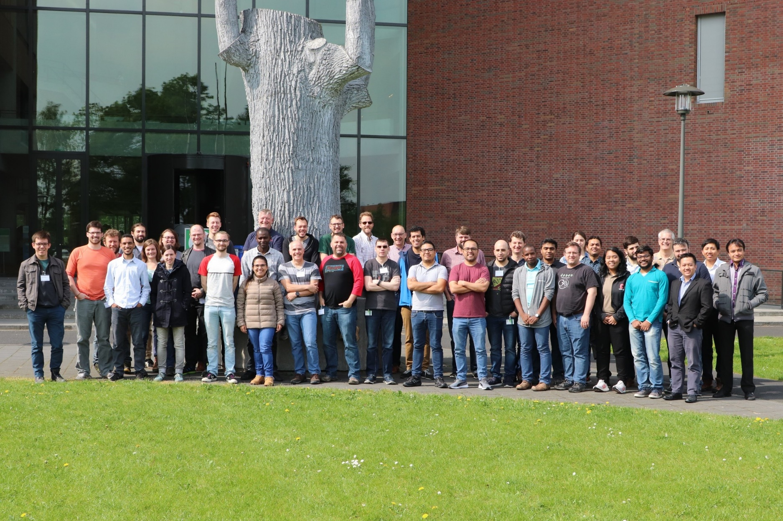
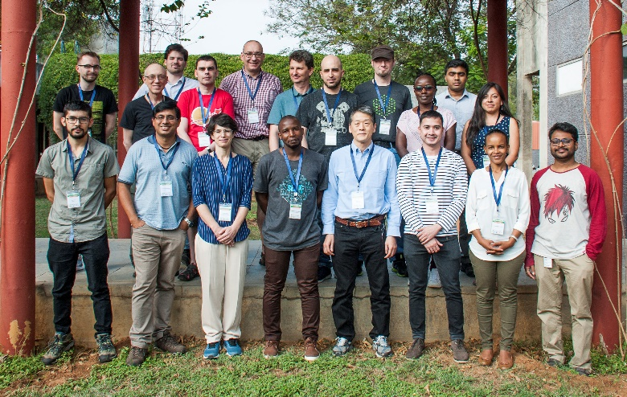
Dundee, Scotland
2019
Versailles, France
2018
Texcoco, Mexico
2018
Wageningen, Netherlands 2019
Hyderabad, India 2020
Notes:
(click evenly while speaking)
The BrAPI Community is the true heart and sole of the BrAPI project. We gather regularly for international hackathons to develop tools, and enhance the BrAPI standard. Each hackathon brings a healthy mix of old friends and new faces as new groups are joining the community each year.
The BrAPI Project started as a very small group in 2015. Since then, the community has grown to over 150 software developers, computational biologists, and breeding scientists from all over the world.

Slide 13
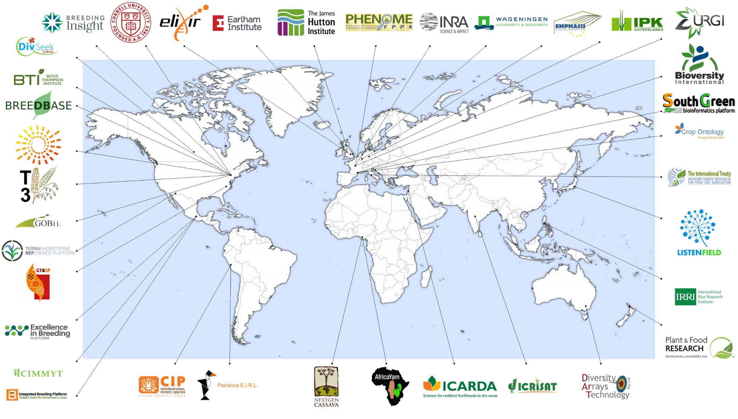
Notes:
BrAPI has 36 registered Partners and Collaborators around the world, with more formally joining the community each year. Each of these groups has contributed their knowledge, time, and resources to making the BrAPI project successful. There are so many different BrAPI related projects

Slide 14
For more information, please visit brapi.org
Peter.Selby@cornell.edu
Special Thanks to
Music: https://www.bensound.com

