Slide 1
Hardening Linux Kernel Subsystems by Architectural Capabilities
Zahra Tarkhani
@ztfasr
ztarkhani@microsoft.com
This Photo by Unknown author is licensed under CC BY.

Slide 2
Outline
Introduction
Background
Morello Linux state
Capability-based hardening
Opportunities & security considerations
Summary

Slide 3
Linux Security Subsystems
Proper OS hardening is hard and complex
Various SW-based CFI and fuzzing techniques
Still seeing many vulnerabilities
Various security features
DAC, MAC, LSMs, eBPF, seccomp, etc
Corse-grained privilege separation
Recent HW-security features
TEE/enclave, PAC, MTE, MPU, SMMU, TZASC/TZPC, RDC, XPPU, SPM
Different designs and protection capabilities
Several features on the same SoC

Slide 4
CHERI
Capability-based security concepts are old
Very long history in the University of Cambridge
A hardware/software/semantics co-design project
Fine-grained memory protection leading to increased memory safety.
Scalable compartmentalization.
Extends ISAs with new capability-aware instructions.
MIPS, RISC-V, ARMV8.A

Slide 5
Morello-CHERI
Extends the Armv8.2-A (aarch64 only)
It implements 129-bit CHERI capabilities, simplified as capabilities in this supplement, with compressed bounds
Validity Tag: Providing integrity protection.
Permissions: Limiting operations that can be performed.
Bounds: Limiting how the value can be used, for example, for memory access.
An object type: Supporting higher-level software encapsulation (e.g., Unsealing operations).
Controlled non-monotonicity (via exceptions, executive/restrictive, unsealing ops)

Slide 6
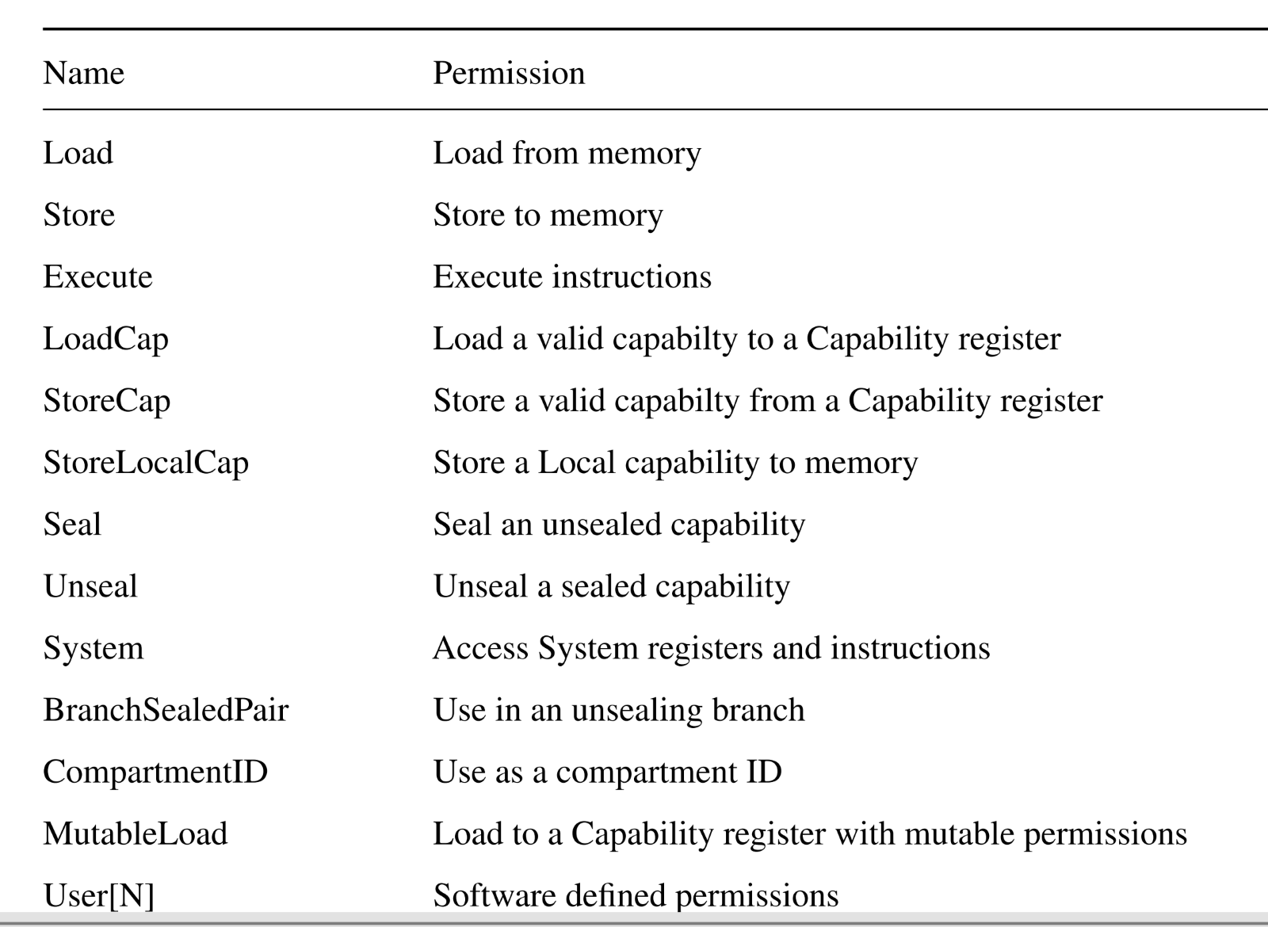
Morello-CHERI
The behaviour of SVC, HVC, and SMC are not affected by System permission.​

Slide 7
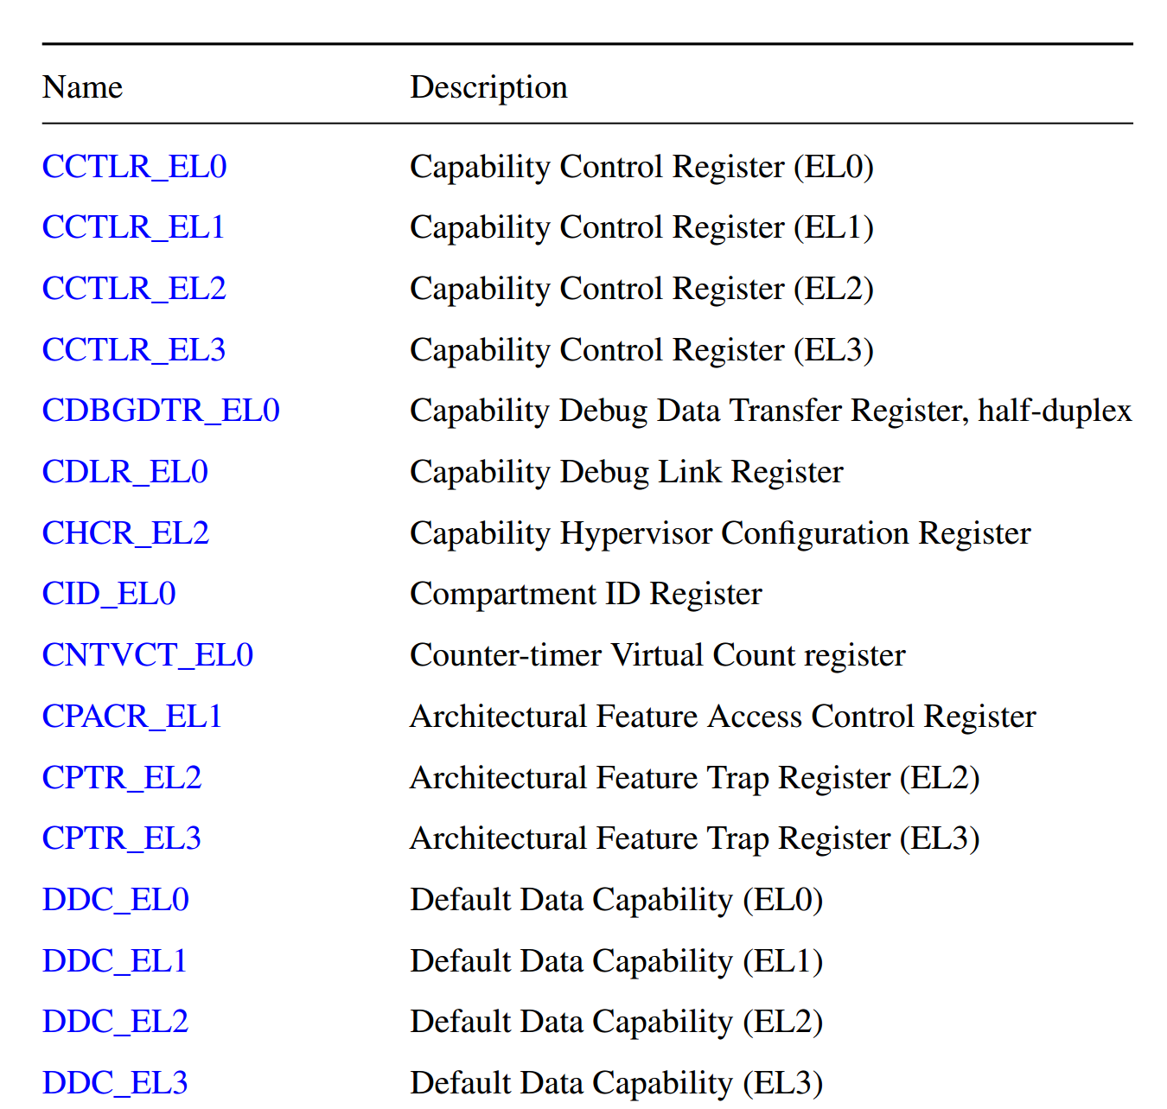
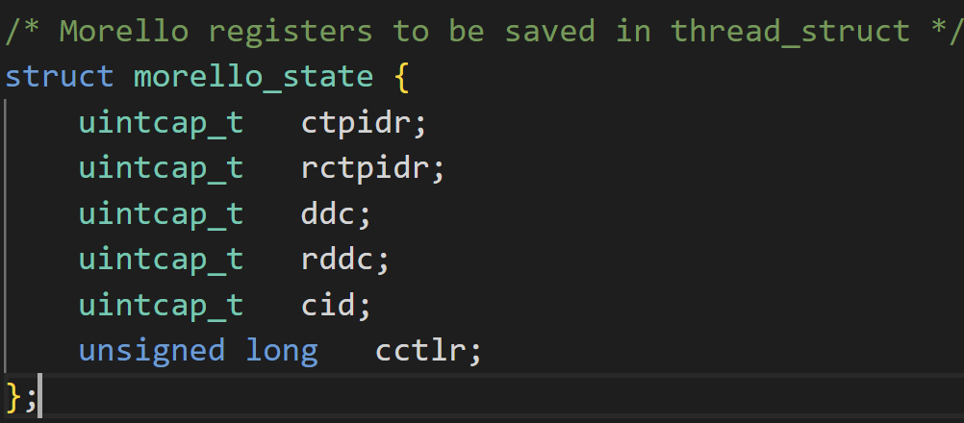
Morello-CHERI
Capability-extended registers
e.g., Program Counter Capability (PCC)
CVTD: Convert pointer to capability
SCBNDS (register): Set Bounds (register).
...
PE (executive and restrictive modes)

Slide 8
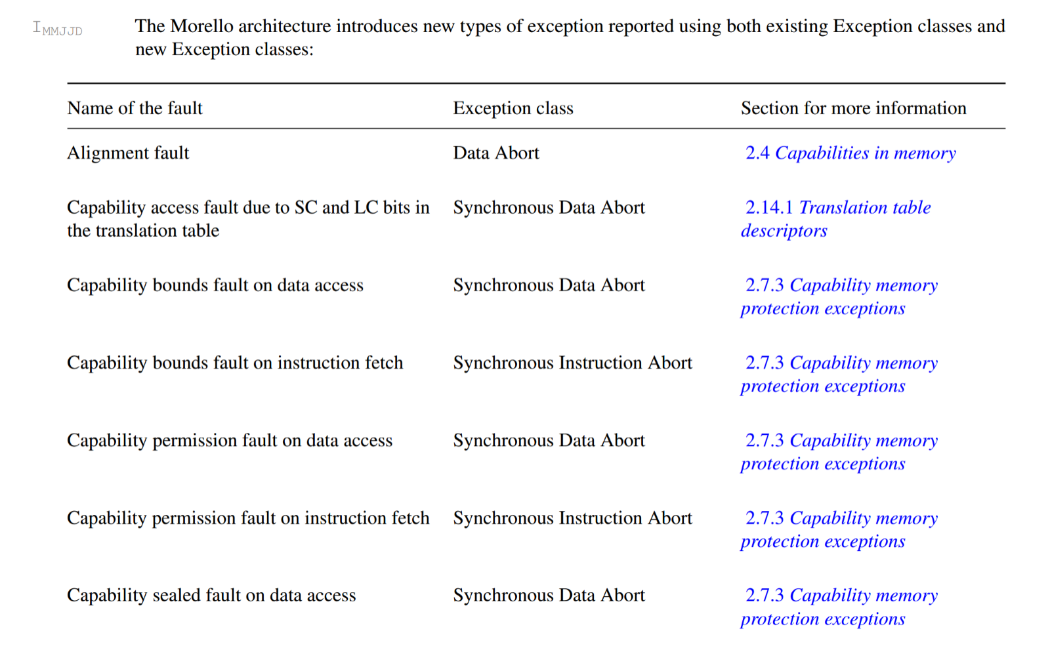
Morello-CHERI
Capability-extended exceptions

Slide 9
Resources
Many resources are available:
https://www.cl.cam.ac.uk/research/security/ctsrd/cheri/
https://www.arm.com/architecture/cpu/morello
https://git.morello-project.org/
Board request: https://www.dsbd.tech/get-involved/morello-board-request/
Arm® Architecture Reference Manual Supplement Morello for A-profile Architecture

Slide 10
Morello-Linux
Morello-Linux ABI
A pure-capability ABI (CONFIG_CHERI_PURECAP_UABI)
Many kernel features are added
All pointers passed to or provided by the kernel via syscalls are capabilities
e.g., mmap returns capability.
Pointers in structs and unions pointed to by syscall arguments, recursively
(e.g., iov->iov_base for readv()).
More proper syscall hardening is needed.
Address space management changes to handle capabilities
https://git.morello-project.org/morello/kernel/linux/-/wikis/Morello-pure-capability-kernel-user-Linux-ABI-specification

Slide 11
Morello-Linux
Relatively easy dev environment (FVP and dev board)
e.g., debian and busybox
After few steps & repo init & sync
./build-scripts/build-all.sh -p <fvp/soc> -f debian
https://git.morello-project.org/morello/docs/-/blob/morello/mainline/user-guide.rst

Slide 12
Morello-Linux
Minimal changes when enabling kernel security features
CONFIG_BPF_JIT=y,CONFIG_TRUSTED_KEYS=y, CONFIG_TEE=y, CONFIG_OPTEE=y, CONFIG_IMA=y CONFIG_SECURITYFS=y, CONFIG_ENCRYPTED_KEYS=y,CONFIG_TCG_TPM=y …etc
An example of minor issues when enabling kernel TEE support:

Slide 13
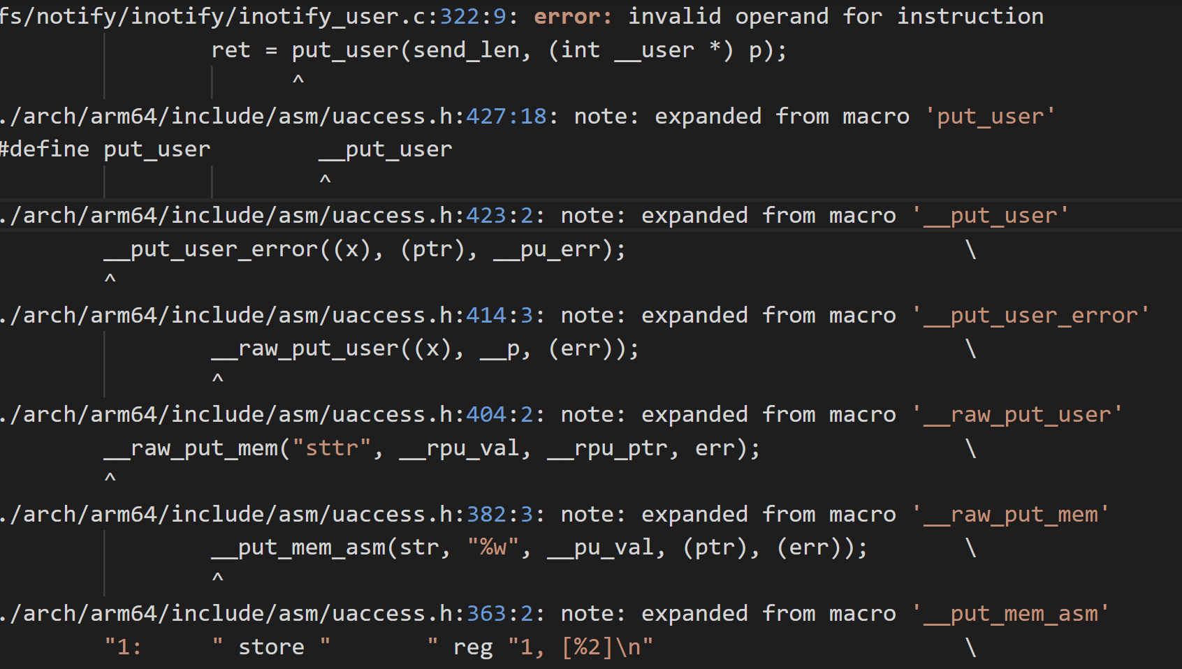
Morello-Linux
cheri-aware uaccess:
About 47 places to change (e.g., sched/core, syscall.c, selinux/hooks.c, ipc/msg.c, fs, etc)
ret = put_user(send_len, (__cheri_tocap int * __capability) (int __user *) p);

Slide 14
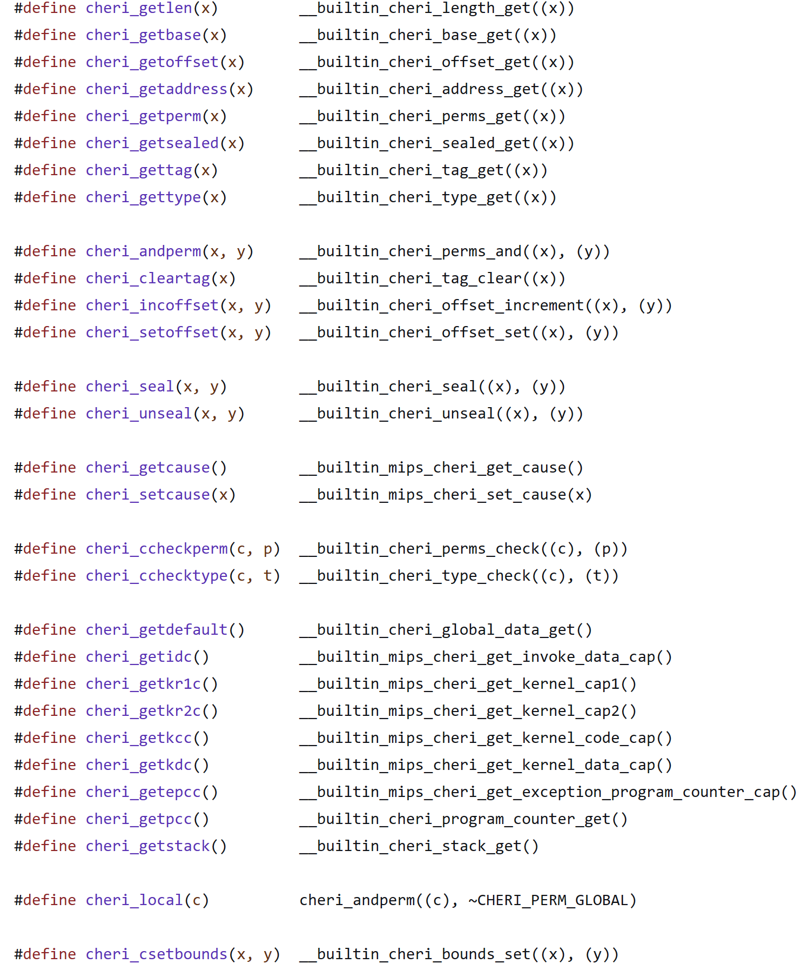
Morello-Linux
cheri-aware uaccess:
About 47 places to change
e.g., sched/core, syscall.c, selinux/hooks.c, ipc/msg.c, fs, etc
There are helper funcs to speed up the process:
__cheri_tocap and __cheri_fromcap
So many more helpers

Slide 15
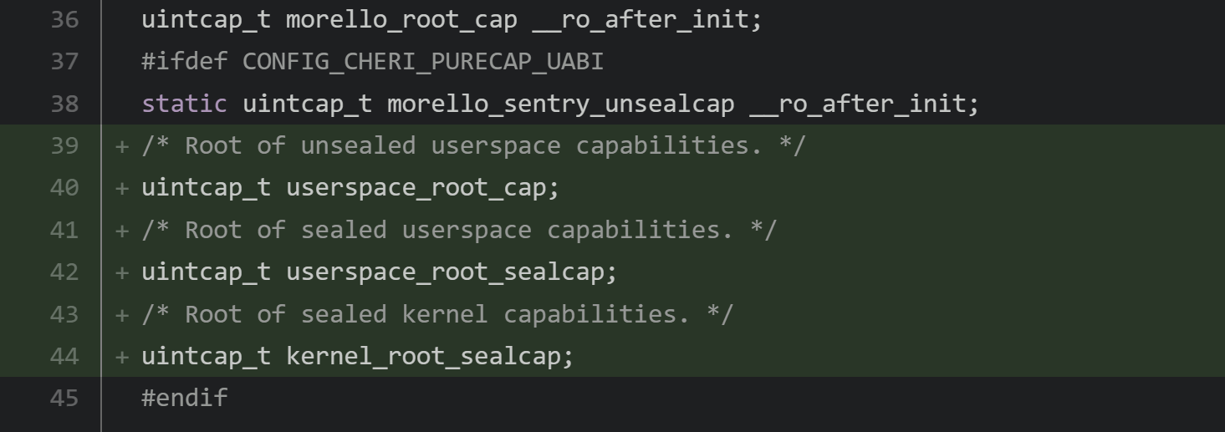
Improving CHERI-aware privilege separation
Currently mainstream supports one kernel root capability

Slide 16
Improving CHERI-aware privilege separation
Combining SW-defined permissions with HW-defined permissions
CHERI_PERM_SYSCALL
authorising system calls from $pcc
syscall sandboxing
CHERI_PERM_SW_VMEM
restrict the ability to change the page mapping underlying a capability
Better combinations for Linux sandboxing mechanisms?
Improving CHERI-aware privilege separation
Principled approaches and compartmentalization abstractions
e.g., subprocesses, co-procs, intra-kernel trust domains

Slide 17
Opportunities and security considerations
Clear and HW-protected security boundaries within the kernel
LSMs, eBPF, seccomp, namespaces, etc

Slide 18
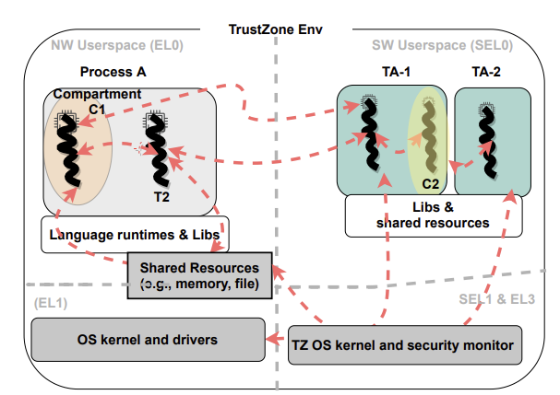
Opportunities and security considerations
More secure C/C++ systems stack and extensible compartmentalization
OS, hypervisor, secure kernels/TEE, etc

Slide 19
Opportunities and security considerations
More secure C/C++ systems stack and extensible compartmentalization
OS, hypervisor, secure kernels/TEE, etc
Integration with Linux security subsystems
For both hardening the features and HW-assisted guarantees for users
Integration with other HW-security features
Compartmentalization tools
More secure debuggers and traces?
...

