Slide 1
Pre Read
The slides in this deck are publicly available!
These are the slides that correspond to Kris Nóva’s 2023 FOSDEM talk.
All comments on the slides will be publicly visible.
For private feedback please email: nova@nivenly.org

Slide 3
Hachyderm
Decentralized Social Media

Slide 4
Quick Check-in
Who knows what Mastodon is?
Who knows what Hachyderm is?
Who knows how to DoS a service?
Who knows how to abuse a service?

Slide 5
45 minutes
Please try to abuse/DDoS hachyderm.io

Slide 6
Goal
Wake my partner and my puppy up
Trigger my phone alerts

Slide 7
Public Grafana
grafana.hachyderm.io/public

Slide 8
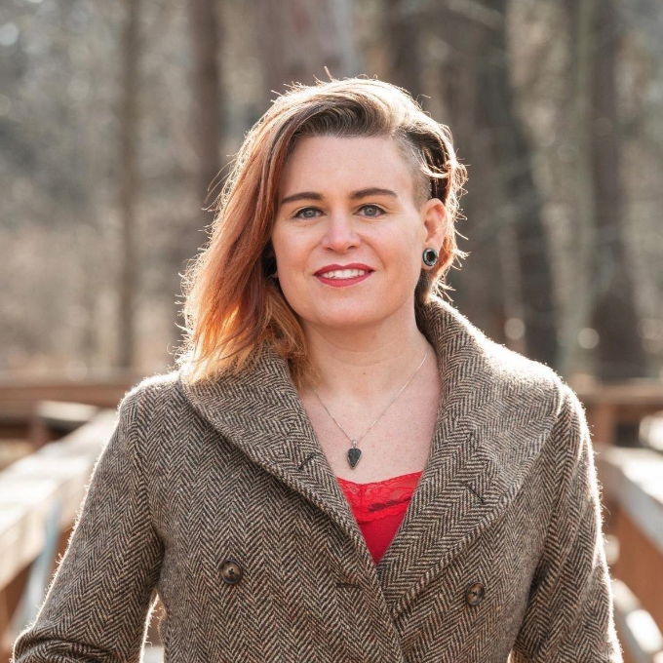
Principal Engineer
Author
President | Board Member
Kris Nóva
hachyderm.io/@nova

Slide 9
What is Hachyderm?
My little Mastodon server.

Slide 10
What is Hachyderm?
My little Mastodon server.
My medium Mastodon server.

Slide 11
What is Mastodon?

Slide 12
What is Mastodon?

Slide 13
What about the name?
Hacky
+
Pachyderm
A clumsy, temporary, or inelegant solution to a technical problem
A large thick skinned mammal such as an elephant, rhinoceros, or hippopotamus

Slide 14
What about the name?
Hachyderm
A clumsy, temporary, or inelegant thick skinned social media server

Slide 15
45,000
Hachydermians
20,000
Active Hachydermians
February 4th, 2023

Slide 16
Technical and Open Source professionals such as yourselves.

Slide 17
hachyderm.io/about
Here we are trying to build a curated network of respectful professionals in the tech industry around the globe. Welcome anyone who follows the rules and needs a safe home or fresh start.
We are hackers, professionals, enthusiasts, and are passionate about life, respect, and digital freedom. We believe in peace and balance.
Safe space. Tech Industry. Economics. OSINT. News. Rust. Linux. Aurae. Kubernetes. Go. C. Infrastructure. Security. Black Lives Matter. LGTBQIA+. Pets. Hobbies.

Slide 18
The Story of Leaving the Basement
25%

Slide 19
November 27th 2022
Hachyderm.io is unresponsive

Slide 20
November Leading Up To “The Outage”
35,000
30,212
30,000
25,000
The Outage
25,701
20,000
15,000
10,000
5,000
6,004
720
Nov 1st
Nov 15th
Nov 27th

Slide 21
The State of The Systems

Slide 22
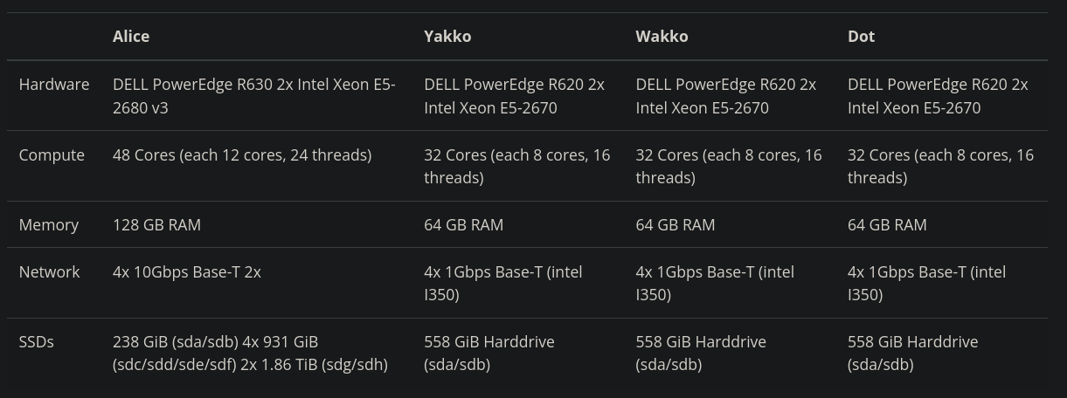
“The Water Tower”
At the time of the incident

Slide 23
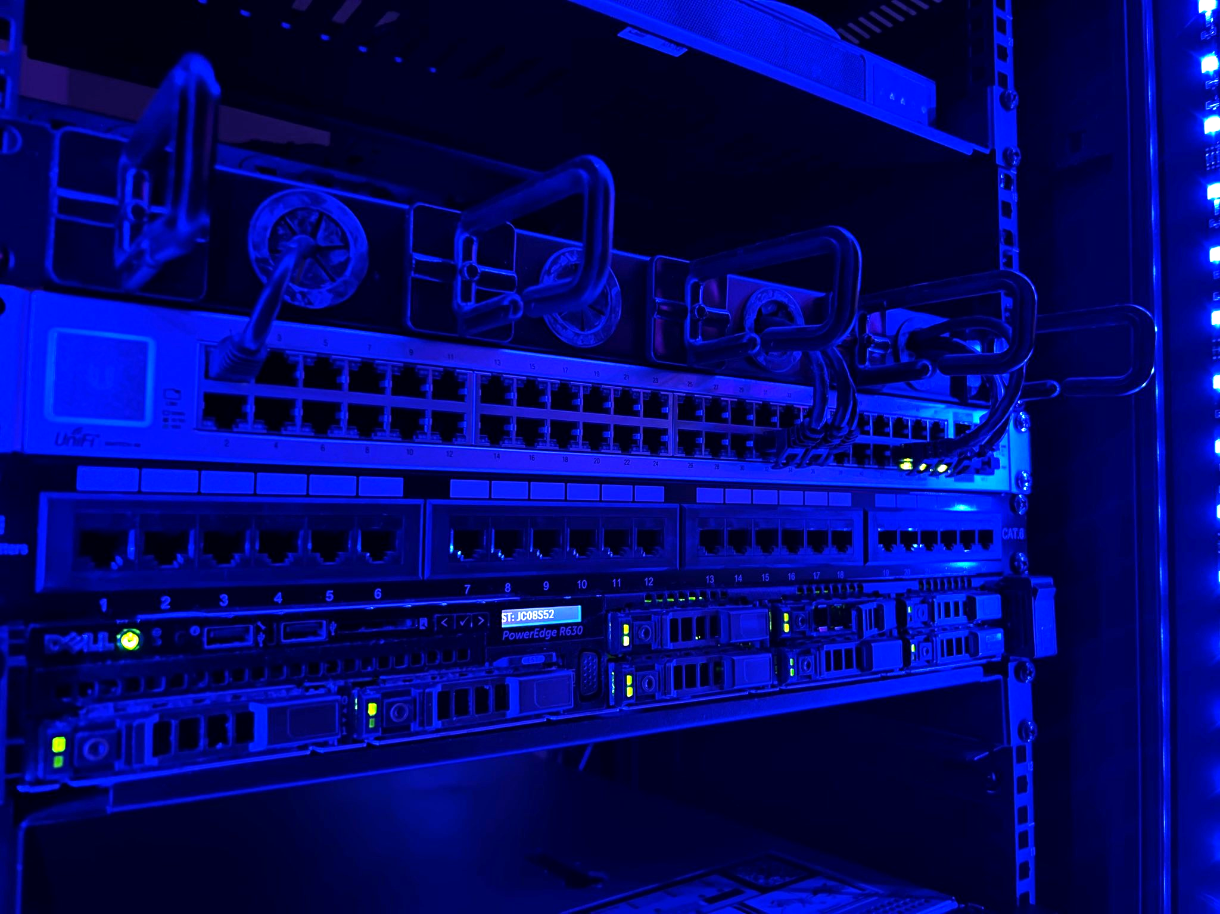
Meet Alice

Slide 24
Bro, it was a fucking homelab okay?

Slide 25
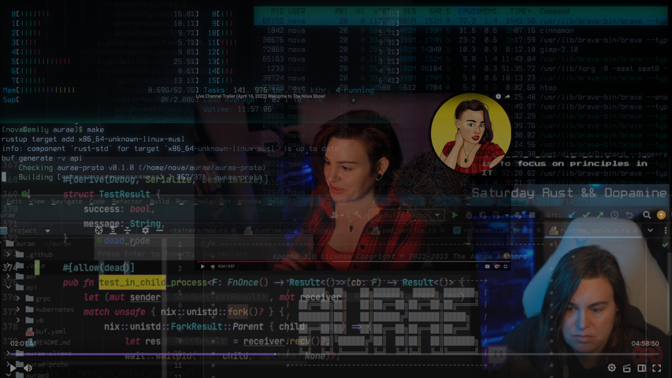
Twitch
twitch.tv/krisnova

Slide 26
List of things from my stream homelab that you have probably never heard of
Boopkit - eBPF Rootkit
Aurae Distributed Runtime
STUN for NAT traversal
Arch linux package maintainer
NAML
Xpid
Kernel modules in Rust
Kubernetes root kit
Kubernetes exploit shell (Kush)
ZFS over SSH

Slide 27
Turns out 50,000 people trust me and really dislike a certain billionaire.

Slide 28
Core Cause
Bad (slow) Disks on Alice
lead to cascading failures across our CDN and edge geographic nodes

Slide 29
Meet Alice
Aforementioned Bad Disk

Slide 30
Cascading Failures
Frankfurt
Shared Redis
Dot
Fremont
PostgresQL
New York
Wakko
Alice
Yakko
Iceland

Slide 31
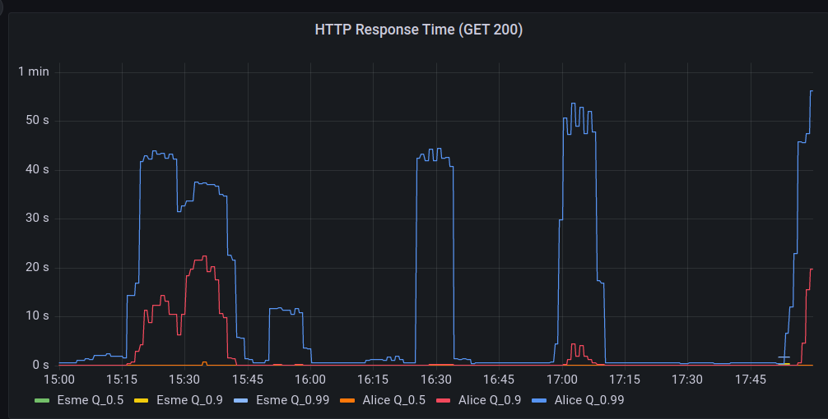
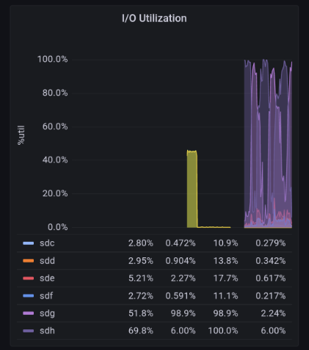
Correlating Cascading Failures to Disk IO

Slide 32
This was very exciting
50%
1.5 Users per minute

Slide 33
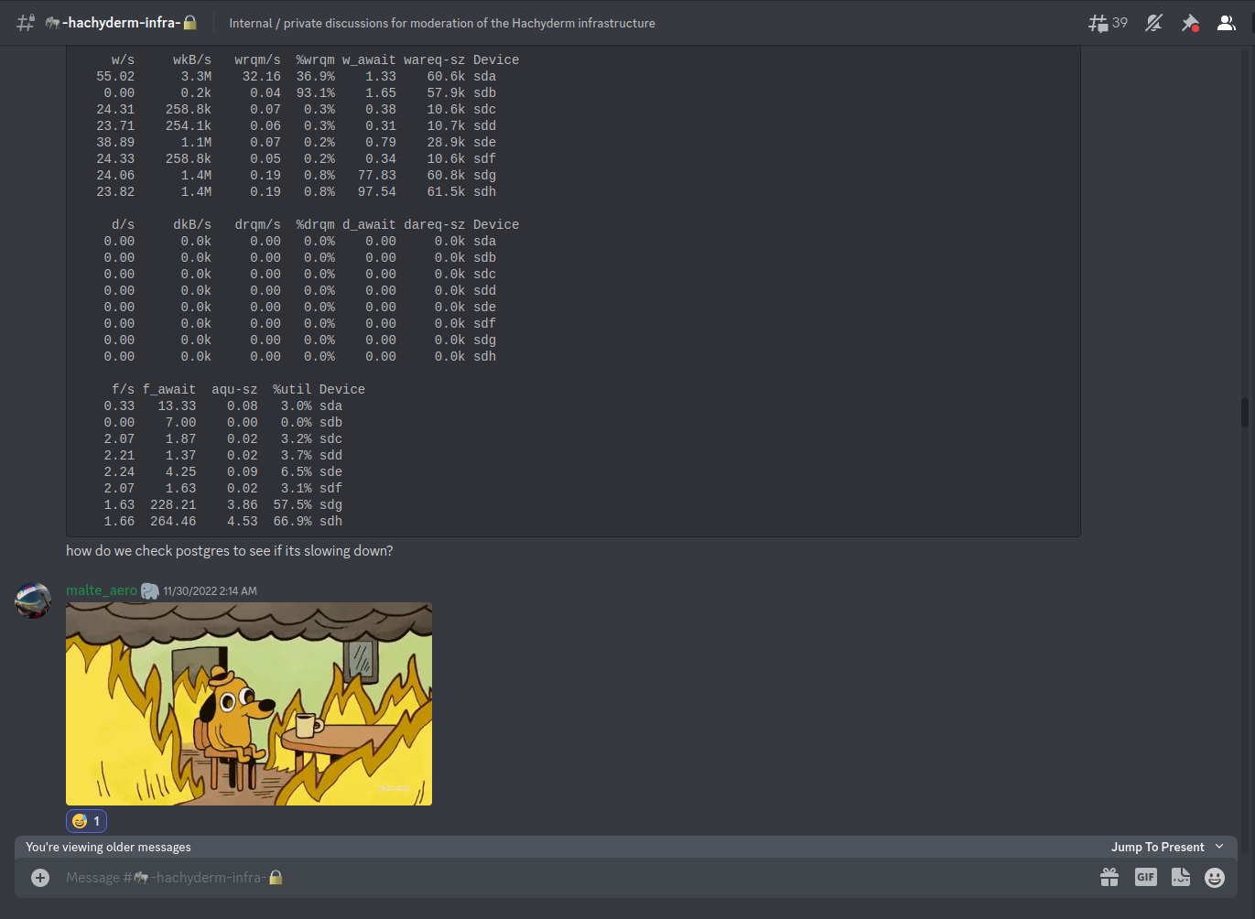

Slide 34
Failure Modes
More computers
Getting good at wrong things
@nova tries to just turn on more computers and hopes that things will just start working
@dma creates a lovely spreadsheet for us to count threads and connections

Slide 35
But Gabe’s rooster videos
Hachyderm community is made up of thousands of amazing technologists

Slide 36
Malte’s Plan
writes
Frankfurt
rclone
Block 2 Tb
Fremont
try_files
New York
reads
PostgresQL 40 Gb
Alice
Iceland
media.hachyderm.io

Slide 37
8 Days To Finish Transfer

Slide 38
Out of the basement
Hetzner Colocation in Germany

Slide 39
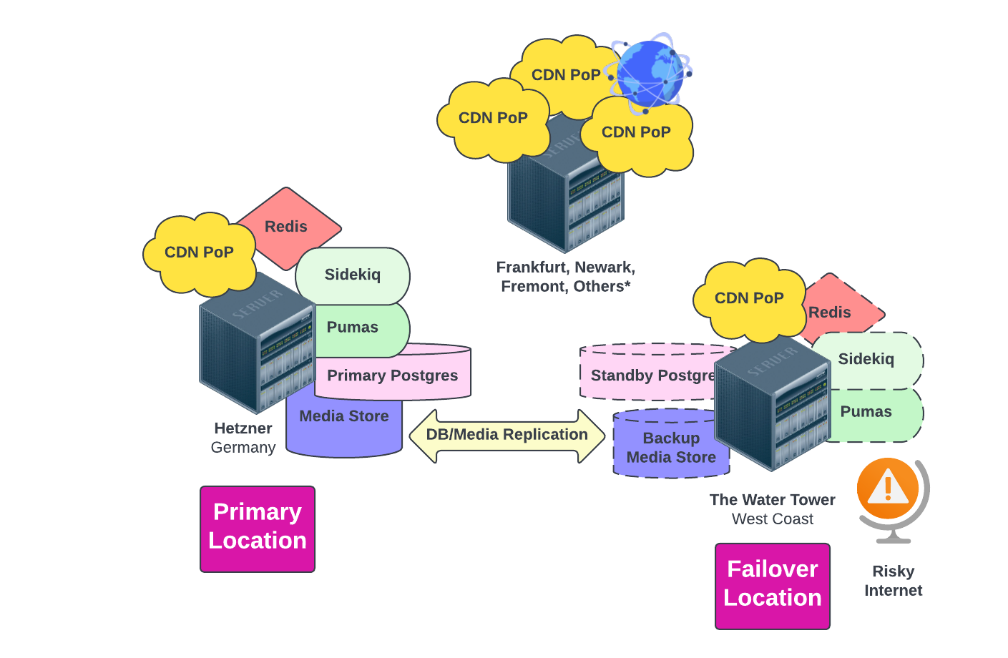
Hetzner Infrastructure

Slide 40
So Now What?
Operations

Slide 41
Top “ruby monolith” Problems
(we think we’ve solved)
Sidekiq scaling
Network scaling
Splitting jobs across hosts
Balancing threads and processes
Global CDN nginx reverse proxies

Slide 42
How much network scaling?

Slide 43
Federation: Moderation Implications
Friendly Instance
Neutral Instance
Evil Instance
Original Content
Boosted Content
Access Granted

Slide 44
Top “non-ruby monolith” Problems
Legal
Mod
International Privacy Laws
DMCA, User data
Federation risk
Trolls, Dog Whistles, Bad Actors
Judgement calls, expectation managing
Volunteers
Funding
Discord, Time zones, Zoom, Communication
1,000 EU a month in hosting

Slide 45
Hachyderm Community
75%
community.hachyderm.io

Slide 47
Aurae

Slide 48
Quintessence Anx
Executive Director
Nivenly Foundation

Slide 49
Establishing a governance model
for social media and open source

Slide 50
Observations in Tech (Twitter, Corps, etc)
Communities isolated from
Users are detached from
People are unable to impact.
decisions.
technology.
change.

Slide 51
Observations in Tech (Twitter, Corps, etc)
Corporations are not isolated from
Corporations are not detached from
Corporations are able to impact.
decisions.
technology.
change.

Slide 52
Culture Consequence: People are Unheard
Cyberbullying
Assuming evil
Criticize instead of contribute

Slide 53
Striking a Balance
Corporations
Communities

Slide 54
Path To Nivenly Governance
General Members
Project Members
Corporate Members
Small opt-in monthly fee
Contributions
Based on Company Size

Slide 55
General members have a vote!
Democratic Governance
Targeting $5.00 a month

Slide 56
Foundation Update:
Early Stages
Seeking help with democratic model

Slide 57
Keep Hachyderm Online
So now what?
Work Towards Democracy
Hopefully there are no unexpected abuse attacks.
How do we onboard corporations and general members? How do we vote?

Slide 58
Thank You
Quintessence Anx
Dominic Hamon
Preston Doster
Molly Monroy
Mod Team
Infra Team

Slide 59
Online?
Let’s see how the DDoS went!
Photo upload

Slide 60
Public Resources
grafana.hachyderm.io/public

Slide 61
Public Resources
github.com/nivenly/public

Slide 62
President | Board Member
Kris Nóva
hachyderm.io/@nova

