Slide 1
Hardware attestation in TLS

Slide 2
Who am I?
Ionuț Mihalcea
Senior Software Engineer at Arm
ionut.mihalcea@arm.com
https://www.linkedin.com/in/ionut-mihalcea-985314a5/
@ionut-arm

Slide 3
Overview
The theory
Remote attestation
TLS
The practice
MbedTLS
Parsec
Veraison

Slide 4
The theory
Remote attestation, TLS, and standards

Slide 5
What are we trying to improve?
Current status quo:
Attacker assumed on communication path
Workload authentication is rooted primarily in software
Trust is necessarily bound to the entity provisioning the workload
Hardware backing is usually reserved for protecting an identity key (e.g., HSMs)
Can we use remotely-verifiable information about the security state of the workload, beyond key state/backing?

Slide 6
Use cases
PRIVATE IDENTITY KEY
SERVICE
ATTESTATION
CREDENTIAL
CLOUD WORKLOAD
CERTIFICATE
ATTESTATION
CREDENTIAL
CERTIFICATE
EDGE DEVICE
PRIVATE IDENTITY KEY
LOCAL DEVICE
IoT/Edge Device Onboarding
Confidential Computing

Slide 7
Remote attestation
A class of hardware-backed mechanisms which enables a relying party¹ to cryptographically verify the state of a previously-untrusted workload
The attester device can issue its own credentials
… backed by a certificate provided by the manufacturer
¹ Using RATS terminology in this presentation

Slide 8
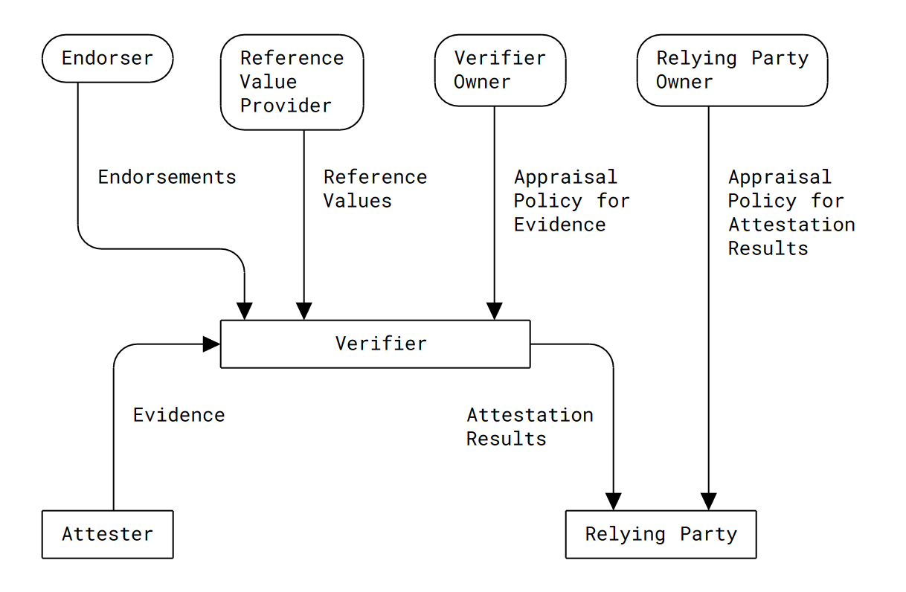
Remote attestation data flow
Provision device
and its identity
Authentication

Slide 9
Transport Layer Security (TLS)
TLS is a ubiquitous component of network security, offering confidentiality and integrity to communication via a secure channel
The secure channel is established following a handshake protocol
The handshake protocol enables authentication between the two peers

Slide 10
TLS v1.3 Handshake
Client
Server
Client Hello (supported cipher suites, any extensions…), Key Share
Server Hello (chosen cipher suite, any extensions…), Key share,
Certificate, Certificate Verify, Finished
(Mostly) Encrypted
Certificate (Optional), Certificate Verify (Optional), Finished
Secure data channel

Slide 11
Goals
To enhance authentication via remote attestation in TLS
To support a wide range of platforms
To support most common deployment patterns

Slide 12
Security and privacy
Planning to formally verify the extensions
Meticulously working to prevent attacks (e.g., relay/splicing)
Attestation credentials can reveal a lot of private and security-relevant metadata …
… but this could be (partially) mitigated by use of specially-crafted attestation results

Slide 13
The practice
Prototype and ecosystem

Slide 14
Big picture
Producing an end-to-end proof of concept
From attester through a TLS implementation, to a verifier
Uses background-check model, TPM2.0 as a RoT
Open-sourcing the entire stack
The components themselves are open-source software
Our work is harbored under the CCC Attestation SIG

Slide 15
Prototype Architecture
Verification
Relying Party
Verifier
Authentication
Attester
Attester Private + Attestation Key(s)
Platform State
Attester RoT

Slide 16
Prototype Architecture
Verification
Server
Verifier
TLS Stack (MbedTLS)
Server Certificate
Handshake (Augmented)
Secure Channel
Attestation Evidence
Client
TLS Stack (MbedTLS)
Client Private + Attestation Key(s)
Platform State
Client RoT

Slide 17
Parsec: A Platform Abstraction For Security
Cloud-Native Applications, Any Programming Language, Any Runtime, Any Orchestration
Any Platform, Any Architecture, Any Hardware
Discrete TPM
Firmware TPM
Local HSM
Remote HSM
Trusted Services
Custom

Slide 18
What is Veraison?
An Open-Source Library of Components to Build Attestation Verifier Services
Verifier Service
Standard Provisioning
Data Model
Verification
API
endorse
verify
Any Architecture, Any Deployment, Any Policy
deploy
Device
attest
Application/Service
(Relying Party)
Manufacturing

Slide 19
Enhancements to Parsec
A (generic) key attestation API
Specific service configuration options (attesting key, TPM PCRs…)
An API to enable generation of endorsements

Slide 20
Extensions to Veraison
Support for the attestation scheme required for the prototype:
New plugin for evidence
New plugin for endorsements

Slide 21
MbedTLS
Implementation of TLS and DTLS protocols
Provides a reference implementation of the PSA Cryptography API
Small code footprint, more suitable for IoT and Edge devices

Slide 22
Open source ecosystem
Pooling expertise and work across the industry
”Open sourcing” should be more than an item on a checklist
It should bring a continuous involvement in the ecosystem
We’ve been seeding and expanding projects in CNCF and CCC to build communities

Slide 23
Rust ecosystem
Released a number of crates relevant to RoTs:
tss-esapi
cryptoki
psa-crypto
The more important goal is to make these hardware features easier to consume via the Parsec Rust client

Slide 24
Go ecosystem
Released the veraison/go-cose package, used quite broadly
Notary
Sigstore
Also other packages relevant to remote attestation and verification:
Veraison/swid
Veraison/corim

Slide 25
Attestation as a plug-in
Verification
Server
Verifier
QUIC Stack
Authentication Server
TLS Stack
Server Certificate
Authentication
Attestation Evidence
Client
Workload
QUIC Stack
TLS Stack
Client Private + Attestation Key(s)
Platform State
Client RoT

Slide 26
Wrap up

Slide 27
Remote attestation is a viable authentication mechanism for TLS
Our design aims to be as flexible and secure as possible
We want to reify the theory into an end-to-end prototype
We’re hoping that the prototype will serve as a model for integrating remote attestation in other protocols

Slide 28
Questions?

Slide 29
Bibliography
TLS extension draft: https://datatracker.ietf.org/doc/draft-fossati-tls-attestation/
CCC project repo: https://github.com/CCC-Attestation/attested-tls-poc
Parsec: https://parsec.community/
Veraison: https://github.com/veraison
MbedTLS: https://www.trustedfirmware.org/projects/mbed-tls/
Draft repo: https://github.com/yaronf/draft-tls-attestation
RATS architecture: https://datatracker.ietf.org/doc/rfc9334/

