Slide 1
Load balancing & DNS
deep dive

Slide 2
Consistent Hashing Load balancing
What?
Why?
How?
What’s DNS got to do with it?

Slide 3
What?
Distribute load over backends
Take a property from an outgoing connection
Ensure the same property value always ends up on the same backend

Slide 4
Load balancing
Upstream
Invoice instance 1
Target
Invoice instance 2
Target
Client traffic
Upstream
Loadbalancer
Ticket instance 1
Target
Ticket instance 2
Target
Upstream
Report instance 1
Target

Slide 5
Hashing
Hash on UserID
Upstream
Harry
John
Mary
Invoice Instance 1
Target
Client traffic
Loadbalancer
Paul
Ann
Joanne
Invoice Instance 2
Target

Slide 6
Why?
Backend cache optimization
Sticky sessions (for legacy mostly)

Slide 7
Hashing
Hash on UserID
Upstream
Harry
John
Mary
Invoice Instance 1
Target
Client traffic
Loadbalancer
Paul
Ann
Joanne
Invoice Instance 2
Target

Slide 8
How? hash-buckets
modulo
the continuum (the buckets):
0 | 1 | 2 | 3 | 4 | 5 | 6 | 7 | 8 | 9
targetInfo := continuum[modulo(hash(input), len(continuum))]

Slide 9
The continuum distribution
A
B
C
D
4 target nodes, each serving 25% of the continuum

Slide 10
The continuum distribution
A
B
C
D
A
B
C
D
E
Add a node, each now serving 20% of the continuum

Slide 11
The continuum distribution
A
B
C
D
5%
10%
15%
20%
+
+
+
= 50%
A
B
C
D
E
20% capacity added, 50% of the continuum changed destination

Slide 12
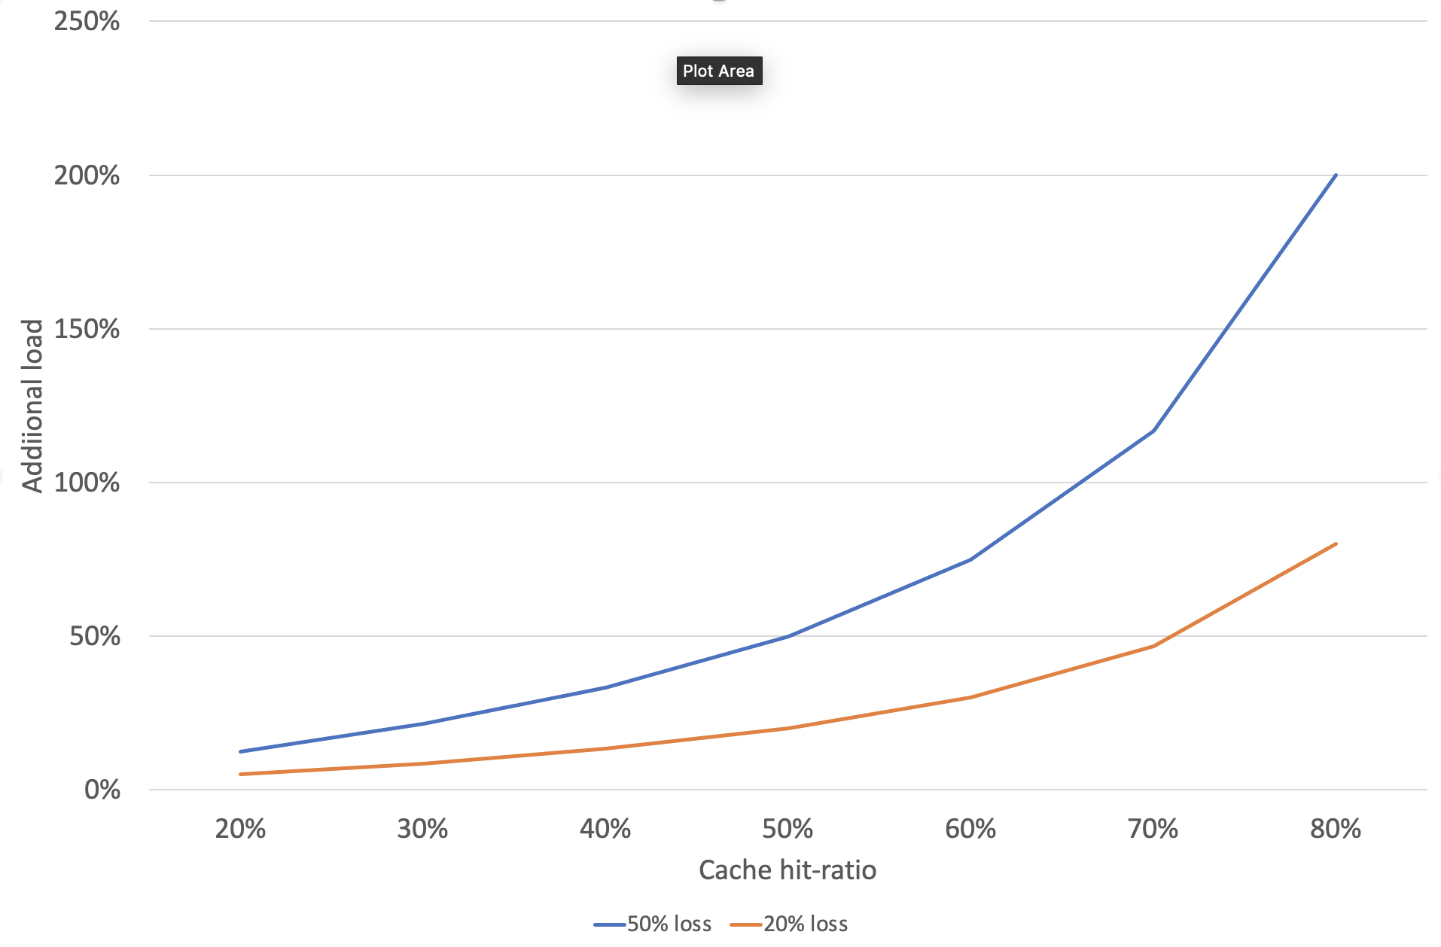
Effect of consistency loss

Slide 13
DNS in the bigger picture
Typical server side behaviour:
Randomize records
Respond with only a subset (UDP size)
Synchronize TTL
Caching:
DNS caching on Nginx worker level

Slide 14
DNS & plugins
OpenResty TCP/UDP socket functions
Monkey patched in “global patches”

Slide 15
Some (typical) issues
Bad dns servers (3 dns servers, 1 bad)
Configuring name servers in parallel instead of hierarchically #3072
Low frequency, failing requests, retries #3082
No response on CNAME query

Slide 16
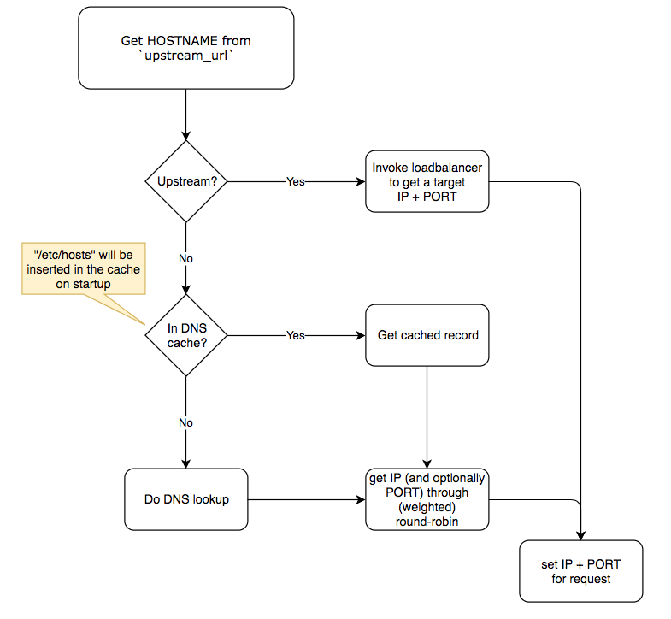
upstream_url = “http://ticket_service_v1/api/v1/”

Slide 17
Load balancer features
(weighted) round robin
Consistent hashing
Sticky sessions
Improve cache hit ratio
Ketama: minimal consistency loss
Enable/disable nodes without consistency loss
Auto-refresh DNS records

Slide 18
Continuum modeled as a ring
D
B
A
B
20
1
C
A
A
C
D
B
15
5
B
C
D
D
A
C
10
D
A
C
B
Real case: use 50-100 positions per expected target (so 5 instances == 500 positions/hash-buckets)

Slide 19
D
B
A
B
20
1
C
A
A
C
D
target
1
ꝏ
slot
1
1
hash bucket
5
B
15
B
weight
random
C
D
D
A
C
10
D
A
C
B

Slide 20
D
B
A
B
20
1
C
A
A
C
D
target
1
ꝏ
slot
1
1
hash bucket
B
15
5
B
C
D
D
A
C
10
D
A
C
B

Slide 21
D
B
A
B
20
1
C
A
A
hash
#18
C
D
B
15
5
B
hash
#9
D
C
hash
#13
D
A
C
10
D
A
C
B

Slide 22
cluster wide consistent hashing
randomness

Slide 23
Ring-balancer with 20 positions
20 slots
4 service targets having equal weights
A gets slot 1 – 5
B gets slot 6 – 10
C gets slot 11 – 15
D gets slot 16 – 20
E gets slots: 5, 10, 15, 20
Add new target E with the same weight
1 – 4
6 – 9
11 – 14
16 – 19

Slide 24
E
E
D
B
A
B
20
1
C
A
A
C
D
minimal consistency loss
5
B
B
15
C
D
D
A
C
10
D
A
C
E
E
B

Slide 25
Ring-balancer with slots
The “simple” alternative: 10 slots move, 50% consistency loss
20 slots
4 service targets having equal weights
A gets slot 1 – 5
B gets slot 6 – 10
C gets slot 11 – 15
D gets slot 16 – 20
E gets slots:
1 – 4
5 – 8
9 – 12
13 – 16
17 - 20
1
2
3
4
—
10 moved!

Slide 26
D
B
A
B
20
1
C
A
A
C
D
B
15
5
B
C
D
D
A
C
10
D
A
C
B

Slide 27
Caveats
Consistency loss:
DNS names instead of IP’s (non-deterministic)
Upon history changes (auto-cleanup)
Resizing the upstream (#slots)
Rebuilding (local appr. 20ms)
Updating the upstream (no #slot changes)
Out of sync updates
General
Use at least 100 slots per ‘expected’ target

