Slide 1


Introducing –accel mshv in QEMU
FOSDEM 2026, 2026-31-01
Magnus Kulke, Azure Core Upstream

Slide 2
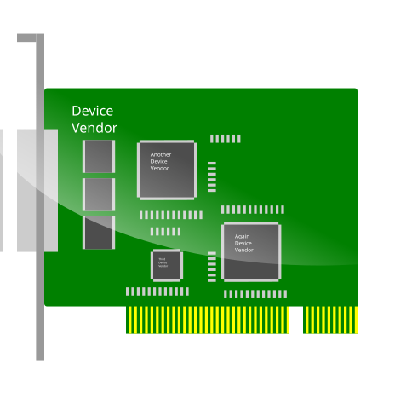
QEMU Accelerators
Examples: KVM, HVF, WHPX
VMM: maps RAM/MMIO into guest space
VMM: pass control to HV to execute guest code on vCPU
HV: trap unmapped GPA access, yield back to VMM
VMM: emulate device
VMM
Host memory
vcpu_run()
Hypervisor
GPA space
Guest
vm exit

Slide 3
KVM/Microsoft Hypervisor (MSHV)
Both are Type 1 hypervisors
  MSHV: thin dedicated layer between Hardware and root partition
  KVM embeds hypervisor functionality into the Linux kernel
VMM
VMM
HV
Root Partition OS
Kernel
HV
Hardware
Hardware
KVM
Microsoft Hypervisor

Slide 4
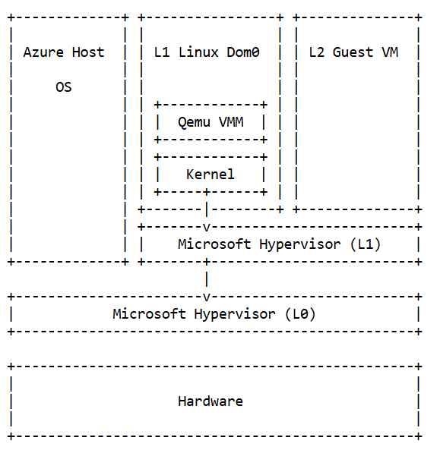
Linux Root Partitions for MSHV
/dev/mshv – like dev/kvm: ioctl/fd interface to manage guests + resources
Used in AKS Pod Sandboxing: minimal container-optimized Linux w/ Kata + Cloud-Hypervisor on Azure Linux
Baremetal*, Nested HV*, or Direct Virtualization
First parts upstreamed in 6.15, incrementally more features are added
* Not yet in mainline kernel

Slide 5
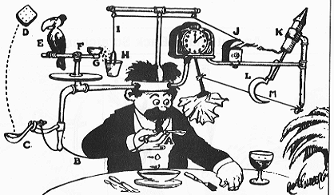
Why QEMU + Linux + MSHV?
Sandbox untrusted code
  FaaS
  Coding agents
  “Hostile multitenancy”
Enable CX’s to build platforms w/ virt
Linux is the #1 workload on Azure*
QEMU is a popular and comprehensive VMM, not just for cloud-native workloads
Foundation for higher level virt solutions (libvirt, Kubevirt)
* Lessons from Running Linux at Hyperscale (OSS NA 2024)

Slide 6


Direct Virtualization (Hierarchical Virt.)
Parenting
Parenting
L1 Virtual Host (L1VH): spawns Virtual L2 Guest
L2: sibling with shared or assigned resources from L1VH
Avoid: CPU and I/O perf hit of nested virtualization (reducing world switches)
Enable: L1 => L2 Device assignment (GPU, NVMe)
Announced Nov 2025*, public preview on Azure soon
Azure Host
L1VH
Virtual L2 Guest VM
DDA
VFIO
QEMU
Linux Kernel
Microsoft Hypervisor
Assign
Share
Hardware
* Inside Azure Innovations (Microsoft Ignite 2025)

Slide 7
Integration Points
Guest Driver
Guest ISR
enqueue data
…
complete op
x86 instruction decoder/emu for MMIO (generalized/extended HVF impl)
accel-irq: “split irqchip” in MSHV driver, generalized KVM impl
irqfd/ioeventfd: use fastpaths to avoid VMM in data plane
vfio-pci: hook up to generic accel-irq
Interrupt
MMIO write
Host Kernel
CPU
inject MSI/X
PT Violation?
irqfd kick
VM Exit
Device Backend
process
Host Kernel
ioeventfd registered?
ioeventfd kick

Slide 8
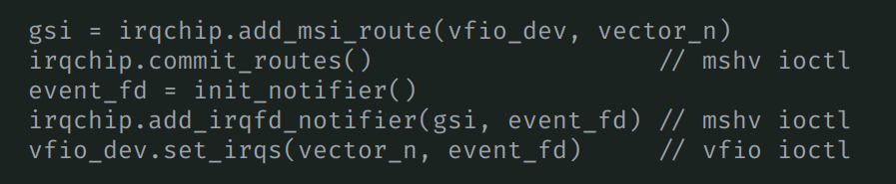
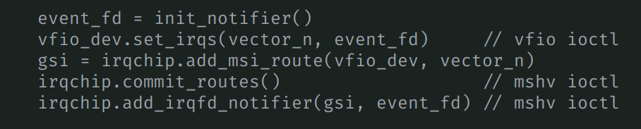
Challenges: VFIO
VMM bridges VFIO device w/ irqchip via eventfd
KVM and MSHV expect different setup sequences
IRQs are dropped
Options:
  Use MSHV-specific setup path
  Adjust driver behavior
  Adjust QEMU behavior
Simplified QEMU sequence
Simplified Cloud-Hypervisor sequence

Slide 9
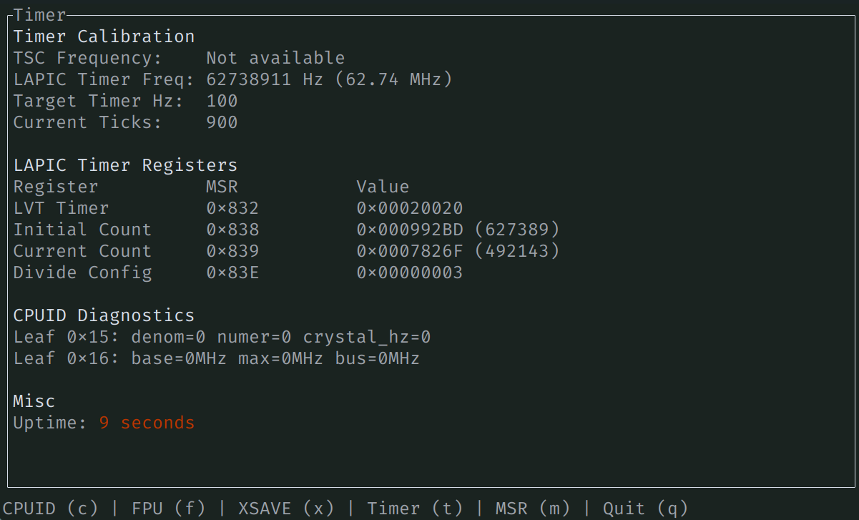
Challenges: Migration
x86 guests have a lot of (implicit) state
VMM doesn’t need to care about most of it (CPU registers)
Migration needs to capture, serialize, roundtrip-able state
LAPIC, XSAVE, MSRs, SynIC, …
Long tail of subtle hard-to-reproduce issues
x86_64 baremetal debugging (♥️ratatui)

Slide 10
Upcoming
QEMU CPU model support
Device passthrough
Live Migration
ARM

Slide 11
thx!

