Slide 1
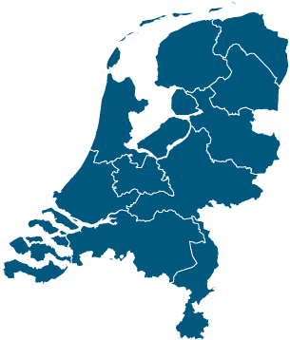
From Policy to Practice: Open Source in the Dutch Government
Gina Plat
Open Source Program Office (OSPO)
Dutch Ministry of Interior and Kingdom Relations (BZK)

Slide 2




Open source in gov
From hobby projects
And cost saving
To digital sovereignty
Europe-wide need to regain control of our digital infrastructure, networks, applications, code, etc.
Recent launch of the European Digital Infrastructure Consortium (EDIC) to build sovereign tech together! 🎉

Slide 3
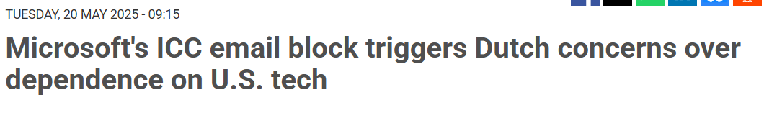
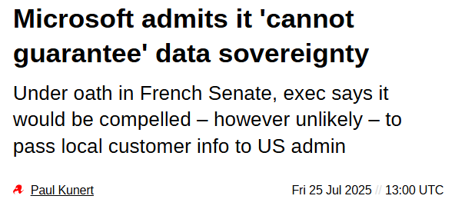
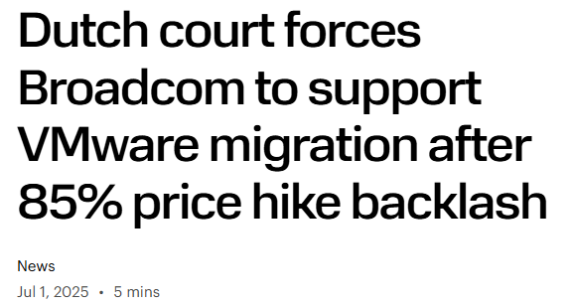
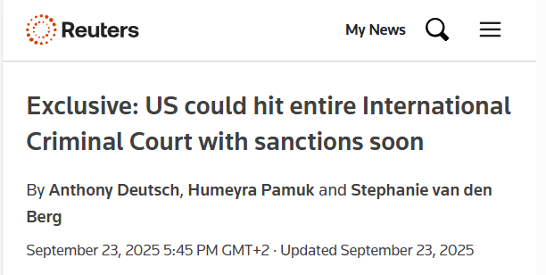
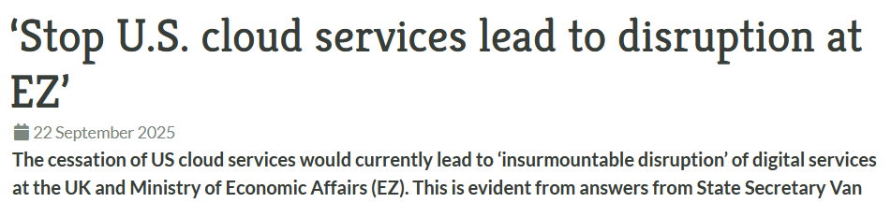
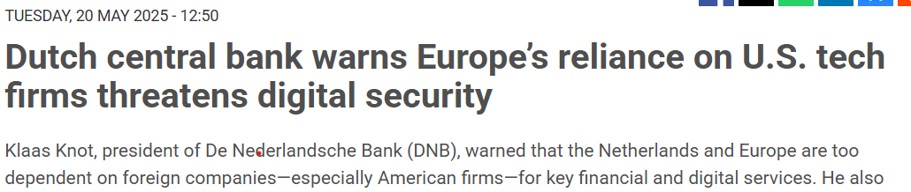
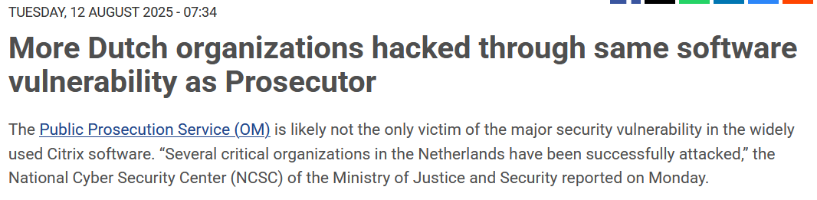
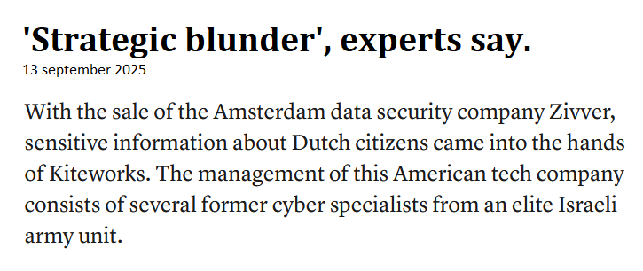
Why open source alternatives

Slide 4
Open Source Policy
Policy = Money
Vendrik motion
Action Plan Open in Connection (NOiV)
Open, Unless Policy
Dutch Digitalization Strategy - NDS
Minister of Digital Affairs?
2003
2016
2023
2025
2002
2007
2020
2025
2026
Open Standards and Open Source Software (OSOSS) program
Oosenbrug Motion
Digital Open Strategic Autonomy Agenda - DOSA
Government Vision on Digital Autonomy and Sovereignty

Slide 5
Open Source Policy
Action Plan Open in Connection (NOiV)
Open, Unless Policy
Open, Unless (2020)
Vendrik motion
Dutch Digitalization Strategy - NDS
Minister of Digital Affairs?
Default is open source, or explain why not.
Active publication
Focus on re-use, security innovation, transparancy
Public money = public code
2003
2016
2023
2025
2002
2007
2020
2025
2026
Open Standards and Open Source Software (OSOSS) program
Oosenbrug Motion
Digital Open Strategic Autonomy Agenda - DOSA
Government Vision on Digital Autonomy and Sovereignty

Slide 6
Open Source Policy
Dutch Digitalization Strategy (NDS) (2025)
Vendrik motion
Action Plan Open in Connection (NOiV)
Open, Unless Policy
Dutch Digitalization Strategy - NDS
Minister of Digital Affairs?
6 priorities (cloud, data, ai, citizen services, digital autonomy, digital skills)
Open source as foundation, especially digital autonomy.
Serious funding for each priority.
2003
2016
2023
2025
2002
2007
2020
2025
2026
Open Standards and Open Source Software (OSOSS) program
Oosenbrug Motion
Digital Open Strategic Autonomy Agenda - DOSA
Government Vision on Digital Autonomy and Sovereignty

Slide 7
Open Source Policy
Government Vision on Digital Autonomy and Sovereignty (2025)
Vendrik motion
Action Plan Open in Connection (NOiV)
Open, Unless Policy
Dutch Digitalization Strategy - NDS
Minister of Digital Affairs?
Political commitment and strategic direction gov
Emphasizes control of our own tech and sovereignty
Strong call to use EU-based open source alternatives
In line with NDS and DOSA
2003
2016
2023
2025
2002
2007
2020
2025
2026
Open Standards and Open Source Software (OSOSS) program
Oosenbrug Motion
Digital Open Strategic Autonomy Agenda - DOSA
Government Vision on Digital Autonomy and Sovereignty

Slide 8


Practice: OpenKat
A vulnerability analysis tool built during the covid days
Open source project by the Ministry of Health, Welfare and Sport
Scans and analyzes information systems, like the Covid App.
Now steered by the LibreKAT foundation
Many legal questions at the time, what is allowed to be published and where? How does support work? Who is going to maintain this?

Slide 9
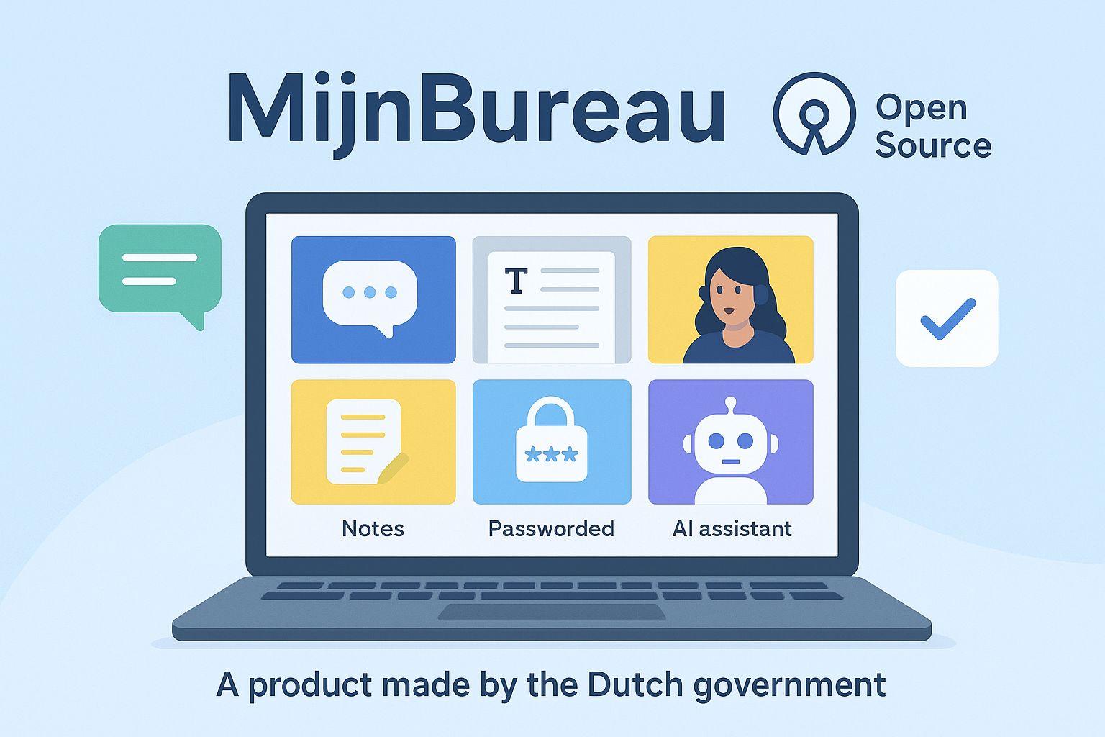
Practice: MijnBureau
A sovereign, modular workspace based on open source alternatives:
Email (Open Xchange)
Files (Drive / Nextcloud)
Chat (Matrix)
Video (LiveKit)
Made in EDIC collaboration with France (LaSuite) and Germany (OpenDesk)
Where is this going to land? How will support of each app work (SLA’s)? How do we collaborate and finance across government?

Slide 10

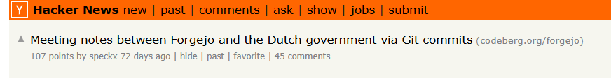
Practice: Codeplatform
A sovereign, opensource, government-wide codeplatform
Aim is to move all gov code to our own Forgejo instance
Pilot starts end of Feb 2026 🥳
Hosted on the Digitally Autonomous Workspace (DAWO) stack
How do we ensure we don’t just take code, but also support the Forgejo community? How do we ensure sustainability?

Slide 11
Challenge
Government needs to get out of its own way
Tech is not the problem ☺

Slide 12
Lessons learned
Beyond the simple ‘is this allowed or not’ questions:
Bottom-up innovation, top-down funding
We must build a place where our open source gov tech can land, with maintainer support, infrastructure and funding.
If we buy: fix procurement rules! Stop funding Big Tech and Big Consultancy, start aligning with communities. Build a European, open source market.

Slide 13
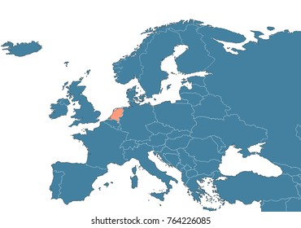

Thank you!
Questions?
OSPO NL
https://opensourcewerken.nl

