Slide 1


31/01/2026
Scaling GoBGP:
Learnings
2026

Slide 2

About me
Maxime Peim
Software Engineer @ Cisco for 3y
Mainly focused on Dataplane (FD.io VPP) and BGP Controlplane
Amateur long distance cyclist

Slide 3

Disclaimer
GoBGP Logo
You will see the GoBGP mascot in other situations, which were AI generated

Slide 4

BGP is air-traffic control for the internet, coordinating routes between Autonomous Systems

Slide 5

Problem statement
Multi-tenanted BGP daemon
Management
Number of tenants not known in advance
Multiple peerings per tenant across multiple regions
Route overlapping between tenants
Per tenant BGP servers
NAT
BGP
Tenant 1
Device
Tenant 1
server
Device
Device
Tenant 2
Device
Tenant 2
server
Device
Device

Slide 6
Problem statement
Life of a peering
Management
Tenant T
NAT
BGP
Device D
Tenant registers to our fabric

Slide 7
Problem statement
Life of a peering
Management
Tenant registers to our fabric
NAT
BGP
Tenant T
Device D
Management plane informs BGP control plane

Slide 8
Problem statement
Life of a peering
Management
Tenant registers to our fabric
Management plane informs BGP control plane
NAT
BGP
Tenant T
Device D
Tenant T
server
BGP control plane initialize new BGP servers to receive peerings

Slide 9
Problem statement
Life of a peering
Management
XXXX -> 169.254.0.1
Tenant registers to our fabric
Management plane informs BGP control plane
BGP control plane initialize new BGP servers to receive peerings
NAT
BGP
Tenant T
Device D
Tenant T
server
6.D.D.D -> 7.T.T.T
Tenant devices peers with its servers
Tenant traffic is tagged with tenant id before NAT

Slide 10
Problem statement
Life of a peering
Management
XXXX’ -> 169.254.0.1
Tenant registers to our fabric
Management plane informs BGP control plane
BGP control plane initialize new BGP servers to receive peerings
Tenant devices peers with its servers
NAT
BGP
Tenant T
Device D
Tenant T
server
Device D’
6.D’.D’.D’ -> 7.T.T.T
Tenant devices peers with its servers
Tenant traffic is tagged with tenant id before NAT

Slide 11


Goals
Our system requires dynamicity
Custom path manipulation, to propagate internal logic
Thousands of tenants in one region, coming and going
  Aim tenths of thousands of peers in one single region
  ~ hundreds of thousands of routes per region
Be able to connect thousands of peers as rapidly as possible

Slide 12


FOSS BGP
Overview
Bird
FRR
GoBGP
Fast
Multi-threaded (since 3.0)
Static configuration
Fast
Multi-threaded for IO
BGP daemon still mono threaded
Experimental Northbound gRPC
Natively multi-threaded (goroutines)
API driven
  Go Package
  gRPC server

Slide 13

Why GoBGP?
Pros
Cons
Dynamicity (API)
Strong* path manipulation
Ease of use, integrates in our Go codebase
Does not scale as well as Bird and FRR
  More cores does not solve the issue
* compared to Bird DSL

Slide 14

Benchmark - setup
Bird server
Fixed #threads
Unlimited access to RAM
Configuration generated for P peers, R routes / peers
GoBGP server
GOMAXPROC=N
Unlimited access to RAM
P peering
Start Bird and add peer with the API to GoBGP
Monitor peering over time
Monitor routes reception over time
Profiling CPU and memory usage

Slide 15
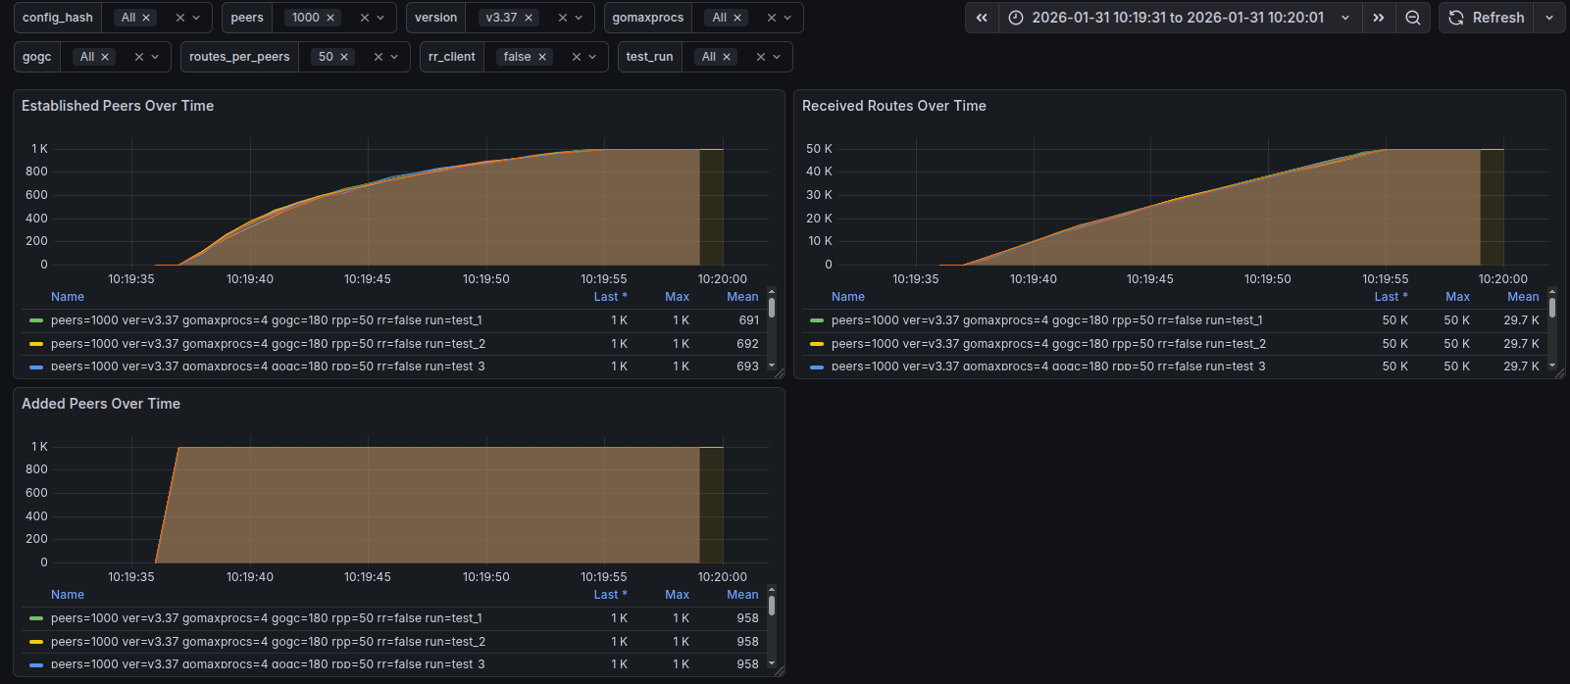
Benchmark - results
N = 4
P = 1000
R = 50
Time ~ 1m
GoBGP v3.37

Slide 16
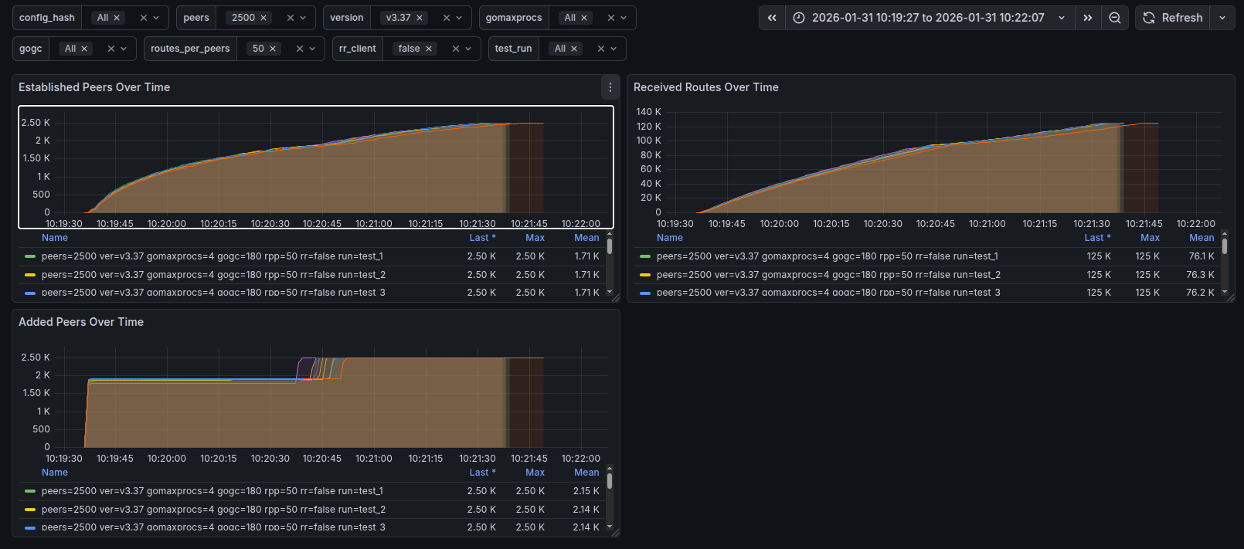
Benchmark - results
N = 4
P = 2500
R = 50
Time ~ 2m
GoBGP v3.37

Slide 17
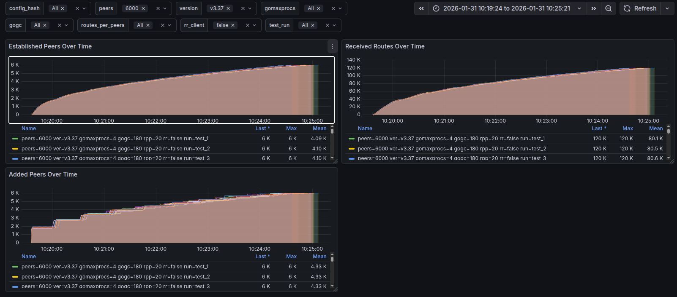
Benchmark - results
N = 4
P = 6000
R = 20
Time ~ 5m
GoBGP v3.37

Slide 18
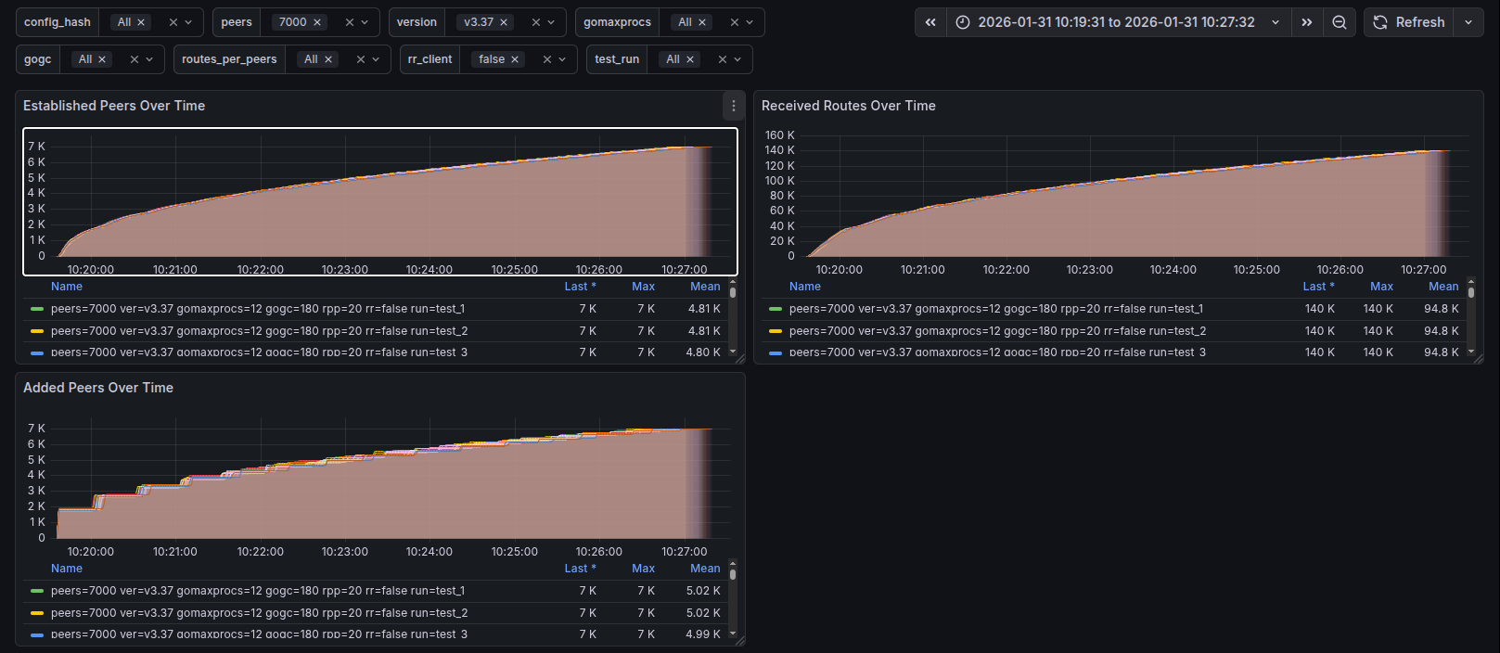
Benchmark - results
N = 4
P = 7000
R = 20
Time ~ 7m
GoBGP v3.37

Slide 19
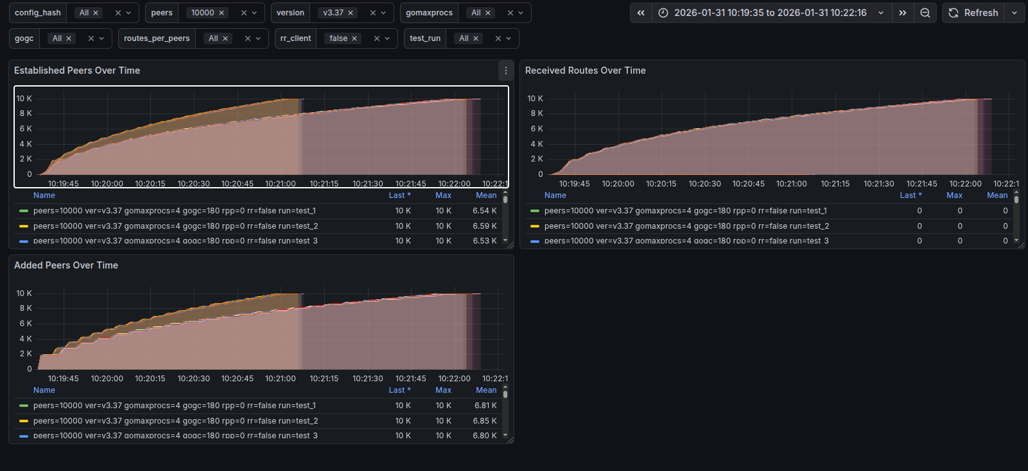
Benchmark - results
N = 4
P = 10k
R = 0, 1
GoBGP v3.37

Slide 20
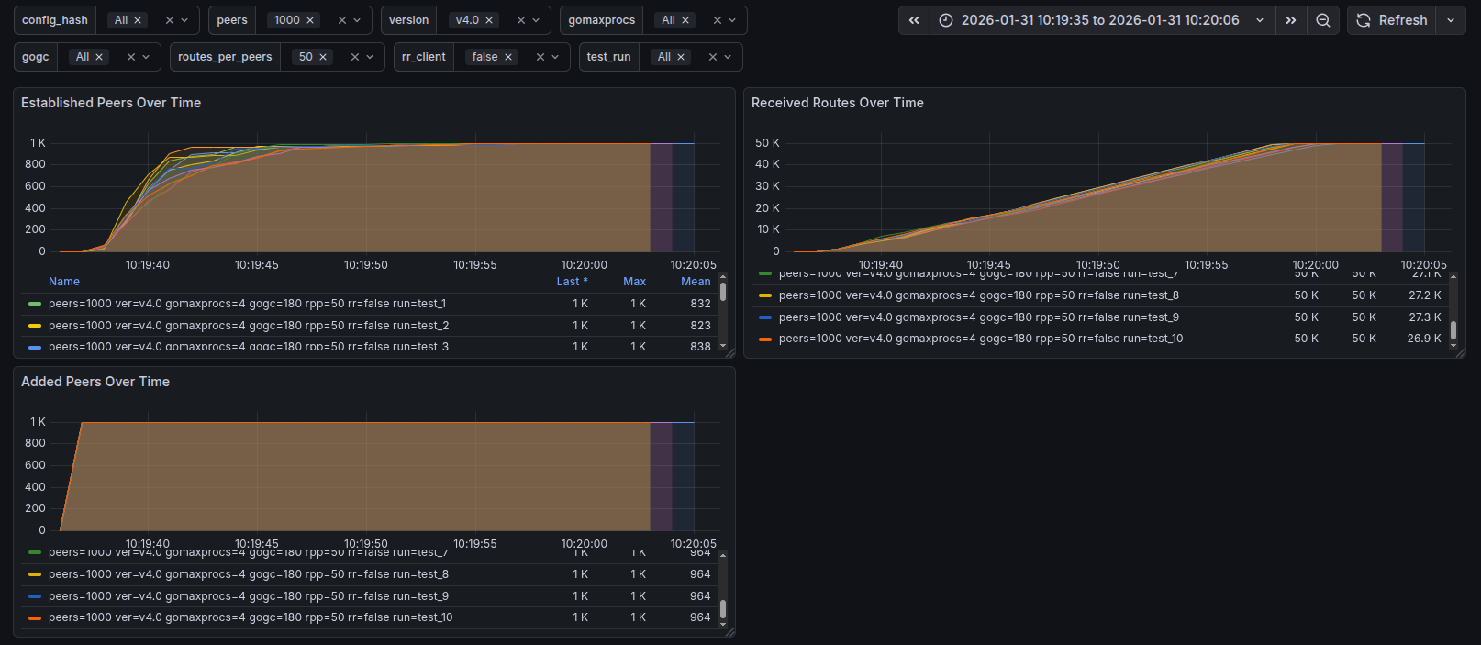
Benchmark - results
N = 4
P = 1000
R = 50
Time ~ 1m
GoBGP v4.0

Slide 21
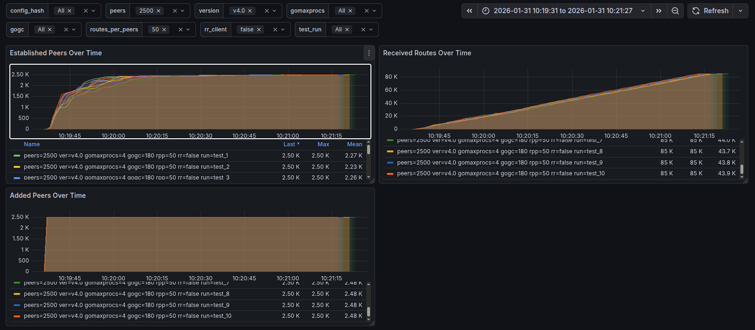
Benchmark - results
N = 4
P = 2500
R = 50
Time ~ 2m
GoBGP v4.0

Slide 22
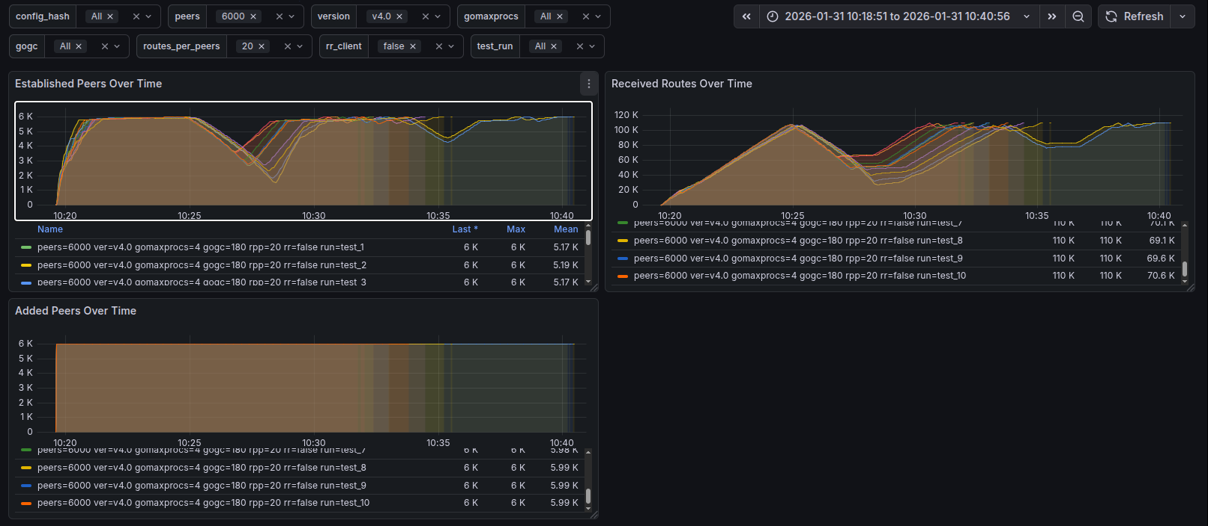
Benchmark - results
N = 4
P = 6000
R = 20
Time ~ [15m; 20m]
GoBGP v4.0

Slide 23
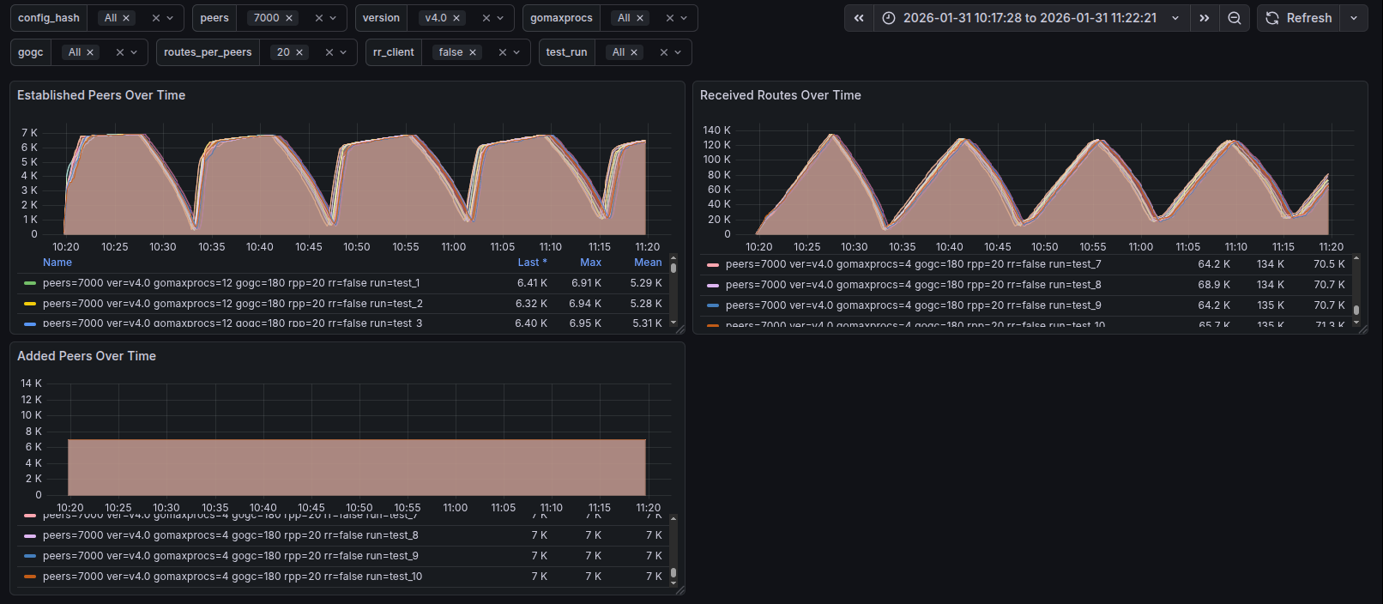
Benchmark - results
N = 4, 12
P = 7000
R = 20
Time ~ ∞
GoBGP v4.0

Slide 24

Benchmark - results
Change in behavior between v3.37 and v4.0
v3.37 pushes every messages (BGP, management/API) into a single Go channel
  see v3.37 - 6000P - 20RPP
v4.0 decouples management/API and BGP, but introduces a mutex
  Needs more fine grained locks (around path tables, connected peers map etc…)
PR #3303 release contention on the lock
  6000P - 20RPP under 30s

Slide 25
Benchmark - results
However, we can still leverage GoBGP capacities
1 GoBGP can sustain thousands of peers with few tenth of routes, that can peer within minutes
But we want to go higher!

Slide 26

Scaling out GoBGP
NAT layer attributes peers traffic to differents BGP servers
Routes are redistributed between BGP servers (thanks to GoBGP watchers)
Management
Tenant T
NAT+LB
BGP
Device D
7.T.T.T
Tenant T
server
Device D
Device
8.T.T.T
Device
Tenant T
server
x.T.T.T
Device
Tenant T
server

Slide 27




The future of GoBGP
v4.2.0 currently released
  Some contention point where released
  Others were introduced
Some work is being done to unleash its potential (PR #3303)
  Global mutex relaxation
  Benchmarks looks way better in the same config
Some work has already be done to improve API internals
If you are interested in improving software performances, go take a look and add your contribution!
GoBGP
Bird
FRRouting

Slide 28

Q&A

Slide 29
Backup slide
Management
Tenant T
IPsec
EP
NAT
BGP
Carry:
D & T
Device D
IPsec
Geneve
Tenant T
server
XXXX -> 169.254.0.1
6.D.D.D -> 7.T.T.T
Zero conf, 169.254.0.0/24 to connect to BGP server

