Slide 1

The MariaDB Server Contribution Process
A Case Study
Georgi Kodinov: joro@mariadb.org

Slide 2
The MariaDB Server Contribution Process
The Scene
A standard contribution process!
It's a PROPER GitHub repository
With some extensions:
  Contributor's License Agreement Bot
  A BuildBot for regression tests
  Need a Jira (MDEV-99999) for the "larger" contributions

Slide 3
How To Pick a Task To Work On?
Something important to you!
Check the List Of Beginner Friendly Tasks from CONTRIBUTING.md
Engage online with other community members
Check Jira for open issues that sound appealing
MariaDB participates in Google Summer of Code program!

Slide 4
The Contribution Process in a Nutshell
Things To Remember
Clone (and star!) the "MariaDB/Server" repository and create a branch
Work on your feature
Submit a pull request from your branch
Make sure the CLA and the Build bots report success (regression tests etc)
Get a review from the team: preliminary by me and final by a developer
Have the final reviewer merge your pull request!

Slide 5
Case Study:
An Actual Contribution!

Slide 6

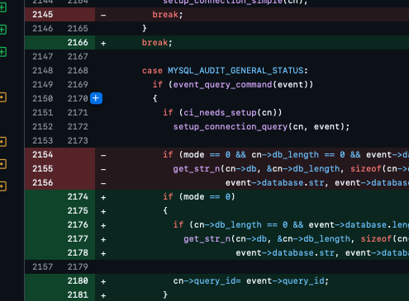
10 lines of actual code

Slide 7
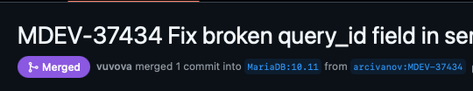
Based on a Jira MDEV-37434
10 lines of actual code

Slide 8
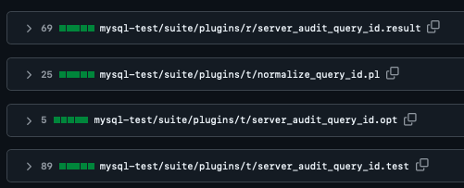
Great Test Coverage!
Based on a Jira MDEV-37434
10 lines of actual code

Slide 9
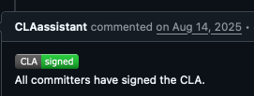

Great Test Coverage!
A Signed CLA
Properly Tagged
Based on a Jira MDEV-37434
10 lines of actual code

Slide 10

Great Test Coverage!
A Signed CLA
Active Conversation
Properly Tagged
Based on a Jira MDEV-37434
10 lines of actual code

Slide 11

Great Test Coverage!
A Signed CLA
Active Conversation
Properly Tagged
Based on a Jira MDEV-37434
Several Iterations
10 lines of actual code

Slide 12

Great Test Coverage!
A Signed CLA
Active Conversation
Properly Tagged
Based on a Jira MDEV-37434
Several Iterations
10 lines of actual code
Merged By A Developer!

Slide 13
Takeways!
Feel free to ask me (Zulip or email) if you need help!
Communicate early! Communicate often!
Be responsive to requests by reviewers
Be nice!
Don't Panic!

Slide 14
Thank You!
Contact Data
joro@mariadb.org
https://mariadb.zulipchat.com/#user/996698
https://lists.mariadb.org/postorius/lists/developers.lists.mariadb.org/

