Slide 1

Awesome NAPCORE Tools
.
A Community Registry for European Mobility Data Tools
FOSDEM 2026
31/1/2026

Slide 2


Awesome NAPCORE Tools List
Jan Vlčinský
TamTam Research, CZ
NAPCORE Task 5.2 Leader
jan.vlcinsky@tamtamresearch.com
GitHub: vlcinsky
LinkedIn: vlcinsky
Brede Dammen
Entur, OpenRail Association, NO
NAPCORE Awesome NAPCORE Tools List Content Leader
brede.dammen@entur.org
GitHub: BredeD
LinkedIn: brededammen

Slide 3
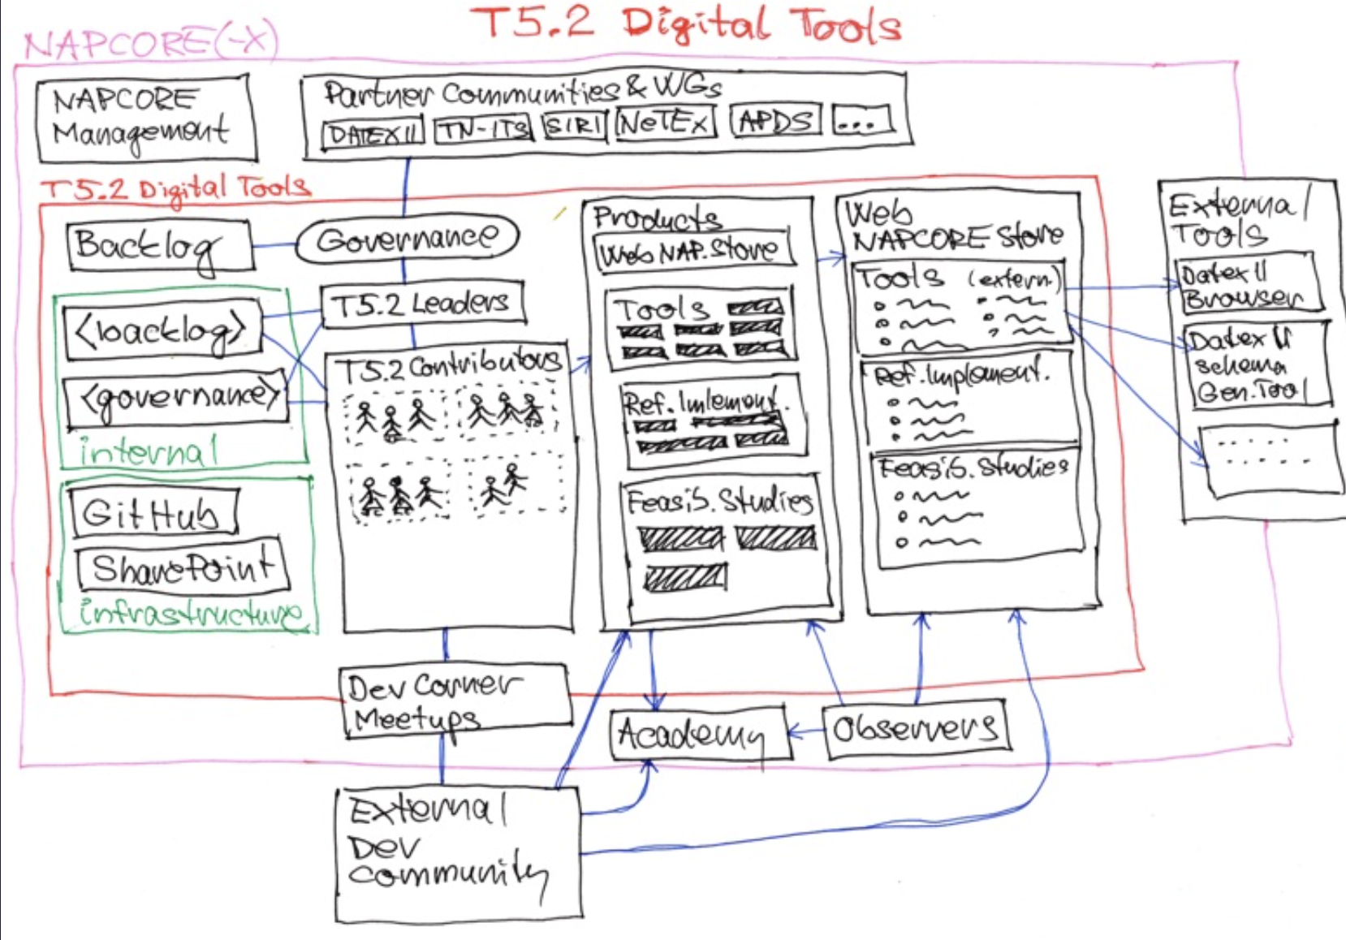
Plan
WP5 Objectives
These tools will be made available in a generic NAP-Store, so all stakeholders have access to the open-source tooling that is developed (in and outside the realm of NAPCORE).
T5.2 Description
A “NAP-Store” website shall be set up and maintained to promote existence of tools available (what includes relevant tools developed elsewhere).
Notes:
Goal: make multimodal passenger information consistent, reliable, and usable across Europe.

Slide 4
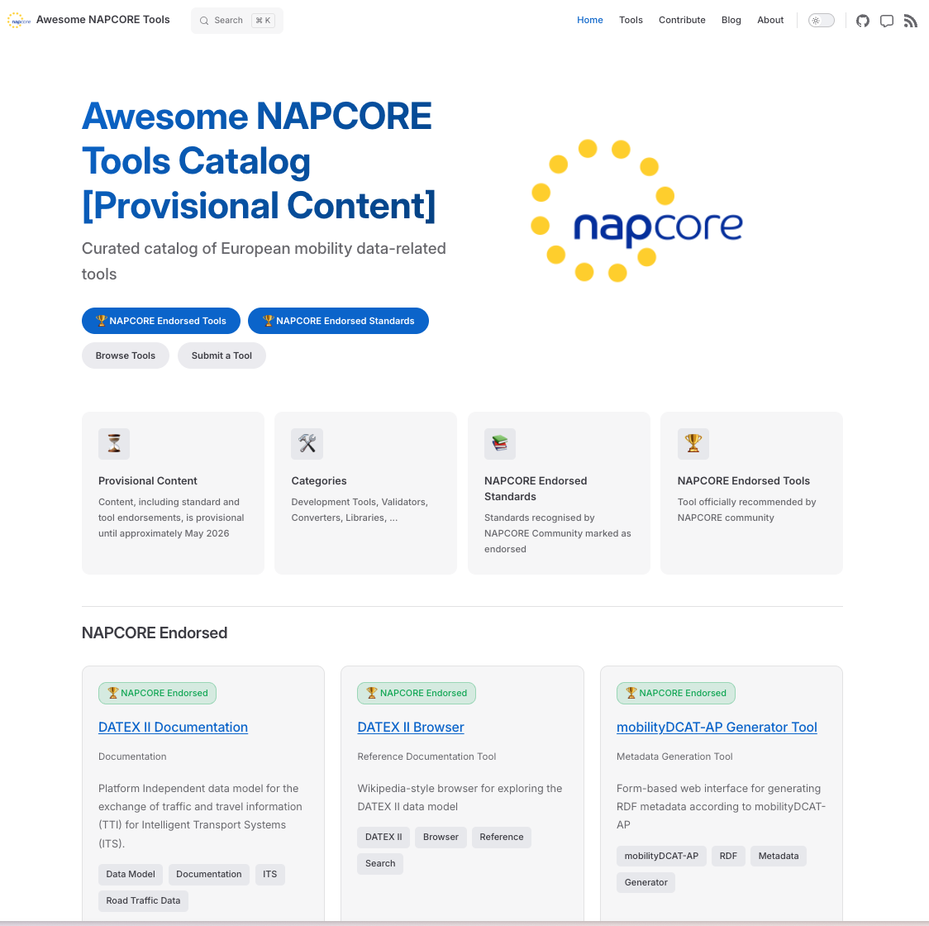

Your tools are WANTED too
https://awesome.napcore.eu

