Slide 1
Harnessing Hardware For High-Performance Traffic Management(TM) In FD.io VPP
FOSDEM-2026
Alok Mishra, Sr. Staff Engineer
Venkata Ravichandra Mynidi, Sr. Principal Engineer
January 31,2026

Slide 2
Agenda
The Role of Traffic Management(TM)
VPP as a High‑Performance Dataplane
Hardware TM in Modern NICs
VPP’s New TM Offload Framework
Technical Overview
Performance Gains
Community Path Forward

Slide 3
Traffic Management: Fair and Predictable Networking
TM decides who gets bandwidth, when, and how much.
It ensures fairness, low latency, and stable QoS.
If TM slows down or misbehaves → the whole network suffers.

Slide 4
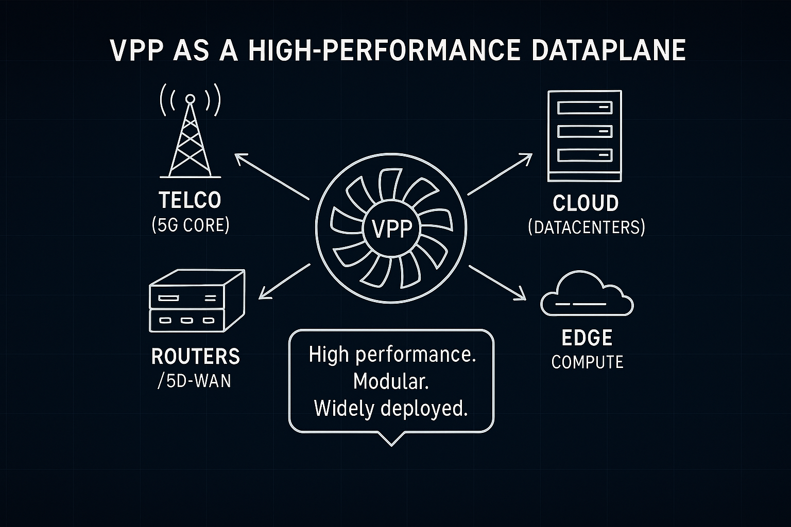
VPP: The Packet Engine Powering Today’s Networks
    VPP is high‑performance, highly modular, used in telco, cloud, and edge.
    It powers production deployments at massive scale.
    It is trusted for speed, reliability, and flexibility.

Slide 5
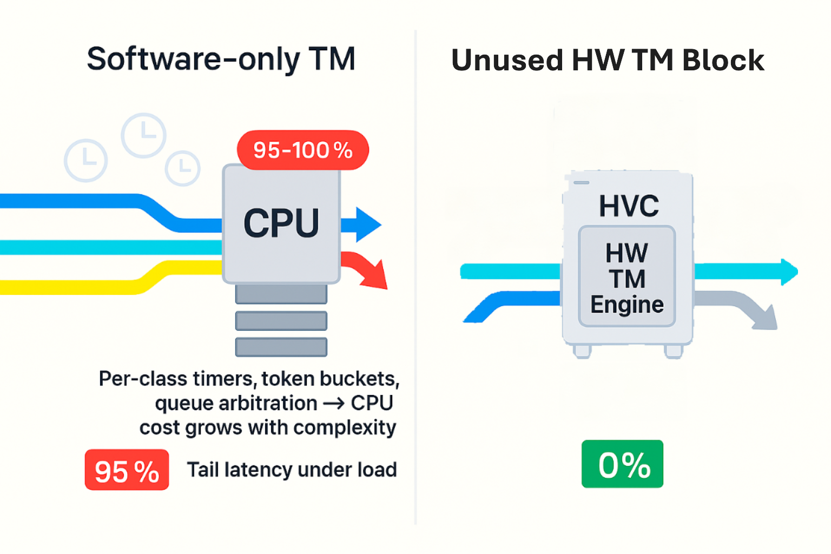
The Problem: Software‑Only TM in VPP
VPP does TM entirely in software today.
For shaping, scheduling, policing, class-based decisions → CPU cycles grow with complexity.
High Bandwidth workloads and multi‑class scenarios stress software TM.

Slide 6
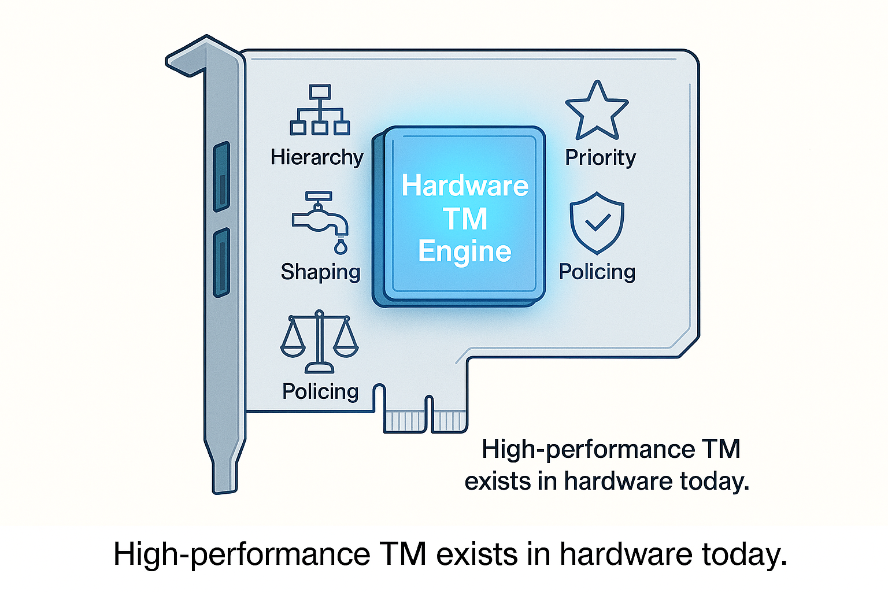
Modern NICs Already Have Dedicated TM Engines
Modern NICs, SmartNICs, and DPUs include advanced TM engines.
These engines support scheduling, shaping, priority, fairness, hierarchy — at line rate.
Support for these hardware TM features is not available in VPP today.

Slide 7
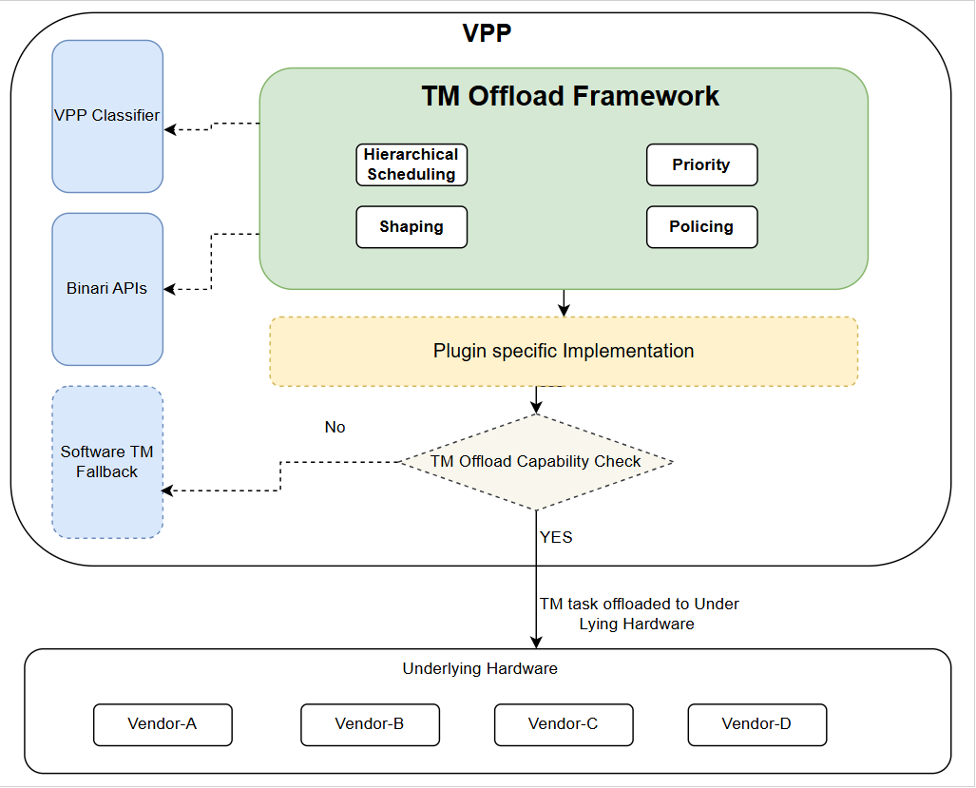
Solution: Hardware‑Agnostic TM Offload Framework for VPP
Hardware-agnostic
  One API, any NIC vendor. No vendor lock‑in.
Capability-based
  Hardware advertises capabilities. VPP adapts.
Dynamic runtime operations
  Add, update, suspend, resume, delete nodes at runtie.
Covers the full TM spectrum
  Shapers, schedulers, policers, dual‑rate etc.
User Engagement
  Coupled with VPP’s Classifier
  Uses Binary APIs
RFC Compliant

Slide 8
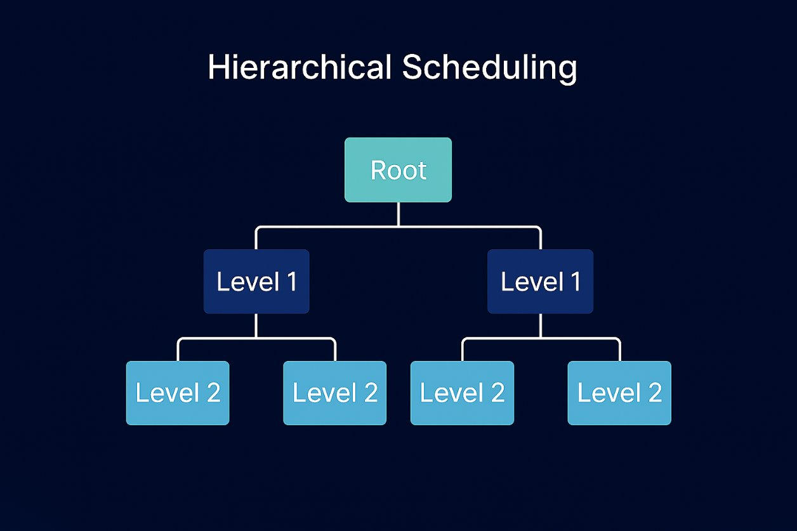
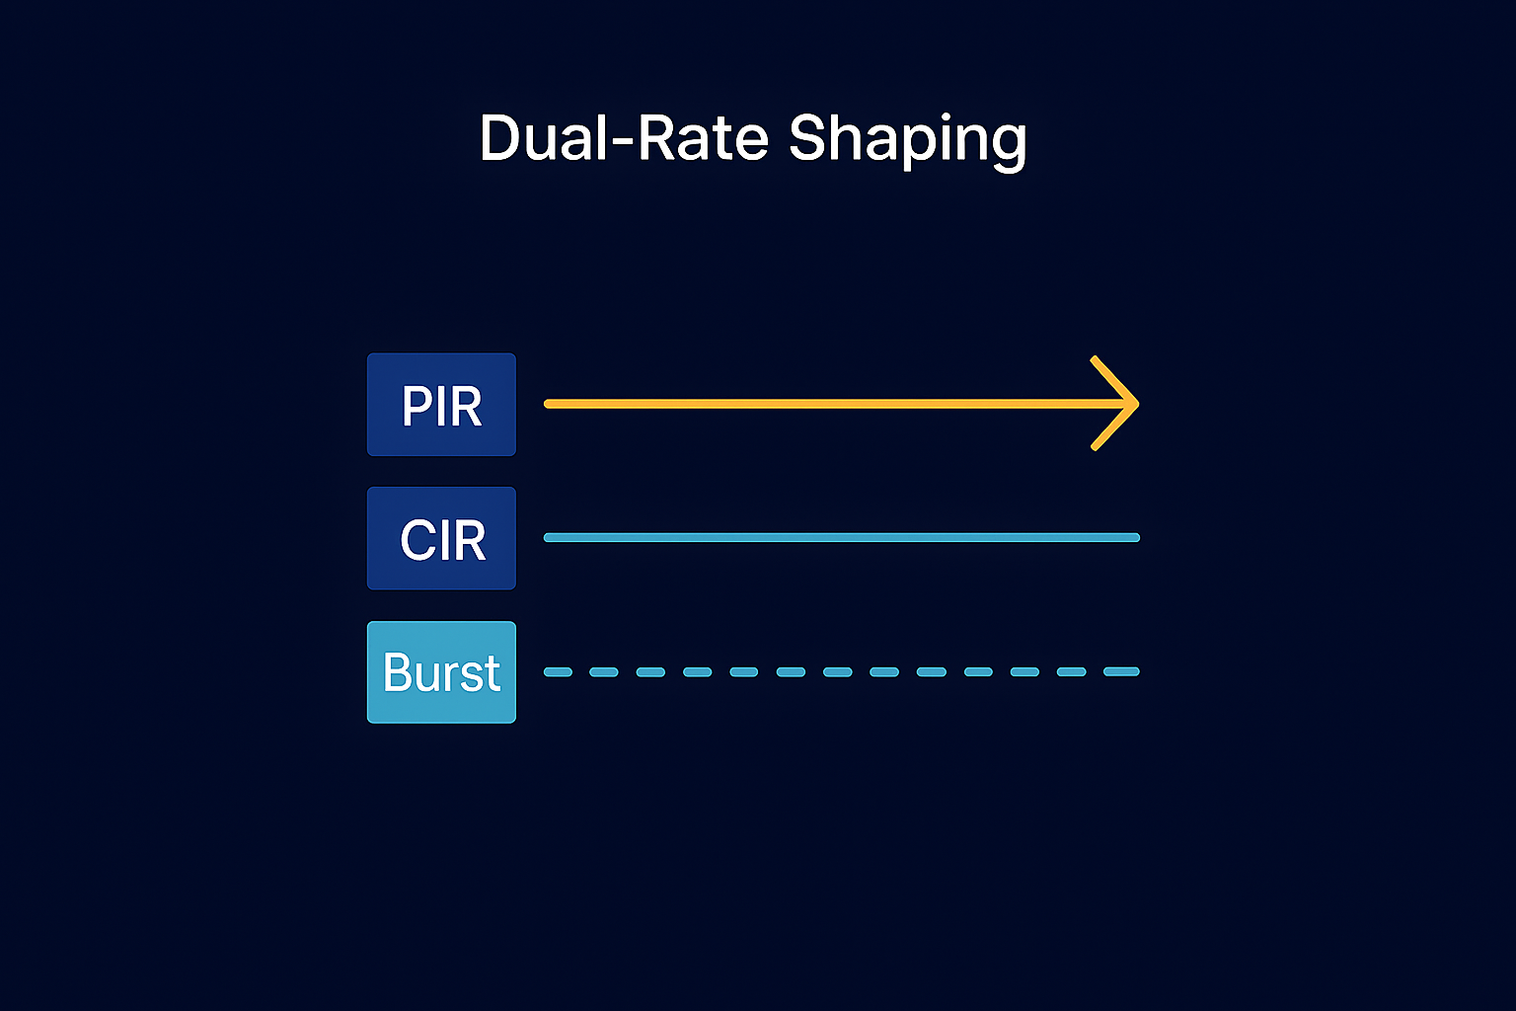
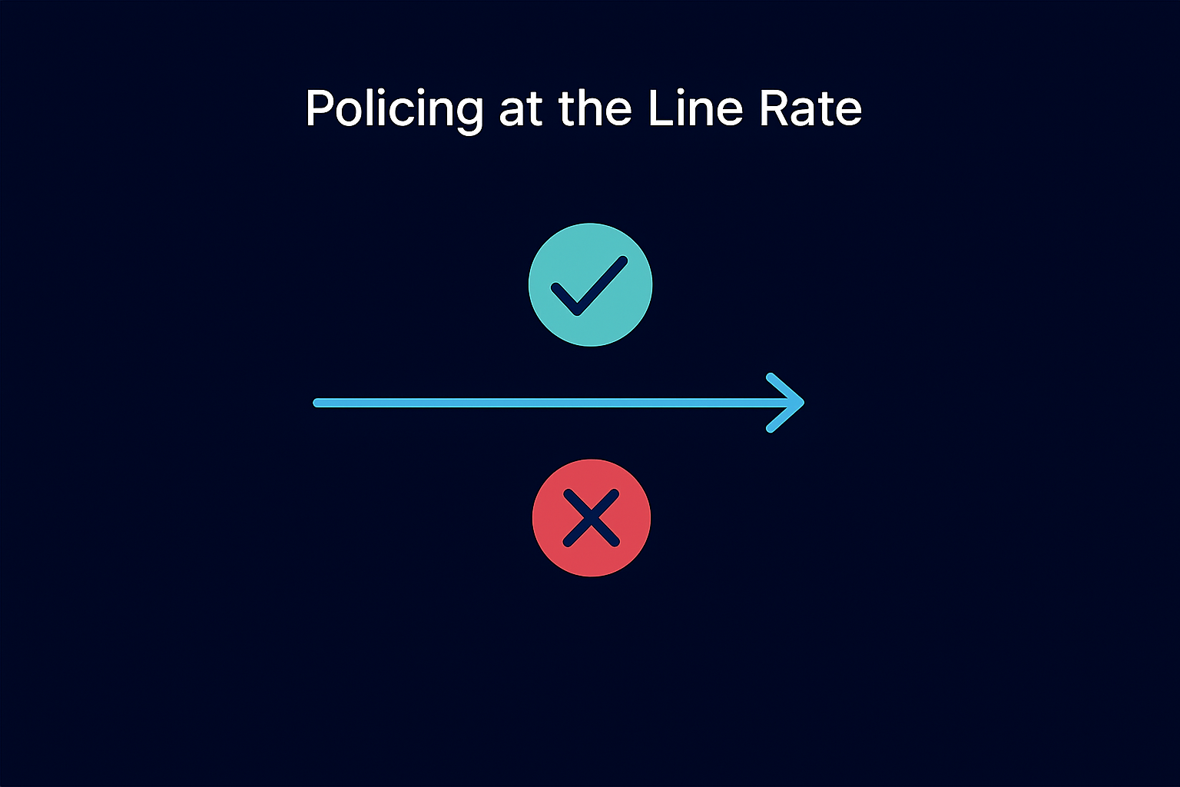
Key Technical Concepts and Features
Hierarchical Scheduling
  Multi‑level queueing to prioritize critical services while ensuring fairness.
Dual‑Rate Shaping
  Applies committed and peak rates with burst handling for predictable performance.
Priority & Fairness
  Combines strict priority for latency‑sensitive traffic with weighted sharing for bulk flows.
Policing
  Enforces traffic limits at line rate by marking or dropping packets to maintain reliability.
RFC 2697, 2698

Slide 9
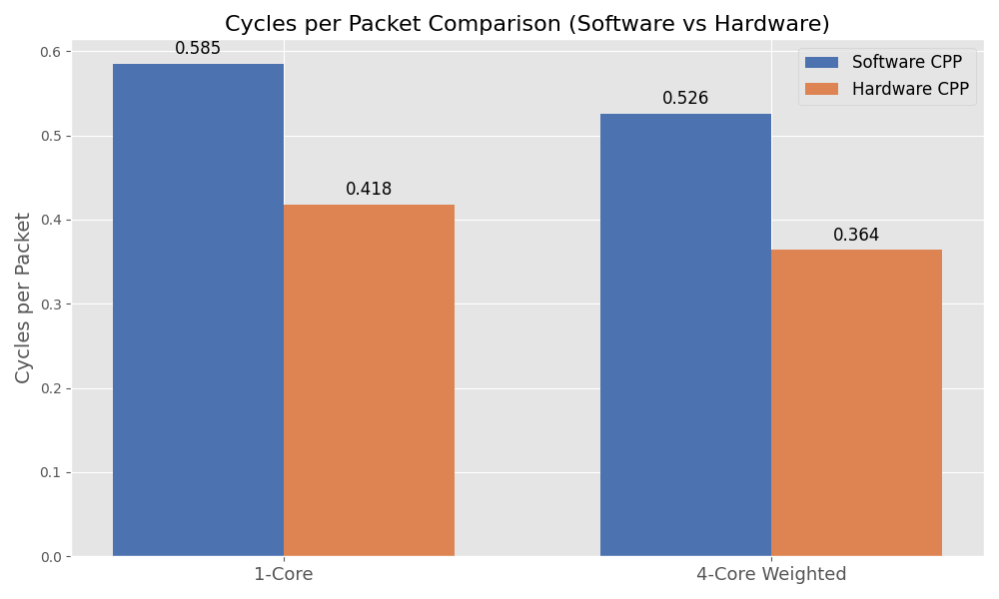
Gains That Matter
(Diff Nodes only)
Performance: Line‑rate TM, accurate shaping, ultra-low latency.
Scalability: Thousands of queues without CPU penalties.
Efficiency: Offloads CPU → saves energy, frees cycles for applications.
Reliability: Stable QoS under peak load.
Early Observations on Marvell OCTEON 10 Processor

Slide 10
Future‑Ready VPP, Built Together
Hardware TM unlocks new performance headroom
Software TM remains fully supported
Enhances TM in VPP for next‑generation workloads (200G / 400G / 800G).
Upstream patches:
  https://gerrit.fd.io/r/c/vpp/+/40775
  https://gerrit.fd.io/r/c/vpp/+/42958
  https://gerrit.fd.io/r/c/vpp/+/42257
Marvell DAO Solutions:
  https://github.com/MarvellEmbeddedProcessors/vpp

Slide 11
“Software is powerful. Hardware is faster.
VPP deserves both.”

